Slide 1
chapter 2
Local Area Networks – An Introduction

Slide 2
CHAPTER OBJECTIVES
2-<number>
Define server, LAN services, clients, and describe the role of each in a LAN.
Describe a mainframe and terminal LAN configuration.
Discuss peer-to-peer, client-dominant, client/server, and distributed processing LANs.
Define cable types such as coaxial, twisted-pair, and fiber optic.
Identify three types of wireless media.
Describe how network interface cards work.
Identify types of network interface cards.

Slide 3
TECHNOLOGY OVERVIEW
2-<number>
LANs utilize specialized hardware and software.
  Computers that function as servers and workstations.
  Operating systems that provide services.
  Network interface cards to connect to the LAN.
  Cabling or wireless media.
  Hubs, bridges, switches, routers, and other connectivity devices.

Slide 4
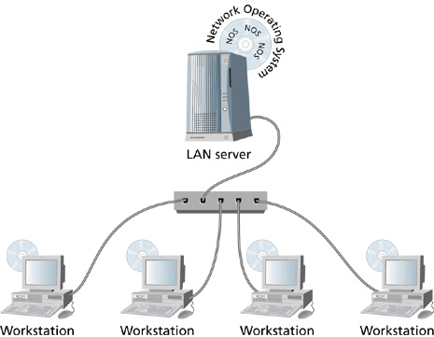
Physical Configuration of a Simple Local Area Network
2-<number>

Slide 5
SERVERS
2-<number>
Server – a computer that connects to a LAN and has network operating system software installed to provide shared LAN services to clients on the network.

Slide 6
LAN SERVICES
2-<number>
LAN Services – define the personality of a local area network.
  Example services include data storage and retrieval services, printing services, shared application access, centralized logon services, directory services, desktop management, and so on.

Slide 7
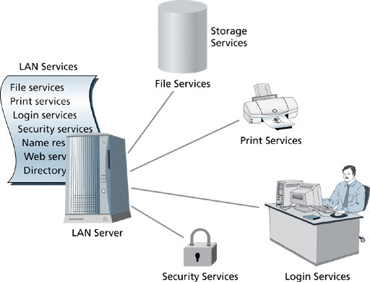
Basic Services on a Local Area Network
2-<number>

Slide 8
CLIENTS
2-<number>
A LAN client is a computer that connects a user to the LAN services provided by a server’s network operating system.

Slide 9
LAN CONFIGURATIONS
2-<number>
Mainframes and Terminals – computing functions are performed on the mainframe, and terminals supported data input and data viewing.
  Because processing takes place at the mainframe, terminals are considered “dumb”.
  Mainframes deliver a fixed amount of computing power for given level of capital expenditure.
  Upgrades to processing power are expensive.
  Application development is expensive.
  Mainframe technology has been adapted as storage area networking for data storage functions in today’s LANs.

Slide 10
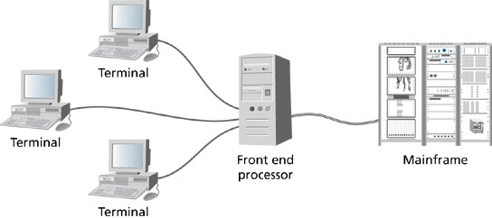
A Mainframe Network
2-<number>

Slide 11
LAN CONFIGURATIONS (cont’d)
2-<number>
Peer-to-Peer LANs – fill a business need for organizations that don’t have a substantial need for centralized computing power on a dedicated mainframe or server.
  With peer-to-peer LANs, each computer on the LAN acts as a peer to every other computer.
  Each computer can provide services to and request services from every other computer on the LAN.
  Peer computers are generally configured to belong to the same “workgroup”

Slide 12
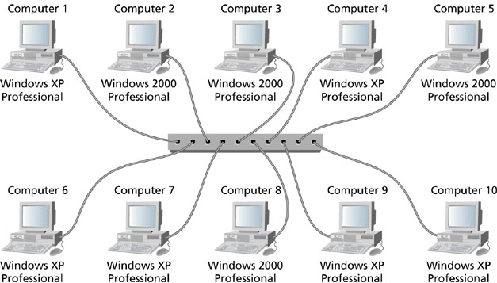
Peer-to-Peer LAN
2-<number>

Slide 13
LAN CONFIGURATIONS (cont’d)
2-<number>
Client-dominant LANs
  Evolved during the 1980s from the single-user applications that were developed for individual PCs.
  Data storage on LAN servers provided centralized file access.
  Application processing and data manipulation took place on the client.
  Reduced the dependence on “sneaker-net” between users’ PCs.

Slide 14
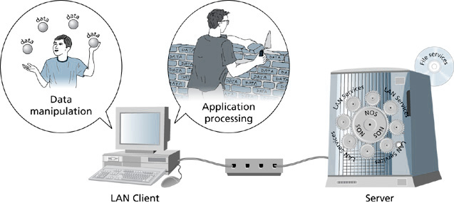
A Client-dominant Local Area Network
2-<number>

Slide 15
LAN CONFIGURATIONS (cont’d)
2-<number>
Client/Server LANs
  Some processing is performed at the client and some at the server.
  Server handles data access and storage.
  Only required information is copied to the client computer for data manipulation.
  Benefits to the LAN are reduced demand on the network media and better overall network performance.

Slide 16
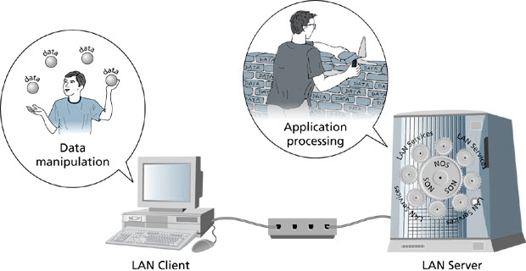
A Client/Server Local Area Network
2-<number>

Slide 17
LAN CONFIGURATIONS (cont’d)
2-<number>
Distributed Processing LANs
  Data access and storage components are separated out from the data processing component of an application.
  Application processing is shared across several computers.
  Different components of an application can be installed on one or more servers.
  Logic built into the application allows all component modules to communicate.

Slide 18
LAN CONFIGURATIONS (cont’d)
2-<number>
Distributed Processing LANs (cont’d)
  Client component of the application doesn’t care where the actual processing takes place.
  This type of LAN scales well to growing processing demands.
  Load sharing and redundancy provide improved performance.

Slide 19
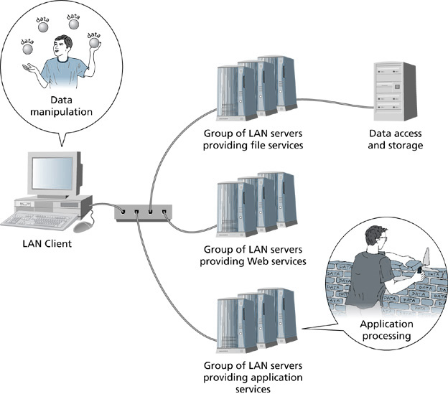
Distributed Processing
2-<number>

Slide 20
LAN CONFIGURATIONS (cont’d)
2-<number>
Connecting Computers to a LAN
  Client computers require a workstation OS and an NOS client.
  Servers require NOS installation and configuration.
  Network administrator configures client software and hardware, server hardware and software, protocols, NICs, media, and connectivity devices.

Slide 21
MEDIA TYPES and CONNECTORS
2-<number>
Coaxial Cable
  Commonly referred to as “coax”.
  Consists of two conductors separated by special insulating material.
  One conductor carries the signal and the other acts as a ground and as shielding.
  Was a common media choice for early Ethernet LANs.

Slide 22
MEDIA TYPES and CONNECTORS (cont’d)
2-<number>
Coaxial Cable (cont’d)
  Thicknet – also known as thick Ethernet cabling – provided data transmission rates up to 10 Mbps over a distance of 500 meters and supported connectivity of 100 computers on a LAN segment.

Slide 23
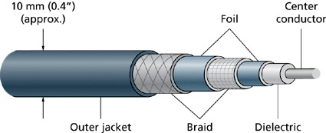
The Characteristics of Thicknet Cabling
2-<number>

Slide 24
MEDIA TYPES and CONNECTORS (cont’d)
2-<number>
Coaxial Cable (cont’d)
  Thinnet – also known as thin Ethernet – was introduced in 1985 as an alternative to thicknet.
  It was cheaper than thicknet.
  Provided 10 Mbps but over a distance of only 185 meters.
  30 computers could attach to a LAN segment.

Slide 25
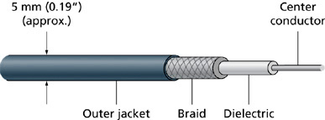
The Characteristics of Thinnet Cabling
2-<number>

Slide 26
MEDIA TYPES and CONNECTORS (cont’d)
2-<number>
Thinnet Connectors
  Thinnet uses BNC connectors to connect cabling to cabling, NICs to cabling, and connectivity devices to cabling.

Slide 27
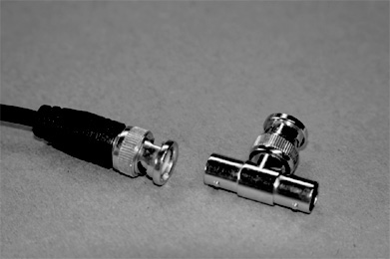
BNC Connectors used with Thinnet Cabling
2-<number>

Slide 28
MEDIA TYPES and CONNECTORS (cont’d)
2-<number>
Twisted Pair Media
  Very popular in LAN installations.
  Consists of several pairs of twisted copper wires.
  Is available in both unshielded and shielded varieties – UTP and STP.

Slide 29
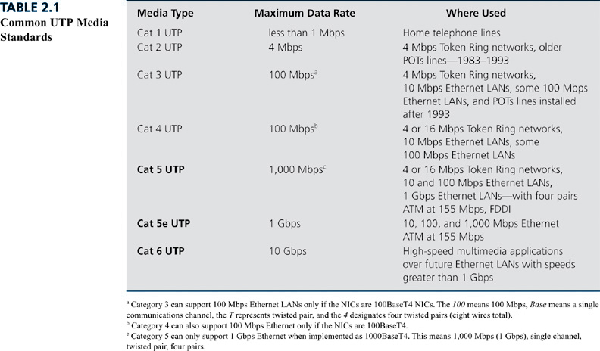
Common UTP Media Standards
2-<number>

Slide 30
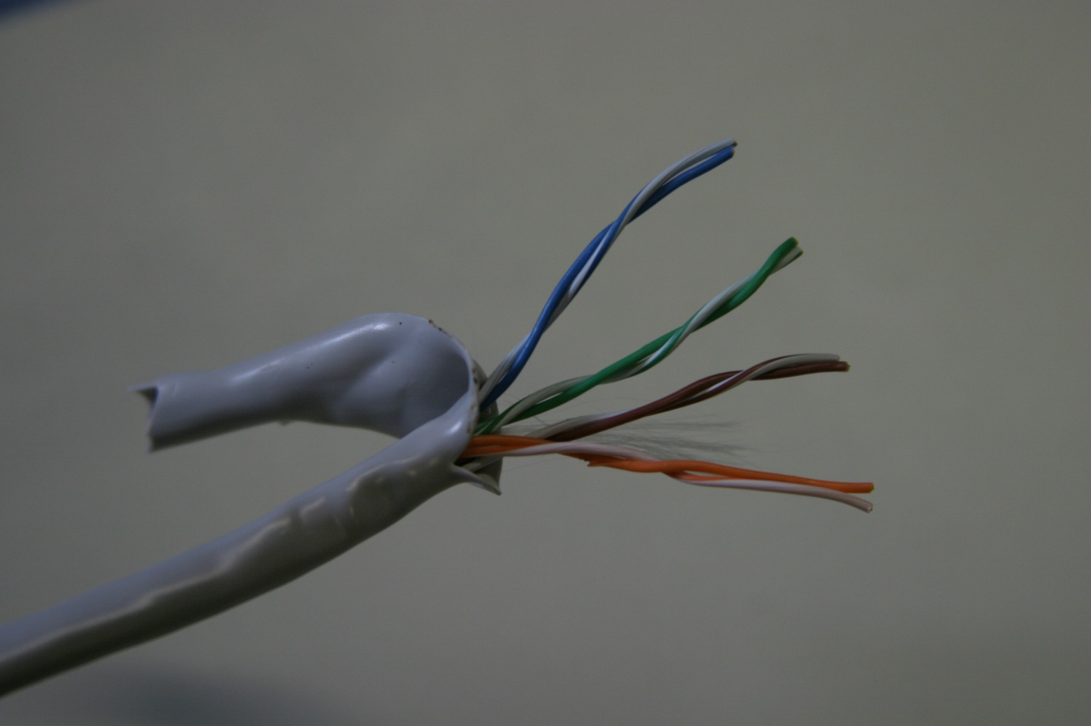
Unshielded Twisted-Pair Cabling
2-<number>

Slide 31
MEDIA TYPES and CONNECTORS (cont’d)
2-<number>
UTP Connectors
  UTP cabling is terminated with UTP 8-pin connectors.
  UTP connectors are commonly referred to as RJ-45 connectors.

Slide 32
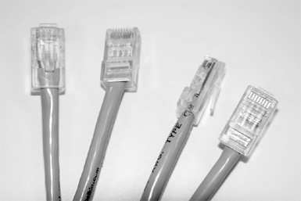
UTP Cable Connectors
2-<number>

Slide 33
MEDIA TYPES and CONNECTORS (cont’d)
2-<number>
Shielded Twisted Pair
  Provides the same connectivity benefits as UTP, but STP adds two levels of shielding material to protect data transmissions from EMI (Electromagnetic Interference).

Slide 34
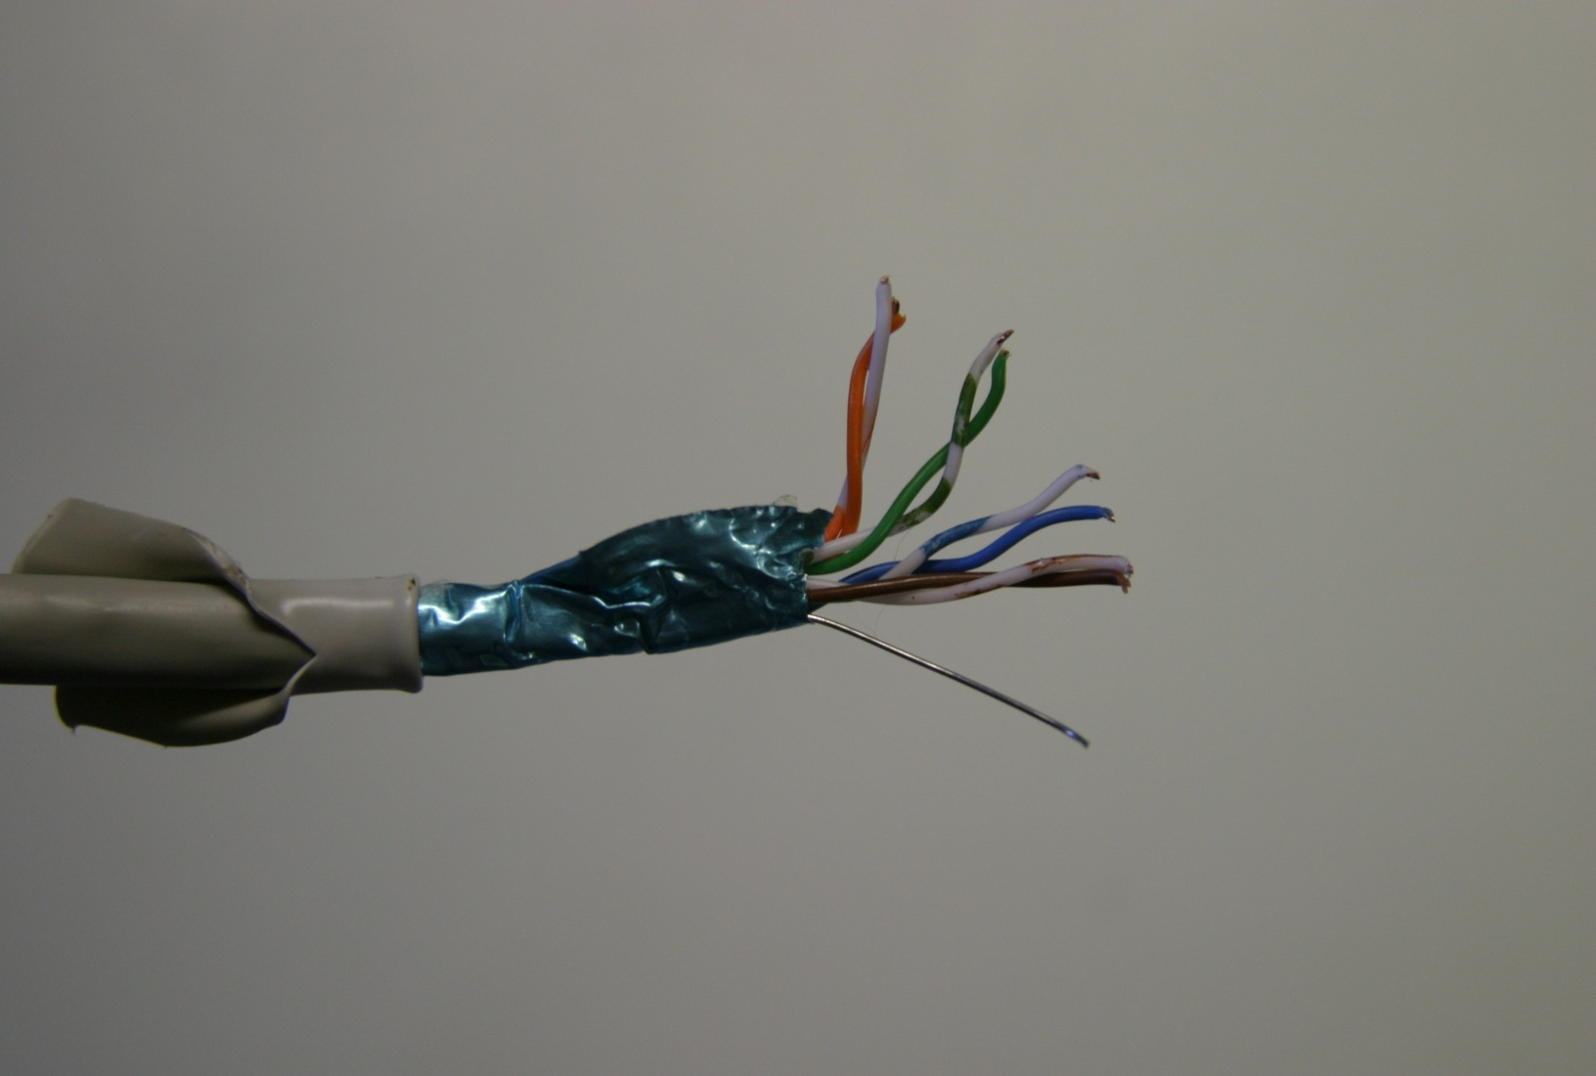
Shielded Twisted-Pair Cabling
2-<number>

Slide 35
MEDIA TYPES and CONNECTORS (cont’d)
2-<number>
STP Connectors
  Very much like UTP connectors, except STP connectors provide a ground casing to which the shielding of the STP cabling is connected.

Slide 36
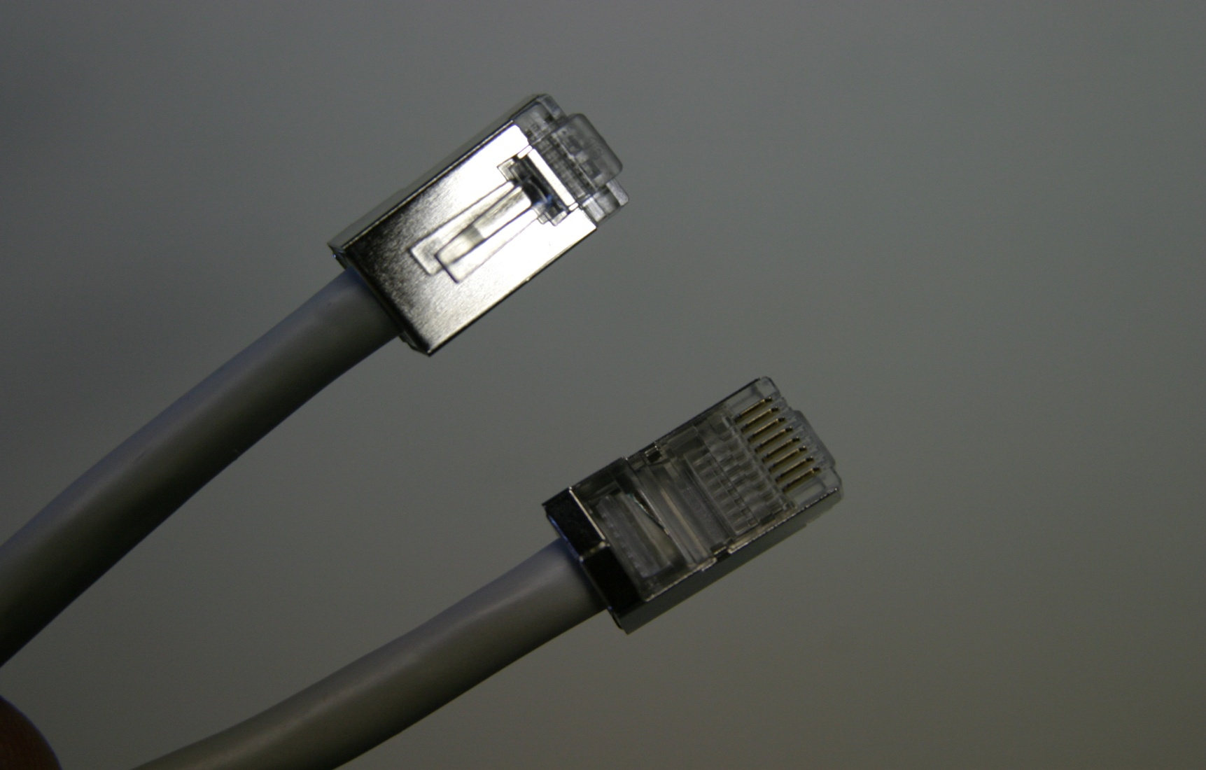
STP Cable Connectors
2-<number>

Slide 37
MEDIA TYPES and CONNECTORS (cont’d)
2-<number>
Fiber-Optic Media
  Uses glass or plastic fibers to transmit pulses of light.
  Used where high data rates and large volumes of data transmissions are required.
  Typical implementations include two fiber-optic cables between source and destination devices – one for transmitting and one for receiving.
  FO media is not susceptible to EMI.
  FO media can support greater distances and higher transmission rates than copper cabling.

Slide 38
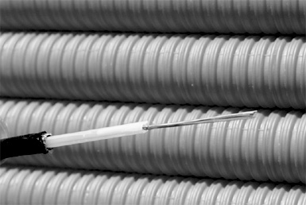
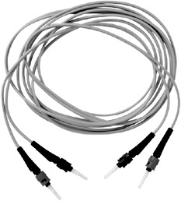
Examples of Fiber Optic Cabling
2-<number>

Slide 39
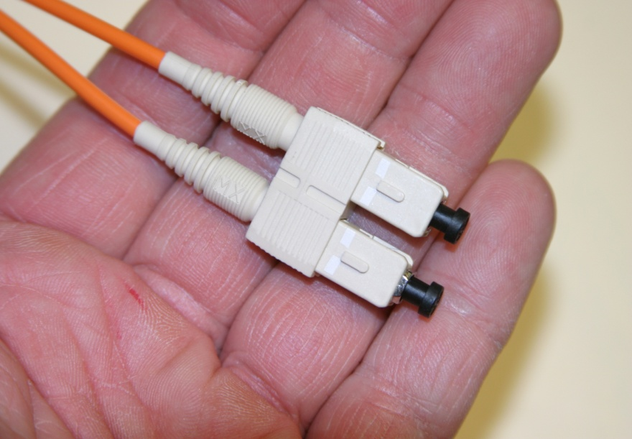
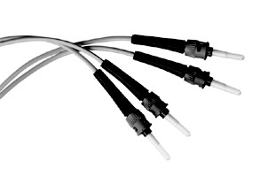
An Example of Fiber-Optic Cable Connectors
2-<number>

Slide 40
MEDIA TYPES and CONNECTORS (cont’d)
2-<number>
Wireless Media
  Does not require an electrical or optical conductor.
  Options include radio frequency, infrared, and microwave.

Slide 41
MEDIA TYPES and CONNECTORS (cont’d)
2-<number>
Wireless Media – Radio Frequency
  Each LAN device has a transceiver and antenna.
  Wireless LAN radio frequencies do not interfere with radio stations.
  Radio frequencies are allocated by the KCC
  Wireless devices use access points for connecting to a LAN.

Slide 42
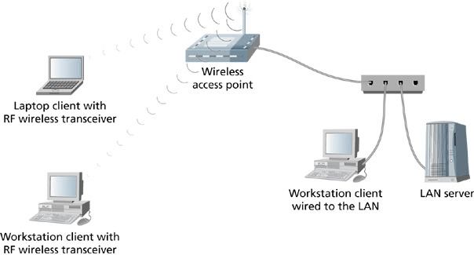
RF Wireless LAN Devices on a Local Area Network
2-<number>

Slide 43
MEDIA TYPES and CONNECTORS (cont’d)
2-<number>
Wireless Media – Infrared
  Uses light frequencies for data transmission.
  Generally limited to very short distances.
  Susceptible to many types of interference.
  Can be used in point-to-point or broadcast transmissions.

Slide 44
MEDIA TYPES and CONNECTORS (cont’d)
2-<number>
Wireless Media – Microwave
  Uses very high frequency radio waves for data transmission.
  When used in LAN applications is generally implemented for transmissions between buildings.
  Terrestrial microwave uses parabolic antennas to transmit data.

Slide 45
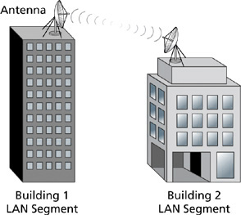
Terrestrial Microwave Data Communications
2-<number>

Slide 46
MEDIA TYPES and CONNECTORS (cont’d)
2-<number>
Wireless Connectors
  Wireless data transmissions don’t use connectors that are analogous to the connectors used in coax, twisted-pair, and fiber optic cabling.
  Instead, wireless devices use antennas and transceivers to make connections between wireless devices.

Slide 47
NETWORK INTERFACE CARDS
2-<number>
Network Interface Card
  Also known as a network adapter, network card, or simply NIC.
  A NIC is the interface between a computer or other networking device and a LAN.
  NICs are available in various forms – built in to a computer’s motherboard, as a separate expansion card, as a PC card, as a USB device, etc.

Slide 48
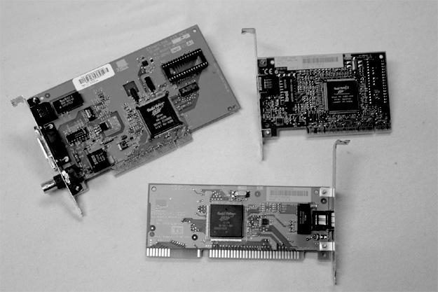
Examples of Ethernet NICs
2-<number>

Slide 49
NETWORK INTERFACE CARDS (cont’d)
2-<number>
Network Interface Card (cont’d)
  Different transmission rates are available – 10 Mbps, 100 Mbps, 1000 Mbps, 10 Gbps, etc.
  Different architectures are available – Ethernet, Token Ring, FDDI (Fiber Distributed Data Interface), ATM (Asynchronous Transfer Mode), etc.

Slide 50
NETWORK INTERFACE CARDS (cont’d)
2-<number>
What NICs do
  NICs translate data from a computer into an acceptable format for the transmission medium.
  NICs segment data into frames.
  NICs provide the physical node address of a device.

Slide 51
NETWORK INTERFACE CARDS (cont’d)
2-<number>
NIC Characteristics
  NIC drivers allow a NIC to communicate with workstation operating systems and network operating systems.
  Many NICs have built in features that provide management capabilities and enhanced performance features.
  NIC management features include abilities such as the ability to turn on a PC’s power via an external command.

