Slide 1
chapter 3
Local Area Networks – Topologies and Architectures

Slide 2
CHAPTER OBJECTIVES
3-<number>
Define the term LAN topology, and identify bus, star, ring, and wireless topologies.
Describe the differences between physical and logical topologies.
Define the term LAN architecture.
Describe the Ethernet LAN architecture and identify common Ethernet standards.
Describe the Ethernet access method.

Slide 3
CHAPTER OBJECTIVES (cont’d)
3-<number>
Describe the wireless LAN architecture.
Discuss wireless LAN and wireless PAN technologies and their histories.
Identify common standards and access methods for IEEE 802.11, Bluetooth, HiperLAN2, and HomeRF.
Discuss technical and business considerations of wireless architectures.
Identify FDDI and ATM standards, access methods, and technical and business aspects.

Slide 4
LAN TOPOLOGIES
3-<number>
A LAN topology is the basic map or layout of a local area network.
Four common types are bus, star, ring, and wireless.
Logical and physical topologies must be considered in a LAN design.

Slide 5
LAN TOPOLOGIES (cont’d)
3-<number>
Logical topology defines the conceptual layout of a LAN, or the way in which data flows across the LAN.
Physical topology defines the actual physical layout of the LAN and the configuration of the cabling, computers, printers, and other devices on the LAN.

Slide 6
LAN TOPOLOGIES – BUS
3-<number>
A bus topology is comprised of a shared network medium to which various network devices are attached, and every connected device hears every data transmission on the network.
A bus topology that is implemented with coax cable is both a physical bus and a logical bus.

Slide 7
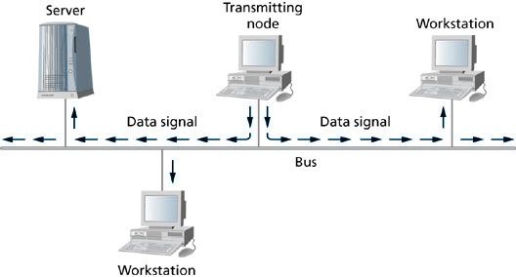
Simple Bus Topology
3-<number>

Slide 8
LAN TOPOLOGIES – BUS (cont’d)
3-<number>
Bus topology advantages/disadvantages:
  Easy and inexpensive to implement. (Adv.)
  If a cable segment is disconnected or damaged, the entire network becomes unavailable. (Disadv.)
  Difficult to troubleshoot because if a cable segment fails, it is not readily apparent which cable segment has failed. (Disadv.)

Slide 9
LAN TOPOLOGIES – STAR
3-<number>
A star topology is comprised of network devices, data transmission media, and a centralized device that provides connectivity among all attached devices.
Common implementations include UTP cabling connected to a hub or a switch.

Slide 10
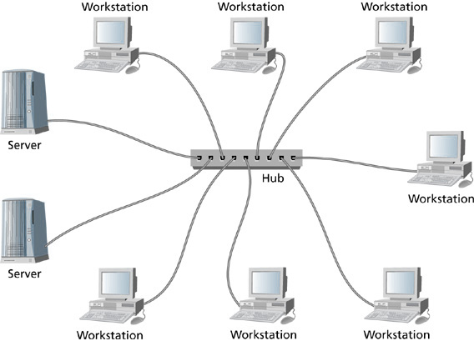
Star Topology
3-<number>

Slide 11
LAN TOPOLOGIES – STAR (cont’d)
3-<number>
Physical star/logical bus
  A physical star/logical bus topology uses twisted pair cabling and a hub.
  All computing devices that are connected to the hub immediately hear the data, which makes the configuration a logical bus.
  The actual physical layout that links devices to the hub via twisted pair cabling is a physical star.

Slide 12
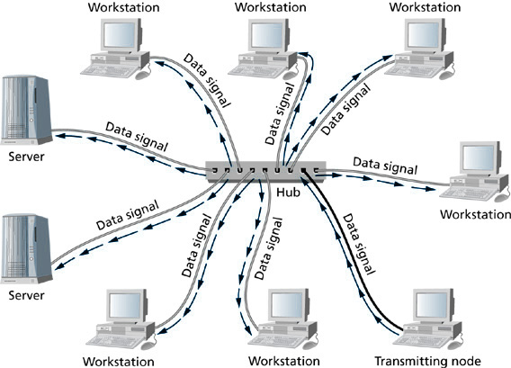
Physical Star/Logical Bus
3-<number>

Slide 13
LAN TOPOLOGIES – STAR (cont’d)
3-<number>
Physical star/logical star
  Uses twisted pair cabling and a switch.
  Has the physical configuration of a star.
  The flow of data emanates only to the intended recipients, which makes the configuration a logical star as well.

Slide 14
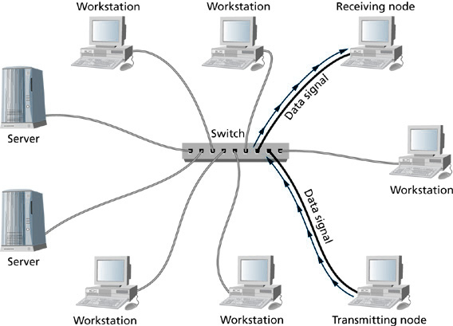
Physical Star/Logical Star
3-<number>

Slide 15
LAN TOPOLOGIES – STAR (cont’d)
3-<number>
Physical star advantages/disadvantages:
  Connectivity to the LAN is through a centralized device. (Adv.)
  Centralized device is a potential single point of failure. (Disadv.)
  The loss of one cable segment does not bring down the entire network. (Adv.)

Slide 16
LAN TOPOLOGIES – RING
3-<number>
In a ring topology, all network devices are connected in a closed loop, and the data flows from device to device in a unidirectional fashion, around the ring.

Slide 17
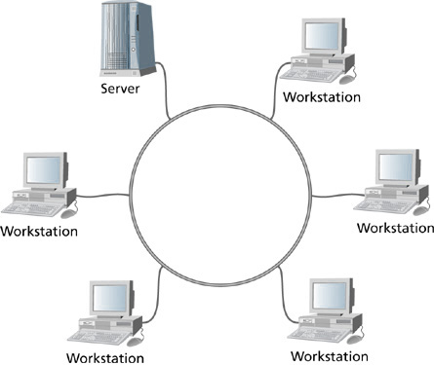
Ring Topology
3-<number>

Slide 18
LAN TOPOLOGIES – RING (cont’d)
3-<number>
Advantages/disadvantages:
  Without a star configuration, any break in the cable between devices can crash the entire ring. (Disadv.)
  Dual rings can provide failover protection if the first ring fails or is damaged.

Slide 19
LAN TOPOLOGIES - WIRELESS
3-<number>
Wireless topologies use radio frequencies instead of cables as the transmission medium.
Wireless topologies use access points instead of hubs for connecting wireless devices to a LAN.
Geographic areas are divided into cells, and each cell contains an access point.

Slide 20
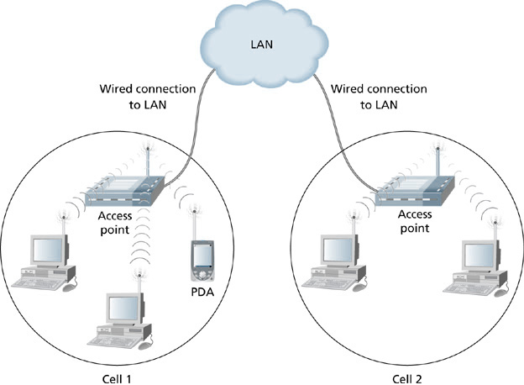
Wireless Topology
3-<number>

Slide 21
LAN TOPOLOGIES – WIRELESS (cont’d)
3-<number>
The physical topology of a wireless LAN can be compared to a physical star.
The logical topology can be compared to a logical bus.
BUT – wireless devices on a wireless LAN do not always hear each other. This is different from a logical bus topology in which all devices hear every other device on the LAN.

Slide 22
LAN TOPOLOGIES – WIRELESS (cont’d)
3-<number>
Advantages/disadvantages to wireless:
  Wireless LANs are easy to install. (Adv.)
  No cables to install or holes to drill. (Adv.)
  Network devices can move from cell to cell. (Adv.)
  Network devices must be located within a few hundred feet of an access point. (Disadv.)
  Security requires more attention. (Disadv.)

Slide 23
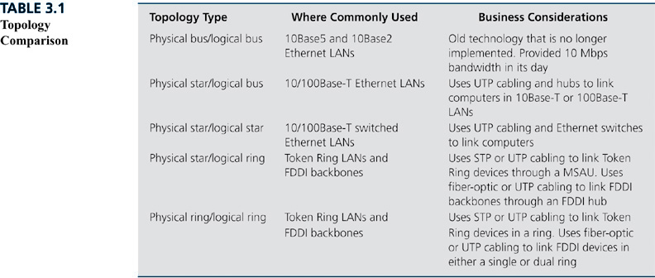
Topology Comparison
3-<number>

Slide 24
LAN ARCHITECTURES
3-<number>
LAN architecture is the way in which data accesses network media and the structure of the data frames that are placed on the media.

Slide 25
LAN ARCHITECTURES - ETHERNET
3-<number>
Originated in the early 1970s.
It’s based on the data transmission method used by a network known as Alohanet.
Bob Metcalfe is credited with its invention.
First Ethernet standard was known as DIX.
First IEEE Ethernet standard is known as IEEE 802.3
Popular in modern LANs.
It’s reliable, easy to implement, and cost effective.
It’s a widely accepted industry standard.

Slide 26
LAN ARCHITECTURES – ETHERNET (cont’d)
3-<number>
Ethernet was originally deployed across thicknet (10Base5) and later thinnet (10Base2).
10Base-T is 10 Mbps baseband Ethernet over UTP cable.
100Base-T is 100 Mbps baseband Ethernet over UTP cable.
Other Ethernet standards fall under the IEEE 802.3x set of standards.

Slide 27
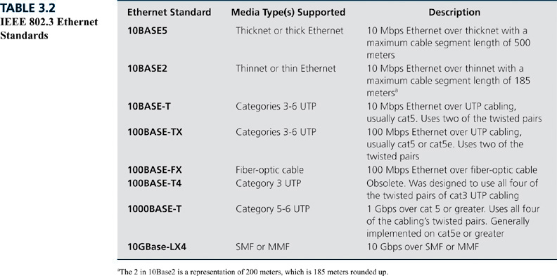
IEEE 802.3 Ethernet Standards
3-<number>

Slide 28
LAN ARCHITECTURES - ETHERNET ACCESS METHOD
3-<number>
Ethernet uses CSMA/CD.
Carrier sense refers to a network device listening for or sensing a neutral electrical signal on the network media.
Multiple access specifies that all network devices have equal access to the network media.

Slide 29
LAN ARCHITECTURES - ETHERNET ACCESS METHOD (cont’d)
3-<number>
Collision detection ensures that the sending device that detects the collision sends out a signal to all other devices to indicate that a collision has taken place.
When a collision occurs, network devices wait a random amount of time before attempting to retransmit.

Slide 30
LAN ARCHITECTURES - ETHERNET ACCESS METHOD (cont’d)
3-<number>
Advantages and disadvantages of CSMA/CD:
  It’s easy to configure and has widespread standardization and implementation. (Adv.)
  Increasing numbers of collisions as more devices are added to the network. (Disadv.)

Slide 31
ETHERNET: TECHNICAL AND BUSINESS CONSIDERATIONS
3-<number>
Ethernet has distance limitations.
  For example, 100 Mbps Ethernet has a maximum segment length of 100 meters and a network span of 205 meters.
Ethernet is an industry standard.
  Vendors continue to develop new products.
  Newer versions of Ethernet are backward compatible with older versions.
  Plentiful technical support.

Slide 32
LAN ARCHITECTURES – WIRELESS
3-<number>
Wireless architectures are comprised of IEEE 802.11, Bluetooth, and HomeRF.
IEEE supports the IEEE 802.11 series of standards and the IEEE 802.15 (Bluetooth) series of standards.
HomeRF Working Group supports HomeRF.

Slide 33
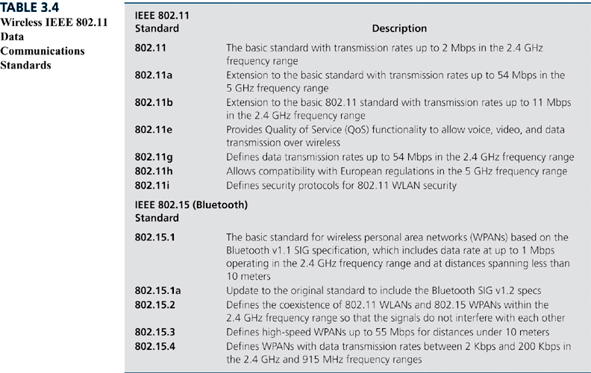
Wireless IEEE 802.11 Data Communications Standards
3-<number>

Slide 34
LAN ARCHITECTURES – WIRELESS ACCESS METHODS
3-<number>
IEEE 802.11 uses a method of collision avoidance known as distributed coordination function (DCF).
DCF reduces the need for a full-duplex channel to communicate collision detection.

Slide 35
LAN ARCHITECTURES – WIRELESS ACCESS METHODS (cont’d)
3-<number>
Bluetooth uses a polling mechanism with controlled access.
Devices establish themselves as either Master or Slave devices on a Bluetooth piconet, and communication between any two devices is controlled by the Master device.
This method prevents data collisions and ensures efficient use of the communications channel.

Slide 36
LAN ARCHITECTURES – WIRELESS ACCESS METHODS (cont’d)
3-<number>
HomeRF uses different media access methods depending on the types of data being transmitted.
  TDMA is used where timing is critical as in multimedia transmissions.
  CSMA/CA is used for data transmissions that are not critically dependent upon the timing of the delivery.

Slide 37
WIRELESS TECHNICAL CONSIDERATIONS
3-<number>
Frequency overlap between competing standards.
Access point location should provide optimal coverage for users and not overlap with adjacent access points.

Slide 38
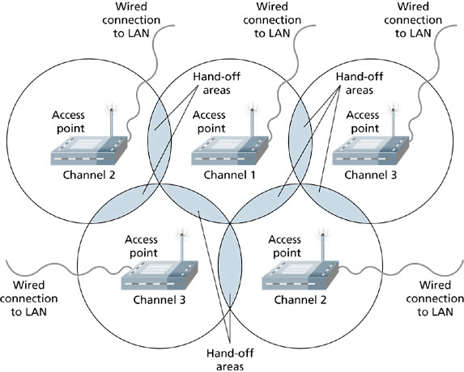
Locating Access Points with No Channel Overlap
3-<number>

Slide 39
WIRELESS BUSINESS CONSIDERATIONS
3-<number>
Cost.
Which wireless architecture to choose.
Standards are important for longevity and interoperability with existing “wired” technologies.
Distance and speed requirements to meet business needs.

Slide 40
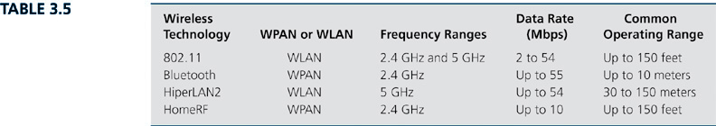
Wireless Technologies Compared
3-<number>

Slide 41
LAN ARCHITECTURES – FDDI
3-<number>
FDDI – Fiber Distributed Data Interface
It’s an older data transmission technology.
It’s roots date back to the early 1980s.
It’s still supported in various network environments.
At one time it was a common choice for high-speed connectivity between remote LANs in a campus environment.

Slide 42
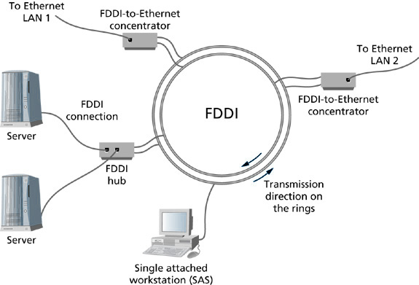
FDDI Dual-ring Configuration and Network Interconnectivity
3-<number>

Slide 43
LAN ARCHITECTURES – FDDI (cont’d)
3-<number>
FDDI can be maintained in existing installations, but as higher data rates are required, it is generally replaced by Gigabit (or faster) Ethernet.

Slide 44
LAN ARCHITECTURES – ATM
3-<number>
ATM is a technology that dates back to the late 1960s at Bell Labs.
ATM provides high-speed and low-latency data transfer on networks that require reliable and timely delivery of data, voice, and video transmissions.
Is generally reserved for network backbones, wide area networks, and carrier service networks.

Slide 45
LAN ARCHITECTURES – ATM (cont’d)
3-<number>
Business Considerations for ATM:
  Not widely used in LANs due to cost and efficient competitors such as Ethernet.
  Can be used for backbone connectivity in LAN settings, but Gigabit (and faster forms of) Ethernet are efficient competitors here as well.
  ATM is used extensively in carrier service networks for the transmission of data, voice, and video.

Slide 46
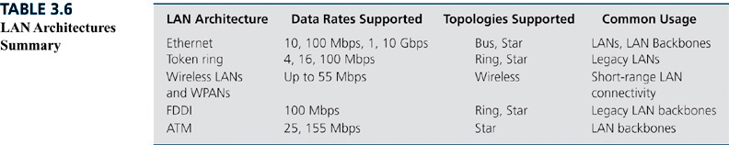
LAN Architectures Summary
3-<number>

