Slide 1
chapter 8
Wide Area Networks

Slide 2
CHAPTER OBJECTIVES
8-<number>
Define circuit switching, describe circuit-switched architecture, and identify and describe different types of circuit-switched carrier services.
Define dedicated circuit, and list and describe dedicated-circuit carrier services.
Discuss packet-switched networks, and list and describe different types of packet-switched carrier services.
List and describe other high-speed carrier services.
Identify and describe different types of multiplexing.

Slide 3
CONNECTIVITY TO REMOTE NETWORKS (cont’d)
8-<number>
Circuit-Switched Carrier Services
  Circuit switching is a communications method that creates a dedicated communications path between points A and B for the exclusive use of the end nodes for the duration of the connection.
  Data rates for circuit-switched carrier services range from modem dial-up speeds of 28.8 Kbps to 56 Kbps, to low-end broadband data rates of 1.544 Mbps.
  Businesses implement circuit-switched carrier services if data transmission requirements between remote locations are mostly text-based and don’t require a continuous connection.

Slide 4
CONNECTIVITY TO REMOTE NETWORKS (cont’d)
8-<number>
Circuit-Switched Carrier Services (cont’d)
  All circuit-switched services use the PSTN, which provides the carrier-service infrastructure between remote locations.
  Circuit-switched connections provide flexibility in connecting to remote locations – you dial a number to connect to a remote computer or network, and the connection is maintained until you hang up.
  Circuit-switched connections charge for every minute of connection time.

Slide 5
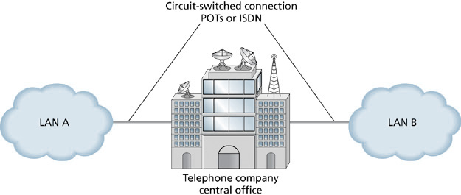
LAN-to-LAN Connectivity through the PSTN
8-<number>

Slide 6
CONNECTIVITY TO REMOTE NETWORKS (cont’d)
8-<number>
Integrated Services Digital Network
  ISDN is a digital circuit-switched service.
  Was originally developed in the 1960s as a digital replacement for analog phone lines.
  ISDN has many of the same features as regular analog phone lines.
  ISDN can accommodate voice and data traffic, graphics, video, audio, and any other data that can be converted to digital.
  It was never widely deployed because of the cost of telephone replacement at every home in the U.S. in the days when AT&T held a telephone monopoly.

Slide 7
CONNECTIVITY TO REMOTE NETWORKS (cont’d)
8-<number>
Dedicated-Circuit Carrier Services Provides an exclusive communications channel between remote locations.
  Provides dedicated bandwidth.
  Also called a point-to-point connection or circuit.
  A dedicated circuit is multiplexed with other circuits throughout a carrier’s network.

Slide 8
CONNECTIVITY TO REMOTE NETWORKS (cont’d)
8-<number>
T-Carrier Circuits
  Originated in the 1960s as high-capacity circuits between central offices.
  Phone companies offered T-carrier circuits to organizations that needed to fill data communications needs.
  T1 provides 1.544 Mbps capacity and can be divided into 24 64 Kbps digital channels.
  T3 provides 44.736 Mbps, or the equivalent of 28 T1 circuits. A T3 can be divided into 672 digital channels.
  T-carrier circuits require a CSU/DSU (Channel/Digital Service Unit)

Slide 9
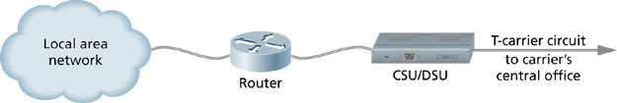
CSU/DSU Interface
8-<number>

Slide 10
CONNECTIVITY TO REMOTE NETWORKS (cont’d)
8-<number>
SONET (Synchronous Optical Network)
  It’s an ANSI standard for high-speed data communications over fiber-optic cables.
  It’s defined in terms of optical carrier levels (OC-x).
  SONET is deployed as redundant rings for fault tolerance.

Slide 11
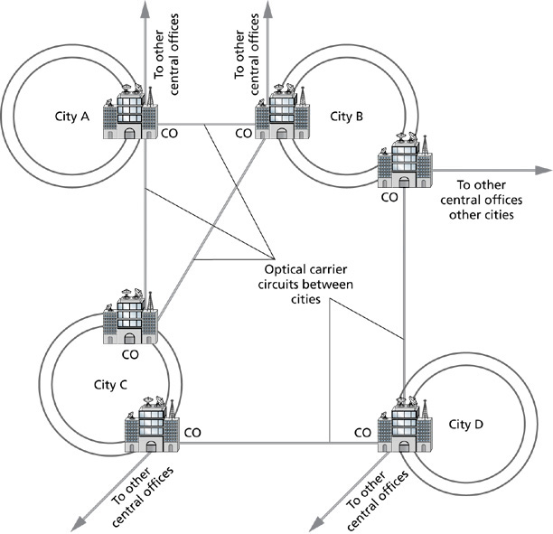
SONET Ring Infrastructure
8-<number>

Slide 12
CONNECTIVITY TO REMOTE NETWORKS (cont’d)
8-<number>
Packet-Switched Carrier Services
  Were developed as more efficient data and voice transmission services – packet switching reduced idle time on transmission circuits.
  Are always on and ready to transmit.
  There’s no call setup with packet-switched services.
  There’s no wasted capacity when the connection is not in use.

Slide 13
CONNECTIVITY TO REMOTE NETWORKS (cont’d)
8-<number>
Packet-Switched Carrier Services (cont’d)
  Are represented as a cloud in diagrams.
  Are referred to as the Public Data Network (PDN).
  Packets must pass through a packet assembler/disassembler (PAD) to reach the PDN.

Slide 14
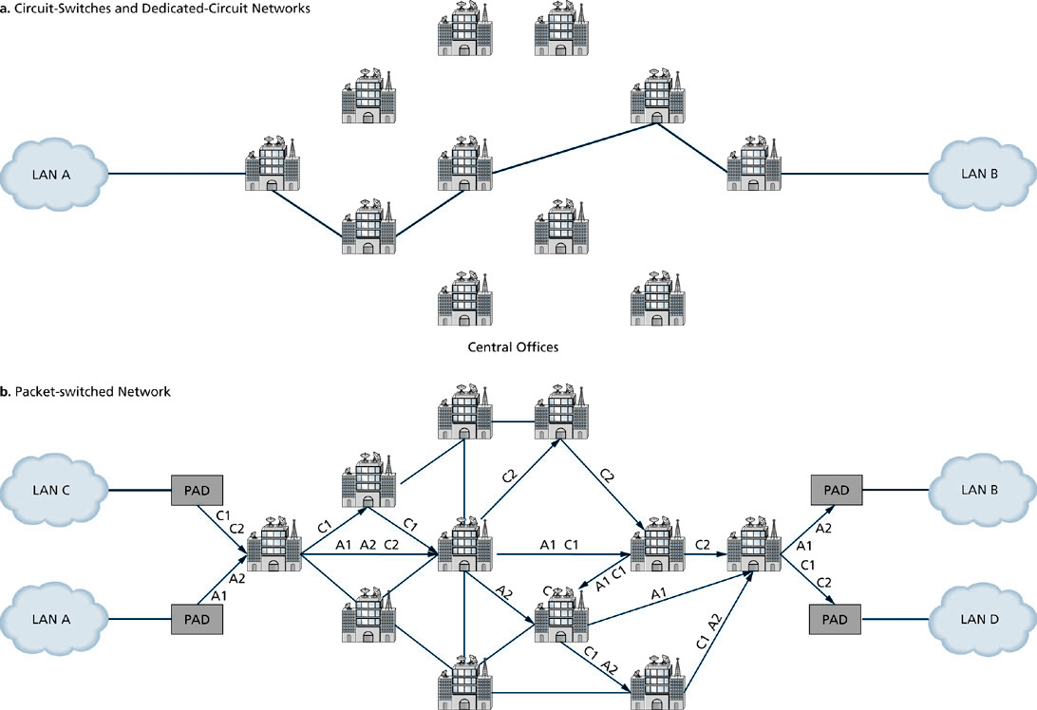
Circuit-Switched and Dedicated-Circuit Networks vs. Packet-Switched Networks
8-<number>

Slide 15
CONNECTIVITY TO REMOTE NETWORKS (cont’d)
8-<number>
Packet-Switched Services
  X.25 specifies data communications across the PSTN between remote computers with a maximum data rate of 64 Kbps.
  Frame Relay provides data rates ranging from 56 Kbps to 45 Mbps
  Asynchronous Transfer Mode (ATM) is the widely accepted standard of cell relay technology.

Slide 16
CONNECTIVITY TO REMOTE NETWORKS (cont’d)
8-<number>
Other High-Speed Carrier Services
  Digital Subscriber Line Technologies (DSL) use existing telephone lines for high-speed Internet access and data communications.
  DSL requires extra equipment at both the customer location and at the carrier’s central office.
  Customers require a DSL modem and a line splitter.
  The carrier’s central office (CO) requires a main distribution frame to separate incoming voice and data traffic.
  The carrier’s CO also requires a digital subscriber line access multiplexer (DSLAM) to convert DSL data streams into ATM cells.

Slide 17
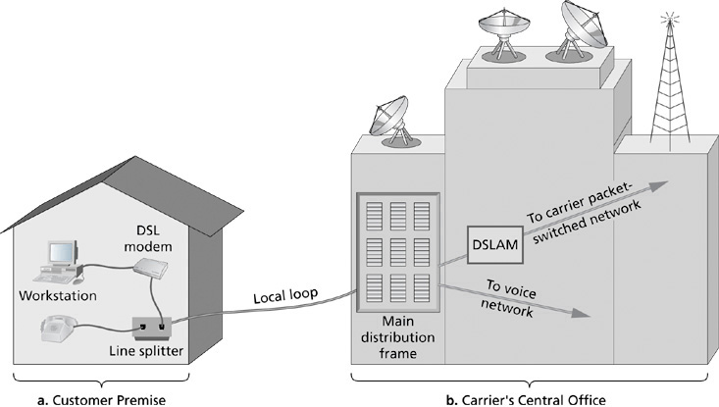
DSL Configuration
8-<number>

Slide 18
CONNECTIVITY TO REMOTE NETWORKS (cont’d)
8-<number>
Other High-Speed Carrier Services (cont’d)
  VDSL is very-high-data-rate DSL.
  Upload speeds approach 16 Mbps.
  Download speeds approach 52 Mbps.
  Distance between customer premise and central office must be 4,000 feet or less.
  VDSL has competing standards that are not compatible with each other.

Slide 19
CONNECTIVITY TO REMOTE NETWORKS (cont’d)
8-<number>
Other High-Speed Carrier Services (cont’d)
  Cable Television (CATV) is marketed toward home users, home offices, and small businesses.
  Upload transmission rates of 3 Mbps and download rates in the 27-56 Mbps range are achievable.
  Customer equipment includes a cable modem and an Ethernet NIC or USB port.
  The CATV company provides the hybrid fiber coax (HFC) network, the cable headend transmitter, and the cable modem termination system (CMTS).

Slide 20
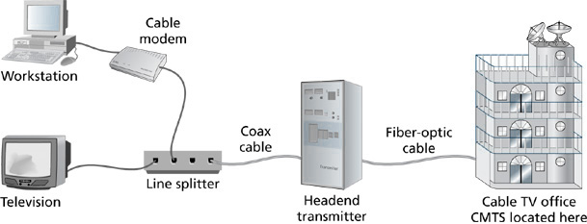
Cable TV Network for Data Transmission
8-<number>

Slide 21
CONNECTIVITY TO REMOTE NETWORKS (cont’d)
8-<number>
Other High-Speed Carrier Services (cont’d)
  Metropolitan Ethernet networks (MENs) provide high-speed Ethernet connectivity beyond the physical boundaries of an organizations’ campus.
  100 Mbps Ethernet, 1 Gbps Ethernet, or 10 Gbps Ethernet can be specified with the carrier.
  The Metro Ethernet Forum (MEF) oversees the development of the metro Ethernet standards.

Slide 22
CONNECTIVITY TO REMOTE NETWORKS (cont’d)
8-<number>
Other High-Speed Carrier Services (cont’d)
  A passive optical network (PON) is a fiber optic network in which all active components have been removed between the customer and the carrier’s CO.
  Optical splitters distribute optical signals to multiple customers.
  ATM-based PONs (APONs) provide 155 Mbps or 622 Mbps downstream and 155 Mbps upstream.
  Ethernet PONs (EPONs) and Gigabit Ethernet PONs (GPONs) are in development.

Slide 23
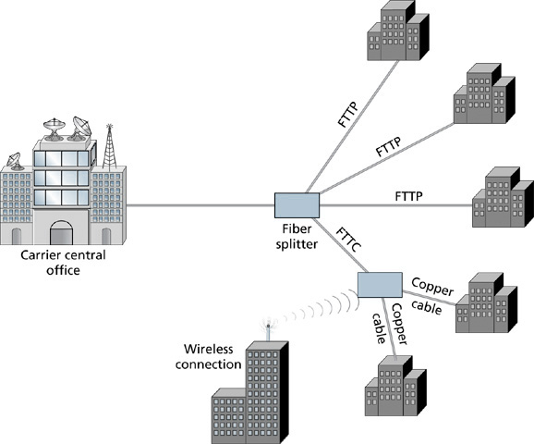
Passive Optical Network
8-<number>

Slide 24
CONNECTIVITY TO REMOTE NETWORKS (cont’d)
8-<number>
Other High-Speed Carrier Services (cont’d)
  Wireless MAN/WAN services provide shared bandwidth of up to 70 Mbps over a 30-mile non-line-of-sight range.
  Wireless MAN/WAN services are commonly known as WiMAX.
  WiMAX follows the IEEE 802.16 standards.

Slide 25
DATA COMMUNICATION THROUGH THE CARRIER
8-<number>
Multiplexing
  - Multiplexing combines multiple signals from multiple sources into a single, composite signal.
  - The composite signal traverses the carrier’s and other carriers’ networks.
  - Multiplexing makes more efficient use of carriers’ available infrastructure and allows delivery of high-speed WAN services at affordable rates.

Slide 26
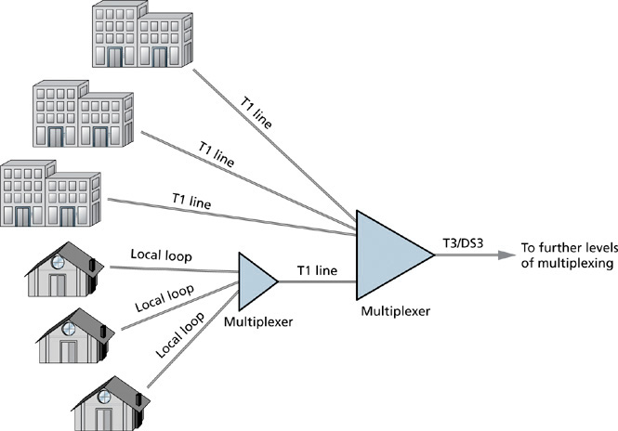
Multiplexing at the Carrier
8-<number>

Slide 27
DATA COMMUNICATION THROUGH THE CARRIER (cont’d)
8-<number>
Multiplexing (cont’d)
  Several types of multiplexing are implemented by carriers to create these combined, complex signals:
    - Frequency division multiplexing (FDM)
    - Time-division multiplexing (TDM)
    - Statistical time-division multiplexing (STDM)
    - Wavelength division multiplexing (WDM)
    - Dense wavelength division multiplexing (DWDM)
    - Inverse multiplexing (IMUX)

Slide 28
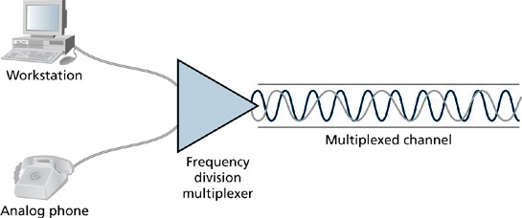
Frequency Division Multiplexing
8-<number>

Slide 29
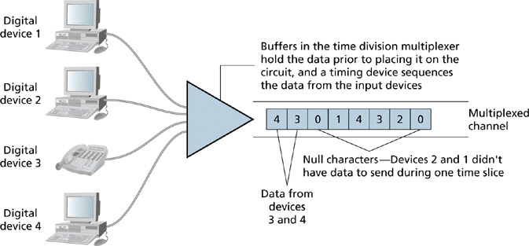
Time-Division Multiplexing
8-<number>

