Slide 1
CPU cache
임종범
jblim@kpu.ac.kr

Slide 2
Layering and Interfaces
Application Programming Interface (API), Application Binary Interface (ABI), and Instruction Set Architecture (ISA).
An application uses library functions (A1), makes system calls (A2), and executes machine instructions (A3)

Slide 3
Interfaces
Instruction Set Architecture (ISA) – at the boundary between hardware and software.
Application Binary Interface (ABI) – allows the ensemble consisting of the application and the library modules to access the hardware; the ABI does not include privileged system instructions, instead it invokes system calls.
Application Program Interface (API) - defines the set of instructions the hardware was designed to execute and gives the application access to the ISA; it includes high-level language (HLL) library calls which often invoke system calls

Slide 4
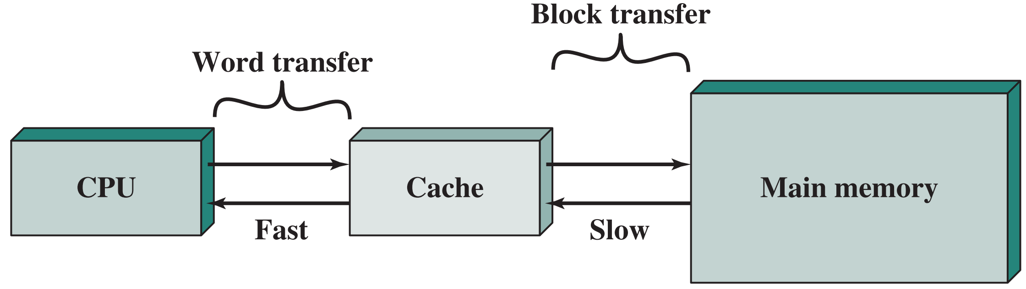
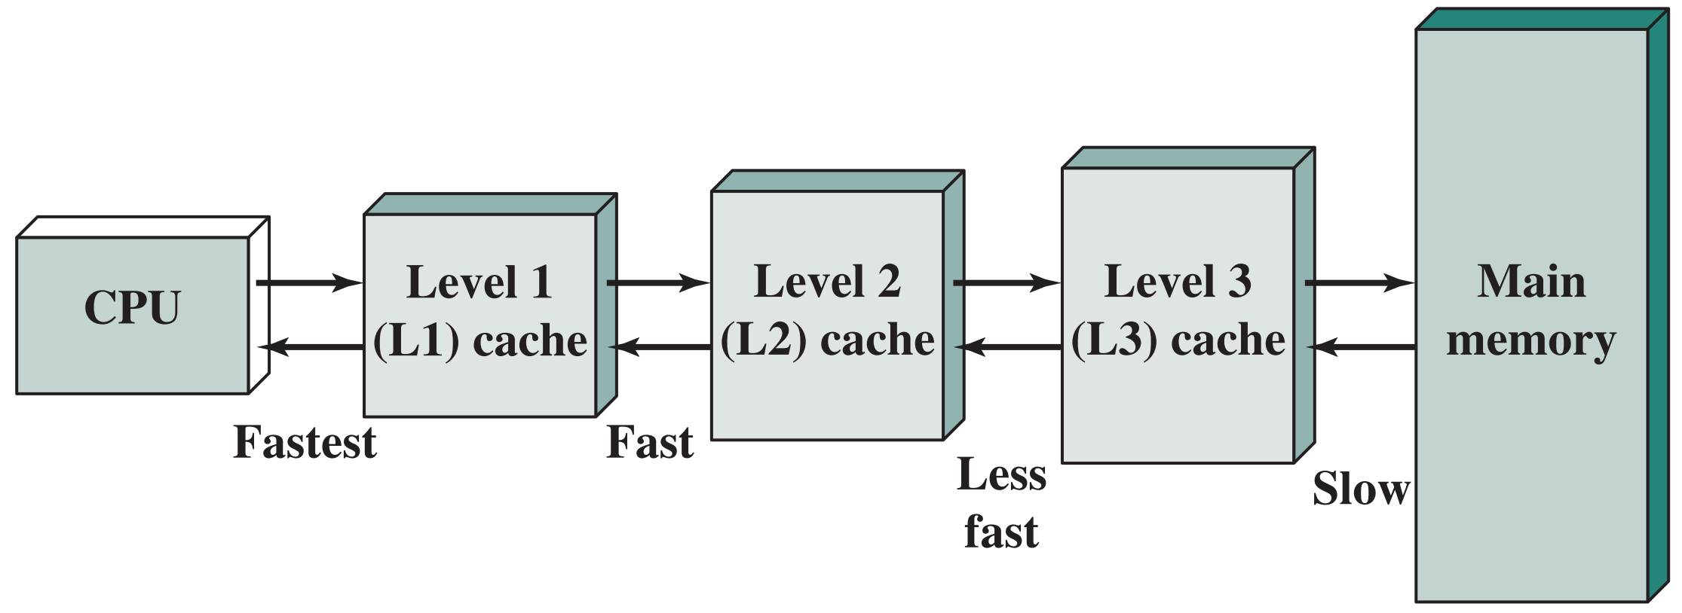
cache and main memory

Slide 5
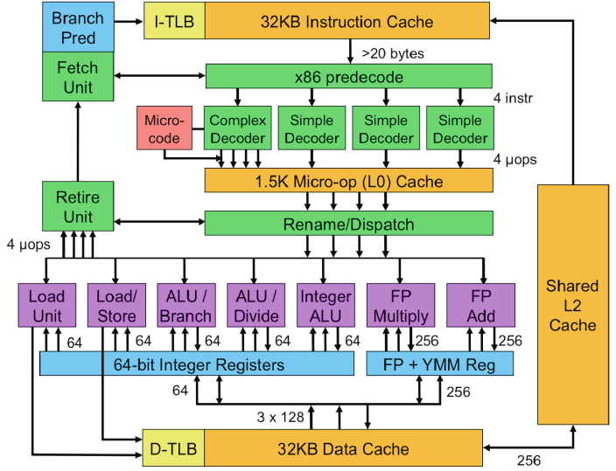
CPU Pipelines (Sandy Bridge)

Slide 6
microcode for movsb (AMD)
movsb (move byte string)
1. LDDF ; load directioni flag to latch in funtional unit
2. OR ecx, ecx ; test if ECX is zero
3. JZ end ; terminate string move if ECX is zero
loop:
4. MOVFM+ tmp0, [esi] ; move to tmp data from source and inc/dec ESI
5. MOVTM+ [edi], tmp0 ; move the data to destination and inc/dec EDI
6. DECXJNZ loop ; dec ECX and repeat until zero
end:
7. EXIT

Slide 7
A Typical Memory Hierarchy
Take advantage of the principle of locality to present the user with as much memory as is available in the cheapest technology at the speed offered by the fastest technology
Secondary
Storage
(Disk)
On-Chip Components
Main
Memory
(DRAM)
CPU Core
L1I (Instr Cache)
L2 (Second
Level)
Cache
ITLB
Reg File
DTLB
L1D (Data Cache)

Slide 8
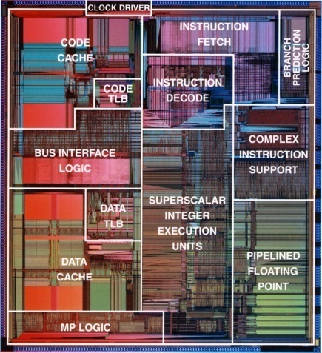
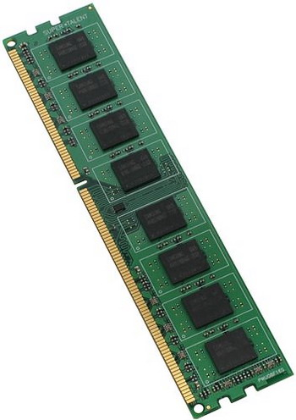
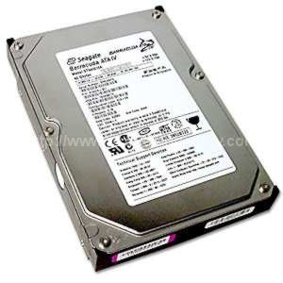
How is the Hierarchy Managed?
Who manages data transfer between
Main memory ↔ Disks
by the operating system (virtual memory)
by the programmer (files)
Registers ↔ Main memory
by compiler (and programmer)
Cache ↔ Main memory
by hardware (cache controller)
DDR3
HDD
Pentium
(1993)

Slide 9
Basic Cache Operation
Processor
address
Main Memory
(DRAM)
CPU
Cache
CPU
data
Cache line (block)
(4 words in this example)
Memory
34343434
0x121C
1023
1022
.
.
.
.
.
1
0
23232323
0x1218
12121212
0x1214
0x0000_1208
0x0000_1
77777777
99999999
0x1210
88888888
0x120C
88888888
77777777
0x1208
...
...
...
...
...
77777777
66666666
0x1204
66666666
0x1200
55555555
55555555
0x0000_0
44444444
...
0x0000_0004
22222222
0x0000_000C
TAG (Address)
D0
D1
D2
D3
44444444
0x000C
44444444
0x0008
33333333
33333333
0x0004
22222222
22222222
0x0000
11111111
11111111

Slide 10
Why Caches Work?
The size of cache is tiny compared to main memory
How to make sure that the data CPU is going to access is in caches?
Caches take advantage of the principle of locality in your program
Temporal Locality (locality in time)
If a memory location is referenced, then it will tend to be referenced again soon. So, keep most recently accessed data items closer to the processor
Spatial Locality (locality in space)
If a memory location is referenced, the locations with nearby addresses will tend to be referenced soon. So, move blocks consisting of contiguous words closer to the processor

Slide 11
Example of Locality
int A[100], B[100], C[100], D;
for (i=0; i<100; i++) {
C[i] = A[i] * B[i] + D;
}
D
C[99]
C[98]
C[97]
C[96]
. . . . . . . . . . . . . .
C[7]
C[6]
C[5]
C[4]
C[3]
C[2]
C[1]
C[0]
. . . . . . . . . . . . . .
Cache
B[11]
B[10]
B[9]
B[8]
B[7]
B[6]
B[5]
B[4]
B[3]
B[2]
B[1]
B[0]
A[99]
A[98]
A[97]
A[96]
. . . . . . . . . . . . . .
A[7]
A[6]
A[5]
A[4]
A[3]
A[2]
A[1]
A[0]
A Cache Line (block)

Slide 12
Cache Terminology
Block (cache line): the minimum unit of data present in a cache
For example, 64B block in modern CPUs
Hit: if the requested data is in cache, it is called a hit
Hit rate: the fraction of memory accesses found in caches
For example, CPU requested data from memory, and cache was able to supply data 90% of the requests. Then, the hit rate of the cache is 90%
Hit time: the time required to access the data found in cache
Miss: if the requested data is not in cache, it is called a miss
Miss rate: the fraction of memory accesses not found in cache (= 1 - Hit Rate)
Miss penalty: the time required to fetch a block into a level of the memory hierarchy from the lower level

Slide 13
Direct-mapped Cache
The simplest cache structure: Direct mapped cache
Each memory block is mapped to exactly one block in cache
Lots of memory blocks must share a block in cache
Address mapping to cache
(block address) modulo (# of blocks in cache)
Have a tag associated with each cache block that contains the address information
The tag is the upper portion of the address required to identify the block
Cache line
(=block)
Valid
Tag
Data
11
11
00
10
01
00
11
10

Slide 14
Memory Address
CPU Core
address
Cache
data
Address from CPU
31 30 . . . . . . 8 7 6 5 4 3 2 1 0
Byte Address
Word (4B) Address
Block (16B) Address
Block (32B) Address
Block (64B) Address

Slide 15
Direct-mapped Cache
Mapping to cache
(block address) modulo (# of blocks in the cache)
Cache structure
Data: actual data
Tag: which block is mapped to the cache?
Valid: Is the block in the cache valid?
Valid
Tag
Data

Slide 16
Example
4KB direct-mapped cache with 1 word (32-bit) blocks
31 30 . . . 13 12 11 . . . 2 1 0
Byte offset
Address from CPU
CPU Core
address
Cache
Tag
20
10
Index
data
Index
Valid
Tag
Data
0
1
2
.
.
.
1021
1022
1023
20
32
4B
Hit
Data

Slide 17
Example: DM$, 8-Entry, 4B blocks
Assume that address bus from CPU is 8-bit wide
lw $1, 24($0)
lw $2, 28($0)
sw $3, 60($0)
sw $4, 188($0)
Main Memory
Address
a
24
b
28
c
60
Index
Valid
Tag
Data
0
1
2
3
4
5
6
7
d
188
Cache (32B)

Slide 18
Example: DM$, 8-Entry, 4B blocks
4-byte block, drop low 2 bits for byte offset! Only matters for byte-addressable systems
lw $1, 24($0)
lw $2, 28($0)
sw $3, 60($0)
sw $4, 188($0)
Main Memory
Address
a
24
#24 is 0001 1000
Index = log₂(8) bits
b
28
Index
3
c
60
Index
Valid
Tag
Data
0
1
2
3
4
5
6
7
0
0
d
188
0
0
0
0
Cache miss!
0
0
Cache (32B)

Slide 19
Example: DM$, 8-Entry, 4B blocks
lw $1, 24($0)
lw $2, 28($0)
sw $3, 60($0)
sw $4, 188($0)
Main Memory
Address
a
24
#24 is 0001 1000
To CPU (a)
b
28
c
60
Index
Valid
Tag
Data
0
1
2
3
4
5
6
7
0
0
d
188
0
0
0
Index
0
1
a
0
000
0
Cache (32B)

Slide 20
Example: DM$, 8-Entry, 4B blocks
lw $1, 24($0)
lw $2, 28($0)
sw $3, 60($0)
sw $4, 188($0)
Main Memory
Address
a
24
#28 is 0001 1100
b
28
To CPU (b)
c
60
Index
Valid
Tag
Data
0
1
2
3
4
5
6
7
0
0
d
188
0
0
0
0
Index
1
000
a
1
0
000
b
Cache miss!
Cache (32B)

Slide 21
Example: DM$, 8-Entry, 4B blocks
lw $1, 24($0)
lw $2, 28($0)
sw $3, 60($0)
sw $4, 188($0)
Main Memory
Address
a
24
#60 is 0011 1100
b
28
c
60
Index
Valid
Tag
Data
0
1
2
3
4
5
6
7
0
0
d
188
0
0
0
0
Index
1
000
a
1
000
b
It’s valid! Is it a hit or a miss?
Cache (32B)

Slide 22
Example: DM$, 8-Entry, 4B blocks
lw $1, 24($0)
lw $2, 28($0)
sw $3, 60($0)
sw $4, 188($0)
Main Memory
Address
a
24
#60 is 0011 1100
b
28
c
60
Index
Valid
Tag
Data
0
1
2
3
4
5
6
7
0
0
d
188
0
0
0
0
Index
1
000
a
The tags don’t match! It’s not what we want to access!
Cache Miss!
1
000
b
Cache (32B)

Slide 23
Example: DM$, 8-Entry, 4B blocks
Do we have to bring the block to the cache and write to cache?
lw $1, 24($0)
lw $2, 28($0)
sw $3, 60($0)
sw $4, 188($0)
Let’s assume that (it’s called write-allocation policy)
Main Memory
Address
a
24
#60 is 0011 1100
b
28
c
60
Index
Valid
Tag
Data
0
1
2
3
4
5
6
7
0
0
d
188
0
0
0
0
Index
1
000
a
1
b
001
c
000
Cache (32B)

Slide 24
Example: DM$, 8-Entry, 4B blocks
Now, we can write a new value to the location
Main Memory
Address
lw $1, 24($0)
lw $2, 28($0)
sw $3, 60($0)
sw $4, 188($0)
a
24
#60 is 0011 1100
b
28
c
60
Index
Valid
Tag
Data
0
1
2
3
4
5
6
7
0
0
d
188
0
0
0
0
Do we update memory now? Or later?
Index
1
000
a
1
new value ($3)
001
c
Assume later (it is called write-back cache)
Cache (32B)

Slide 25
Example: DM$, 8-Entry, 4B blocks
How do we know which blocks in cache need to be written back to main memory?
lw $1, 24($0)
lw $2, 28($0)
sw $3, 60($0)
sw $4, 188($0)
Main Memory
Address
Need extra state! The “dirty” bit!
a
24
b
28
c (old)
60
Index
Valid
Tag
Data
Dirty
0
1
2
3
4
5
6
7
0
0
0
0
d
188
0
0
0
0
0
0
0
0
1
000
a
0
1
001
new value ($3)
1
Cache (32B)

Slide 26
Example: DM$, 8-Entry, 4B blocks
lw $1, 24($0)
lw $2, 28($0)
sw $3, 60($0)
sw $4, 188($0)
Main Memory
Address
a
24
#188 is 1011 1100
b
28
c (old)
60
Index
Valid
Tag
Data
Dirty
0
1
2
3
4
5
6
7
0
0
0
0
d
188
0
0
0
0
0
0
0
0
Index
1
000
a
0
1
001
new value ($3)
1
Cache miss!
Cache (32B)

Slide 27
Example: DM$, 8-Entry, 4B blocks
lw $1, 24($0)
lw $2, 28($0)
sw $3, 60($0)
sw $4, 188($0)
Main Memory
Address
a
24
#188 is 1011 1100
b
28
new value ($3)
60
c (old)
Index
Valid
Tag
Data
Dirty
0
1
2
3
4
5
6
7
0
0
0
0
d
188
0
0
0
0
0
0
0
0
Index
1
000
a
0
Dirty bit is set!
1
001
new value ($3)
1
So, we need to write the block to memory first
Cache (32B)

Slide 28
Example: DM$, 8-Entry, 4B blocks
lw $1, 24($0)
lw $2, 28($0)
sw $3, 60($0)
sw $4, 188($0)
Main Memory
Address
a
24
#188 is 1011 1100
b
28
new value ($3)
60
Index
Valid
Tag
Data
Dirty
0
1
2
3
4
5
6
7
0
0
0
0
d
188
0
0
0
0
0
0
0
0
Index
1
000
a
0
Now, we can bring the block to the cache
1
d
001
new value ($3)
0
101
Cache (32B)

Slide 29
Example: DM$, 8-Entry, 4B blocks
Now, we can write a new value to the location
Main Memory
Address
lw $1, 24($0)
lw $2, 28($0)
sw $3, 60($0)
sw $4, 188($0)
a
24
#188 is 1011 1100
b
28
new value ($3)
60
Index
Valid
Tag
Data
Dirty
0
1
2
3
4
5
6
7
0
0
0
0
d (old)
188
0
0
0
0
0
0
0
0
Index
1
000
a
0
1
101
d
1
new value ($4)
Cache (32B)

Slide 30
Handling Writes
When it comes to a read miss, we bring the block to cache and supply data to CPU
When it comes to a write miss, there are options you can choose from
Upon a write-miss,
Write-allocate: bring the block into cache and write
Write no-allocate: write directly to main memory w/o bringing the block to the cache
When writing,
Write-back: update values only to the blocks in the cache and write the modified blocks to memory (or the lower level of the hierarchy) when the block is replaced
Write-through: update both the cache and the lower level of the memory hierarchy
Write-allocate is usually associated with write-back policy
Write no-allocate is usually associated with write-through policy

Slide 31
Write-Allocate & Write-back
Processor
address
Main Memory
(DRAM)
CPU
Cache
CPU
data
12345678
dddddddd
Cache line (block)
(4 words in this example)
memory
34343434
0x121C
23232323
0x1218
12121212
0x1214
0x0000_1208
0x0000_1
55555555
66666666
77777777
88888888
1
1
99999999
0x1210
88888888
0x120C
...
...
...
...
...
...
...
77777777
0x1208
66666666
0x1204
55555555
0x1200
0x0000_0
...
0x0000_0004
1
1
TAG (Address)
D0
D1
D2
D3
V
D
44444444
0x000C
44444444
0x0008
33333333
Allocate first upon a write miss
33333333
0x0004
22222222
22222222
0x0000
11111111
11111111

Slide 32
Write No-allocate & Write-through
Processor
address
Main Memory
(DRAM)
CPU
Cache
CPU
data
12345678
12345678
dddddddd
Cache line (block)
(4 words in this example)
memory
34343434
0x121C
23232323
0x1218
12121212
0x1214
0x0000_1208
0x0000_1
55555555
66666666
77777777
88888888
1
99999999
0x1210
88888888
0x120C
...
...
...
...
...
...
77777777
0x1208
66666666
0x1204
55555555
0x1200
...
0x0000_0004
TAG (Address)
D0
D1
D2
D3
V
44444444
0x000C
33333333
0x0008
Do not allocate to cache upon a write miss
22222222
0x0004
11111111
0x0000

Slide 33
Hits vs. Misses
Processor
address
Main Memory
(DRAM)
Read hits
This is what we want!
Read misses
Stall the CPU, fetch the corresponding block from memory, deliver to cache and CPU, and continue to run CPU
Write hits
Write-through cache: write data to both cache and memory
Write-back cache: write the data only into the cache and set the dirty bit (and write the block to memory later when replaced)
Write misses
Write-allocate with write-back: read the block into the cache, then write the word only to the cache
Write no-allocate with write-through: write the word only to the main memory (w/o bringing the block to cache)
CPU
Cache
data

Slide 34
Direct Mapped Cache (4-word Block)
block address
Cache size = 4KB
31 30 . . . 13 12 11 . . . 3 2 1 0
Byte offset
Tag
20
8
Block offset
Index
Index
Valid
Tag
Data (4 words = 16B)
0
1
2
.
.
.
253
254
255
20
Hit
32
Data

Slide 35
Miss Rate vs Block Size vs Cache Size
Miss rate goes up if the block size becomes a significant fraction of the cache size because the number of blocks that can be held in the same size cache is smaller
Stated alternatively, spatial locality among the words in a word decreases with a very large block; Consequently, the benefits in the miss rate become smaller

Slide 36
Cache Hardware Cost
How many total bits are required for a direct mapped data cache with 16KB of data and 4-word blocks assuming a 32-bit address?
tag (18 bits)
Index (10 bits)
Block offset (2 bits)
31 30 . . . 15 14 13 . . . 4 3 2 1 0
Byte offset (2 bits)
Address from CPU
block address
D
V
Tag
Data
0
1
2
.
.
.
1021
1022
1023
(4 words = 16B)
#bits = #blocks x (block size + tag size + valid size + dirty size)
= 1024 x (16B + 18 bits + 1 bit + 1 bit)
= 148 Kbits = 18.5 KB
15.6% larger than the storage for data

Slide 37
Reducing Cache Miss Rates (#1)
Alternatives for more flexible block placement
Direct mapped cache maps a memory block to exactly one location in cache
Fully associative cache allows a memory block to be mapped to any cache block
N-way set associative cache divides the cache into sets, each of which consists of n different locations (ways)
A memory block is mapped to a unique set (specified by the index field) and can be placed in any way of that set (so, there are n choices)

Slide 38
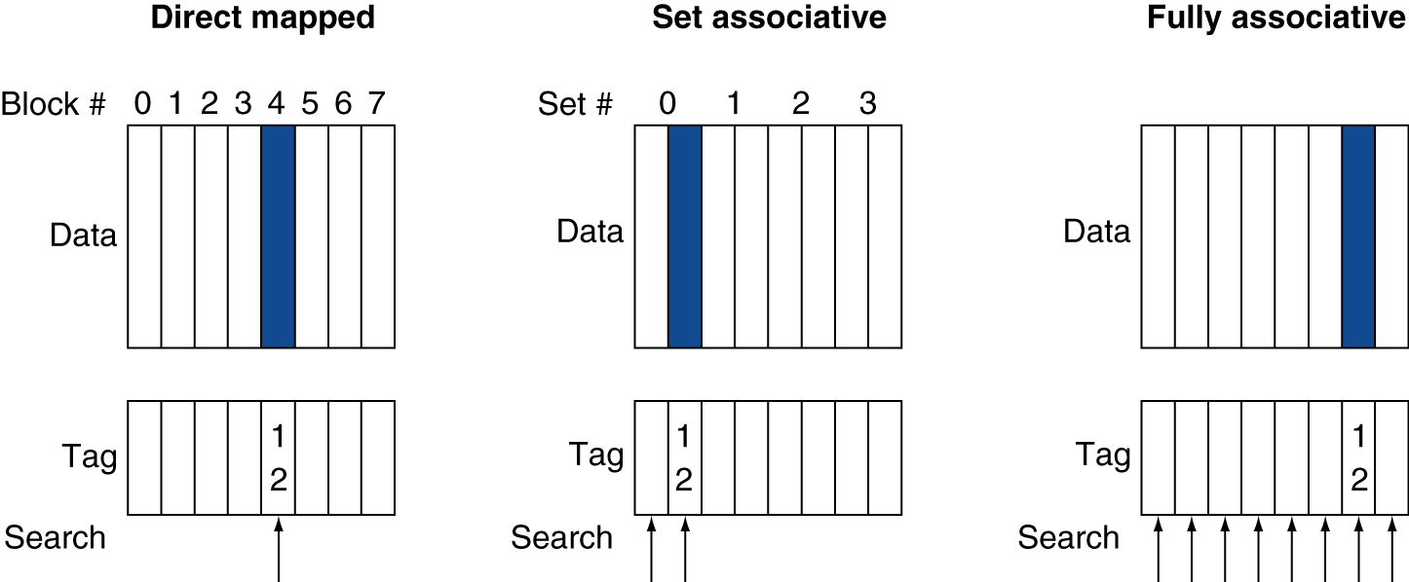
Associative Cache Example
2-way
8 sets
Only 1 set
4 sets

Slide 39
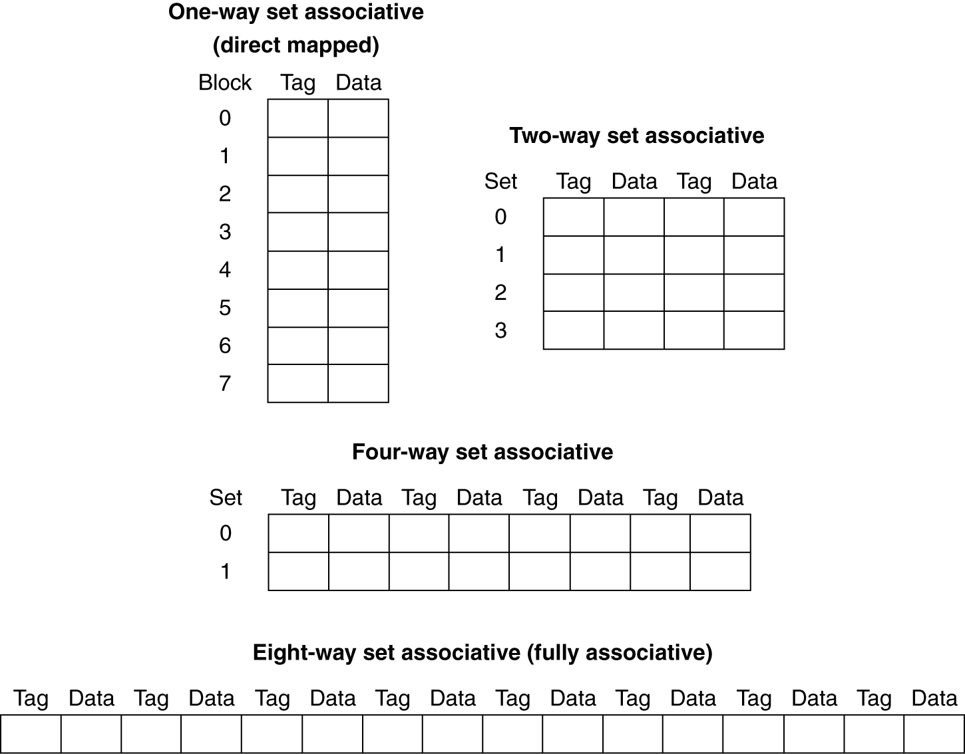
Spectrum of Associativity
For a cache with 8 entries

Slide 40
4-Way Set Associative Cache
16KB cache
4B (32-bit) per block
block address
31 30 . . . 13 12 11 . . . 2 1 0
Byte offset
Tag
20
10
Index
Index
Tag
V
Data
V
Tag
Data
V
Tag
Data
V
Tag
Data
0
1
2
.
.
.
.
1022
1023
0
1
2
.
.
.
.
1022
1023
0
1
2
.
.
.
.
1022
1023
Way 2
0
1
2
.
.
.
.
1022
1023
Way 3
Way 0
Way 1
32
32
32
32
4x1 mux
Hit
Data

Slide 41
Associative Caches
Fully associative
Allow a memory block to go in any cache entry
Requires all cache entries to be searched
Comparator per entry (expensive)
N-way set associative
Each set contains N entries
(Block address) % (#sets in cache) determines which set to search
Search all n entries in a indexed set
n comparators (less expensive)

Slide 42
Associativity Example
Assume that there are 3 small different caches with 4 one-word blocks, and CPU generates 8-bit address to cache
Direct mapped
2-way set associative
Fully associative
Find the number of misses for each cache organization given the following sequence of block addresses: 0, 8, 0, 6, 8
We assume that the sequence is for all memory reads (lw)
Notes:
In 2013, change from block address to byte address and add that CPU is executing 5 different lw instructions.

Slide 43
Associativity Example
Direct mapped cache
block address
7 6 5 4 3 2 1 0
Tag
Index
tag
Byte address | Block address | Cache Index | Hit or Miss?
b’0000 0000 (0x00) | b’00 0000 (0x00) | 0
b’0010 0000 (0x20) | b’00 1000 (0x08) | 0
b’0000 0000 (0x00) | b’00 0000 (0x00) | 0
b’0001 1000 (0x18) | b’00 0110 (0x06) | 2
b’0010 0000 (0x20) | b’00 1000 (0x08) | 0
0, 8, 0, 6, 8
miss
miss
miss
miss
miss
Index
V
Tag
Data
0
1
2
3
1
0010
Mem[0]
0
Mem[8]
Mem[0]
Mem[8]
0000
0000
8
0010
8
0
0
0
6
1
0001
0
Mem[6]
0

Slide 44
Associativity Example (Cont')
block address
2-way set associative
7 6 5 4 3 2 1 0
Tag
Index
tag
Byte address | Block address | Cache Index | Hit or Miss?
b’0000 0000 (0x00) | b’00 0000 (0x00) | 0
b’0010 0000 (0x20) | b’00 1000 (0x08) | 0
b’0000 0000 (0x00) | b’00 0000 (0x00) | 0
b’0001 1000 (0x18) | b’00 0110 (0x06) | 0
b’0010 0000 (0x20) | b’00 1000 (0x08) | 0
0, 8, 0, 6, 8
miss
miss
hit
miss
miss
Index
V
Tag
Data
V
Tag
Data
0
0
1
0
8
6
8
Mem[8]
1
00100
1
Mem[6]
0
Mem[0]
0
00100
00000
Mem[8]
00011
0
0

Slide 45
Associativity Example (Cont)
block address
Fully associative
7 6 5 4 3 2 1 0
Tag
tag
Byte address | Block address | Cache Index | Hit or Miss?
b’0000 0000 (0x00) | b’00 0000 (0x00) | 0
b’0010 0000 (0x20) | b’00 1000 (0x08) | 0
b’0000 0000 (0x00) | b’00 0000 (0x00) | 0
b’0001 1000 (0x18) | b’00 0110 (0x06) | 0
b’0010 0000 (0x20) | b’00 1000 (0x08) | 0
0, 8, 0, 6, 8
miss
miss
hit
miss
hit
Index
V
Tag
Data
V
Tag
Data
V
Tag
Data
V
Tag
Data
8
0
0
0
8
6
1
000110
0
Mem[0]
1
Mem[8]
0
Mem[6]
0
1
000000
0
001000

Slide 46
Benefits of Set Associative Caches
The choice of direct mapped or set associative depends on the cost of a miss versus the cost of implementation
Largest gains are achieved when going from direct mapped to 2-way (more than 20% reduction in miss rate)

Slide 47
Range of Set Associative Caches
For a fixed size cache, the increase by a factor of 2 in associativity doubles the number of blocks per set (the number of ways) and halves the number of sets
Example: An increase of associativity from 4 ways to 8 ways decreases the size of the index by 1 bit and increases the size of the tag by 1 bit
Block address
Used for tag comparison
Selects the set
Selects the word in the block
address
Tag
Index
Block offset
Byte offset
Increasing associativity
Decreasing associativity
Fully associative
(only one set)
Tag is all the bits except
Block offset and byte offset
Direct mapped
(only one way)
Smaller tags, only a single comparator

Slide 48
Replacement Policy
Upon a miss, which way’s block should be picked for replacement?
Direct mapped cache has no choice
Set associative cache prefers non-valid entry if there is one. Otherwise, choose among entries in the set
Least-recently used (LRU)
Choose the one unused for the longest time
Hardware should keep track of when each way’s block was used relative to the other blocks in the set
Simple for 2-way (takes one bit per set), manageable for 4-way, too hard beyond that
Random
Gives approximately the same performance as LRU with high-associativity cache

Slide 49
Example Cache Structure with LRU
2-way set associative data cache
Way 0
Way 1
LRU
V
D
Tag
Data
V
D
Tag
Data
Set 0
Set 1
Set 2
…
Set n-3
Set n-2
Set n-1

Slide 50
Reducing Cache Miss Penalty (#2)
Use multiple levels of caches
Primary cache (Level-1 or L1) attached to CPU
Small, but fast
Level-2 (L2) cache services misses from primary cache
Larger, slower, but faster than L3
Level-3 (L3) cache services misses from L2 cache
Largest, slowest, but faster than main memory
Main memory services L3 cache misses
Advancement in semiconductor technology allows enough room on the die for L1, L2, and, L3 caches
L2 and L3 caches are typically unified, meaning that it holds both instructions and data
CPU Core
Reg File
L1 I$ (32KB)
L1 D$ (32KB)
L2 Cache (256KB)
L3 Cache (8MB)
Memory

Slide 51
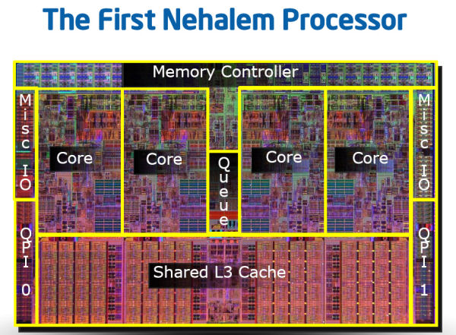
Core i7 Example
Core i7
CPU Core
CPU Core
..
Reg File
Reg File
L1 I$ (32KB)
L1 D$ (32KB)
L1 I$ (32KB)
L1 D$ (32KB)
L2 Cache (256KB)
L2 Cache (256KB)
L3 Cache (8MB) - Shared

Slide 52
Virtualization - VT-x / AMD-V
임종범
jblim@kpu.ac.kr

Slide 53
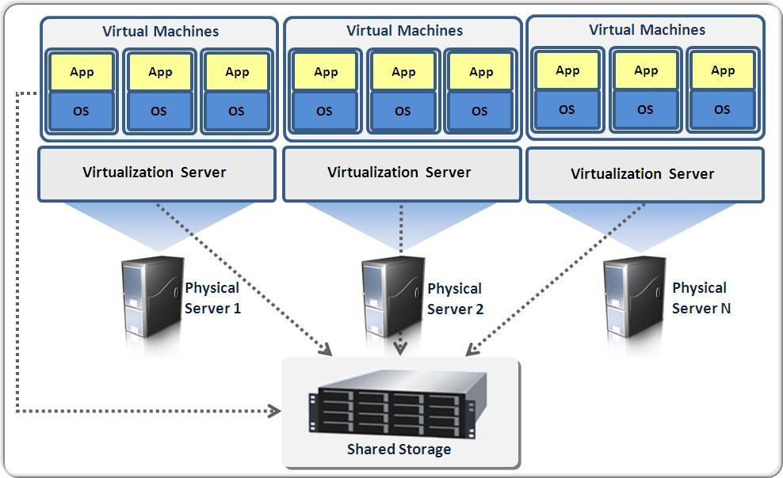

What is virtualization?
Virtualization refers to the act of creating a virtual (rather than actual) version of something, including a virtual computer hardware platform, operating system (OS), storage device, or computer network resources
Hardware virtualization or platform virtualization refers to the creation of a virtual machine that acts like a real computer with an operating system

Slide 54
Hardware virtualization
Major types of hardware virtualization include:
Full virtualization
almost complete simulation of the actual hardware to allow software, which typically consists of a guest operating system, to run unmodified
Paravirtualization
a hardware environment is not simulated; however, the guest programs are executed in their own isolated domains, as if they are running on a separate system
Guest programs need to be specifically modified to run in this environment

Slide 55
Software based techniques
Binary translation
Emulation of one instruction set by another for same CPU.
When source and target instruction set are the same, it’s called instruction set simulation
can be done “just in time” (JIT)
can do some caching to be more efficient (i.e., hot spot detection)
Para-virtualization
modification of guest kernel to support being virtualized
Can be pretty efficient

Slide 56
Binary Translation
x86 assembly cannot be virtualized because some privileged instructions don’t generate exceptions
Workaround: translate the unsafe assembly from the guest to safe assembly
Known as binary translation
Performed by the VMM
Privileged instructions are changed to function calls to code in VMM

Slide 57
Binary Translation Example
Guest OS Assembly
Translated Assembly
do_atomic_operation:
cli
mov eax, 1
xchg eax, [lock_addr]
test eax, eax
jnz spinlock
…
…
mov [lock_addr], 0
sti
ret
do_atomic_operation:
call [vmm_disable_interrupts]
mov eax, 1
xchg eax, [lock_addr]
test eax, eax
jnz spinlock
…
…
mov [lock_addr], 0
call [vmm_enable_interrupts]
ret

Slide 58
Binary translation – example
Guest Code
Translation Cache
vEPC
mov ebx, eax
mov ebx, eax
start
cli
mov [VIF], 0
and ebx, ~0xfff
and ebx, ~0xfff
mov ebx, cr3
mov [CO_ARG], ebx
sti
call HANDLE_CR3
ret
mov [VIF], 1
test [INT_PEND], 1
jne
call HANDLE_INTS
jmp HANDLE_RET
Source: Carl Waldspurger, Introduction to Virtual Machines
Notes:
Source: http://labs.vmware.com/academic/mit-iap-2010

Slide 59
Hypervisor
A hypervisor or virtual machine monitor (VMM) is a piece of computer software, firmware or hardware that creates and runs virtual machines
A computer on which a hypervisor is running one or more virtual machines is defined as a host machine
Each virtual machine is called a guest machine
The hypervisor presents the guest operating systems with a virtual operating platform and manages the execution of the guest operating systems
Multiple instances of a variety of operating systems may share the virtualized hardware resources.

Slide 60
Hypervisor
Linux
Windows
OS X
Guest
Hypervisor
(Virtual Machine Monitor)
Virtual
Machine
Virtual
Machine
Virtual
Machine
Host
Platform
(CPU, Memory, IO, etc)

Slide 61
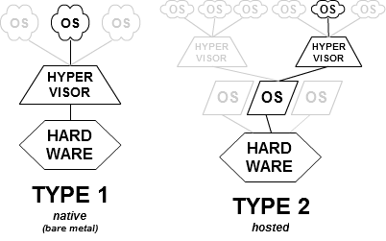
Hypervisor
Type-1: native or bare-metal hypervisors
run directly on the host's hardware to control the hardware and to manage guest operating systems
Type-2: hosted hypervisors
run on a conventional operating system just as other computer programs do

Slide 62
Hardware-assisted virtualization
Hardware-assisted virtualization
A way of improving overall efficiency of virtualization
It involves CPUs that provide support for virtualization in hardware, and other hardware components that help improve the performance of a guest environment.

Slide 63
Vendor technologies
 | Intel | AMD
CPU Flag | Virtual Machine Extensions (VMX) | Secure Virtual Machine (SVM)
Processor emulation | VT-x | AMD-v
Extended page tables | Extended page tables (EPT) | Rapid Virtualization Indexing (RVI)
MMU emulation | VT-d | AMD-Vi
Network emulation | VT-c
PCI emulation | PCI-SIG I/O Virtualization | PCI-SIG I/O Virtualization
We will be focused on Intel VT-x
Notes:
We will primarily be covering VT-x, but most of it maps to AMD-v as well.

Slide 64
Checking The 64-bit feature
Use CPUID input-value 0x80000001 for obtaining extended feature bits
Returned in the ECX and EDX registers
.data
ext_features DB 8 DUP(0) # 8 bytes (zeroed) for extended features bits
.code
mov eax, 80000001h # setup input-value in EAX
cpuid # then execute CPUID
mov [ext_features+0], edx # save feature-bits from EDX
mov [ext_features+4], ecx # save feature-bits from ECX

Slide 65
Extended features bits
31 30 29 28 27 26 25 24 23 22 21 20 19 18 17 16 15 14 13 12 11 10 9 8 7 6 5 4 3 2 1 0
R
R
R
R
R
R
R
R
R
R
R
R
R
R
R
R
R
R
R
R
R
R
R
R
R
R
R
R
R
R
R
L
S
F
ECX =
31 30 29 28 27 26 25 24 23 22 21 20 19 18 17 16 15 14 13 12 11 10 9 8 7 6 5 4 3 2 1 0
R
R
IA32e
R
R
R
R
R
R
R
R
X
D
R
R
R
R
R
R
R
R
S
Y
S
C
A
L
L
R
R
R
R
R
R
R
R
R
R
R
EDX =
IA32e = Intel 64-bit Technology
XD = eXecute Disable paging-bit implemented
SYSCALL = Fast SYSCALL / SYSRET (64-bit mode)
LSF = LAHF / SAHF implemented in 64-bit mode
R = reserved bit

Slide 66
New instructions (x64)
CDQE | Convert doubleword to quadword
CMPSQ | Compare string operands
CMPXCHG16B | Compare RDX:RAX with m128
LODSQ | Load qword at address (R)SI into RAX
MOVSQ | Move qword from address (R)SI to (R)DI
MOVZX (64-bits) | Move doubleword to quadword, zero-extension
STOSQ | Store RAX at address RDI
SWAPGS | Exchanges current GS base register value with value in MSR address C0000102H
SYSCALL | Fast call to privilege level 0 system procedures
SYSRET | Return from fast system call
Notes:
No need to memorize these, just something to keep in mind.

Slide 67
Hardware-assisted virtualization
Privilege ring
Guest
Apps
Apps
Ring 3
Apps
Apps
VMX Non-Root:
Operation restricted
Certain instructions cause a VM Exit
Certain events cause a VM Exit
VMX Root:
Full control over the processor
Some new instructions
Ring 0
OS
MOV CR, RDMSR, WRMSR
VMX Non-Root Mode
VMX Root Mode
VM Exit
Ring 0
VMM

Slide 68
Hardware-assisted virtualization
Privilege ring
Ring 3
Guest
Ring 2
Apps
Apps
Ring 3
Apps
Apps
Ring 1
Ring 0
Ring 0
OS
Ring -1
VMX Non-Root Mode
VMX Root Mode is a new protection level added for virtualization
VMX Root Mode
Ring 0
VMM
Ring -1

Slide 69
Hardware-assisted virtualization
Privilege ring
Ring 3+
(Virtual Ring 3)
Guest
Ring 2+
(Virtual Ring 2)
Apps
Apps
Ring 3
Apps
Apps
Ring 1+
(Virtual Ring 1)
Ring 0+
(Virtual Ring 0)
Ring 0
OS
Ring 0
VMX Non-Root Mode
VMX Root Mode is a new protection level added for virtualization
VMX Root Mode
Ring 0
VMM

Slide 70
Hardware-assisted virtualization
Virtual Machine Control Structure (VMCS)
A VMCS defines the behavior of operation when in VMX Non-Root mode and manages transitions into and out of VMX Non-Root mode
Defined sections:
Guest State Area
Host State Area
VM Execution Control
VM Entry Control
VM Exit Control
VM Exit Information
Up to a 4Kbyte structure
read/write by VMREAD/VMWRITE ops.
Guest
Apps
Apps
Ring 3+
Apps
Apps
Ring 0+
OS
VMX Non-Root Mode
VM Exit
VMX Root Mode
VMCS
VM Entry
Ring 0
VMM

Slide 71
Hardware-assisted virtualization
Active Guest
Idle Guest
Apps
Hypervisor
(VMM)
VMPTRLD
VMLAUNCH
Apps
Apps
Apps
Apps
Apps
OS
OS
Virtual Processor
Virtual Processor
VM Exit
VMCS
VMCS
Core 0
VMCS
VMX Root Mode
VMX Non-Root Mode
VMXON

Slide 72
Hardware-assisted virtualization
Active Guest
Idle Guest
Apps
Hypervisor
(VMM)
VMRESUME
VMCLEAR
Apps
Apps
Apps
Apps
Apps
OS
OS
Virtual Processor
Virtual Processor
VM Exit
VMCS
VMCS
Core 0
VMCS
VMX Root Mode
VMX Non-Root Mode
VMXON

Slide 73
Hardware-assisted virtualization
Active Guest
Active Guest
Idle Guest
Idle Guest
Apps
Hypervisor
(VMM)
VMPTRLD
VMLAUNCH
Apps
Apps
Apps
Apps
Apps
OS
OS
Virtual Processor
Virtual Processor
VMCS
VMCS
Core 0
VMCS
VMX Root Mode
VMX Non-Root Mode
VMXON

Slide 74
Virtualization - memory management
임종범
jblim@kpu.ac.kr

Slide 75
IA32e Page Table Walk Process
63
47 3938
3029
2120 12
11 0
Sign
Extended
PML4 Index
(1 of 512)
PDP Index
(1 of 512)
Page Directory Index
(1 of 512)
Page Table Index
(1 of 512)
Location within Page
(1 of 4096)
Page Map
Level 4
Page Directory
Pointer Table
63 0
Page
Directory
63 0
Page
Table
63 0
Target Page
(4KB each)
63 0
63 0
CR3

Slide 76
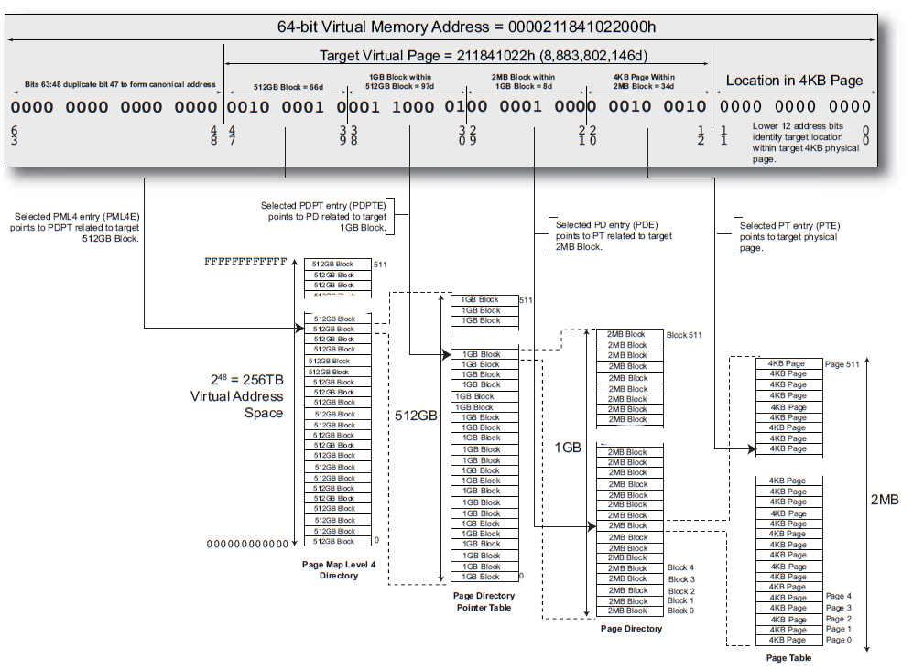

Slide 77
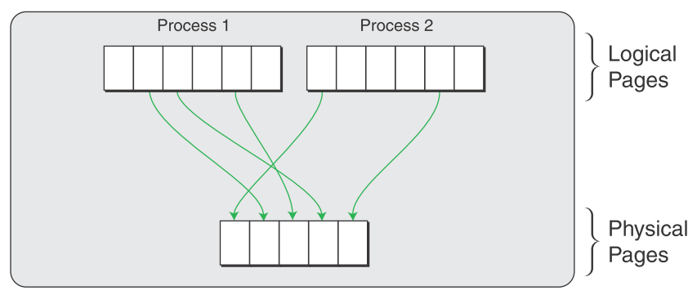
Native System Memory Management Unit Diagram

Slide 78
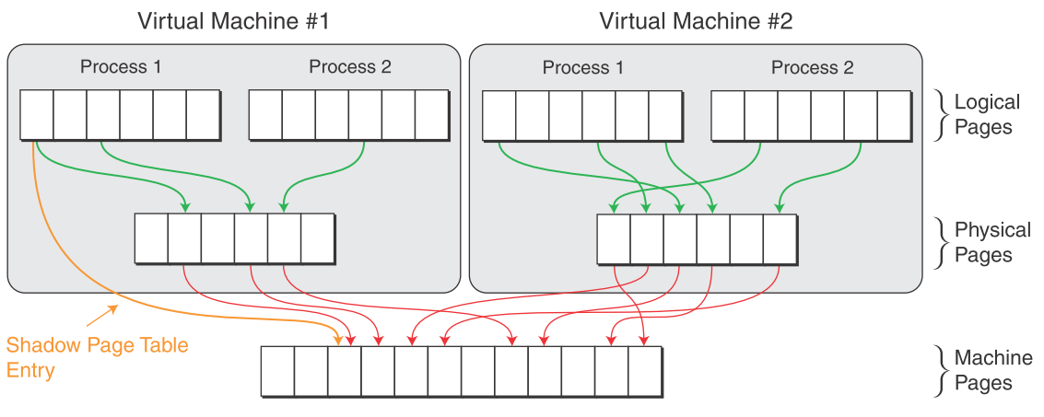
Shadow Page Tables Diagram
VMM maintains PPN->MPN mappings in its internal data structures and stores LPN->MPN mappings in shadow page tables that are exposed to the hardware.
Recently used LPN->MPN translations are cached in the hardware TLB.
VMM keeps these shadow page tables synchronized to the guest page tables.
This synchronization introduces virtualization overhead when the guest updates its page tables.

Slide 79
Second Level Address Translation
AMD-V and VT-x help the VMM control guests
… but, they don’t address the need for shadow page tables
Second level address translation (SLAT) allows the MMU to directly support guest page tables
Intel: Extended Page Tables (EPT)
AMD: Rapid Virtualization Indexing (RVI)
Also known as Two Dimensional Paging (TDP)
Introduced in 2008

Slide 80
SLAT Implementation
VMM installs first and second level tables in the MMU
Context switch to the guest via vmenter
Steps to translate an address:
MMU queries the level 1 (guest) table
MMU queries the level 2 (VMM) table
If any step yields an invalid PTE than page fault to the VMM (vmexit)
CPU

Slide 81
Advantages of SLAT
Huge performance advantages vs. shadow page tables
When guests mov cr3, the CPU updates vmcr3 register
No need to vmexit when guest OS switches context
EPT can be filled on-demand or pre-initialized with PFN→MFN entries
On-demand:
Slower, since many address translations will trigger hidden misses
… but hardware pages for the guest can be allocated when needed
And, the EPT will be smaller
Preallocation:
No need to vmexit when the guest OS creates or modifies it’s page tables
… but hardware pages need to be reserved for the guest
And, the EPT table will be larger

Slide 82
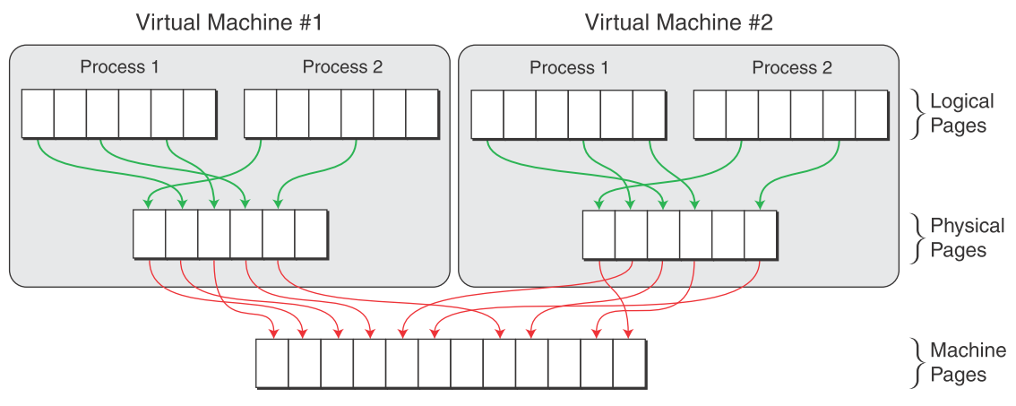
Hardware Memory Management Unit Diagram

Slide 83
Hardware Memory Management Unit Diagram
Guest maintain LPN->PPN mappings in the guest page tables
VMM maintains PPN->MPN mappings called nested page tables
Both the guest page tables and the nested page tables are exposed to the hardware.
When a logical address is accessed, the hardware walks the guest page tables as in the case of native execution,
For every PPN accessed during the guest page table walk, the hardware also walks the nested page tables to determine the corresponding MPN.
This composite translation eliminates the need to maintain shadow page tables and synchronize them with the guest page tables.
However the extra operation also increases the cost of a page walk, thereby impacting the performance of applications that stress the TLB.
This cost can be reduced by using large pages, thus reducing the stress on the TLB for applications with good spatial locality.

Slide 84
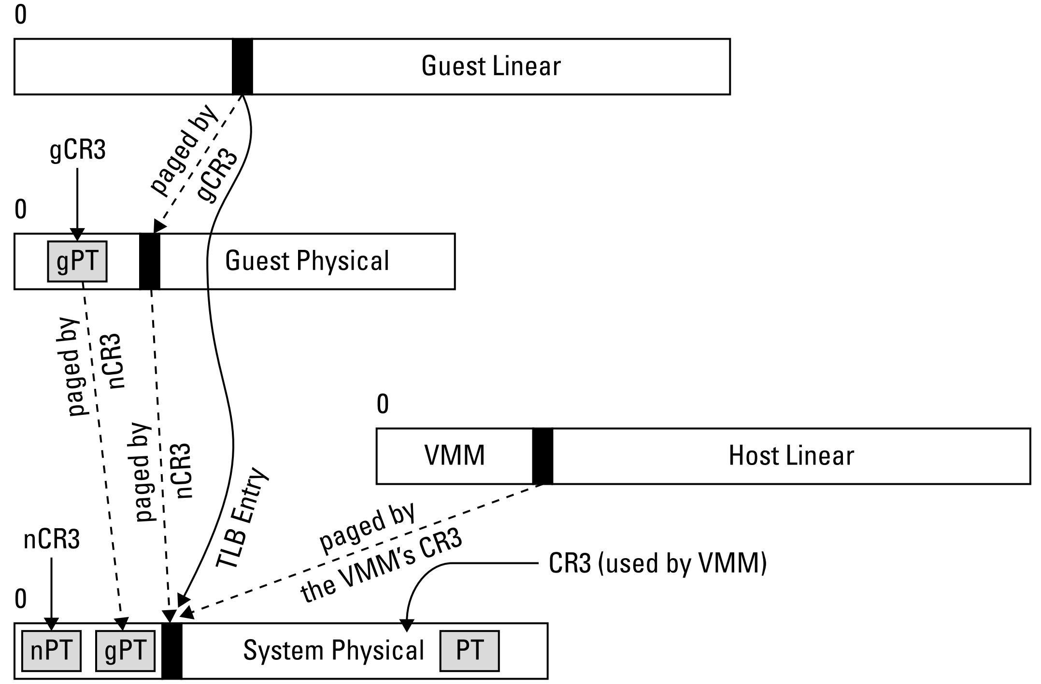

Slide 85
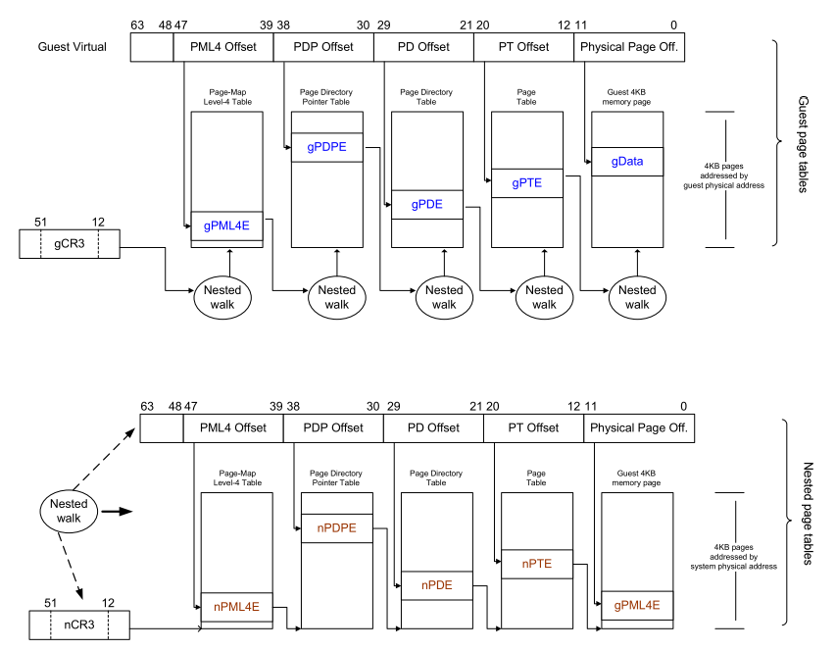

Slide 86
Hardware-Assisted Page Walks
Two-dimensional page walks for virtualized systems
gVA
gCR3
gL4
gL3
gL2
gL1
Guest page table
(gLn)
x86_64
5
10
15
20
gPA (gL4)
nL4
nL4
nL4
nL4
nL4
Nested page table
(nLn)
1
6
11
16
21
nCR3
nL3
nL3
nL3
nL3
nL3
2
7
12
17
22
nL2
nL2
nL2
nL2
nL2
3
8
13
18
23
gVA: guest virtual address
nL1
nL1
nL1
nL1
nL1
gPA: guest physical address
4
9
14
19
24
sPA
sPA: system physical address
sPA

Slide 87
Hardware-Assisted Page Walks
Two-dimensional page walks for virtualized systems
Guest (m-levels) and nested (n-levels) page tables
# of page walks: mn + m + n
x86_64: 4*4 + 4 + 4 = 24
gVA
gCR3
gL4
gL3
gL2
gL1
Guest page table
(gLn)
x86_64
5
10
15
20
gPA (L4)
nL4
nL4
nL4
nL4
nL4
1
6
11
16
21
Nested page table
(nLn)
nCR3
nL3
nL3
nL3
nL3
nL3
2
7
12
17
22
nL2
nL2
nL2
nL2
nL2
gVA: guest virtual address
3
8
13
18
23
gPA: guest physical address
sPA: system physical address
nL1
nL1
nL1
nL1
nL1
4
9
14
19
24
sPA
sPA

Slide 88
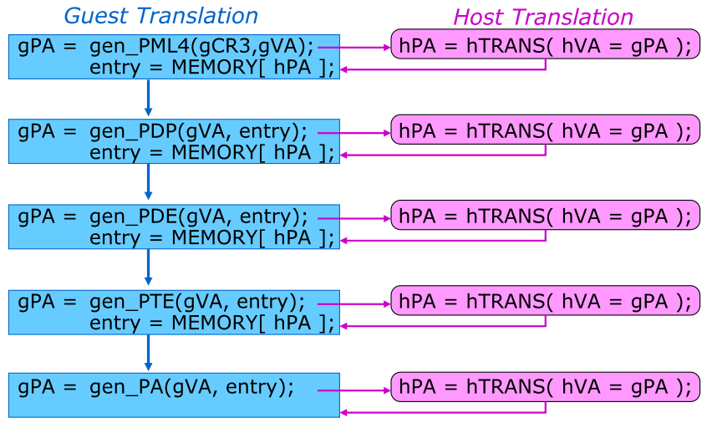
Nested Paging
CPU maps each Guest_PA to Host_VA and then translates to Host_PA
CPU builds compound gVA_to_hPA TLB entries (guarded by ASID)

Slide 89
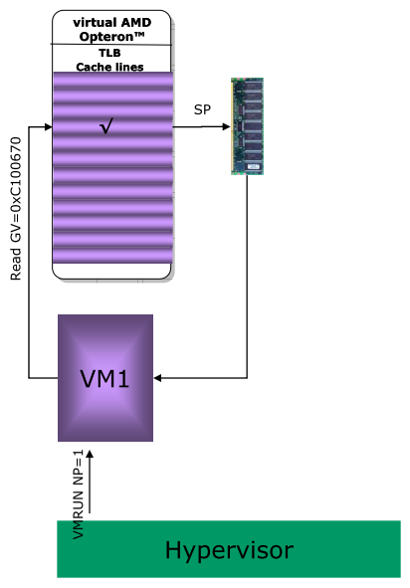
Scenario TBL Hit
Hypervisor starts a guest with Nested Paging enabled
Guest reads from a memory location
vCPU locates memory in TLB
Memory is fetched from DRAM using system physical address in TLB

Slide 90
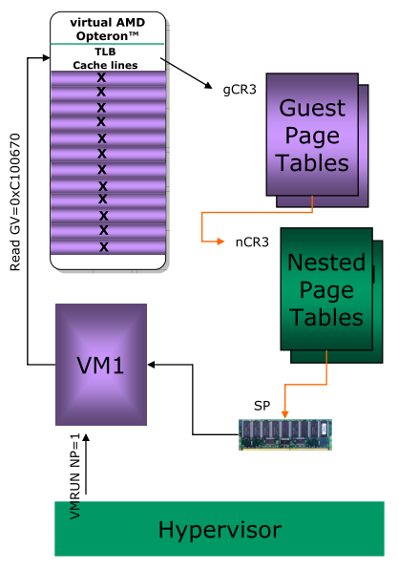
Scenario TBL Miss
Hypervisor starts a guest with Nested Paging enabled
Guest reads from a memory location
vCPU does not locate memory in TLB
Processor walks Nested Page Tables

Slide 91
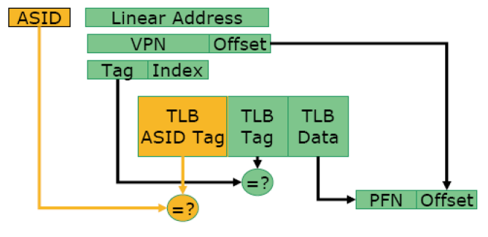
Address space id (ASID)

Slide 92
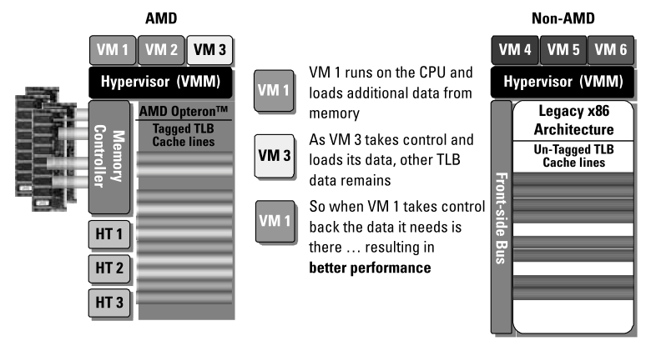
Tagged TLB
Each VM has a unique ASID value, known only to the hyper-visor and the TLB hardware.
The ASID is invisible to the guest OS, thus eliminating the need to modify the guest, preserving the virtual illusion and avoiding any performance degradation.

Slide 93
Hardware support for Nested Paging
Page Walk Cache (PWC)
AMD64 processors maintain a fast internal PWC for memory referenced by frequently used page table entries
Nested TLB (NTLB)
To cache guest physical to system physical translations
To reduce average # of page entry references during a nested walk

Slide 94
Virtualization - Interrupt
임종범
jblim@kpu.ac.kr

Slide 95
Interrupt Info
Interrupts can cause the currently executing program to be interrupted.
Events that are asynchronous to program execution
An interrupt request from a hardware device external to the processor is recognized if recognition of external interrupts is enabled (RFLAGS.IF=1)
The assertion of the processor’s NMI (non-maskableinterrupt) input or the reception of an NMI, SMI, or INIT# IPI from the chipset
Events that are synchronous to program execution
Execution of a software interrupt (INT) instruction
Processor detection of a software exception error condition
Most of these events are represented by an 8-bit Interrupt Vector
The Interrupt Vector is used to locate the correct Interrupt Handler (Interrupt Service Routine, ISR) to handle that specific event

Slide 96
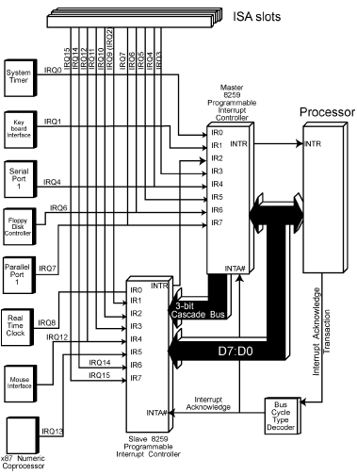
Programmable Interrupt Controller (PIC)

Slide 97
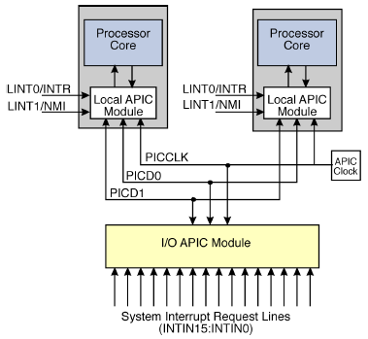
Advanced PIC – APIC
Starting with the P54C version of the Pentium® processor, a Local APIC was incorporated in the processor
IO APIC(s) is (are) implemented as part of the chipsets

Slide 98
Interrupt Delivery Via APIC Bus
This solution allowed the interrupt to target a specific processor, a group of processors, all processors, or the processor currently running the lowest-priority task (from the perspective of the OS)
This implementation also allowed a Local APIC to send an interrupt to another Local APIC or set of Local APICs

Slide 99
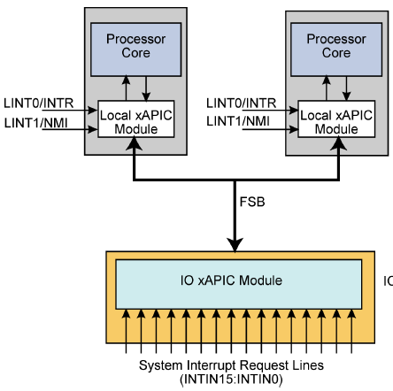
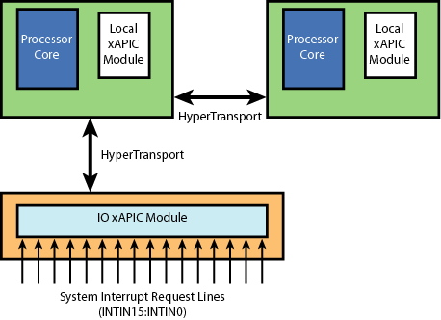
Interrupt Delivery As Messages
Intel Based System AMD Based System
In modern systems, IO based interrupts are now passed to the Local APIC via in-band messages
This architecture is often referred to as xAPIC

Slide 100
User-Defined Interrupts
Interrupt vectors 32-255 are free to be defined by software and possibly allocated to IO devices or allocated for the OS’s own purposes
Interrupt vectors 0-31 are reserved for x86 processor related interrupts and exceptions

Slide 101
Priority of User-Defined Interrupts
User-Defined Interrupts are prioritized based on the upper 4 bits of their vector
Highest -Fxh
: -Exh
: - :
: -2xh
Lowest -1xh

Slide 102
APIC Registers
IRR (Interrupt Request Register)
31 24 16 8 0
0:31
63:32
95:64
127:96
159:128
191:160
223:192
255:224
Processor
Core
Bit 161
Local APIC
Vector A1
(161 Decimal) ^{ISR (In Service Register)}
31 24 16 8 0
0:31
63:32
95:64
127:96
159:128
191:160
223:192
255:224
Bit 161

Slide 103
Multiple Interrupts in Process
IRR (Interrupt Request Register)
31 24 16 8 0
0:31
63:32
95:64
127:96
159:128
191:160
223:192
255:224
Processor
Core
Local APIC
Bit 210
Vector A1
(161 Decimal)
ISR (In Service Register)
31 24 16 8 0
Vector D2
(210 Decimal)
0:31
63:32
95:64
127:96
159:128
191:160
223:192
255:224
Bit 161
Bit 210

Slide 104
Multiple Interrupts in Process
IRR (Interrupt Request Register)
31 24 16 8 0
0:31
63:32
95:64
127:96
159:128
191:160
223:192
255:224
Processor
Core
Local APIC
Bit 93
Vector A1
(161 Decimal)
ISR (In Service Register)
31 24 16 8 0
Vector D2
(210 Decimal)
0:31
63:32
95:64
127:96
159:128
191:160
223:192
255:224
Vector 5D
(93 Decimal)
Bit 161
Not high
enough priority
Bit 210

Slide 105
End Of Interrupt (EOI)
IRR (Interrupt Request Register)
31 24 16 8 0
0:31
63:32
95:64
127:96
159:128
191:160
223:192
255:224
Processor
Core
EOI
Local APIC
Bit 93
ISR (In Service Register)
31 24 16 8 0
0:31
63:32
95:64
127:96
159:128
191:160
223:192
255:224
Traditional APIC behavior is to clear the highest priority interrupt that is in service
Bit 161
Bit 210

Slide 106
Interrupt Control
RFLAGS.IF enables / disables interrupts
cli / sti instructions, or popf
Task Priority Register
Processor TPR allows for control over the priority of interrupts that are permitted to interrupt the processor
APIC TPR provides the same functionality
APIC.TPR
31 87 0
43
Reserved
Task
Priority
Class
Task
Priority
Sub-Class
CR8.TPR
63 43 0
Reserved
Task
Priority
Class

Slide 107
Interrupt Shadows
mov ax, value1
mov ss, ax
mov sp, value2
An interrupt cannot be taken at this point
Hardware defines a single instruction “shadow” where an interrupt will not be taken (ring 0 only)
The behavior is the same for pop ss

Slide 108
Interrupts, Guests and Hypervisors
guest
kernel
guest
kernel
guest
kernel
virtual
interrupt
(timer tick)
EOI
hypervisor
interrupt
e.g.
timer tick
EOI
hardware
In current designs, all physical interrupts are for the hypervisor

Slide 109
Interrupt Handling
The hypervisor chooses whether to intercept interrupts or to allow the guest to take physical interrupts
In the normal “multiple guest with hypervisor” scenario of today, the hypervisor mustintercept physical interrupts
Just like an operating system scheduler, the hypervisor must regain control periodically, in order to schedule the guest (timer ticks)
Guest operating systems also need interrupts
Virtual devices
Periodic timer ticks for the guest operating system to use
Virtual Interrupts
The hypervisor needs a mechanism to inject interrupts (and exceptions) into the guest

Slide 110
Virtual VS. Physical Interrupts
Physical interrupt originates from a hardware device
Virtual interrupt is created by the hypervisor and injected into the guest
End of Interrupt (EOI) should not be driven to the APIC!
The APIC must be virtualized by the hypervisor or perhaps PIC mode

Slide 111
Special Case Of Fault Vectoring Through The Guest IDT
Physical interrupts delivered to the guest need the vector
Interrupt acknowledge cycle is driven to the APIC
Guest then vectors through the IDT
This may cause an intercept to the hypervisor
The interrupt must be restarted
Loss of information
The interrupt acknowledge cycle can not be driven to the APIC again

Slide 112
APIC Virtualization
Device needed by guests (or perhaps PIC)
MMIO, use page table to trap guest accesses
Device emulation example
Guest writes TPR to control interrupts
Hypervisor knows whether to inject interrupts or not
guest
kernel
Interrupts disabled
by the guest kernel
hypervisor
interrupt
hardware
ring 0

Slide 113
Software Model of the APIC
Service
Operating
System
Privileged
guest
Apps
Apps
Console
Virtualization Stack
OS DDs
Where does
the APIC
device model
belong?
DDs
OS
OS
DDs
The service operating is
good for breaking up the
logic, however it does add
overhead (latency) for
very high frequency
operations.
(Thin) Hypervisor
PC Platform

Slide 114
Intel External Interrupts
VM-execution control offers a setting for interrupt behavior
Either deliver the interrupt through the guest IDT, or
Cause a VM-exit
Delivery of physical interrupts to the guest is controlled by RFLAGS.IF and the TPR
Guest execution must not interfere with VMM operation
If interrupts are intercepted, the VM-exit occurs, ignoring guest RFLAGS.IF and ignoring guest TPR

Slide 115
Intel APIC Virtualization
Virtual APIC page address. 4 Kbyte page for a virtual APIC
Contains the TPR shadow that is read / written by mov CR8
TPR threshold
If the TPR shadow falls below this value, VM exit
Typical guest activity is to write the TPR with an unchanged value. An exit is not required in this case

Slide 116
Intel Event Injection
VM-Entry Interrupt Information Field
31 1110 87 0
V
E
Type
Vector
V: (valid) inject the event if the valid bit is set
E: deliver error code if the bit is set
Type:
0 = external interrupt
2 = NMI
3 = hardware exception
4 = software interrupt
5 = privileged software exception
6 = software exception

Slide 117
Errors During Intel Event Injection
Delivery to the guest is using the guest IDT
Errors result in the appropriate guest IDT entry
Vector is beyond the IDT limit
Deliver a #GP to the guest
Subject to the exception bitmap
If #GP is set to VM-exit, then event delivery will VM-exit

Slide 118
Intel Interruptibility States
Guest State -VMCS
0001 | Blocking by RFLAGS.IF. External interrupts also can not be delivered to SMM
0010 | Blocking by interrupt shadow
0100 | Blocking by SMI. Further SMIs can not be delivered in SMM
1000 | Blocking by NMI. Delivery of NMI inhibits the delivery of further NMIs until IRET. NMI can not be delivered to SMM
Event injection overrides the interruptibilty
state for STI and interrupt shadow

Slide 119
Intel Activity States
Guest State -VMCS
0 | Active | Normal execution
1 | HLT | Inactive : HLT executed
2 | Shutdown | Inactive : triple fault or other serious error
3 | Wait for SIPI | Inactive : Waiting for Startup IPI
Active and HLT states block SIPIs (discarded)
Wait for SIPI blocks external interrupts, NMIs, SMIs, INIT
Shutdown blocks external interrupts and SIPIs

Slide 120
AMD Interrupt Virtualization
VMCB control bit to intercept interrupts
VMCB control bit V_INTR_MASKING
Set :
Guest interrupt enable flag (RFLAGS.IF) masks only virtual interrupts
Guest accesses to the TPR (CR8) read / write the V_TPR
Clear:
Guest interrupt enable flag masks physical interrupts
Guest CR8 writes modify the TPR

Slide 121
AMD Interrupt Injection
The hypervisor creates a virtual interrupt – injects it into the guest
VMCB fields : (set by the hypervisor before vmrun invocation)
V_IRQ: set to indicate a virtual interrupt is pending
V_INTR_PRIO: priority for the virtual interrupt
V_IGN_TPR: set to ignore the virtual TPR
V_INTR_VECTOR: vector to use for this interrupt
No cycle run to the APIC
INTERRUPT_SHADOW: guest is in an interrupt shadow
Guest takes the interrupt, dependent on the guest virtual interrupt controls (TPR/IF)
The guest might intercept before taking the interrupt

Slide 122
AMD Event Injection
Event injection is a generic term for the injection of interrupts or exceptions
The hypervisor can create a virtual exception and inject it into the guest
VMCB fields: (set by the hypervisor before vmrun invocation)
EVENTINJ
Guest takes the exception
Not subject to the exception intercepts

Slide 123
AMD Event Injection Information
63
32
Error Code
31 1110 87
0
V
E
V
Type
Vector
V: (valid) set to 1 if the event is to be injected into the guest
EV:(error code valid) set to 1 if the error code should be pushed onto the stack
Type :
0 : Interrupt
2 : NMI
3 : Exception
4 : Software interrupt
The vmrun instruction will fail with an
error code if the supplied event injection
information is inconsistent. E.g., type 3
with a vector of 2 or with a vector > 31.

Slide 124
The need For The IER
Hypervisor timeslicing
guests on a single core
IRR (Interrupt Request Register)
31 24 16 8 0
Guest X
Processing
interrupt:
Guest Y
Processing
interrupts:
0:31
63:32
95:64
127:96
159:128
191:160
223:192
255:224
EC (236)
D2 (210) and
A1 (161)
Processor
Core
Bit 78
ISR (In Service Register)
Local APIC
31 24 16 8 0
0:31
63:32
95:64
127:96
159:128
191:160
223:192
255:224
Processing of interrupt D2
(210) completed?
The APICbehavior would
be to clear EC (236)
This would be wrong!
Bit 161
Bit 210
Bit 236

Slide 125
AMD APIC Use Of The IER
IRR (Interrupt Request Register)
31 24 16 8 0
0:31
63:32
95:64
127:96
159:128
191:160
223:192
255:224
Interrupt
4E (78) is
pending
Processor
Core
Bit 78
IER (Interrupt Enable Register)
Local APIC
31 24 16 8 0
0:31
63:32
95:64
127:96
159:128
191:160
223:192
255:224
Delivery to the In
Service Register blocked

Slide 126
EOI Subject To IER
IER (Interrupt Enable Register)
31 24 16 8 0
Guest X
Processing
interrupt:
Guest Y
Processing
interrupts:
0:31
63:32
95:64
127:96
159:128
191:160
223:192
255:224
EC (236)
D2 (210) and
A1 (161)
Processor
Core
ISR (In Service Register)
Local APIC
31 24 16 8 0
0:31
63:32
95:64
127:96
159:128
191:160
223:192
255:224
Processing of interrupt D2
(210) completed?
The APICbehavior would
be to clear EC (236)
This would be wrong!
Bit 161
Bit 210
Bit 236
D2 (210) cleared as EC (236) reset in IER

Slide 127
AMD End Of Interrupt
Traditional APIC behavior is to clear the highest priority pending interrupt
Does not work if guests directly own devices and process the interrupts
Guest x may have interrupts disabled. The highest priority interrupt in APIC terms is for guest x
Guest y has interrupts enabled, and is processing an interrupt that is lower priority in APIC terms
EOI from guest y would clear the interrupt for guest x

Slide 128
AMD Interrupt Enable Register
Hypervisor sets the IER mask on a per guest basis
Specific EOI added for clearing the pending interrupt
Resides at 420h in APIC space
Hypervisor can clear a targeted pending interrupt
ISR (In Service Register)
31 24 16 8 0
0:31
63:32
95:64
127:96
159:128
191:160
223:192
255:224
Bit 161
Bit 210Bit 236

Slide 129
AMD EXITINTINFO
63
32
Error Code
31 1110 87
0
V
E
V
Type
Vector
V: (valid) set to 1 if the intercept occurred
while the guest was delivering an
exception through the IDT
EV:(error code valid) set to 1 if the error
code should be pushed onto the stack
Type :
0 : Interrupt
2 : NMI
3 : Exception
4 : Software interrupt

