Slide 1
Page image per each flow chart

Slide 2
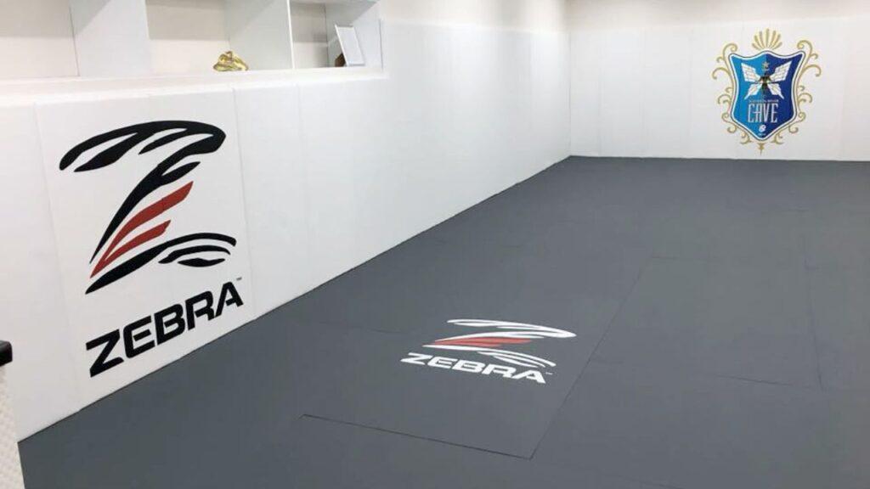
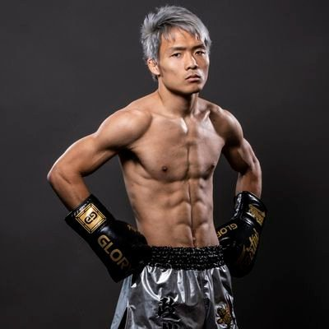
Welcome to Kick boxing Expert Class
TIME:HH:MM:SS(Real Time)
12 hours setting
Instructor
Member
Instructor
Member

Slide 3

Instructor Page
TIME:HH:MM:SS(Real Time)
12 hours setting
Check up Sparring Member
Sparring Status
Set up
Join the Sparring
Quite
Instructor
Member

Slide 4
Sparring Status
TIME:HH:MM:SS(Real Time)
12 hours setting
Total rounds: NN Round
Session Complete: HH:MM
Round :
Round :
Remaining TIME: MM:SS(Sparring time)
Pair 1
Who vs who
Pair 2
Who vs who
Pair 3
Who vs who
Pair 4
Who vs who
Ready to go?
<Sparring sessions will be complete around : HH:MM>
<Pop up every round completes>
Pair 1
Who
VS
Who
Round :
Pair 1
Who vs who
Pair 2
Who vs who
Pair 3
Who vs who
Pair 4
Who vs who
Pair 2
Who
VS
Who
Round :
Pair 1
Who vs who
Pair 2
Who vs who
Pair 3
Who vs who
Pair 4
Who vs who
YES
No
Pair 3
Who
VS
Who
Instructor Page
Instructor
Member
Pair 4
Who
VS
Who

Slide 5
Sparring Status
TIME:HH:MM:SS(Real Time)
24 hours setting
一時停止
再開
Remains rounds: NN Rounds
Session Complete: HH:MM
Round :
Round :
Remaining TIME: MM:SS(Sparring time)
Pair 1
Who vs who
Pair 2
Who vs who
Pair 3
Who vs who
Pair 4
Who vs who
Pair 1
Who
VS
Who
Round :
Pair 1
Who vs who
Pair 2
Who vs who
Pair 3
Who vs who
Pair 4
Who vs who
Pair 2
Who
VS
Who
Round :
Pair 1
Who vs who
Pair 2
Who vs who
Pair 3
Who vs who
Pair 4
Who vs who
Pair 3
Who
VS
Who
Instructor Page
Member
Pair 4
Who
VS
Who

Slide 6
Sparring Status
TIME:HH:MM:SS(Real Time)
12 hours setting
Total rounds: NN Round
Session Complete: HH:MM
Round :
Round :
Remaining TIME: MM:SS(Sparring time)
Pair 1
Who vs who
Pair 2
Who vs who
Pair 3
Who vs who
Pair 4
Who vs who
Pair 1
Who
VS
Who
Round :
Pair 1
Who vs who
Pair 2
Who vs who
Pair 3
Who vs who
Pair 4
Who vs who
Pair 2
Who
VS
Who
Round :
Pair 1
Who vs who
Pair 2
Who vs who
Pair 3
Who vs who
Pair 4
Who vs who
Pair 3
Who
VS
Who
Instructor Page
Instructor
Member
Pair 4
Who
VS
Who

Slide 7
Check up Today Sparing Member
TIME:HH:MM:SS(Real Time)
12 hours setting
Input Directly Button
Instructor
Member
Instructor Page

Slide 8
Set up Page
TIME:HH:MM:SS(Real Time)
12 hours setting
Number of Pairs :
Number of Sparrings:
Round duration
MM:SS
Skip Sparring :
Instructor
Member
Instructor Page

