Slide 1
SA 10 year bond sensitivity estimate

Slide 2
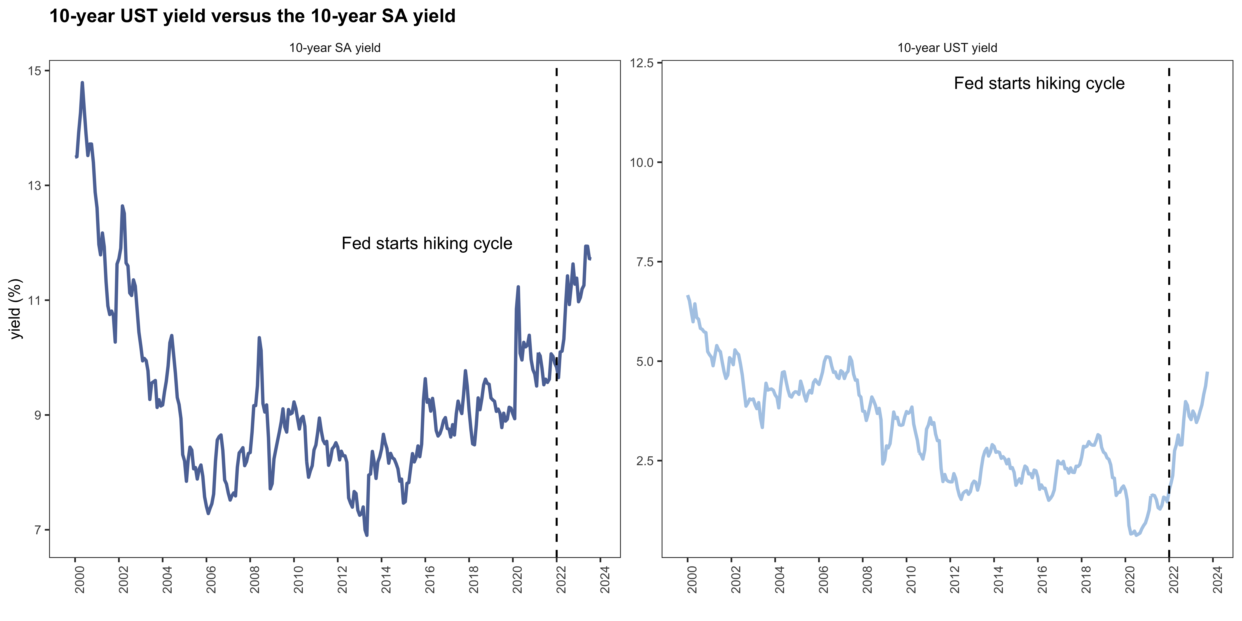
Yields rose significantly in recent months

Slide 3
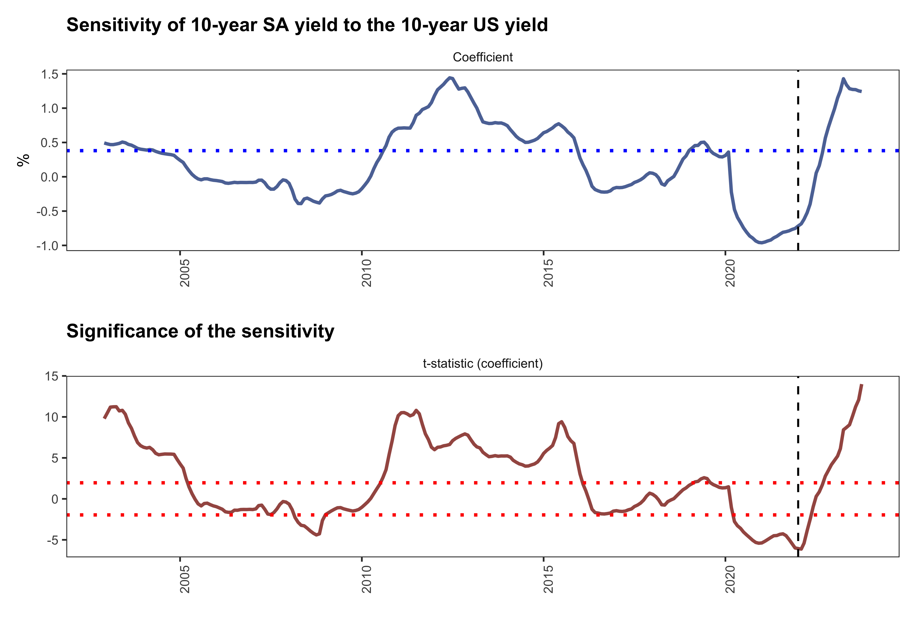
The rolling window estimates suggests a marked increase in sensitivity
The sample is from the year 2000 to September 2023 with a monthly frequency
OLS estimates with a 36 month (3 year window) meaning that we estimate each month with 36 observations and roll until the end of the sample
The post Covid period similar to the period post the financial crisis has seen a significant increase in the sensitivity

Slide 4
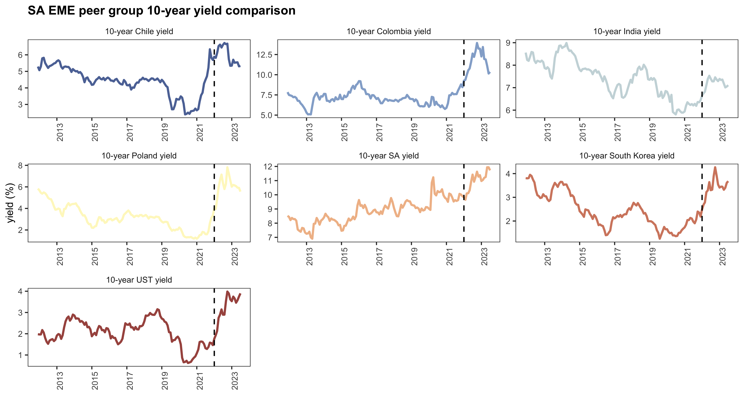
Country comparison

Slide 5
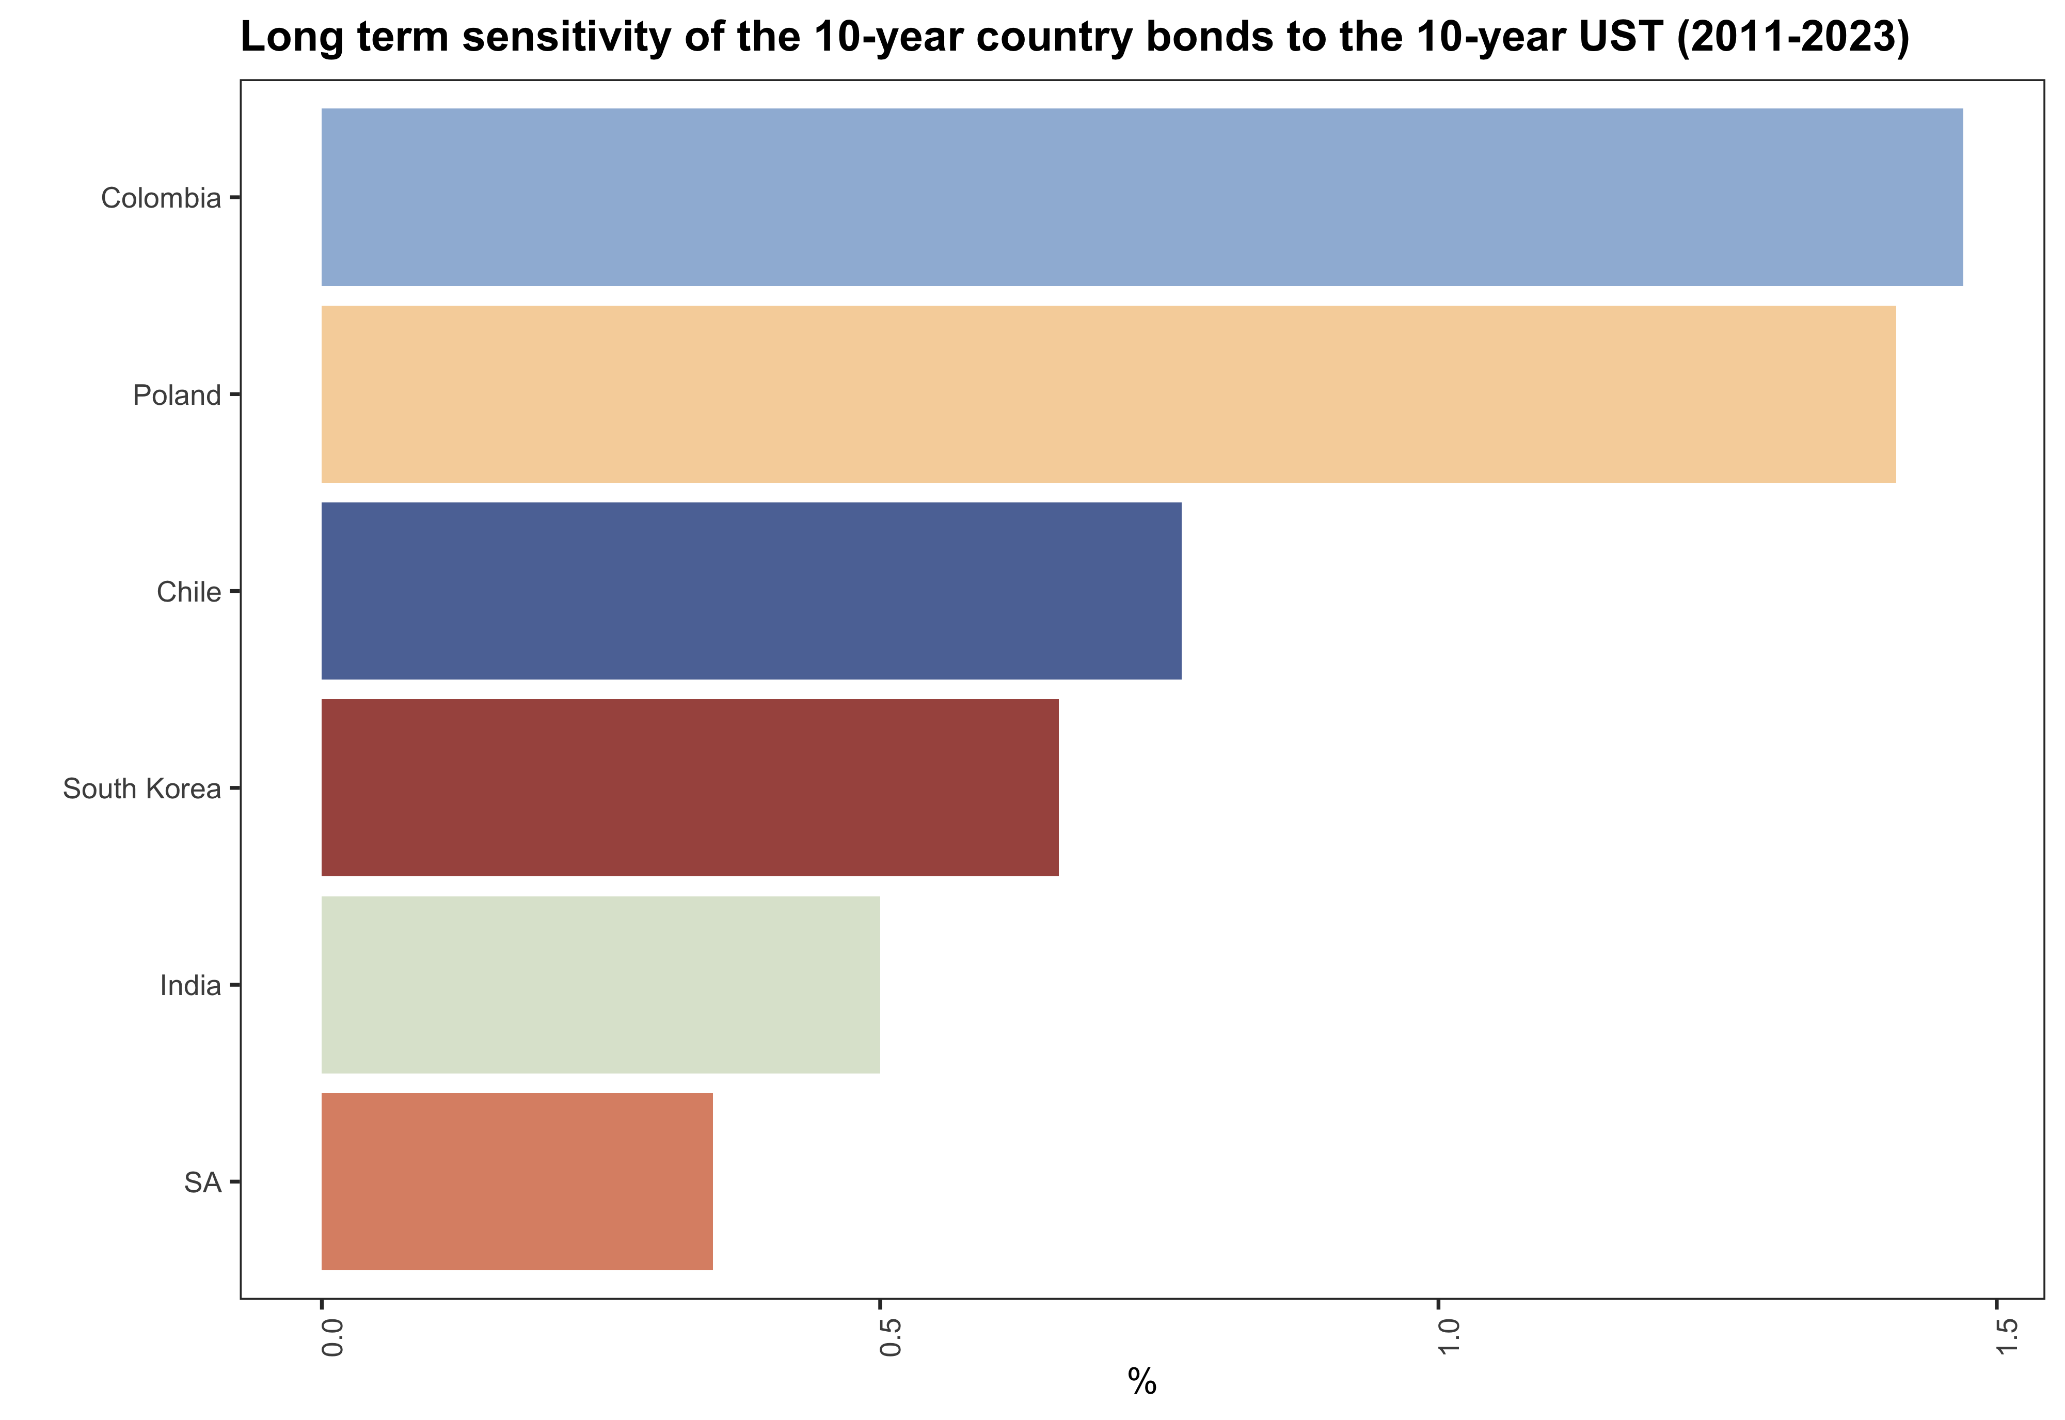
Country 1

Slide 6
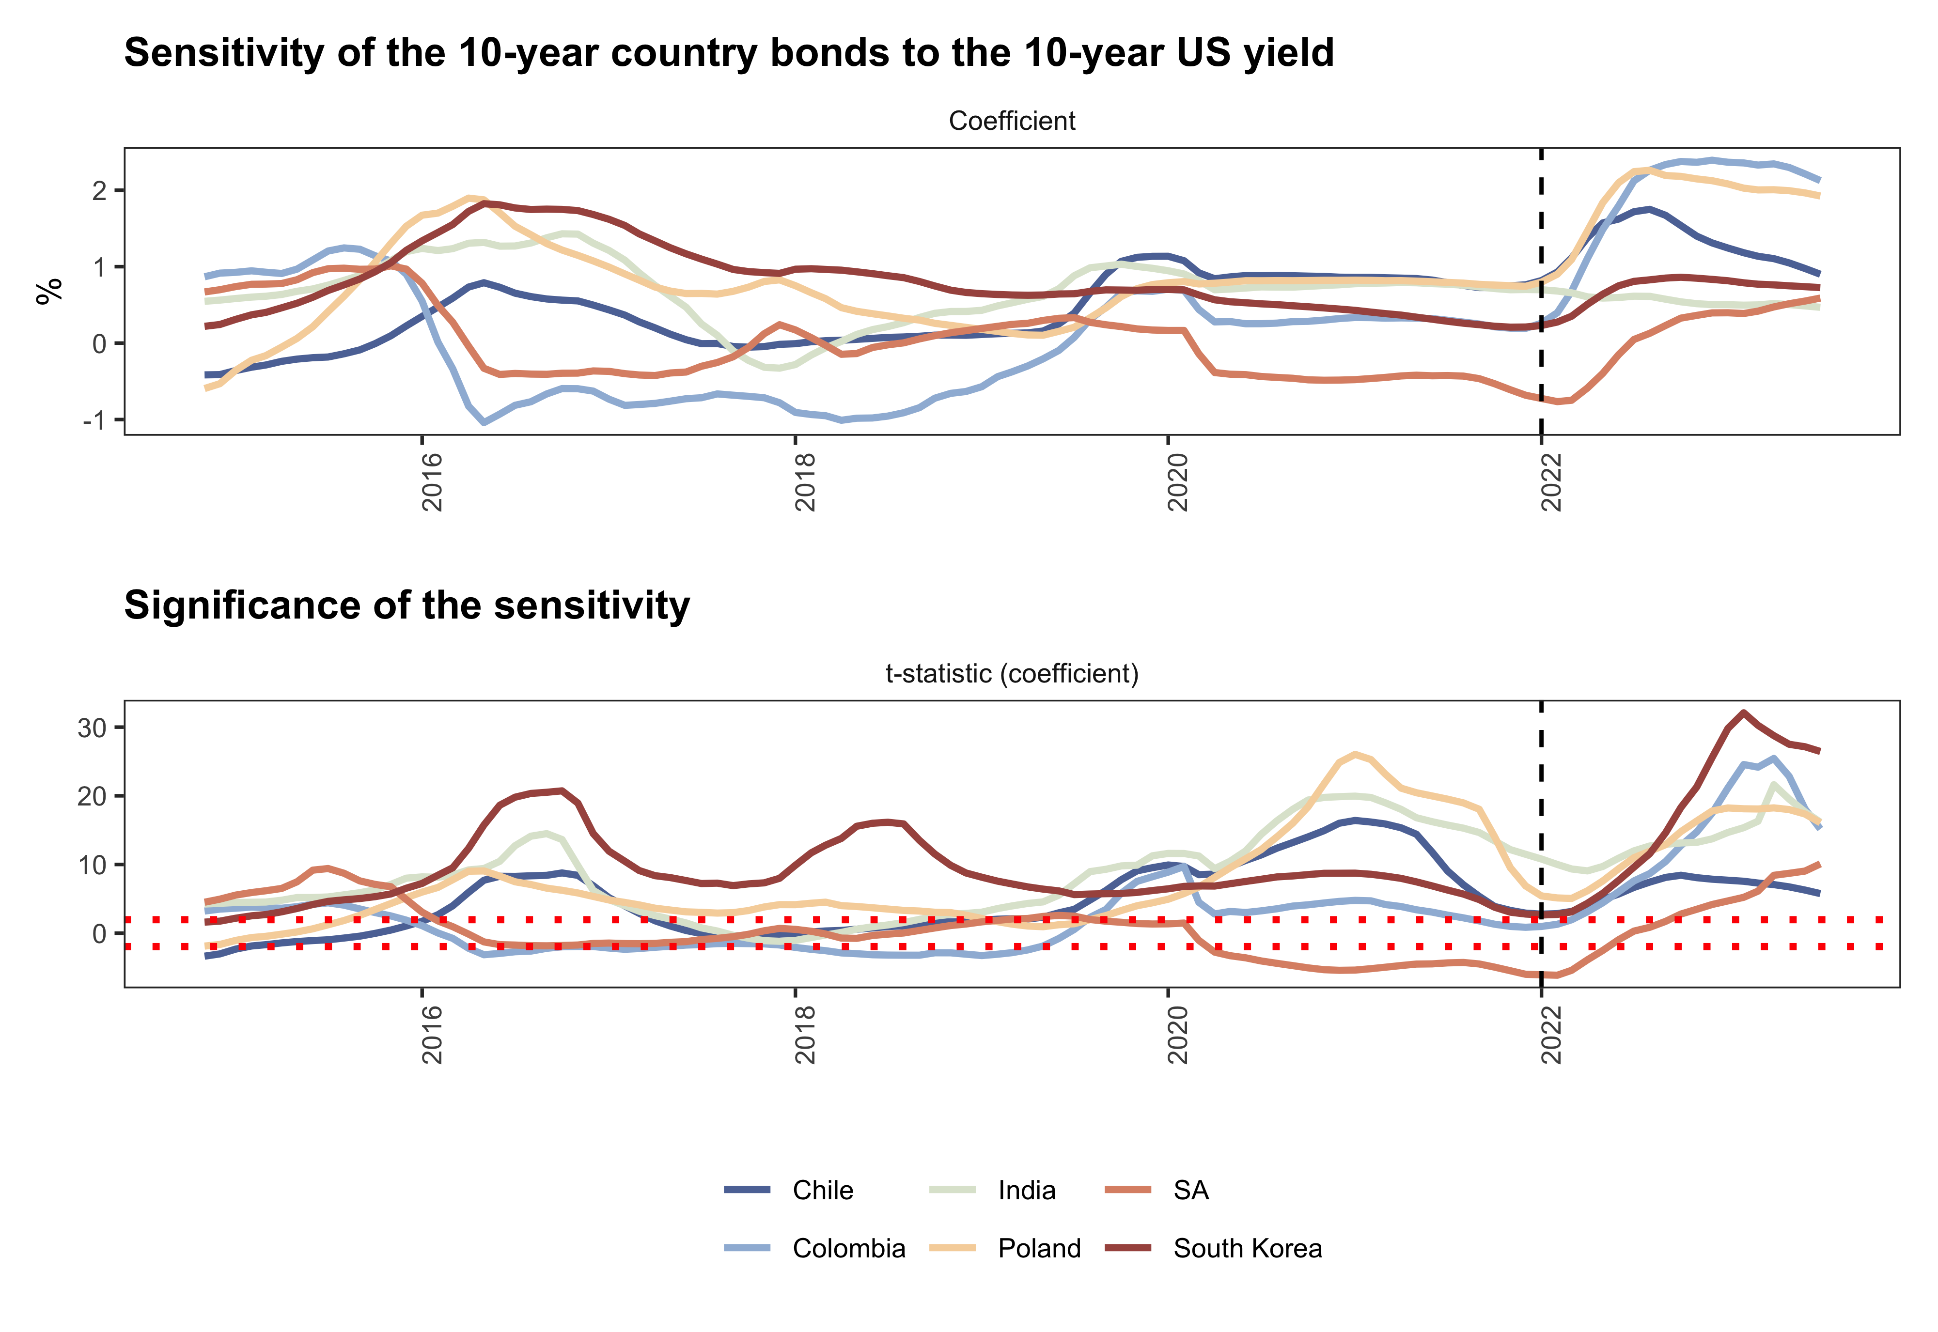
Country 2

Slide 7
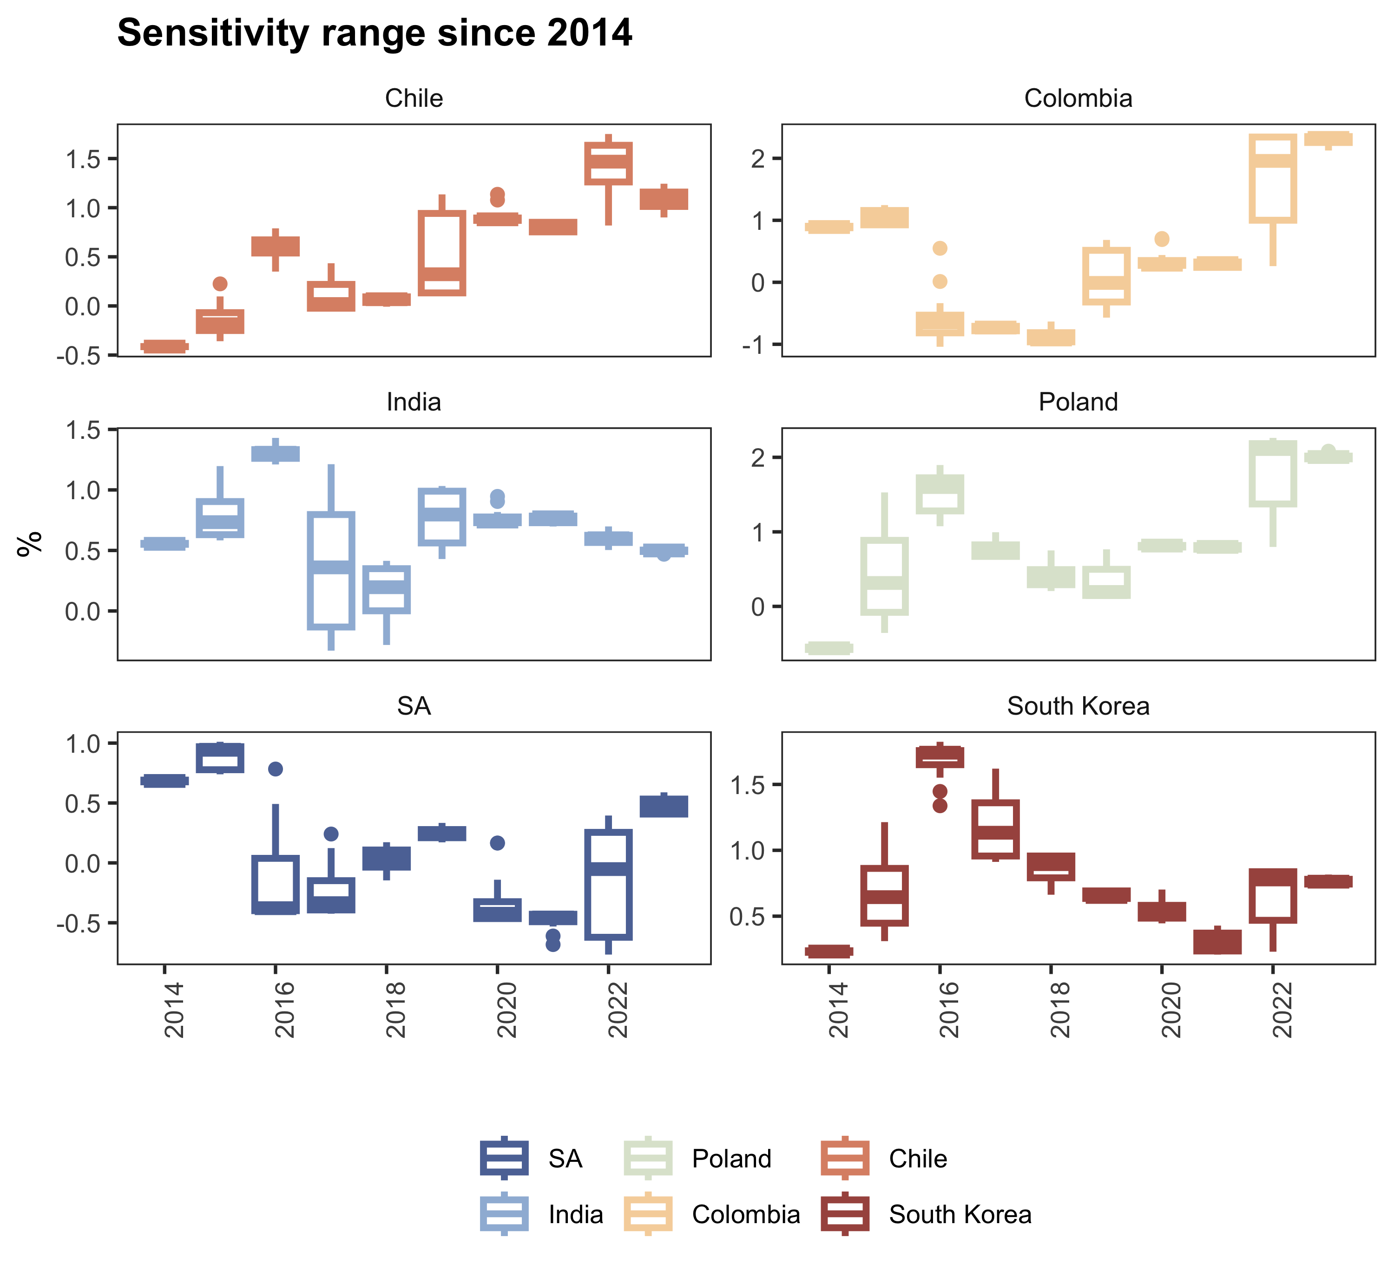
Country 3

