Slide 1
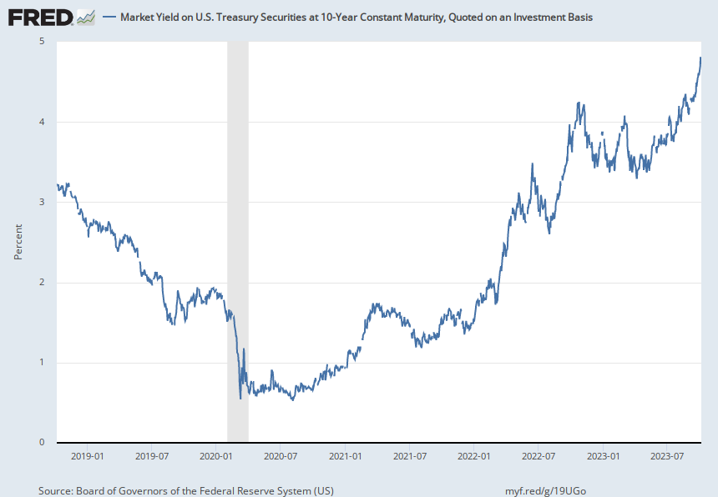
Notes:
Source:
Board of Governors of the Federal Reserve System (US)
Release:
H.15 Selected Interest Rates
Units:
Percent, Not Seasonally Adjusted
Frequency:
Daily
For further information regarding treasury constant maturity data, please refer to the H.15 Statistical Release notes and Treasury Yield Curve Methodology.
Board of Governors of the Federal Reserve System (US),
Market Yield on U.S. Treasury Securities at 10-Year Constant Maturity, Quoted on an Investment Basis [DGS10],
retrieved from FRED,
Federal Reserve Bank of St. Louis;
https://fred.stlouisfed.org/series/DGS10,
October 8, 2023.

