Slide 1
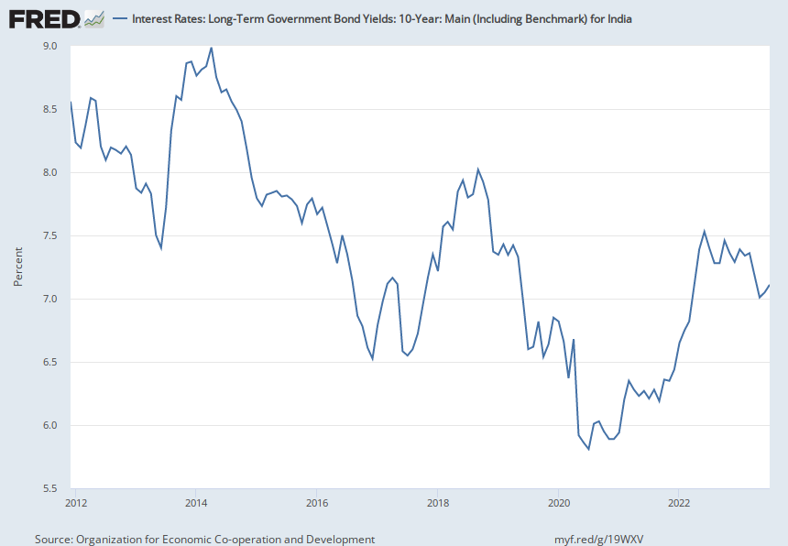
Notes:
Source:
Organization for Economic Co-operation and Development
Release:
Main Economic Indicators
Units:
Percent, Not Seasonally Adjusted
Frequency:
Monthly
OECD Descriptor ID: IRLTLT01OECD unit ID: PCOECD country ID: INDAll OECD data should be cited as follows: OECD, "Main Economic Indicators - complete database", Main Economic Indicators (database), https://dx.doi.org/10.1787/data-00052-en (Accessed on date) Copyright, 2016, OECD. Reprinted with permission
Organization for Economic Co-operation and Development,
Interest Rates: Long-Term Government Bond Yields: 10-Year: Main (Including Benchmark) for India [INDIRLTLT01STM],
retrieved from FRED,
Federal Reserve Bank of St. Louis;
https://fred.stlouisfed.org/series/INDIRLTLT01STM,
October 9, 2023.

