Slide 1
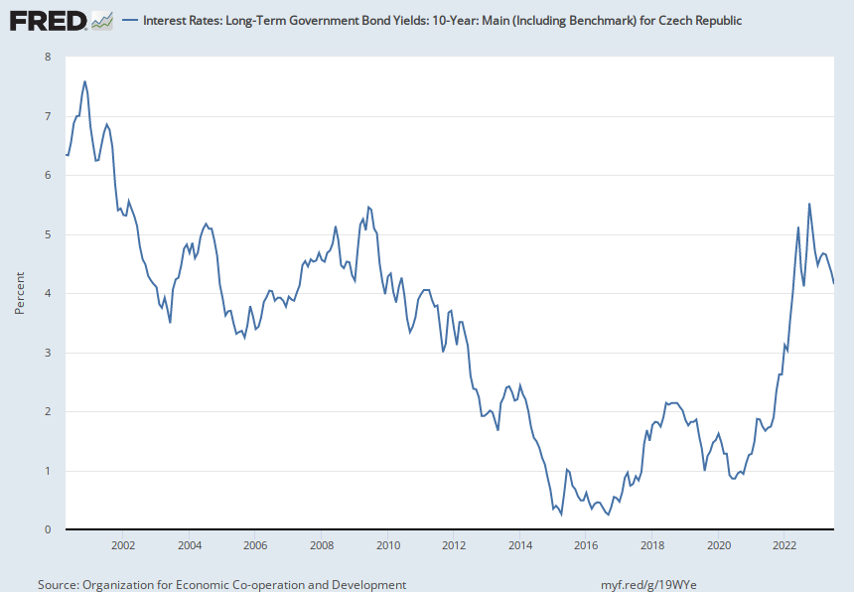
Notes:
Source: Organization for Economic Co-operation and Development Release: Main Economic Indicators Units: Percent, Not Seasonally Adjusted Frequency: Monthly OECD Descriptor ID: IRLTLT01OECD unit ID: PCOECD country ID: CZEAll OECD data should be cited as follows: OECD, "Main Economic Indicators - complete database", Main Economic Indicators (database), https://dx.doi.org/10.1787/data-00052-en (Accessed on date) Copyright, 2016, OECD. Reprinted with permission Organization for Economic Co-operation and Development, Interest Rates: Long-Term Government Bond Yields: 10-Year: Main (Including Benchmark) for Czech Republic [IRLTLT01CZM156N], retrieved from FRED, Federal Reserve Bank of St. Louis; https://fred.stlouisfed.org/series/IRLTLT01CZM156N, October 10, 2023.

