Slide 1
The impact of Basel III implementation on bank lending in South Africa
Alistair Milner and Xolani Sibande
10 May 2023

Slide 2
Introduction

Slide 3
Focus of the study

Slide 4
Literature

Slide 5
Developments in SA banking

Slide 6
Basel III capital structure
Table 3.2: Basel III implementation (%)
 | 2013 | 2014 | 2015 | 2016 | 2017 | 2018 | 2019
Basel III minima | 8 | 8 | 8 | 8 | 8 | 8 | 8
Pillar 2A for Total Capital | 1.5 | 2 | 2 | 1.8 | 1.5 | 1.3 | 1
Minimum Total Capital Plus 2A | 9.5 | 10 | 10 | 9.8 | 9.5 | 9.3 | 9
Phasing in of specified charge for systemically important banks (as % of Pillar 2A) |  |  |  | 25 | 50 | 75 | 100
Capital conservation buffer |  |  |  | 0.625 | 1.25 | 1.875 | 2.5
Countercyclical buffer |  |  |  | 0.625 | 1.25 | 1.875 | 2.5

Slide 7
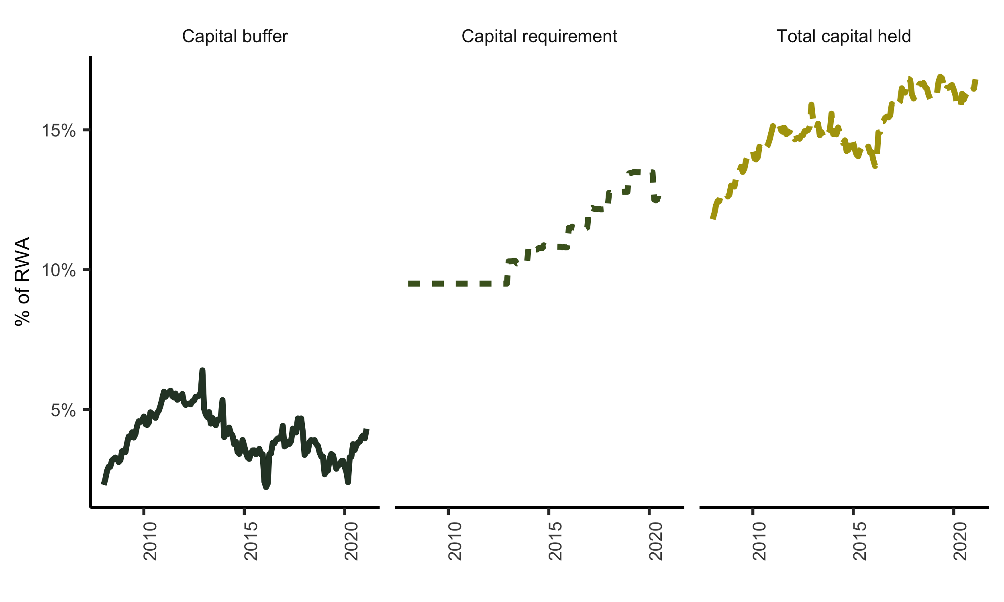
Evolution of capital requirements

Slide 8
Data

Slide 9
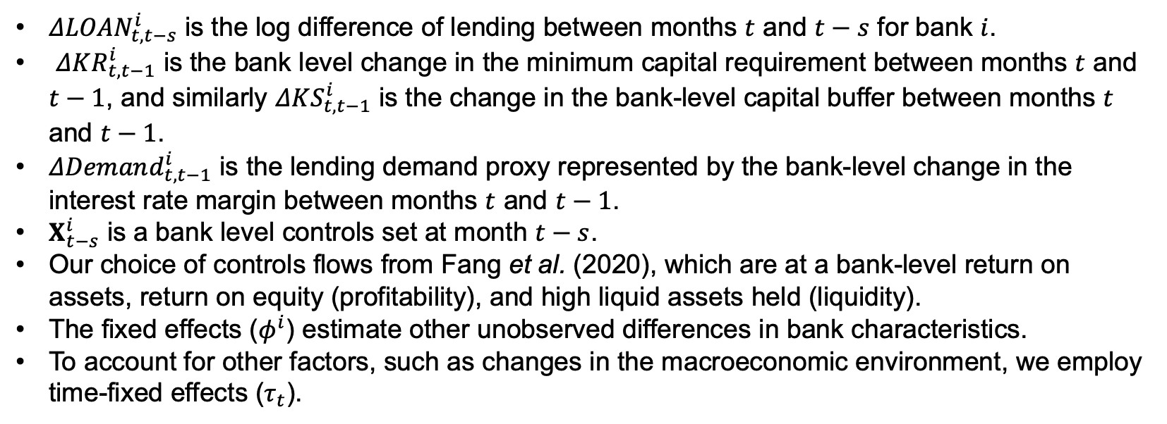
Methodology
$$ΔLOAN_{t,t−s}^{i}=βΔKR_{t,t−1}^{i}+λΔKS_{t,t−1}^{i}+αΔDemand_{t,t−1}^{i}+γ′X_{t−s}^{i}+φ^{i}+τ_{t}+ε_{t}^{i}.$$
$ΔLOAN_{t,t−s}^{i}$ is the log difference of lending between months $t$ and $t−s$ for bank $i$.
$ΔKR_{t,t−1}^{i}$ is the bank level change in the minimum capital requirement between months $t$ and $t−1$, and similarly $ΔKS_{t,t−1}^{i}$ is the change in the bank-level capital buffer between months $t$ and $t−1$.
$ΔDemand_{t,t−1}^{i}$ is the lending demand proxy represented by the bank-level change in the interest rate margin between months $t$ and $t−1$.
$X_{t−s}^{i}$ is a bank level controls set at month $t−s$.
Our choice of controls flows from Fang et al. (2020), which are at a bank-level return on assets, return on equity (profitability), and high liquid assets held (liquidity).
The fixed effects ($φ^{i}$) estimate other unobserved differences in bank characteristics.
To account for other factors, such as changes in the macroeconomic environment, we employ time-fixed effects ($τ_{t}$).

Slide 10
Results

Slide 11
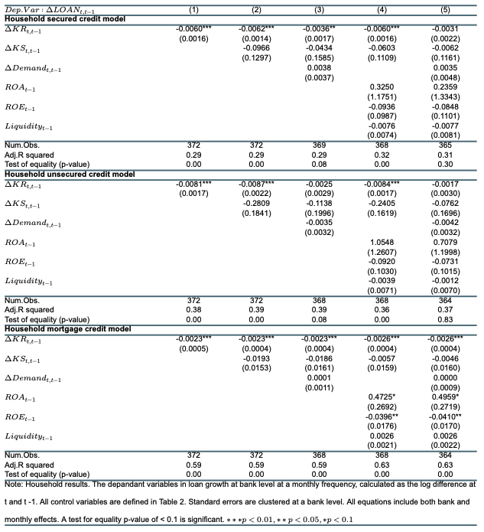
Households

Slide 12
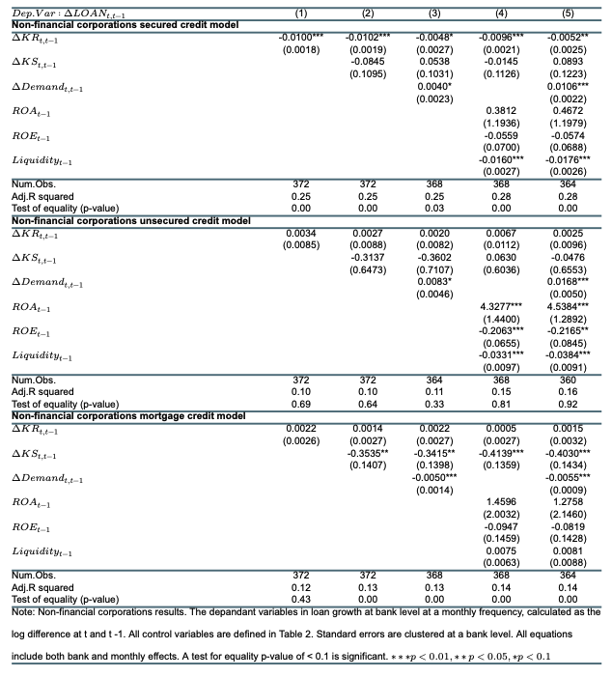
Non-financial corporations

Slide 13
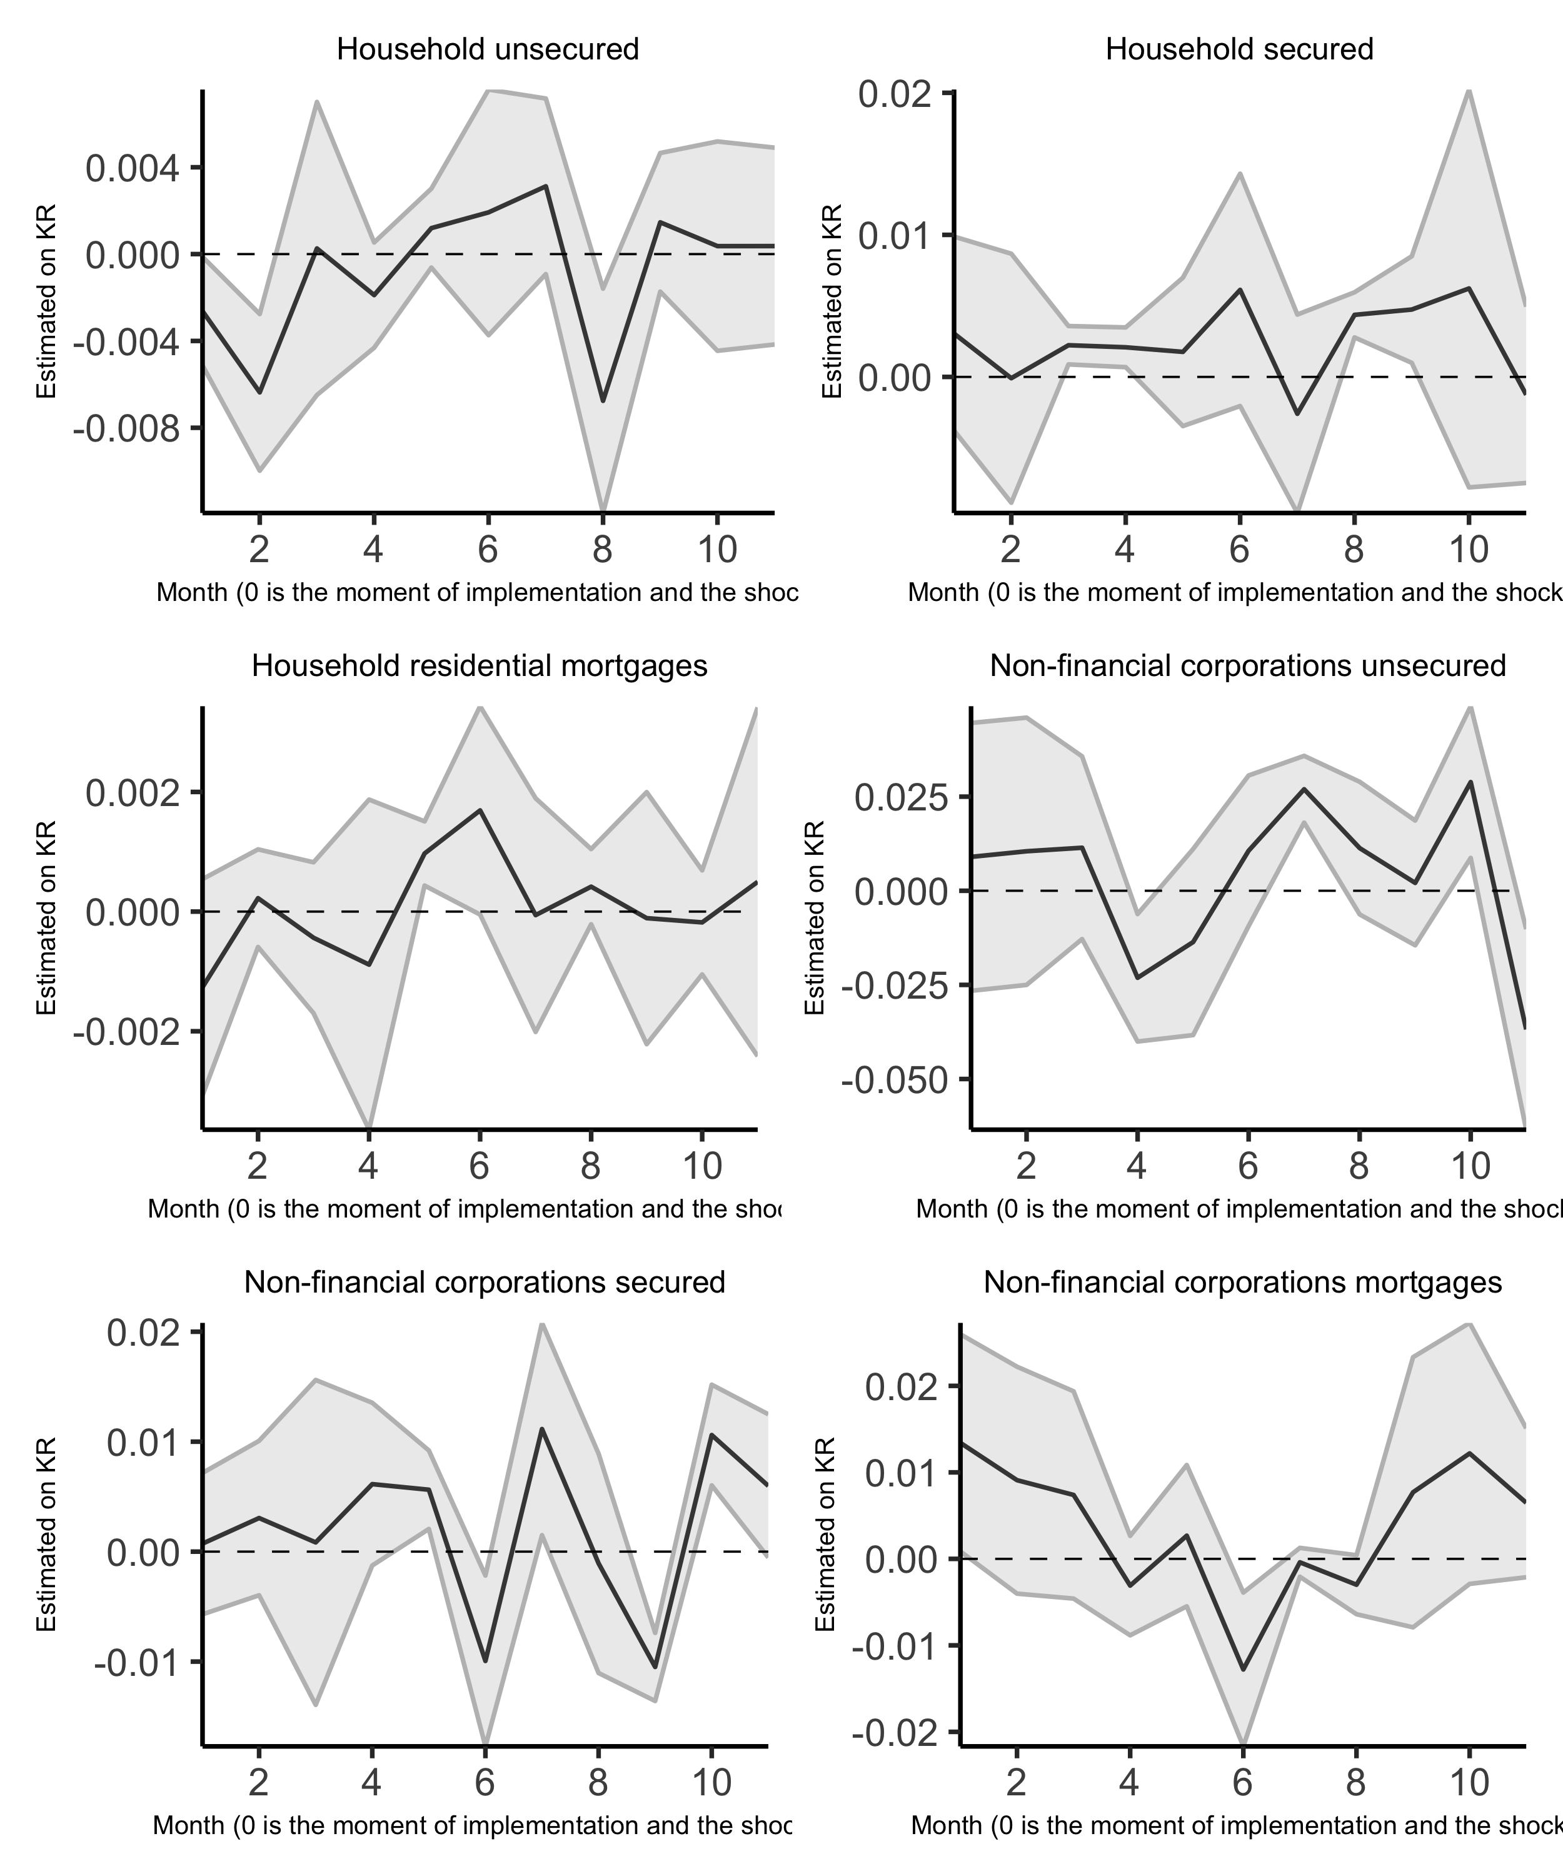
Evolution of the impacts

Slide 14
Discussion

Slide 15
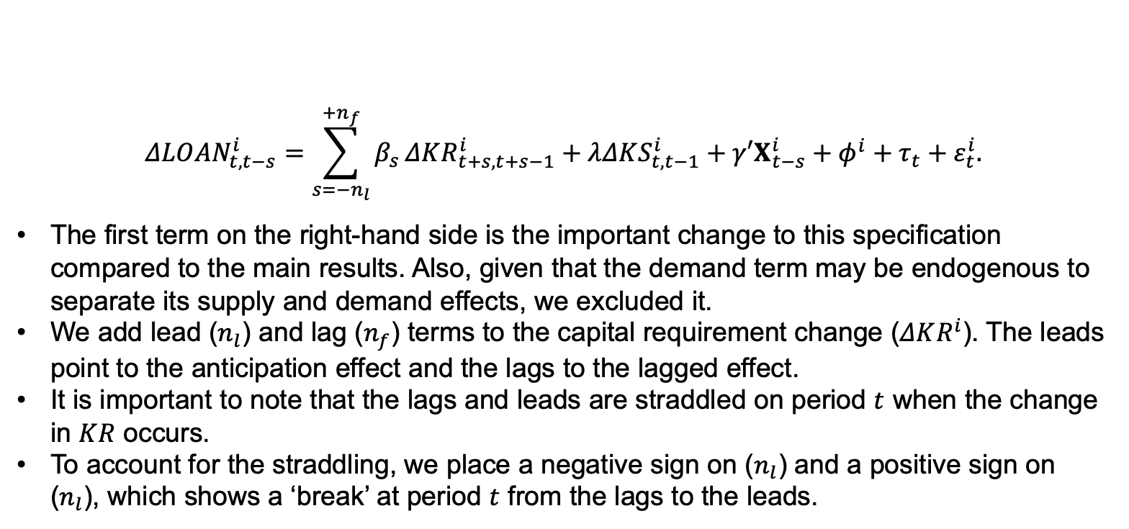
Capital requirement endogeneity
$$ΔLOAN_{t,t−s}^{i}=\sum_{s=−n_{l}}^{+n_{f}}{β_{s}}ΔKR_{t+s,t+s−1}^{i}+λΔKS_{t,t−1}^{i}+γ′X_{t−s}^{i}+φ^{i}+τ_{t}+ε_{t}^{i}.$$
The first term on the right-hand side is the important change to this specification compared to the main results. Also, given that the demand term may be endogenous to separate its supply and demand effects, we excluded it.
We add lead ($n_{l}$) and lag ($n_{f}$) terms to the capital requirement change ($ΔKR^{i}$). The leads point to the anticipation effect and the lags to the lagged effect.
It is important to note that the lags and leads are straddled on period $t$ when the change in $KR$ occurs.
To account for the straddling, we place a negative sign on ($n_{l}$) and a positive sign on ($n_{l}$), which shows a ‘break’ at period $t$ from the lags to the leads.

Slide 16
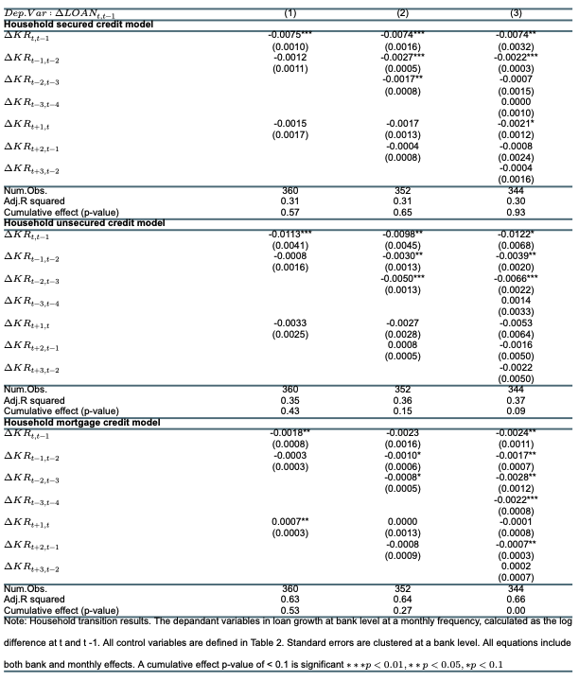
Households

Slide 17
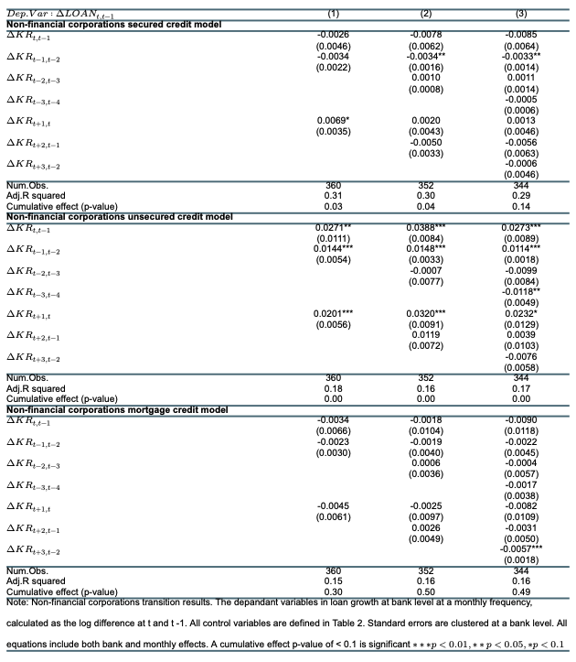
Non financial

Slide 19
Conclusions

