Slide 1
Relative price dispersion and inflation regimes in South Africa
Keagile Lesame (NT)
and
Xolani Sibande (SARB)

Slide 2
The recent target reform raises questions about RPD
Inflation is known to have adverse welfare effects through its distortion of relative price dispersion which causes the misallocation of resources, production inefficiencies leading to lower real economic activity
This is well supported by both theoretical and empirical studies (Nakamura et al., 2018; Head and Kumar, 2005; Adam et al., 2024)
This paper contributes to the empirical literature, by examining the relationship between inflation and relative price variability (RPD) in South Africa given the little evidence available and to better understand how this relationship has evolved and the implications for monetary policy
The South African context can provide further insights into the relationship between inflation and RPD given the shifts in the inflation targets from 3-6 per cent in 2000 to 4.5 per cent since 2017 as structural changes in inflation can affect the link between inflation and relative price variability (Caglayan and Filiztekin 2003)
Given the inflation target reform towards a 3% in South Africa, this study contributes to the policy discussion on the appropriate inflation target and understating how dynamic relations between inflation and relative price dispersion has evolved

Slide 3
RPD through Lucas’s aggregate supply curve (but what is RPD?)

Slide 4
RPD has many explanations or theoretical underpinnings
The theoretical literature generally distinguishes between menu-cost and signal extraction models in explaining the positive relation between trend inflation and RPD.
Due to differences in administrative costs, these nominal price adjustment costs vary across firms moreover these adjustments occur at different times which implies staggard price setting behavior which leads to relative price variability.
Menu cost models predict a that higher expected inflation causes an increase in RPD while Lucas-type signal extraction models (Lucas 1973; Hercowitz 1981; Cukierman 1983) argue unexpected inflation uncertainty causes higher RPD because informational frictions make it difficult to distinguish between idiosyncratic relative shocks or an aggregate (inflationary) shock.
Menu cost and signal-extraction models assume a positive and linear relationship making the optimal inflation rate zero, however, recently monetary search models (Head and Kumar, 2005) show that this relationship is nonlinear making the optimal inflation rate somewhere between zero and positive inflation rate.

Slide 5
As a thought experiment, we focus of Lucas’s supply curve
The concept of relative price dispersion can be abstract and difficult to grasp without a theoretical framework.
One of the most influential frameworks for understanding relative price dispersion is the Lucas (1973) aggregate supply curve, which provides insights into how relative price dispersion can explain the output-inflation relationship.
This theory essentially means (in part) that nominal “rigidities” partially dominate short-run supplier behavior resulting from a lack of information about the some prices relevant to decision making.
For our purposes we ignore other aspects of the theoretical framework and emphasis this aspect of the model to provide an understanding relative price dispersion.

Slide 6
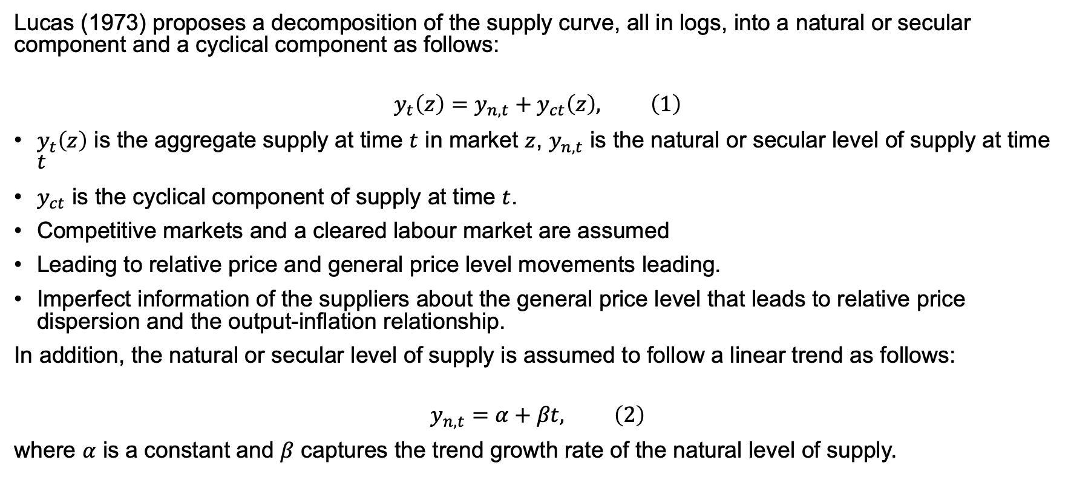
Lucas’s supply curve
Lucas (1973) proposes a decomposition of the supply curve, all in logs, into a natural or secular component and a cyclical component as follows:
$$y_{t}\left(z\right)=y_{n,t}+y_{ct}\left(z\right), \left(1\right)$$
$y_{t}\left(z\right)$ is the aggregate supply at time $t$ in market $z$, $y_{n,t}$ is the natural or secular level of supply at time $t$
$y_{ct}$ is the cyclical component of supply at time $t$.
Competitive markets and a cleared labour market are assumed
Leading to relative price and general price level movements leading.
Imperfect information of the suppliers about the general price level that leads to relative price dispersion and the output-inflation relationship.
In addition, the natural or secular level of supply is assumed to follow a linear trend as follows:
$$y_{n,t}=α+βt, \left(2\right)$$
where $α$ is a constant and $β$ captures the trend growth rate of the natural level of supply.

Slide 7
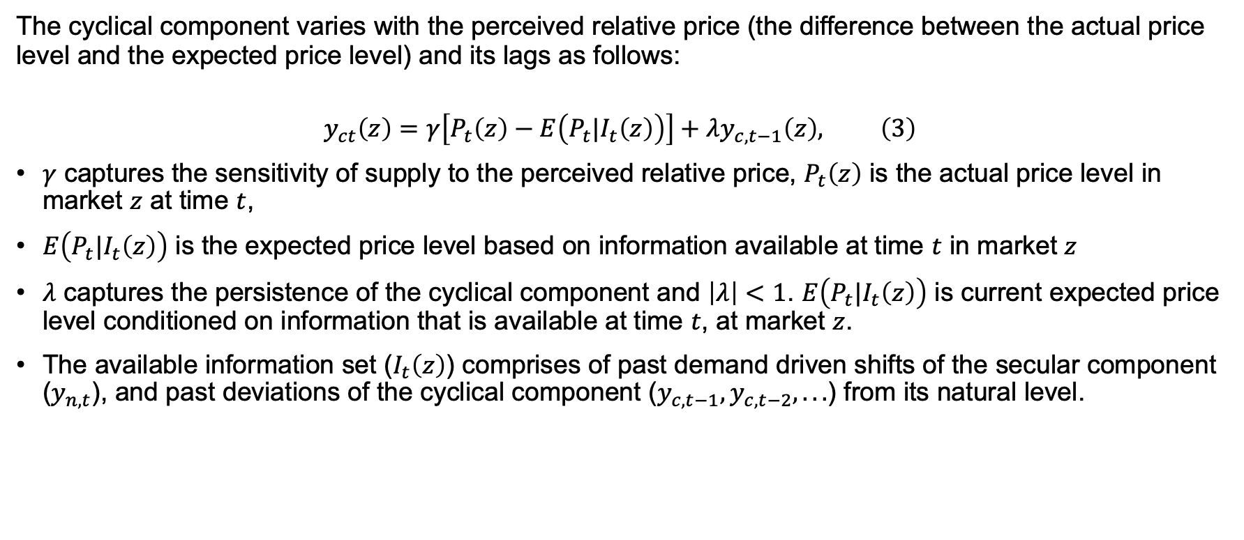
Lucas’s supply curve: Information asymmetry
The cyclical component varies with the perceived relative price (the difference between the actual price level and the expected price level) and its lags as follows:
$$y_{ct}\left(z\right)=γ\left[P_{t}\left(z\right)−E\left(P_{t}|I_{t}\left(z\right)\right)\right]+λy_{c,t−1}\left(z\right), \left(3\right)$$
$γ$ captures the sensitivity of supply to the perceived relative price, $P_{t}\left(z\right)$ is the actual price level in market $z$ at time $t$,
$E\left(P_{t}|I_{t}\left(z\right)\right)$ is the expected price level based on information available at time $t$ in market $z$
$λ$ captures the persistence of the cyclical component and $\left|λ\right|<1$. $E\left(P_{t}|I_{t}\left(z\right)\right)$ is current expected price level conditioned on information that is available at time $t$, at market $z$.
The available information set ($I_{t}\left(z\right)$) comprises of past demand driven shifts of the secular component ($y_{n,t}$), and past deviations of the cyclical component ($y_{c,t−1},y_{c,t−2},...$) from its natural level.

Slide 8
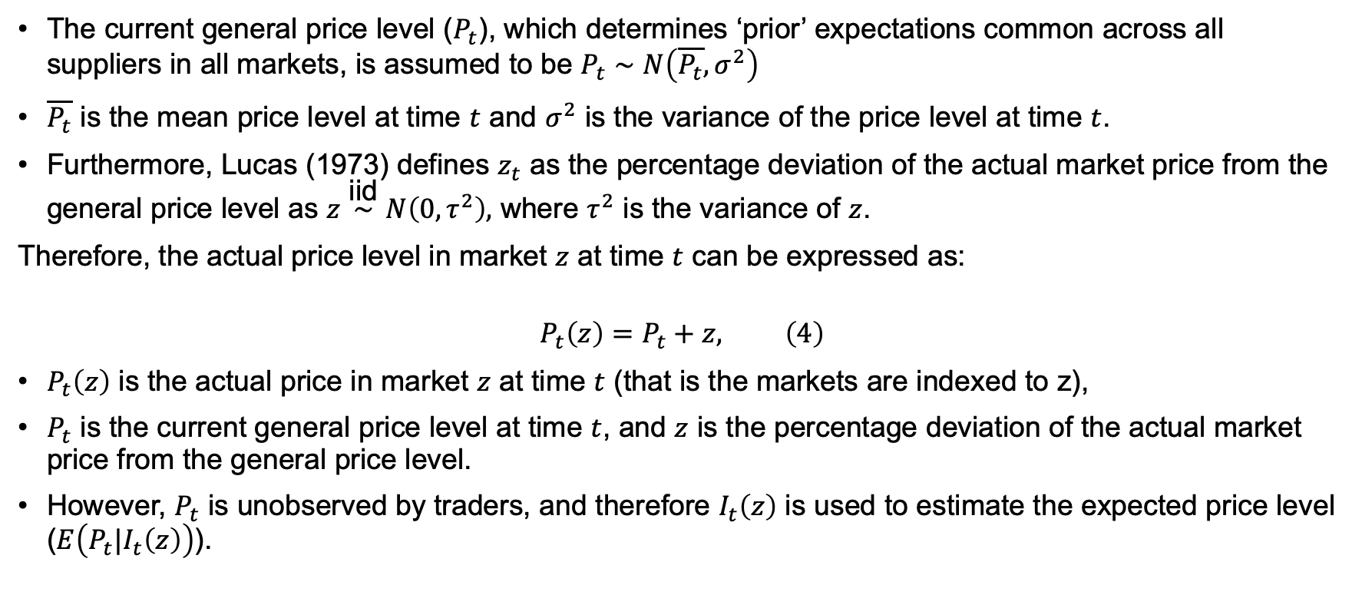
Lucas’s supply curve: General price level
The current general price level ($P_{t}$), which determines ‘prior’ expectations common across all suppliers in all markets, is assumed to be $P_{t}∼N\left(\overline{P_{t}},σ^{2}\right)$
$\overline{P_{t}}$ is the mean price level at time $t$ and $σ^{2}$ is the variance of the price level at time $t$.
Furthermore, Lucas (1973) defines $z_{t}$ as the percentage deviation of the actual market price from the general price level as $z\overset{\text{iid}}{∼}N\left(0,τ^{2}\right),$ where $τ^{2}$ is the variance of $z$.
Therefore, the actual price level in market $z$ at time $t$ can be expressed as:
$$P_{t}\left(z\right)=P_{t}+z, \left(4\right)$$
$P_{t}\left(z\right)$ is the actual price in market $z$ at time $t$ (that is the markets are indexed to z),
$P_{t}$ is the current general price level at time $t$, and $z$ is the percentage deviation of the actual market price from the general price level.
However, $P_{t}$ is unobserved by traders, and therefore $I_{t}\left(z\right)$ is used to estimate the expected price level ($E\left(P_{t}|I_{t}\left(z\right)\right)$).

Slide 9
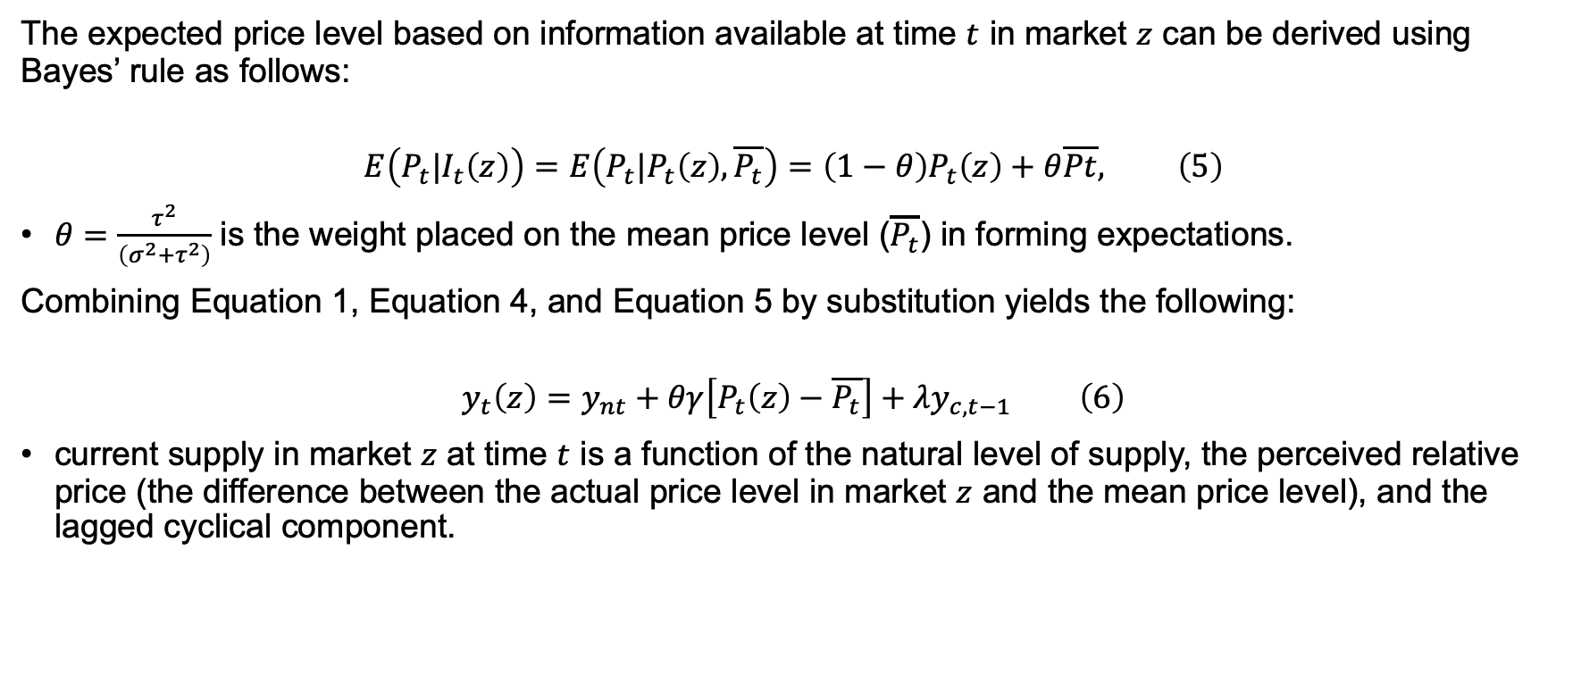
Lucas’s supply curve: Weight on formatting expectations
The expected price level based on information available at time $t$ in market $z$ can be derived using Bayes’ rule as follows:
$$E\left(P_{t}|I_{t}\left(z\right)\right)=E\left(P_{t}|P_{t}\left(z\right),\overline{P_{t}}\right)=\left(1−θ\right)P_{t}\left(z\right)+θ\overline{Pt}, \left(5\right)$$
$θ=\frac{τ^{2}}{\left(σ^{2}+τ^{2}\right)}$ is the weight placed on the mean price level ($\overline{P_{t}}$) in forming expectations.
Combining Equation 1, Equation 4, and Equation 5 by substitution yields the following:
$$y_{t}\left(z\right)=y_{nt}+θγ\left[P_{t}\left(z\right)−\overline{P_{t}}\right]+λy_{c,t−1} \left(6\right)$$
current supply in market $z$ at time $t$ is a function of the natural level of supply, the perceived relative price (the difference between the actual price level in market $z$ and the mean price level), and the lagged cyclical component.

Slide 10
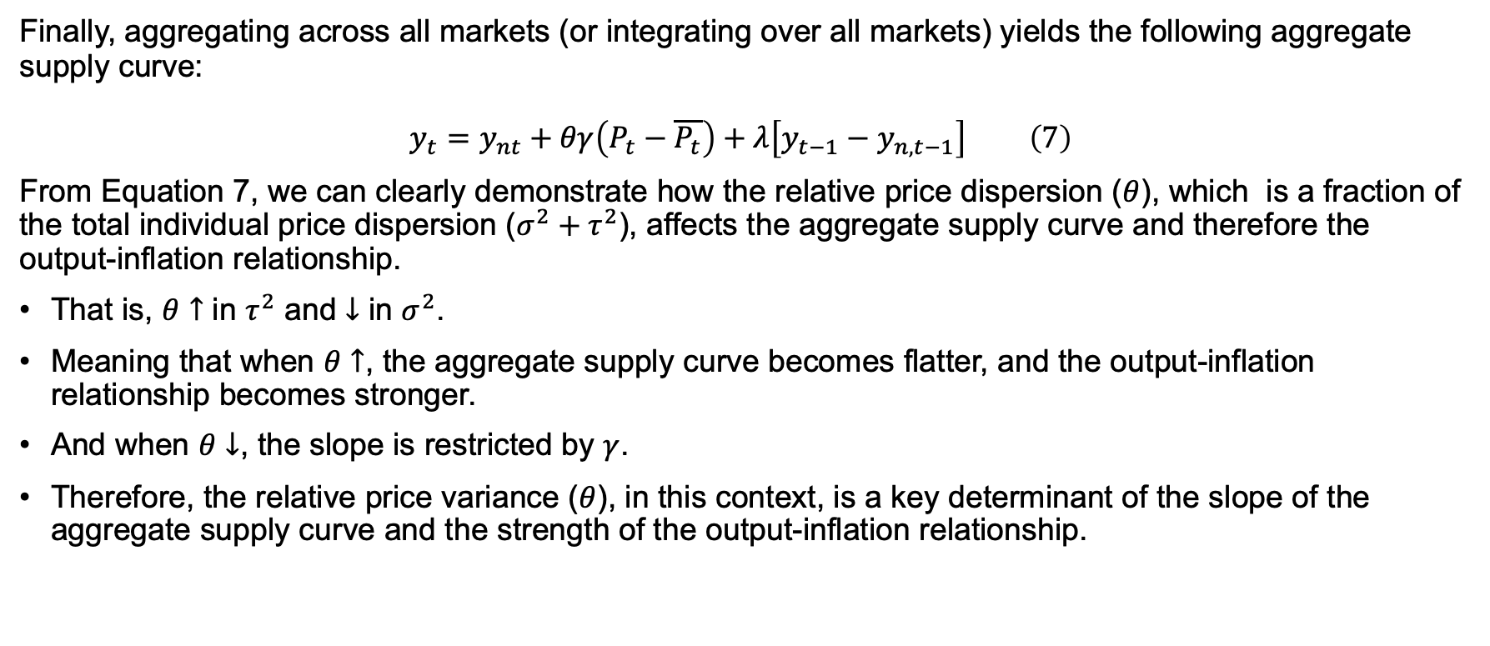
Lucas’s supply curve: Relative price dispersion (RPD)
Finally, aggregating across all markets (or integrating over all markets) yields the following aggregate supply curve:
$$y_{t}=y_{nt}+θγ\left(P_{t}−\overline{P_{t}}\right)+λ\left[y_{t−1}−y_{n,t−1}\right] \left(7\right)$$
From Equation 7, we can clearly demonstrate how the relative price dispersion ($θ$), which is a fraction of the total individual price dispersion ($σ^{2}+τ^{2}$), affects the aggregate supply curve and therefore the output-inflation relationship.
That is, $θ↑$ in $τ^{2}$ and $↓$ in $σ^{2}$.
Meaning that when $θ↑$, the aggregate supply curve becomes flatter, and the output-inflation relationship becomes stronger.
And when $θ↓$, the slope is restricted by $γ$.
Therefore, the relative price variance ($θ$), in this context, is a key determinant of the slope of the aggregate supply curve and the strength of the output-inflation relationship.

Slide 11
Data and methodology (what did we do?)

Slide 12
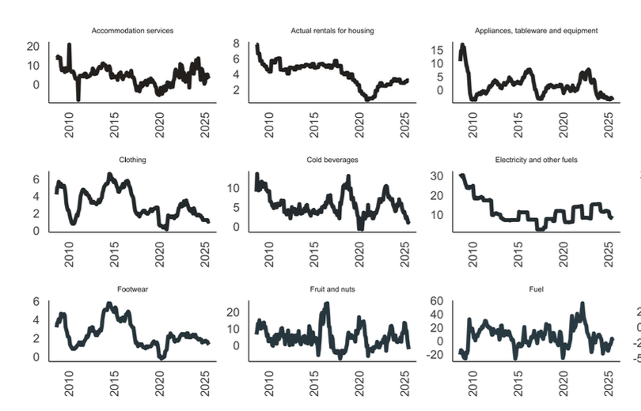
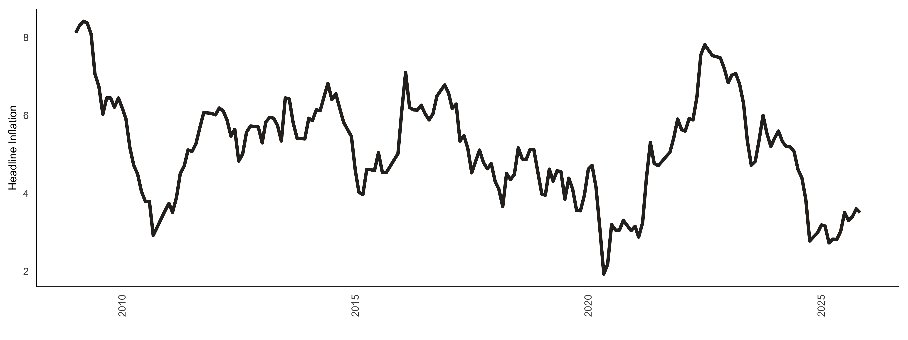
We rely entirely on Stats SA CPI data, …
Our analysis uses monthly inflation data on 45 goods categories from January 2009 to November 2025 obtained from Statistics South Africa (Stats SA).¹
Figure 1 below shows the long term inflation rate in South Africa, and Figure 2 shows some of the various price categories used in the analysis
Figure 1: Headline inflation overtime
Figure 2: Inflation categories overtime (sample)

Slide 13

… and calculate inflation in the standard way
We first calculate the monthly inflation rate as follows:
$$π_{i,t}=ln\left(\frac{P_{i,t}}{P_{i,t−1}}\right)∗100, \left(8\right)$$
$π_{i,t}$ is the inflation rate of good $i$ at time $t$
$P_{i,t}$ is the price of good $i$ at time $t$
$P_{i,t−1}$ is the price of good $i$ at time $t−1$

Slide 14
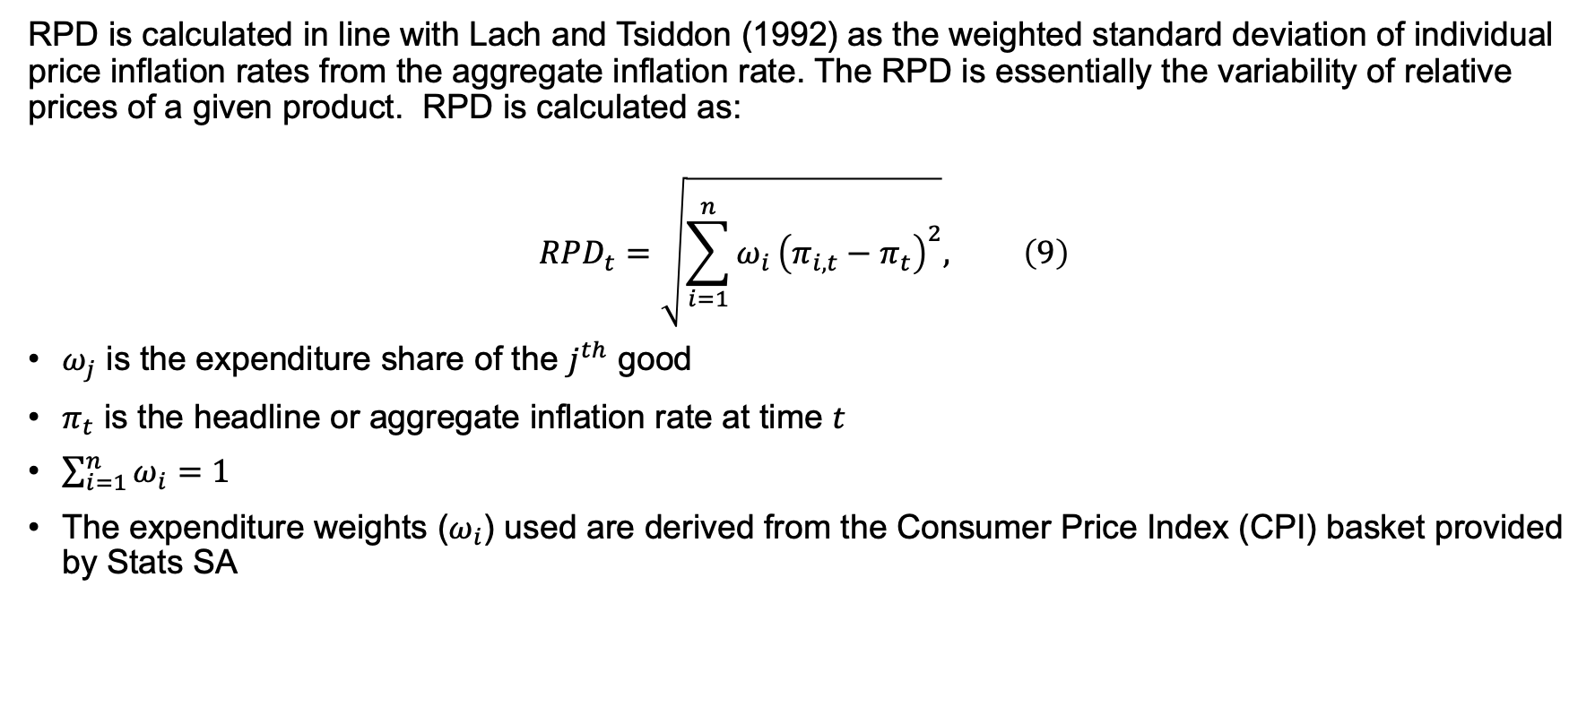
The definition of RPD is well understood in the literature
RPD is calculated in line with Lach and Tsiddon (1992) as the weighted standard deviation of individual price inflation rates from the aggregate inflation rate. The RPD is essentially the variability of relative prices of a given product. RPD is calculated as:
$$RPD_{t}=\sqrt{\sum_{i=1}^{n}{ω_{i}}{\left(π_{i,t}−π_{t}\right)}^{2}}, \left(9\right)$$
$ω_{j}$ is the expenditure share of the $j^{th}$ good
$π_{t}$ is the headline or aggregate inflation rate at time $t$
$\sum_{i=1}^{n}{ω_{i}}=1$
The expenditure weights ($ω_{i}$) used are derived from the Consumer Price Index (CPI) basket provided by Stats SA

Slide 15
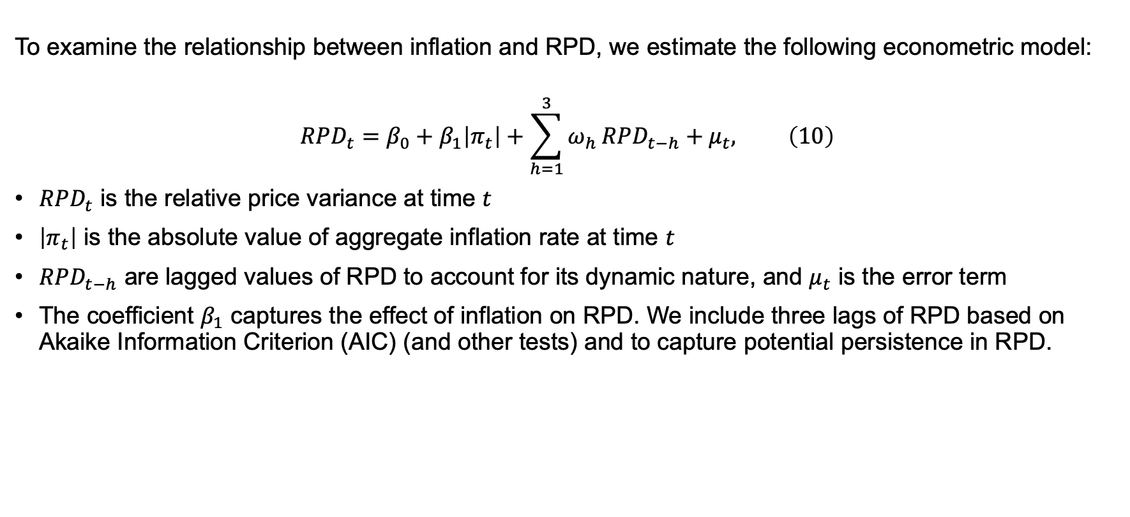
Our main purpose in to estimate the relationship between RPD and inflation
To examine the relationship between inflation and RPD, we estimate the following econometric model:
$$RPD_{t}=β_{0}+β_{1}\left|π_{t}\right|+\sum_{h=1}^{3}{ω_{h}}RPD_{t−h}+μ_{t}, \left(10\right)$$
$RPD_{t}$ is the relative price variance at time $t$
$\left|π_{t}\right|$ is the absolute value of aggregate inflation rate at time $t$
$RPD_{t−h}$ are lagged values of RPD to account for its dynamic nature, and $μ_{t}$ is the error term
The coefficient $β_{1}$ captures the effect of inflation on RPD. We include three lags of RPD based on Akaike Information Criterion (AIC) (and other tests) and to capture potential persistence in RPD.

Slide 16
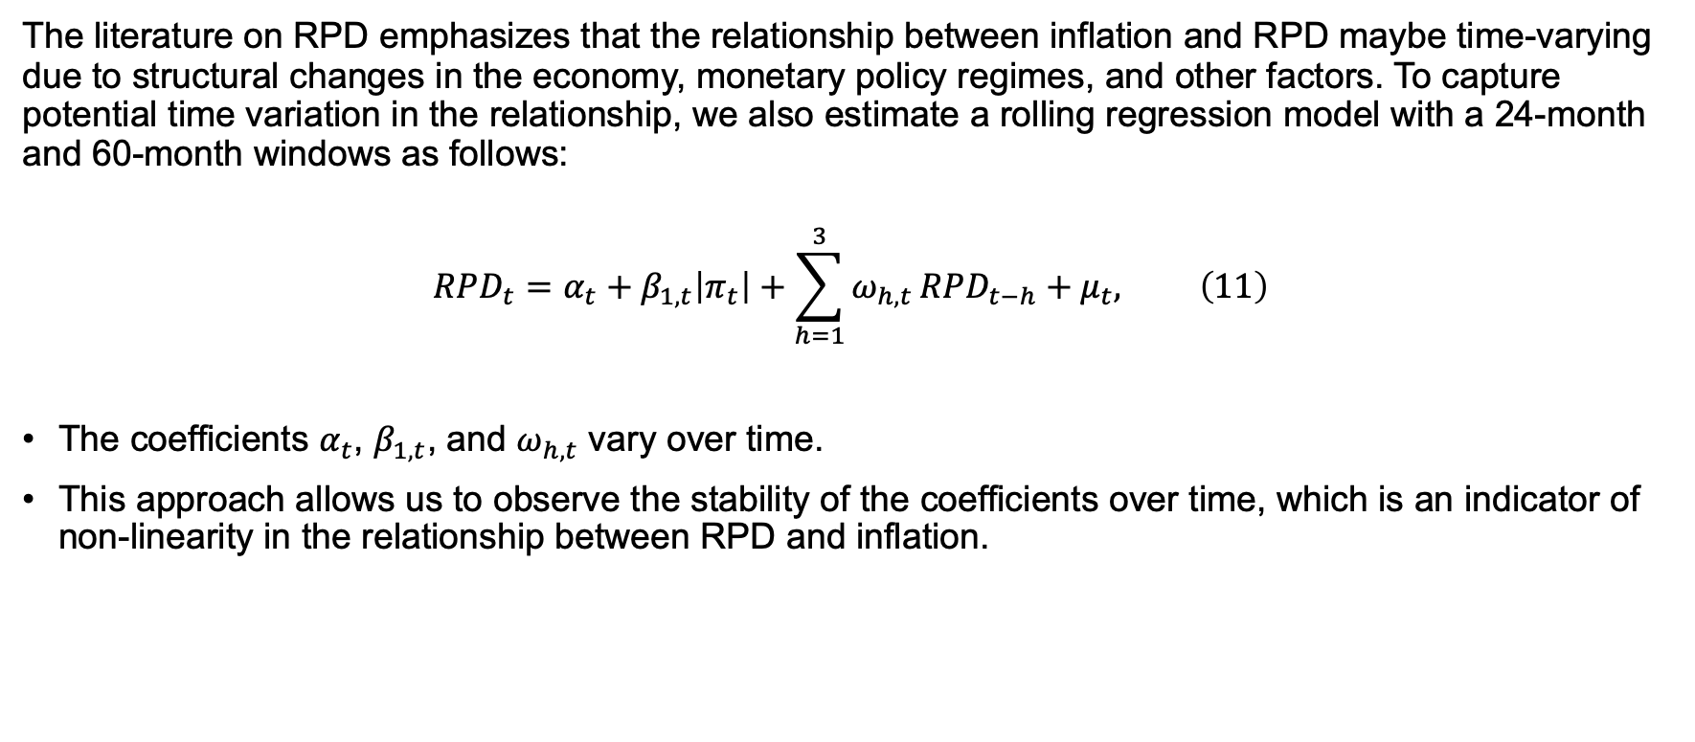
However, this relationship can be time varying, …
The literature on RPD emphasizes that the relationship between inflation and RPD maybe time-varying due to structural changes in the economy, monetary policy regimes, and other factors. To capture potential time variation in the relationship, we also estimate a rolling regression model with a 24-month and 60-month windows as follows:
$$RPD_{t}=α_{t}+β_{1,t}\left|π_{t}\right|+\sum_{h=1}^{3}{ω_{h,t}}RPD_{t−h}+μ_{t}, \left(11\right)$$
The coefficients $α_{t}$, $β_{1,t}$, and $ω_{h,t}$ vary over time.
This approach allows us to observe the stability of the coefficients over time, which is an indicator of non-linearity in the relationship between RPD and inflation.

Slide 17
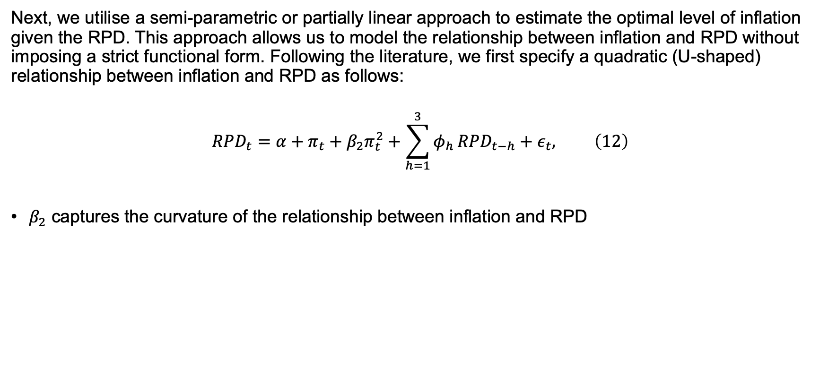
… or even quadratic in nature
Next, we utilise a semi-parametric or partially linear approach to estimate the optimal level of inflation given the RPD. This approach allows us to model the relationship between inflation and RPD without imposing a strict functional form. Following the literature, we first specify a quadratic (U-shaped) relationship between inflation and RPD as follows:
$$RPD_{t}=α+π_{t}+β_{2}π_{t}^{2}+\sum_{h=1}^{3}{φ_{h}}RPD_{t−h}+ε_{t}, \left(12\right)$$
$β_{2}$ captures the curvature of the relationship between inflation and RPD

Slide 18
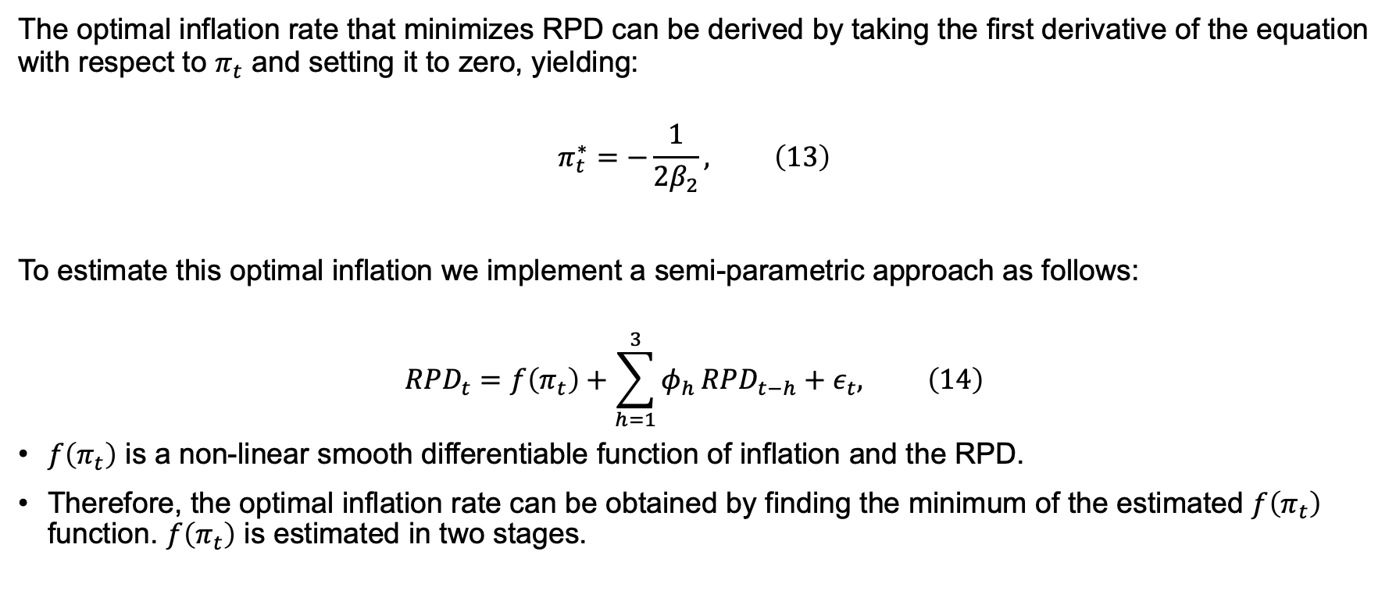
This enables use to estimate RPD minimizing inflation, …
The optimal inflation rate that minimizes RPD can be derived by taking the first derivative of the equation with respect to $π_{t}$ and setting it to zero, yielding:
$$π_{t}^{∗}=−\frac{1}{2β_{2}}, \left(13\right)$$
To estimate this optimal inflation we implement a semi-parametric approach as follows:
$$RPD_{t}=f\left(π_{t}\right)+\sum_{h=1}^{3}{φ_{h}}RPD_{t−h}+ε_{t}, \left(14\right)$$
$f\left(π_{t}\right)$ is a non-linear smooth differentiable function of inflation and the RPD.
Therefore, the optimal inflation rate can be obtained by finding the minimum of the estimated $f\left(π_{t}\right)$ function. $f\left(π_{t}\right)$ is estimated in two stages.

Slide 19
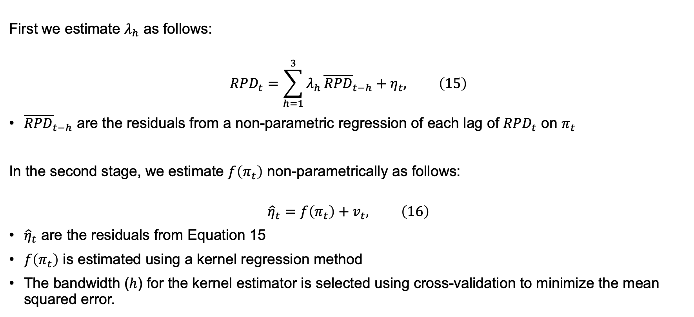
… using semi-parametric (kernel-based) methods
First we estimate $λ_{h}$ as follows:
$$RPD_{t}=\sum_{h=1}^{3}{λ_{h}}{\overline{RPD}}_{t−h}+η_{t}, \left(15\right)$$
${\overline{RPD}}_{t−h}$ are the residuals from a non-parametric regression of each lag of $RPD_{t}$ on $π_{t}$
In the second stage, we estimate $f\left(π_{t}\right)$ non-parametrically as follows:
$${\hat{η}}_{t}=f\left(π_{t}\right)+v_{t}, \left(16\right)$$
${\hat{η}}_{t}$ are the residuals from Equation 15
$f\left(π_{t}\right)$ is estimated using a kernel regression method
The bandwidth ($h$) for the kernel estimator is selected using cross-validation to minimize the mean squared error.

Slide 20
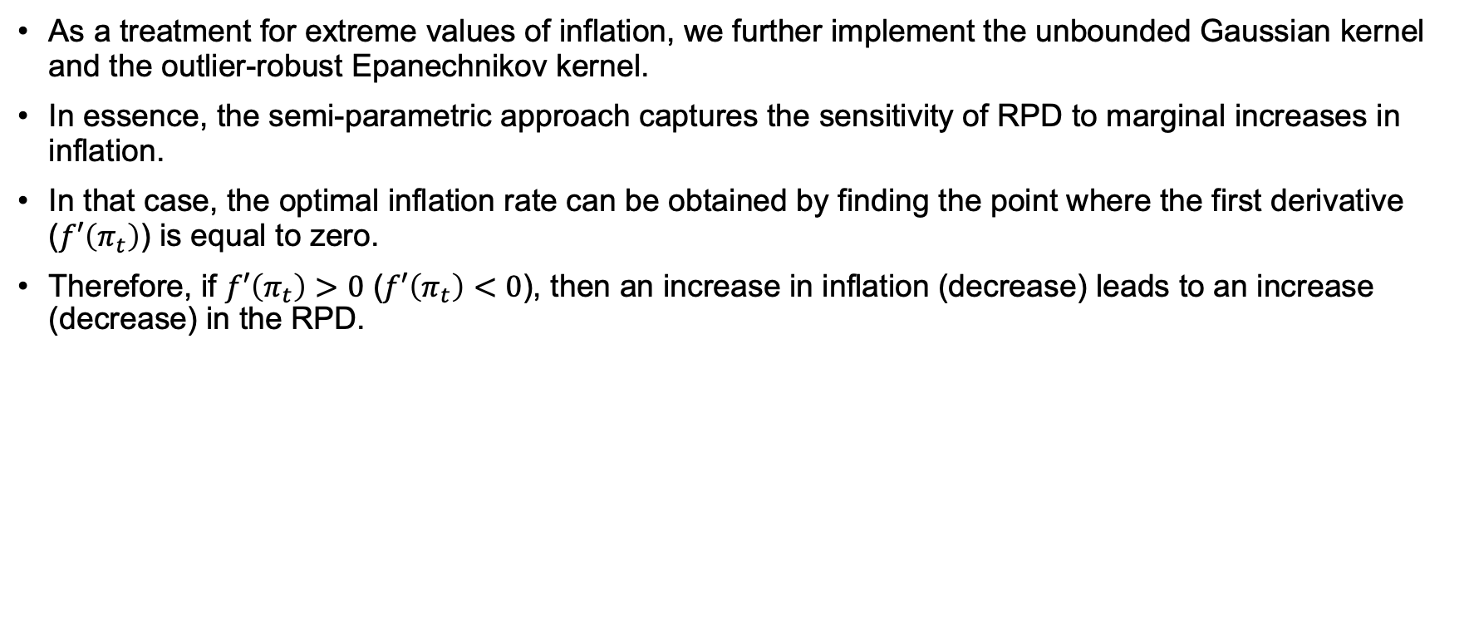
Mainly the Gaussian and Epanechnikov kernel were used
As a treatment for extreme values of inflation, we further implement the unbounded Gaussian kernel and the outlier-robust Epanechnikov kernel.
In essence, the semi-parametric approach captures the sensitivity of RPD to marginal increases in inflation.
In that case, the optimal inflation rate can be obtained by finding the point where the first derivative ($f′\left(π_{t}\right)$) is equal to zero.
Therefore, if $f′\left(π_{t}\right)>0$ ($f′\left(π_{t}\right)<0$), then an increase in inflation (decrease) leads to an increase (decrease) in the RPD.

Slide 21
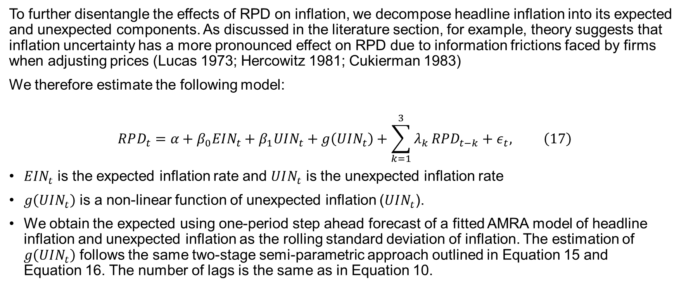
As outlined before, there is an important distinction between expected and unexpected inflation
To further disentangle the effects of RPD on inflation, we decompose headline inflation into its expected and unexpected components. As discussed in the literature section, for example, theory suggests that inflation uncertainty has a more pronounced effect on RPD due to information frictions faced by firms when adjusting prices (Lucas 1973; Hercowitz 1981; Cukierman 1983)
We therefore estimate the following model:
$$RPD_{t}=α+β_{0}EIN_{t}+β_{1}UIN_{t}+g\left(UIN_{t}\right)+\sum_{k=1}^{3}{λ_{k}}RPD_{t−k}+ε_{t}, \left(17\right)$$
$EIN_{t}$ is the expected inflation rate and $UIN_{t}$ is the unexpected inflation rate
$g\left(UIN_{t}\right)$ is a non-linear function of unexpected inflation ($UIN_{t}$).
We obtain the expected using one-period step ahead forecast of a fitted AMRA model of headline inflation and unexpected inflation as the rolling standard deviation of inflation. The estimation of $g\left(UIN_{t}\right)$ follows the same two-stage semi-parametric approach outlined in Equation 15 and Equation 16. The number of lags is the same as in Equation 10.

Slide 22
Lastly, we estimate RPD-Inflation regimes using QQR
Lastly, and some-what novel to the RPD literature, we employ a quantile on quantile regression (QQR) approach (Koenker 2017).
QQRs are robust to outliers and allows us to estimate the regime aspects of the relationship between RPD and inflation.
For brevity, we do not explain the QQR procedure

Slide 23
Results (what did we find?)

Slide 24
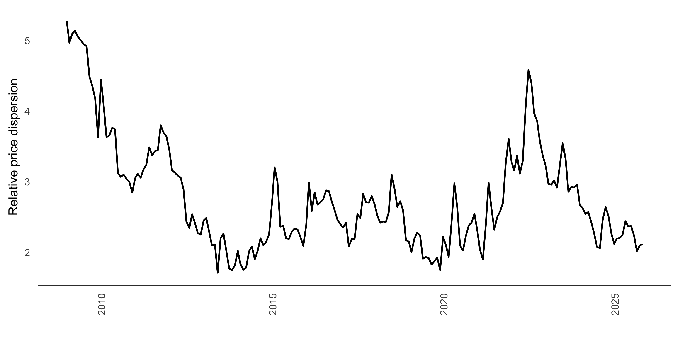
RPD tends to rise rapidly with high inflation shocks
Figure 3: RPD over-time

Slide 25
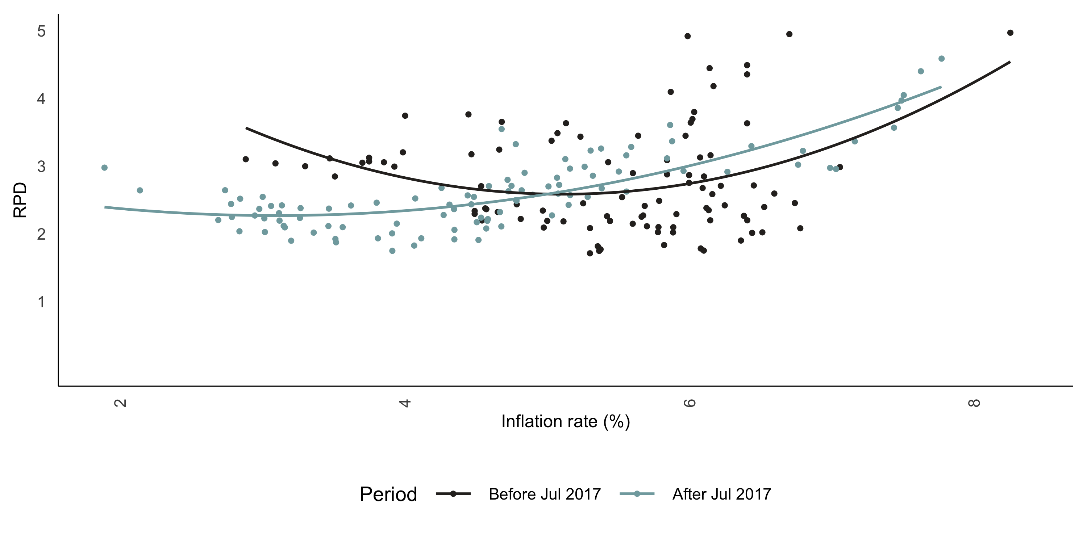
Empirically, the RPD suggests lower optimal inflation
Figure 4: RPD vs headline inflation

Slide 26
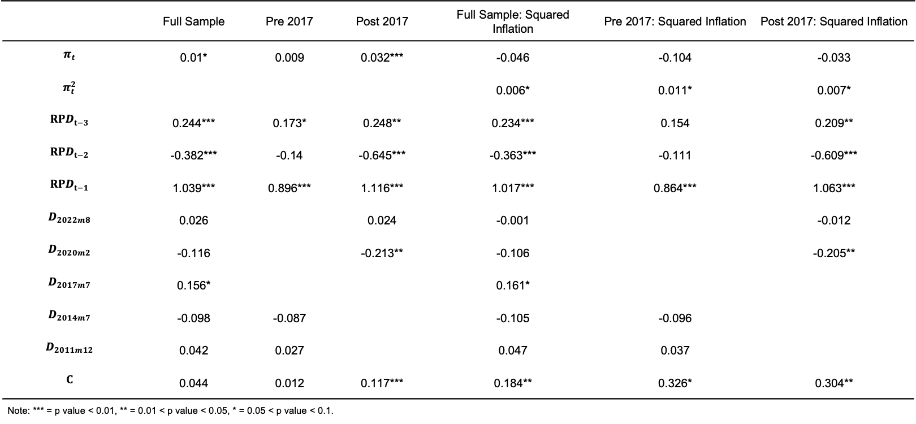
The baseline results suggests a non-linear relationship
Table 1: Baseline regressions
 | Full Sample | Pre 2017 | Post 2017 | Full Sample: Squared Inflation | Pre 2017: Squared Inflation | Post 2017: Squared Inflation
$$π_{t}$$ | 0.01* | 0.009 | 0.032*** | -0.046 | -0.104 | -0.033
$$π_{t}^{2}$$ |  |  |  | 0.006* | 0.011* | 0.007*
$$RPD_{t−3}$$ | 0.244*** | 0.173* | 0.248** | 0.234*** | 0.154 | 0.209**
$$RPD_{t−2}$$ | -0.382*** | -0.14 | -0.645*** | -0.363*** | -0.111 | -0.609***
$$RPD_{t−1}$$ | 1.039*** | 0.896*** | 1.116*** | 1.017*** | 0.864*** | 1.063***
$$D_{2022m8}$$ | 0.026 |  | 0.024 | -0.001 |  | -0.012
$$D_{2020m2}$$ | -0.116 |  | -0.213** | -0.106 |  | -0.205**
$$D_{2017m7}$$ | 0.156* |  |  | 0.161*
$$D_{2014m7}$$ | -0.098 | -0.087 |  | -0.105 | -0.096
$$D_{2011m12}$$ | 0.042 | 0.027 |  | 0.047 | 0.037
$$C$$ | 0.044 | 0.012 | 0.117*** | 0.184** | 0.326* | 0.304**
Note: *** = p value < 0.01, ** = 0.01 < p value < 0.05, * = 0.05 < p value < 0.1. | Note: *** = p value < 0.01, ** = 0.01 < p value < 0.05, * = 0.05 < p value < 0.1. | Note: *** = p value < 0.01, ** = 0.01 < p value < 0.05, * = 0.05 < p value < 0.1. | Note: *** = p value < 0.01, ** = 0.01 < p value < 0.05, * = 0.05 < p value < 0.1. | Note: *** = p value < 0.01, ** = 0.01 < p value < 0.05, * = 0.05 < p value < 0.1. | Note: *** = p value < 0.01, ** = 0.01 < p value < 0.05, * = 0.05 < p value < 0.1. | Note: *** = p value < 0.01, ** = 0.01 < p value < 0.05, * = 0.05 < p value < 0.1.

Slide 27
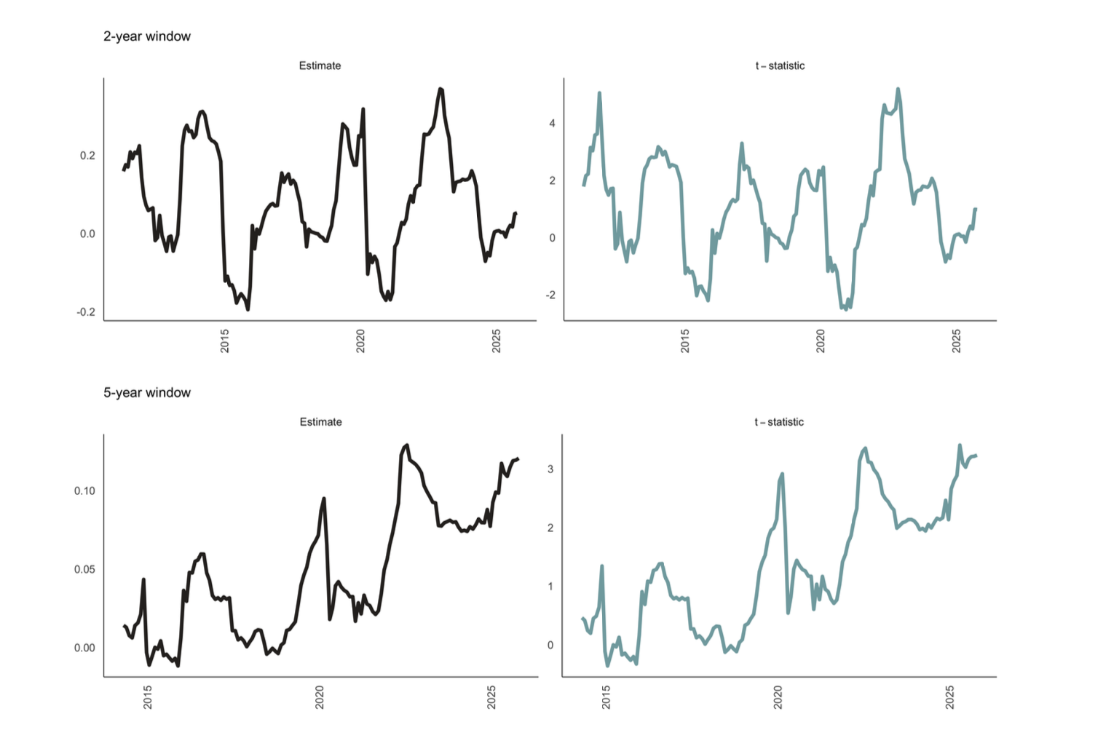
Supported by significant time-varying results
Figure 5: Rolling window regressions

Slide 28
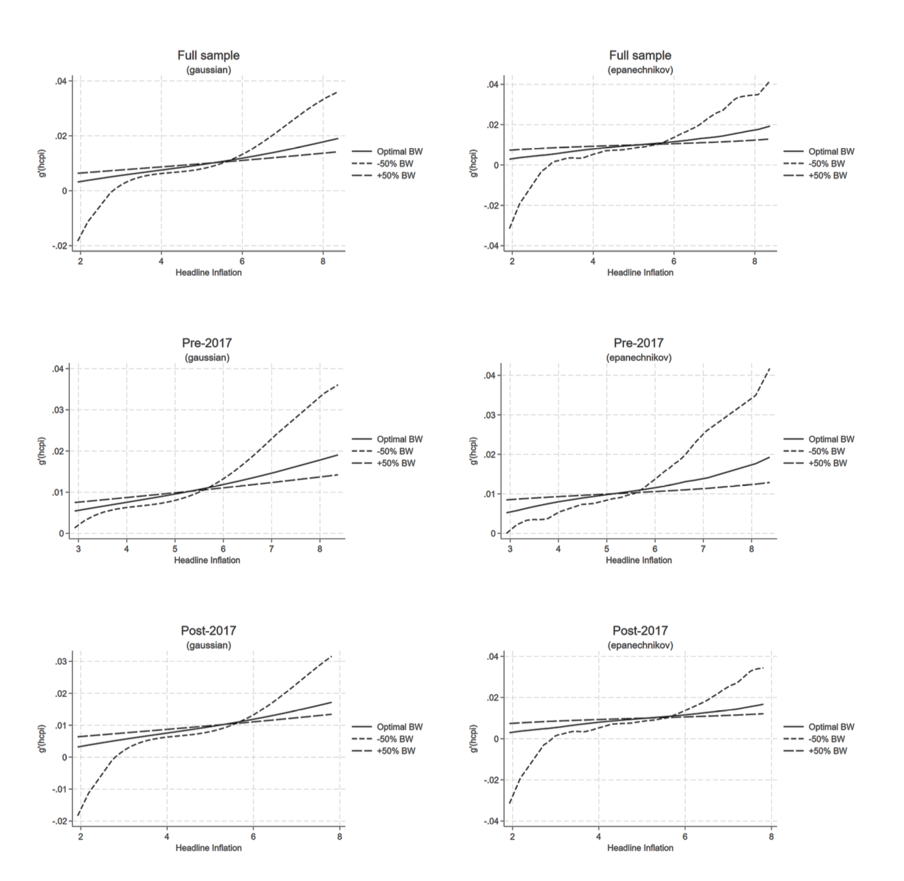
Results suggests an optimal inflation in the range of 2-3%
Figure 6: Semi-parametric regressions
Full sample, the relationship shows a U-shaped profile in line with the theoretical predictions of Head and Kumar(2005)
1
Small positive effects on RPD for an inflation range of 2-3 percent, moreover RPD is at its lowest in this range suggesting this would be the optimal inflation range as RPD is not amplified
2
The post 2017 sub-samples results indicate less rapid response in RPD for a change in inflation
3

Slide 29
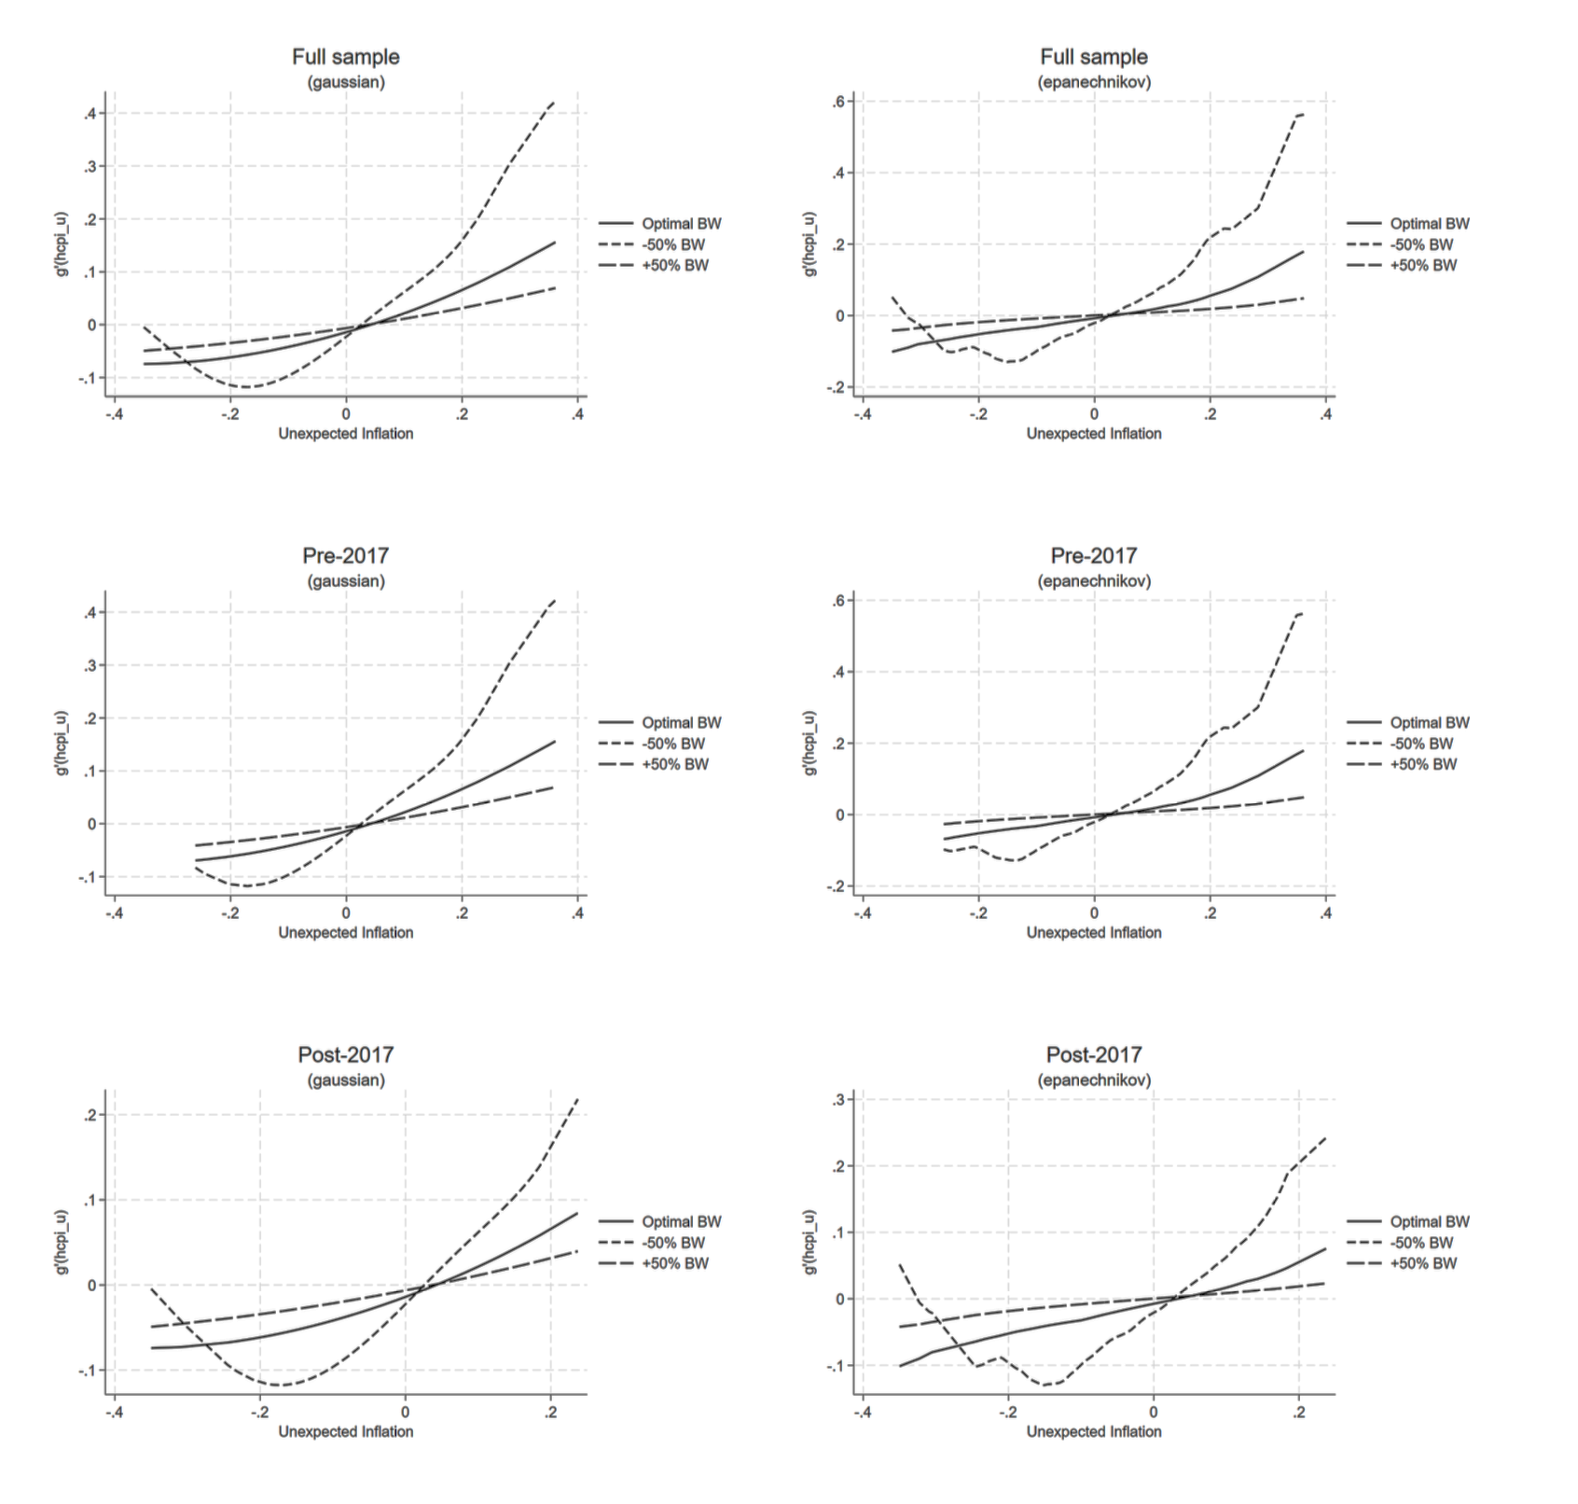
Interestingly, severe inflation shocks compressed RPD
Figure 7: Semi-parametric regressions for unexpected inflation
Full and pre-2017 samples, the intuition is that inflation surprises create informational noise as a result firms confuse aggregate price shocks with relative shocks leading to higher relative price variability consistent with the misperception models
1
The post-2017 period is characterised by significant global shocks to inflation from the COVID-2019 Pandemic in 2020 and associated supply chain disruptions
2
These common unexpected shocks would’ve induced a similar price setting behavioural response in the same direction therefore compressing price dispersion (Nakamura et al., 2018)
3

Slide 30
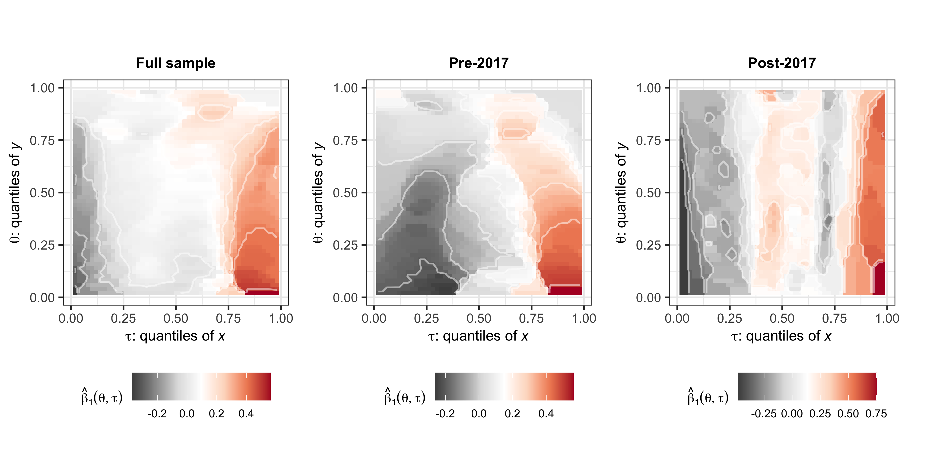
Three distinct regimes emerged further enhancing the initial results
Figure 8: Quantile on quantile regressions for headline inflation
Note: The x-axis represents the quantiles of headline inflation, while the y-axis represents the quantiles of RPD

Slide 31
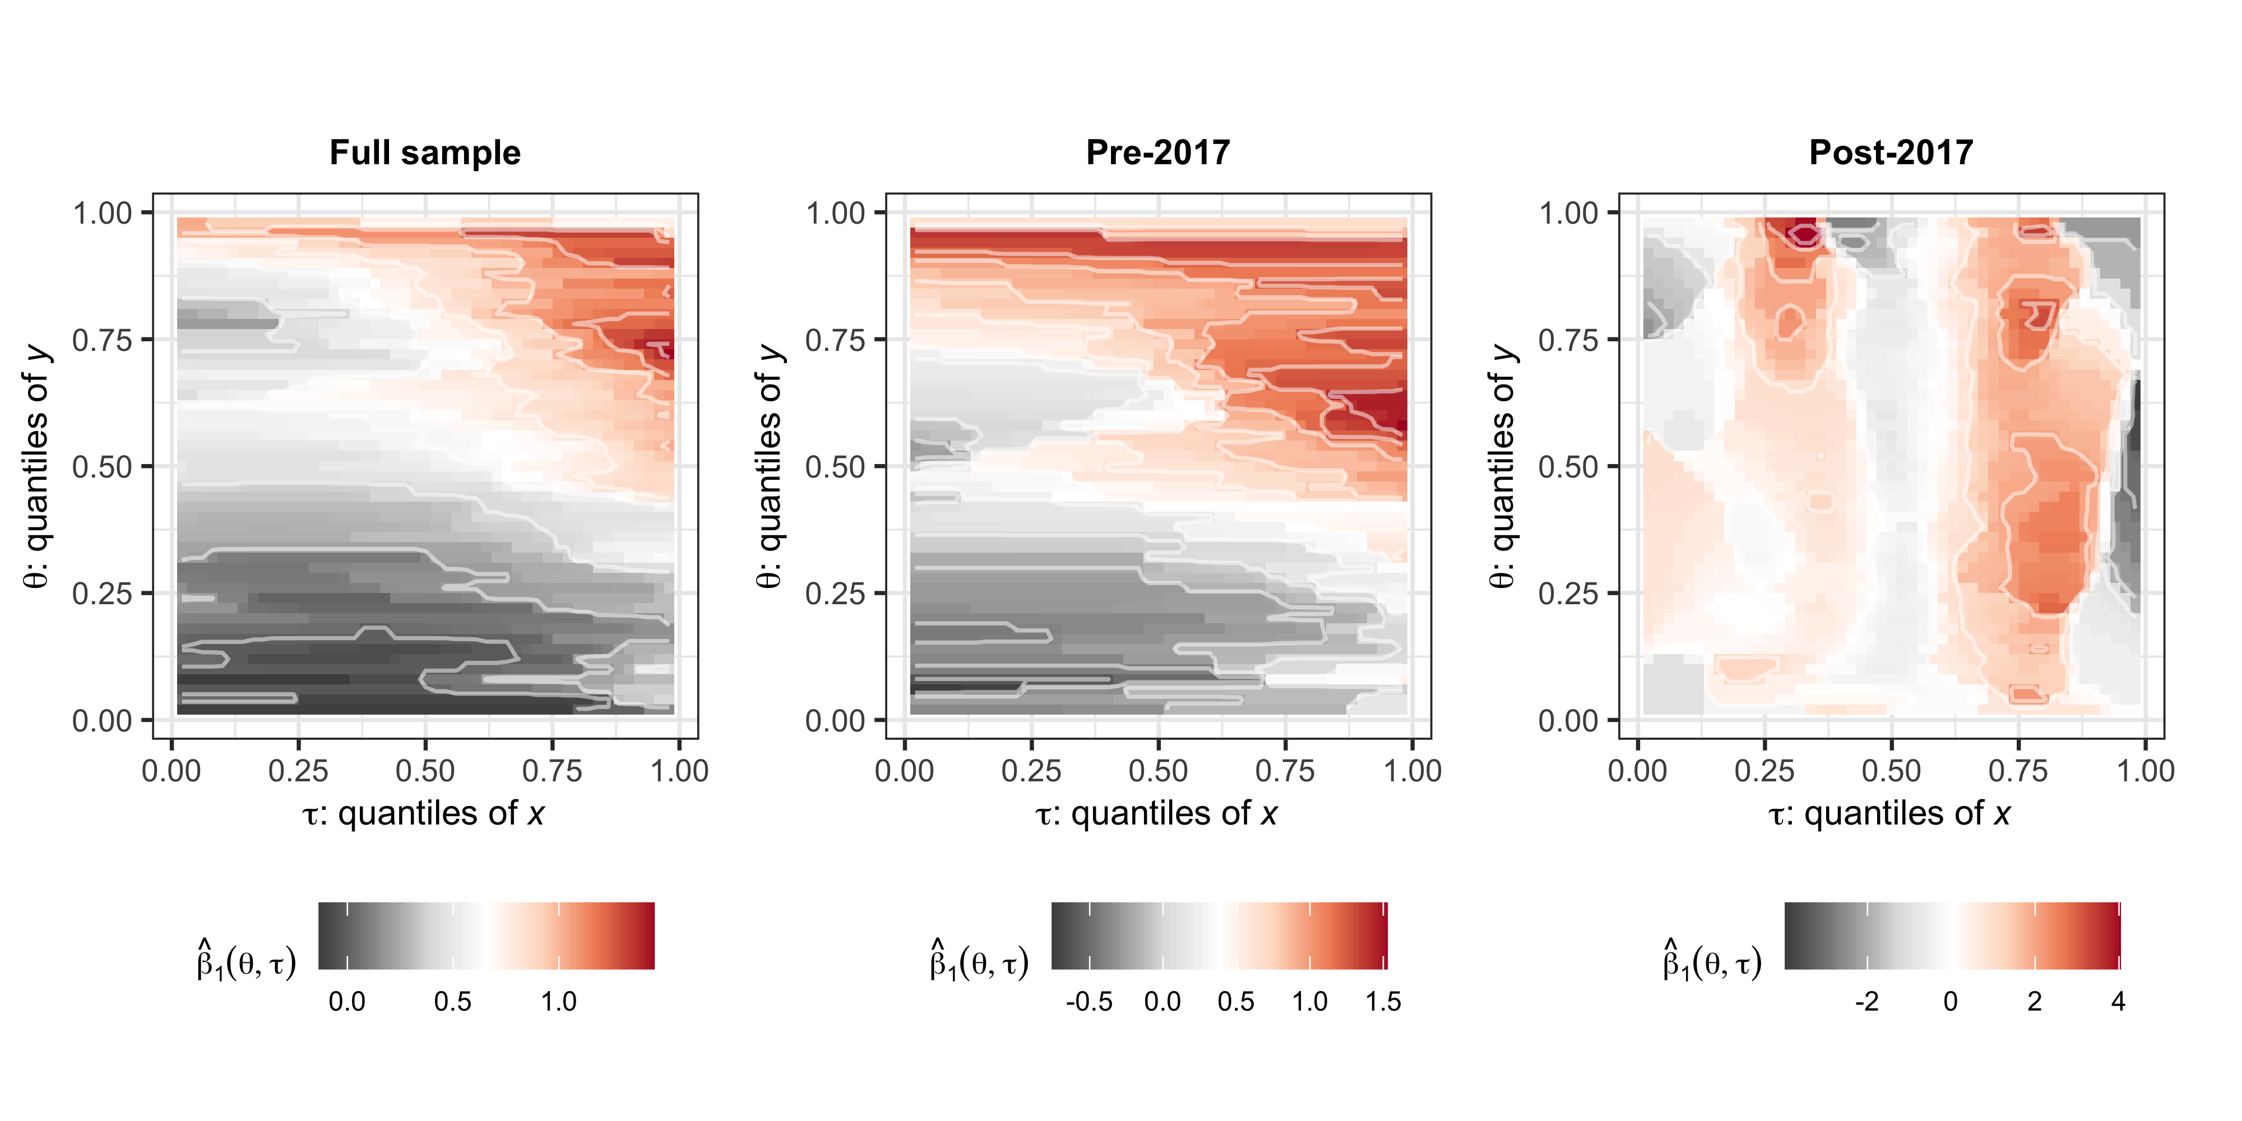
Except post 2017, RPD was well anchored
Figure 9: Quantile on quantile regressions for the unexpected component of inflation.
Note: The x-axis represents the quantiles of the unexpected component of headline inflation, while the y-axis represents the quantiles of RPD

Slide 32
Conclusions (what are we saying?)

Slide 33
Conclusion
SA presents an interesting case given its target reform over the last decade
We find that the RPD Inflation dynamic in SA inline with the literature and with significant regimes
The results suggest that the optimal inflation declined post 2017
In the main we suggest that post the 2017 target change, the response of RPD to changes inflation declined compared to pre-2017
Suggests that the policy path is more predictable (maybe policy more credible)
We cannot discount the role of the recent inflation shocks – possible that we are in a transitory period
But given the further reform in the target, the RPD inflation profile may settle in a more desirable equilibrium
This is as recent evidence suggests that the recent change in the target is resulting in lower expectations in general (Foresto et al., forthcoming; Amaral et al., forthcoming)
Further research is necessary

Slide 34
Thank You! Questions?

Slide 35
References
Caglayan, Mustafa, and Alpay Filiztekin. 2003. “Nonlinear Impact of Inflation on Relative Price Variability.” Economics Letters 79 (2): 213–18.
Choi, Chi-Young. 2010. “Reconsidering the Relationship Between Inflation and Relative Price Variability.” Journal of Money, Credit and Banking 42 (5): 769–98. https://doi.org/10.1111/j.1538-4616.2010.00307.x.
Cukierman, Alex. 1983. “Relative Price Variability and Inflation: A Survey and Further Results.” In Carnegie-Rochester Conference Series on Public Policy, 19:103–57. Elsevier.
Fielding, David, and Paul Mizen. 2000. “Relative Price Variability and Inflation in Europe.” Economica 67 (265): 57–78. https://doi.org/10.1111/1468-0335.00195.
Foresto, Anis, Reid, Monique, Mosoma, Pabalelo. Forthcoming. ”BER Special Question: Do firms know about the new inflation target? Implications for the path to 3%. South African Reserve Bank Working Paper Series
Amaral, Ayrton, Foresto, Anis, Mosoma, Pabalelo. Forthcoming. “Finding the anchor: An assessment of the anchoring of inflation expectations in South Africa” South African Reserve Bank Working Paper Series
Head, Allen, and Alok Kumar. 2005. “Price Dispersion, Inflation, and Welfare.” International Economic Review 46 (2): 533–72. https://doi.org/10.1111/j.1468-2354.2005.00333.x.
Hercowitz, Zvi. 1981. “Money and the Dispersion of Relative Prices.” Journal of Political Economy 89 (2): 328–56. https://doi.org/10.1086/260968.
Koenker, Roger. 2017. “Quantile Regression: 40 Years On.” Annual Review of Economics 9 (1): 155–76. https://doi.org/10.1146/annurev-economics-063016-103651.
Lach, Saul, and Daniel Tsiddon. 1992. “The Behavior of Prices and Inflation: An Empirical Analysis of Disaggregat Price Data.” Journal of Political Economy 100 (2): 349–89. https://doi.org/10.1086/261821.
Lucas, Robert E. 1973. “Some International Evidence on Output-Inflation Tradeoffs.” The American Economic Review 63 (3): 326–34. https://www.jstor.org/stable/1914364.

Slide 36
Notes
1. The data is available at: http://www.statssa.gov.za/ and the data was seasonally adjusted.

