Slide 1
Relative price dispersion and inflation regimes in South Africa
Keagile Lesame and Xolani Sibande | National Treasury of South Africa and South African Reserve Bank

Slide 2
Motivation

Slide 3
Motivation
Inflation is known to have adverse welfare effects through its distortion of relative prices which causes the misallocation of resources, production inefficiencies leading to lower real economic activity.
This is well supported by both theoretical and empirical studies.
This paper contributes to the empirical literature, by examining the relationship between inflation and relative price variability (RPD) in South Africa given the little evidence available and to better understand how this relationship has evolved and the implications for monetary policy.
The South African context can provide further insights into the relationship between inflation and RPD given the shifts in the inflation targets from 3-6 per cent in 2000 to 4.5 per cent since 2017 as structural changes in inflation can affect the link between inflation and relative price variability (Caglayan and Filiztekin 2003)
That the functional form of relationship is U-shaped and dynamic (Fielding and Mizen 2000; Choi 2010)
The latter motivates the estimation of the inflation rate that minimizes relative price distortions since if the relationship was linear then the optimal inflation rate would be zero
Given the inflation target reform towards a 3% in South Africa, this study contributes to the policy discussion on the appropriate inflation target and understating how dynamic relations between inflation and relative price variability has evolved

Slide 4
Theoretical Framework: RPD through Lucas’s aggregate supply curve

Slide 5
RPD theoretical framework
The theoretical literature generally distinguishes between menu-cost and signal extraction models in explaining the positive relation between trend inflation and RPD.
In these models’ firms follow a one-sided dynamic pricing rule when setting prices and face fixed non-zero costs of adjusting nominal prices (e.g. printing new menus) when inflation increases as the latter reduces the optimal real price of goods and services.
Due to differences in administrative costs, these nominal price adjustment costs vary across firms moreover these adjustments occur at different times which implies staggard price setting behaviour which leads to relative price variability.
Menu cost models predict a that higher expected inflation causes an increase in RPD (citations xxx) while Lucas-type signal extraction models (Lucas 1973; Hercowitz 1981; Cukierman 1983) argue unexpected inflation uncertainty causes higher RPD because informational frictions make it difficult to distinguish between idiosyncratic relative shocks or an aggregate (inflationary) shock.
Menu cost and signal-extraction models assume a positive and linear relationship making the optimal inflation rate zero, however, recently monetary search models (Head and Kumar 2005) show that this relationship is nonlinear making the optimal inflation rate somewhere between zero and positive inflation rate.

Slide 6
RPD theoretical framework
The concept of relative price dispersion can be abstract and difficult to grasp without a theoretical framework.
One of the most influential frameworks for understanding relative price dispersion is the Lucas (1973) aggregate supply curve, which provides insights into how relative price dispersion can explain the output-inflation relationship.
This theory essentially means (in part) that nominal “rigidities” partially dominate short-run supplier behaviour resulting from a lack of information about the some prices relevant to decision making.
For our purposes we ignore other aspects of the theoretical framework and emphasis this aspect of the model to provide an understanding relative price dispersion.

Slide 7
RPD theoretical framework
Lucas (1973) proposes a decomposition of the supply curve, all in logs, into a natural or secular component and a cyclical component as follows:
$$y_{t}\left(z\right)=y_{n,t}+y_{ct}\left(z\right), \left(1\right)$$
$y_{t}\left(z\right)$ is the aggregate supply at time $t$ in market $z$, $y_{n,t}$ is the natural or secular level of supply at time $t$
$y_{ct}$ is the cyclical component of supply at time $t$.
Competitive markets and a cleared labour market are assumed
Leading to relative price and general price level movements leading.
Imperfect information of the suppliers about the general price level that leads to relative price dispersion and the output-inflation relationship.
In addition, the natural or secular level of supply is assumed to follow a linear trend as follows:
$$y_{n,t}=α+βt, \left(2\right)$$
where $α$ is a constant and $β$ captures the trend growth rate of the natural level of supply.

Slide 8
RPD theoretical framework
The cyclical component varies with the perceived relative price (the difference between the actual price level and the expected price level) and its lags as follows:
$$y_{ct}\left(z\right)=γ\left[P_{t}\left(z\right)−E\left(P_{t}|I_{t}\left(z\right)\right)\right]+λy_{c,t−1}\left(z\right), \left(3\right)$$
$γ$ captures the sensitivity of supply to the perceived relative price, $P_{t}\left(z\right)$ is the actual price level in market $z$ at time $t$,
$E\left(P_{t}|I_{t}\left(z\right)\right)$ is the expected price level based on information available at time $t$ in market $z$
$λ$ captures the persistence of the cyclical component and $\left|λ\right|<1$. $E\left(P_{t}|I_{t}\left(z\right)\right)$ is current expected price level conditioned on information that is available at time $t$, at market $z$.
The available information set ($I_{t}\left(z\right)$) comprises of past demand driven shifts of the secular component ($y_{n,t}$),
Past deviations of the cyclical component ($y_{c,t−1},y_{c,t−2},...$) from its natural level.

Slide 9
RPD theoretical framework
The current general price level ($P_{t}$), which determines ‘prior’ expectations common across all suppliers in all markets, is assumed to be $P_{t}∼N\left(\overline{P_{t}},σ^{2}\right)$
$\overline{P_{t}}$ is the mean price level at time $t$ and $σ^{2}$ is the variance of the price level at time $t$.
Furthermore, Lucas (1973) defines $z_{t}$ as the percentage deviation of the actual market price from the general price level as $z\overset{\text{iid}}{∼}N\left(0,τ^{2}\right),$ where $τ^{2}$ is the variance of $z$.
Therefore, the actual price level in market $z$ at time $t$ can be expressed as:
$$P_{t}\left(z\right)=P_{t}+z, \left(4\right)$$
$P_{t}\left(z\right)$ is the actual price in market $z$ at time $t$ (that is the markets are indexed to z),
$P_{t}$ is the current general price level at time $t$, and $z$ is the percentage deviation of the actual market price from the general price level.
However, $P_{t}$ is unobserved by traders, and therefore $I_{t}\left(z\right)$ is used to estimate the expected price level ($E\left(P_{t}|I_{t}\left(z\right)\right)$).

Slide 10
RPD theoretical framework
The expected price level based on information available at time $t$ in market $z$ can be derived using Bayes’ rule as follows:
$$E\left(P_{t}|I_{t}\left(z\right)\right)=E\left(P_{t}|P_{t}\left(z\right),\overline{P_{t}}\right)=\left(1−θ\right)P_{t}\left(z\right)+θ\overline{Pt}, \left(5\right)$$
$θ=\frac{τ^{2}}{\left(σ^{2}+τ^{2}\right)}$ is the weight placed on the mean price level ($\overline{P_{t}}$) in forming expectations.
Combining Equation 1, Equation 4, and Equation 5 by substitution yields the following:
$$y_{t}\left(z\right)=y_{nt}+θγ\left[P_{t}\left(z\right)−\overline{P_{t}}\right]+λy_{c,t−1} \left(6\right)$$
current supply in market $z$ at time $t$ is a function of the natural level of supply, the perceived relative price (the difference between the actual price level in market $z$ and the mean price level), and the lagged cyclical component.

Slide 11
RPD theoretical framework
Finally, aggregating across all markets (or integrating over all markets) yields the following aggregate supply curve:
$$y_{t}=y_{nt}+θγ\left(P_{t}−\overline{P_{t}}\right)+λ\left[y_{t−1}−y_{n,t−1}\right] \left(7\right)$$
From Equation 7, we can clearly demonstrate how the relative price dispersion ($θ$) is a fraction of the total individual price dispersion ($σ^{2}+τ^{2}$), affects the aggregate supply curve, and therefore the output-inflation relationship.
That is, $θ↑$ in $τ^{2}$ and $↓$ in $σ^{2}$.
Meaning that when $θ↑$, the aggregate supply curve becomes flatter, and the output-inflation relationship becomes stronger.
And when $θ↓$, the slope is restricted by $γ$.
Therefore, the relative price variance ($θ$), in this context, is a key determinant of the slope of the aggregate supply curve and the strength of the output-inflation relationship.

Slide 12
Empirical literaturer review

Slide 13
Data and methodology

Slide 14
Data
Our analysis uses monthly inflation data on 45 goods categories from January 2009 to November 2025 obtained from Statistics South Africa (Stats SA).¹
Figure 1 below shows the long term inflation rate in South Africa, and Figure 2 in the appendix shows the various price categories used in the analysis

Slide 15
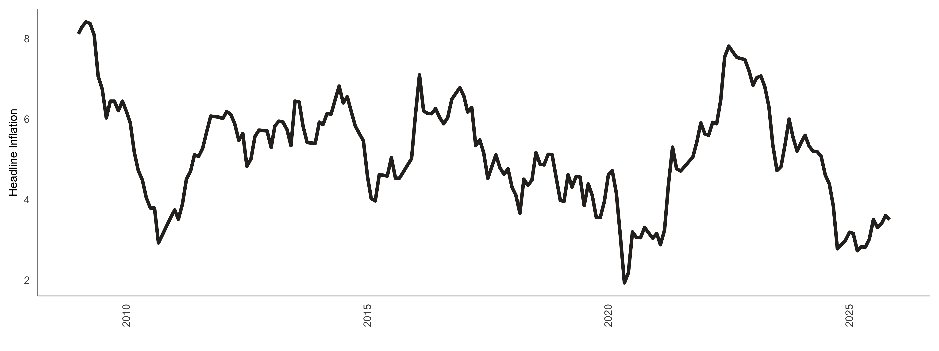
Data

Slide 16
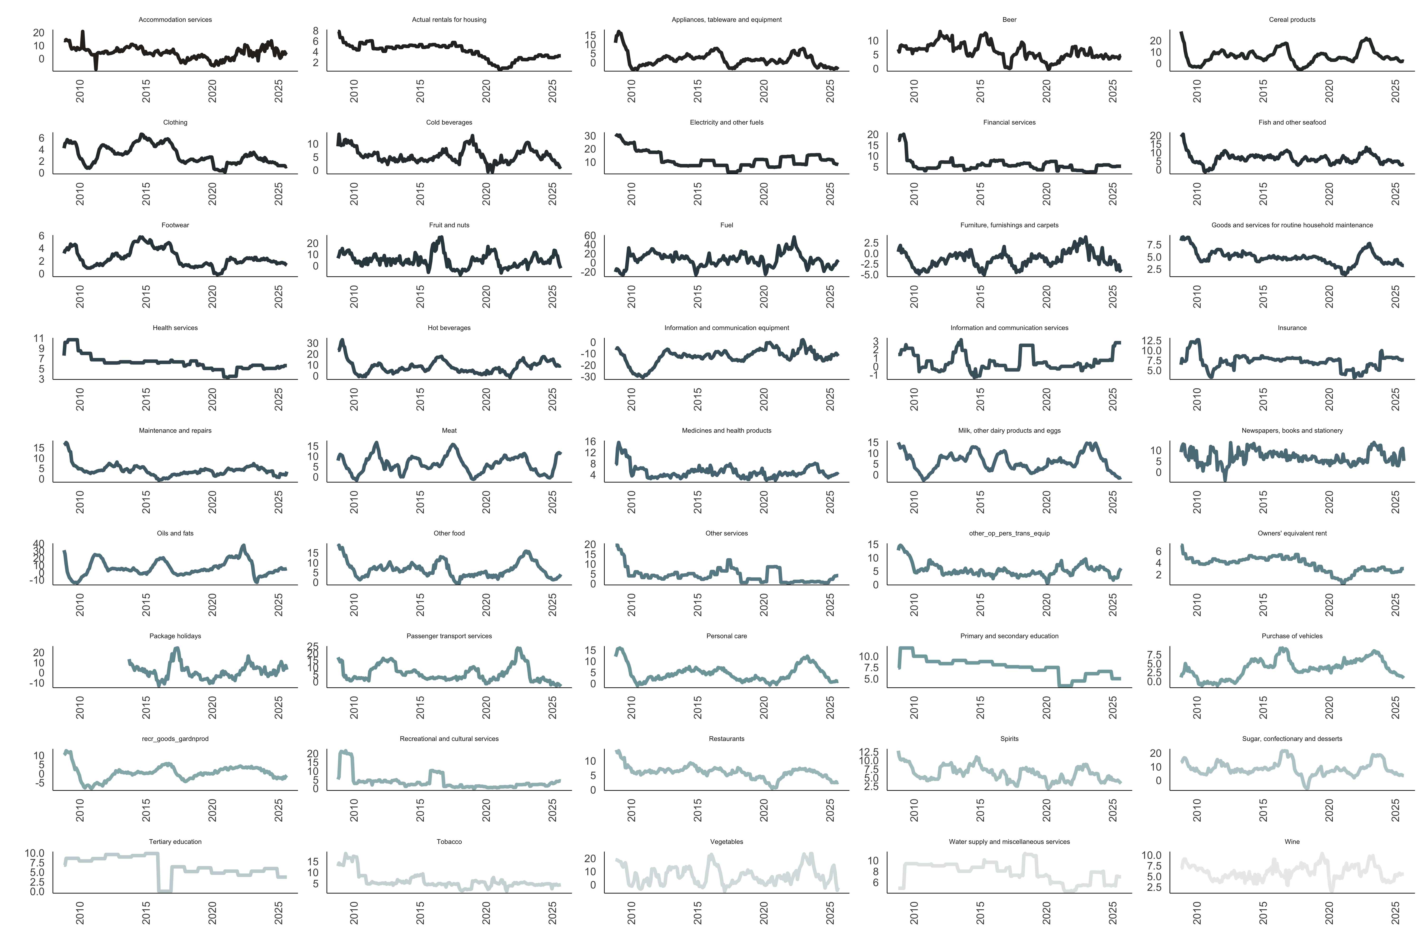
Data

Slide 17
Methodology
RPD is calculated in line with Lach and Tsiddon (1992) as the weighted standard deviation of individual price inflation rates from the aggregate inflation rate. The RPD is essentially the variability of relative prices of a given product. - We first calculate the monthly inflation rate as follows:
$$π_{i,t}=ln\left(\frac{P_{i,t}}{P_{i,t−1}}\right)*100, \left(8\right)$$
$π_{i,t}$ is the inflation rate of good $i$ at time $t$
$P_{i,t}$ is the price of good $i$ at time $t$
$P_{i,t−1}$ is the price of good $i$ at time $t−1$

Slide 18
Methodology
Then, the RPD is calculated as:
$$RPD_{t}=\sqrt{\sum_{i=1}^{n}{ω_{i}}{\left(π_{i,t}−π_{t}\right)}^{2}}, \left(9\right)$$
$ω_{j}$ is the expenditure share of the $j^{th}$ good,
$π_{t}$ is the headline or aggregate inflation rate at time $t$,
$\sum_{i=1}^{n}{ω_{i}}=1$.
The expenditure weights ($ω_{i}$) used are derived from the Consumer Price Index (CPI) basket provided by Stats SA

Slide 19
Methodology
To examine the relationship between inflation and RPD, we estimate the following econometric model:
$$RPD_{t}=β_{0}+β_{1}π_{t}+\sum_{h=1}^{3}{ω_{h}}RPD_{t−h}+μ_{t}, \left(10\right)$$
$RPD_{t}$ is the relative price variance at time $t$
$π_{t}$ is the aggregate inflation rate at time $t$
$RPD_{t−h}$ are lagged values of RPD to account for its dynamic nature, and $μ_{t}$ is the error term
The coefficient $β_{1}$ captures the effect of inflation on RPD. We include three lags of RPD based on Akaike Information Criterion (AIC) (and other tests) and to capture potential persistence in RPD.
For robustness, we repeat this estimation using core inflation (excluding food and non-alcoholic beverages, and fuel and electricity) instead of headline inflation to account for the potential volatility in these components.

Slide 20
Methodology
The literature on RPD emphasises that the relationship between inflation and RPD maybe time-varying due to structural changes in the economy, monetary policy regimes, and other factors. To capture potential time variation in the relationship, we also estimate a rolling regression model with a 24-month and 60-month windows as follows:
$$RPD_{t}=α_{t}+β_{1,t}π_{t}+\sum_{h=1}^{3}{ω_{h,t}}RPD_{t−h}+μ_{t}, \left(11\right)$$
The coefficients $α_{t}$, $β_{1,t}$, and $ω_{h,t}$ vary over time.
This approach allows us to observe the stability of the coefficients over time, which is an indicator of non-linearity in the relationship between RPD and inflation.

Slide 21
Methodology
Next, we utilise a semi-parametric or partially linear approach to estimate the optimal level of inflation given the RPD. This approach allows us to model the relationship between inflation and RPD without imposing a strict functional form. Following the literature, we first specify a quadratic (U-shaped) relationship between inflation and RPD as follows:
$$RPD_{t}=α+π_{t}+β_{2}π_{t}^{2}+\sum_{h=1}^{3}{ϕ_{h}}RPD_{t−h}+ϵ_{t}, \left(12\right)$$
$β_{2}$ captures the curvature of the relationship between inflation and RPD
The optimal inflation rate that minimizes RPD can be derived by taking the first derivative of the equation with respect to $π_{t}$ and setting it to zero, yielding:
$$π_{t}^{*}=−\frac{1}{2β_{2}}. \left(13\right)$$

Slide 22
Methodology
To estimate this optimal inflation we implement a semi-parametric approach as follows:
$$RPD_{t}=f\left(π_{t}\right)+\sum_{h=1}^{3}{ϕ_{h}}RPD_{t−h}+ϵ_{t}, \left(14\right)$$
$f\left(π_{t}\right)$ is a non-linear smooth differentiable function of inflation and the RPD.
Therefore, the optimal inflation rate can be obtained by finding the minimum of the estimated $f\left(π_{t}\right)$ function. $f\left(π_{t}\right)$ is estimated in two stages.

Slide 23
Methodology
First we estimate $λ_{h}$ as follows:
$$RPD_{t}=\sum_{h=1}^{3}{λ_{h}}{\overline{RPD}}_{t−h}+η_{t}, \left(15\right)$$
${\overline{RPD}}_{t−h}$ are the residuals from a non-parametric regression of each lag of $RPD_{t}$ on $π_{t}$
In the second stage, we estimate $f\left(π_{t}\right)$ non-parametrically as follows:
$${\hat{η}}_{t}=f\left(π_{t}\right)+v_{t}, \left(16\right)$$
${\hat{η}}_{t}$ are the residuals from Equation 15
$f\left(π_{t}\right)$ is estimated using a kernel regression method
The bandwidth ($h$) for the kernel estimator is selected using cross-validation to minimize the mean squared error.

Slide 24
Methodology
As a treatment for extreme values of inflation, we further implement the unbounded Gaussian kernel and the outlier-robust Epanechnikov kernel.
In essence, the semi-parametric approach captures the sensitivity of RPD to marginal increases in inflation.
In that case, the optimal inflation rate can be obtained by finding the point where the first derivative ($f′\left(π_{t}\right)$) is equal to zero.
Therefore, if $f′\left(π_{t}\right)>0$ ($f′\left(π_{t}\right)<0$), then an increase in inflation (decrease) leads to an increase (decrease) in the RPD. For robustness we estimate the $g\left(UIN_{t}\right)$ with multiple bandwith ($h$).

Slide 25
Methodology
To further disentangle the effects of RPD on inflation, we decompose headline inflation into its expected and unexpected components. As discussed in the literature section, for example, theory suggests that inflation uncertainty has a more pronounced effect on RPD due to information frictions faced by firms when adjusting prices (Lucas 1973; Hercowitz 1981; Cukierman 1983).
We therefore estimate the following model:
$$RPD_{t}=α+β_{0}EIN_{t}+β_{1}UIN_{t}+g\left(UIN_{t}\right)+\sum_{k=1}^{3}{λ_{k}}RPD_{t−k}+ϵ_{t}, \left(17\right)$$
$EIN_{t}$ is the expected inflation rate and $UIN_{t}$ is the unexpected inflation rate
$g\left(UIN_{t}\right)$ is a non-linear function of unexpected inflation ($UIN_{t}$).
We obtain the expected using a simple moving average of headline inflation, and unexpected inflation as the standard deviation of inflation. The estimation of $g\left(UIN_{t}\right)$ follows the same two-stage semi-parametric approach outlined in Equation 15 and Equation 16. The number of lags is the same as in Equation 10.

Slide 26
Methodology
Lastly, and some-what novel to the RPD literature, we employ a quantile on quantile regression approach (Koenker 2017). Quantile on quantile regressions are robust to outliers and allows us to estimate the regime aspects of the relationship between RPD and inflation.
For brevity, we do not explain the quantile on quantile estimation procedure

Slide 27
Results

Slide 28
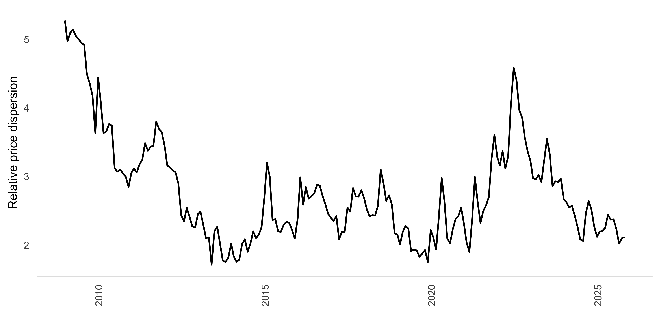
Results

Slide 29
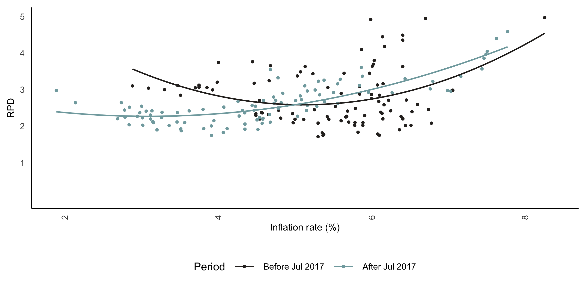
Results

Slide 30
Results
 | Full Sample | Pre 2017 | Post 2017 | Full Sample: Squared Inflation | Pre 2017: Squared Inflation | Post 2017: Squared Inflation
$$π_{t}$$ | 0.01* | 0.009 | 0.032*** | -0.046 | -0.104 | -0.033
$$π_{t}^{2}$$ |  |  |  | 0.006* | 0.011* | 0.007*
$$RPD_{t−3}$$ | 0.244*** | 0.173* | 0.248** | 0.234*** | 0.154 | 0.209**
$$RPD_{t−2}$$ | -0.382*** | -0.14 | -0.645*** | -0.363*** | -0.111 | -0.609***
$$RPD_{t−1}$$ | 1.039*** | 0.896*** | 1.116*** | 1.017*** | 0.864*** | 1.063***
$$D_{2022m8}$$ | 0.026 |  | 0.024 | -0.001 |  | -0.012
$$D_{2020m2}$$ | -0.116 |  | -0.213** | -0.106 |  | -0.205**
$$D_{2017m7}$$ | 0.156* |  |  | 0.161*
$$D_{2014m7}$$ | -0.098 | -0.087 |  | -0.105 | -0.096
$$D_{2011m12}$$ | 0.042 | 0.027 |  | 0.047 | 0.037
$$C$$ | 0.044 | 0.012 | 0.117*** | 0.184** | 0.326* | 0.304**
Note: *** = p value < 0.01, ** = 0.01 < p value < 0.05, * = 0.05 < p value < 0.1. | Note: *** = p value < 0.01, ** = 0.01 < p value < 0.05, * = 0.05 < p value < 0.1. | Note: *** = p value < 0.01, ** = 0.01 < p value < 0.05, * = 0.05 < p value < 0.1. | Note: *** = p value < 0.01, ** = 0.01 < p value < 0.05, * = 0.05 < p value < 0.1. | Note: *** = p value < 0.01, ** = 0.01 < p value < 0.05, * = 0.05 < p value < 0.1. | Note: *** = p value < 0.01, ** = 0.01 < p value < 0.05, * = 0.05 < p value < 0.1. | Note: *** = p value < 0.01, ** = 0.01 < p value < 0.05, * = 0.05 < p value < 0.1.

Slide 31
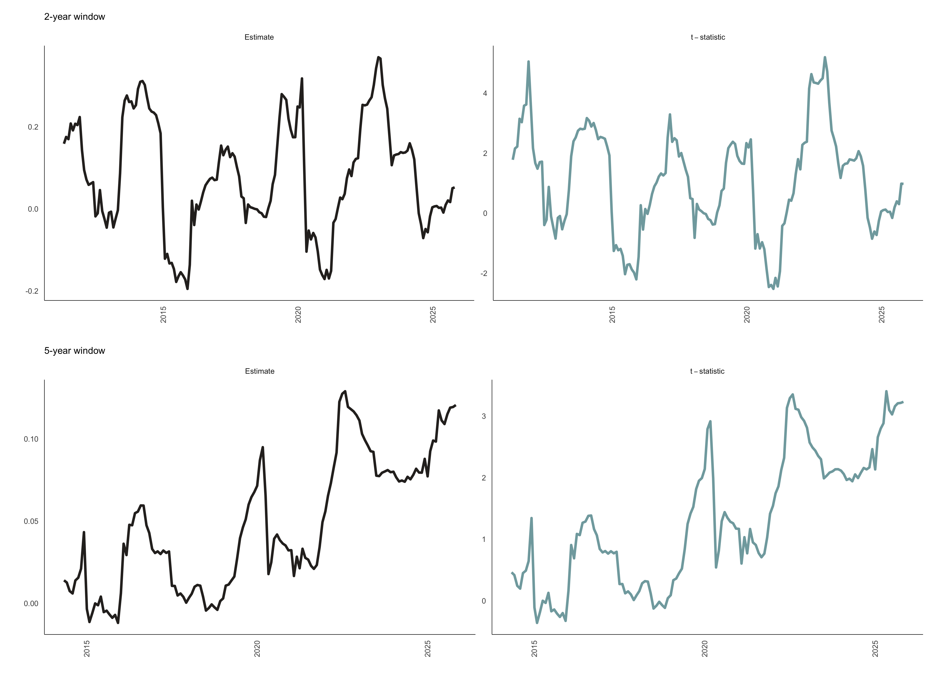
Results

Slide 32
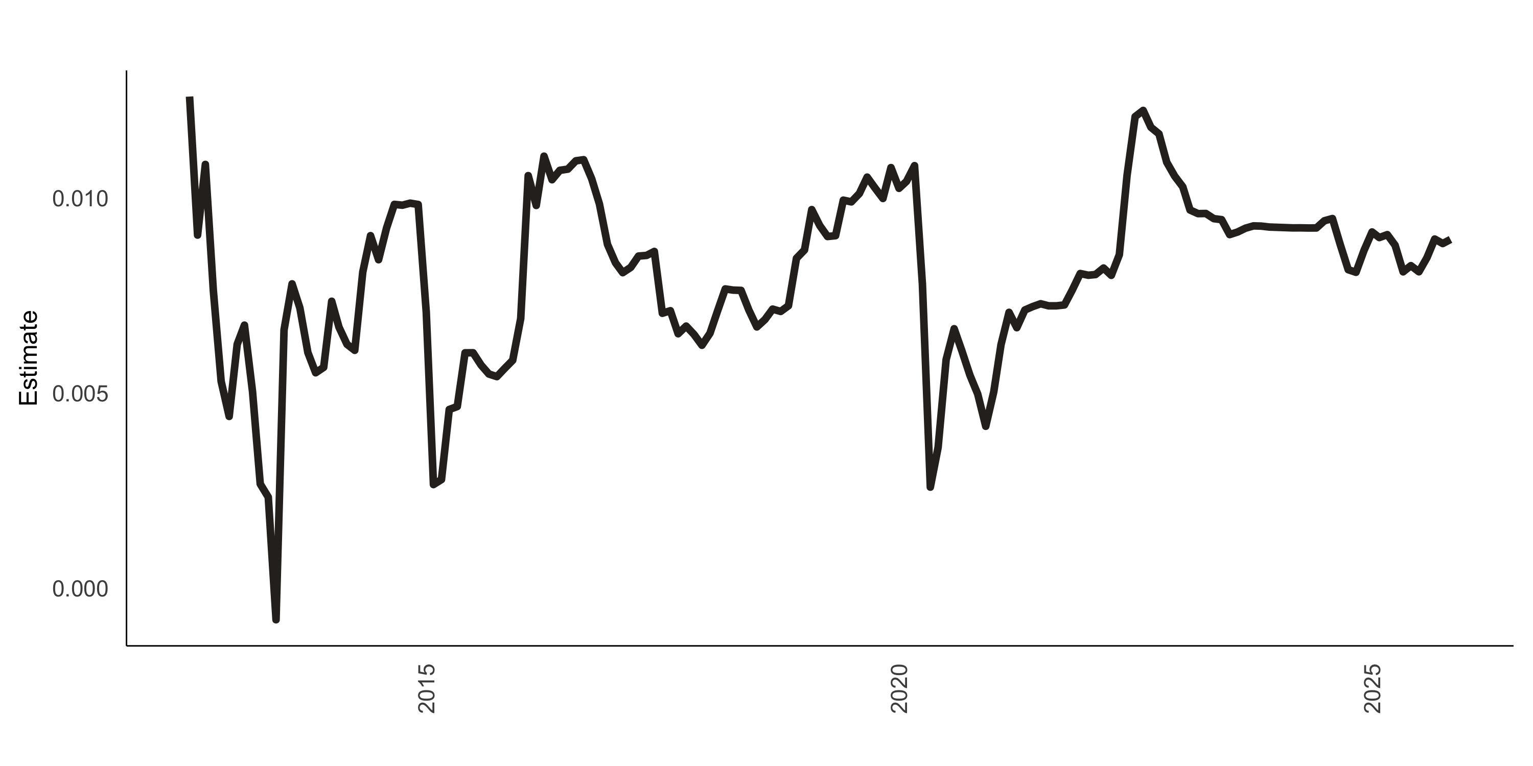
Results

Slide 33
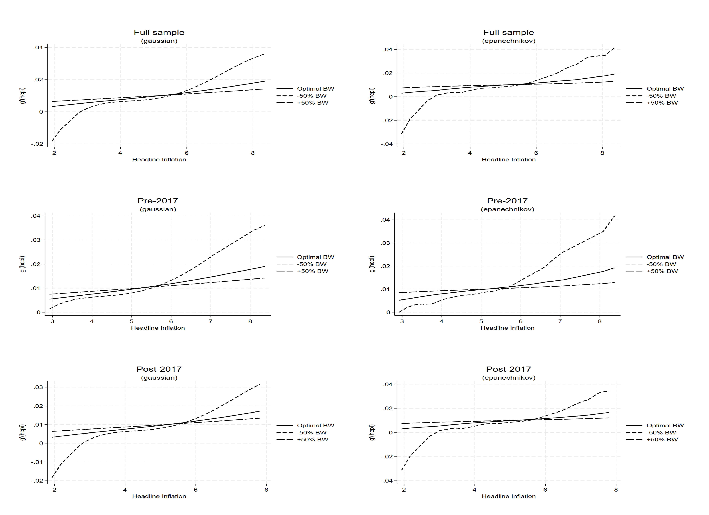
Results

Slide 34
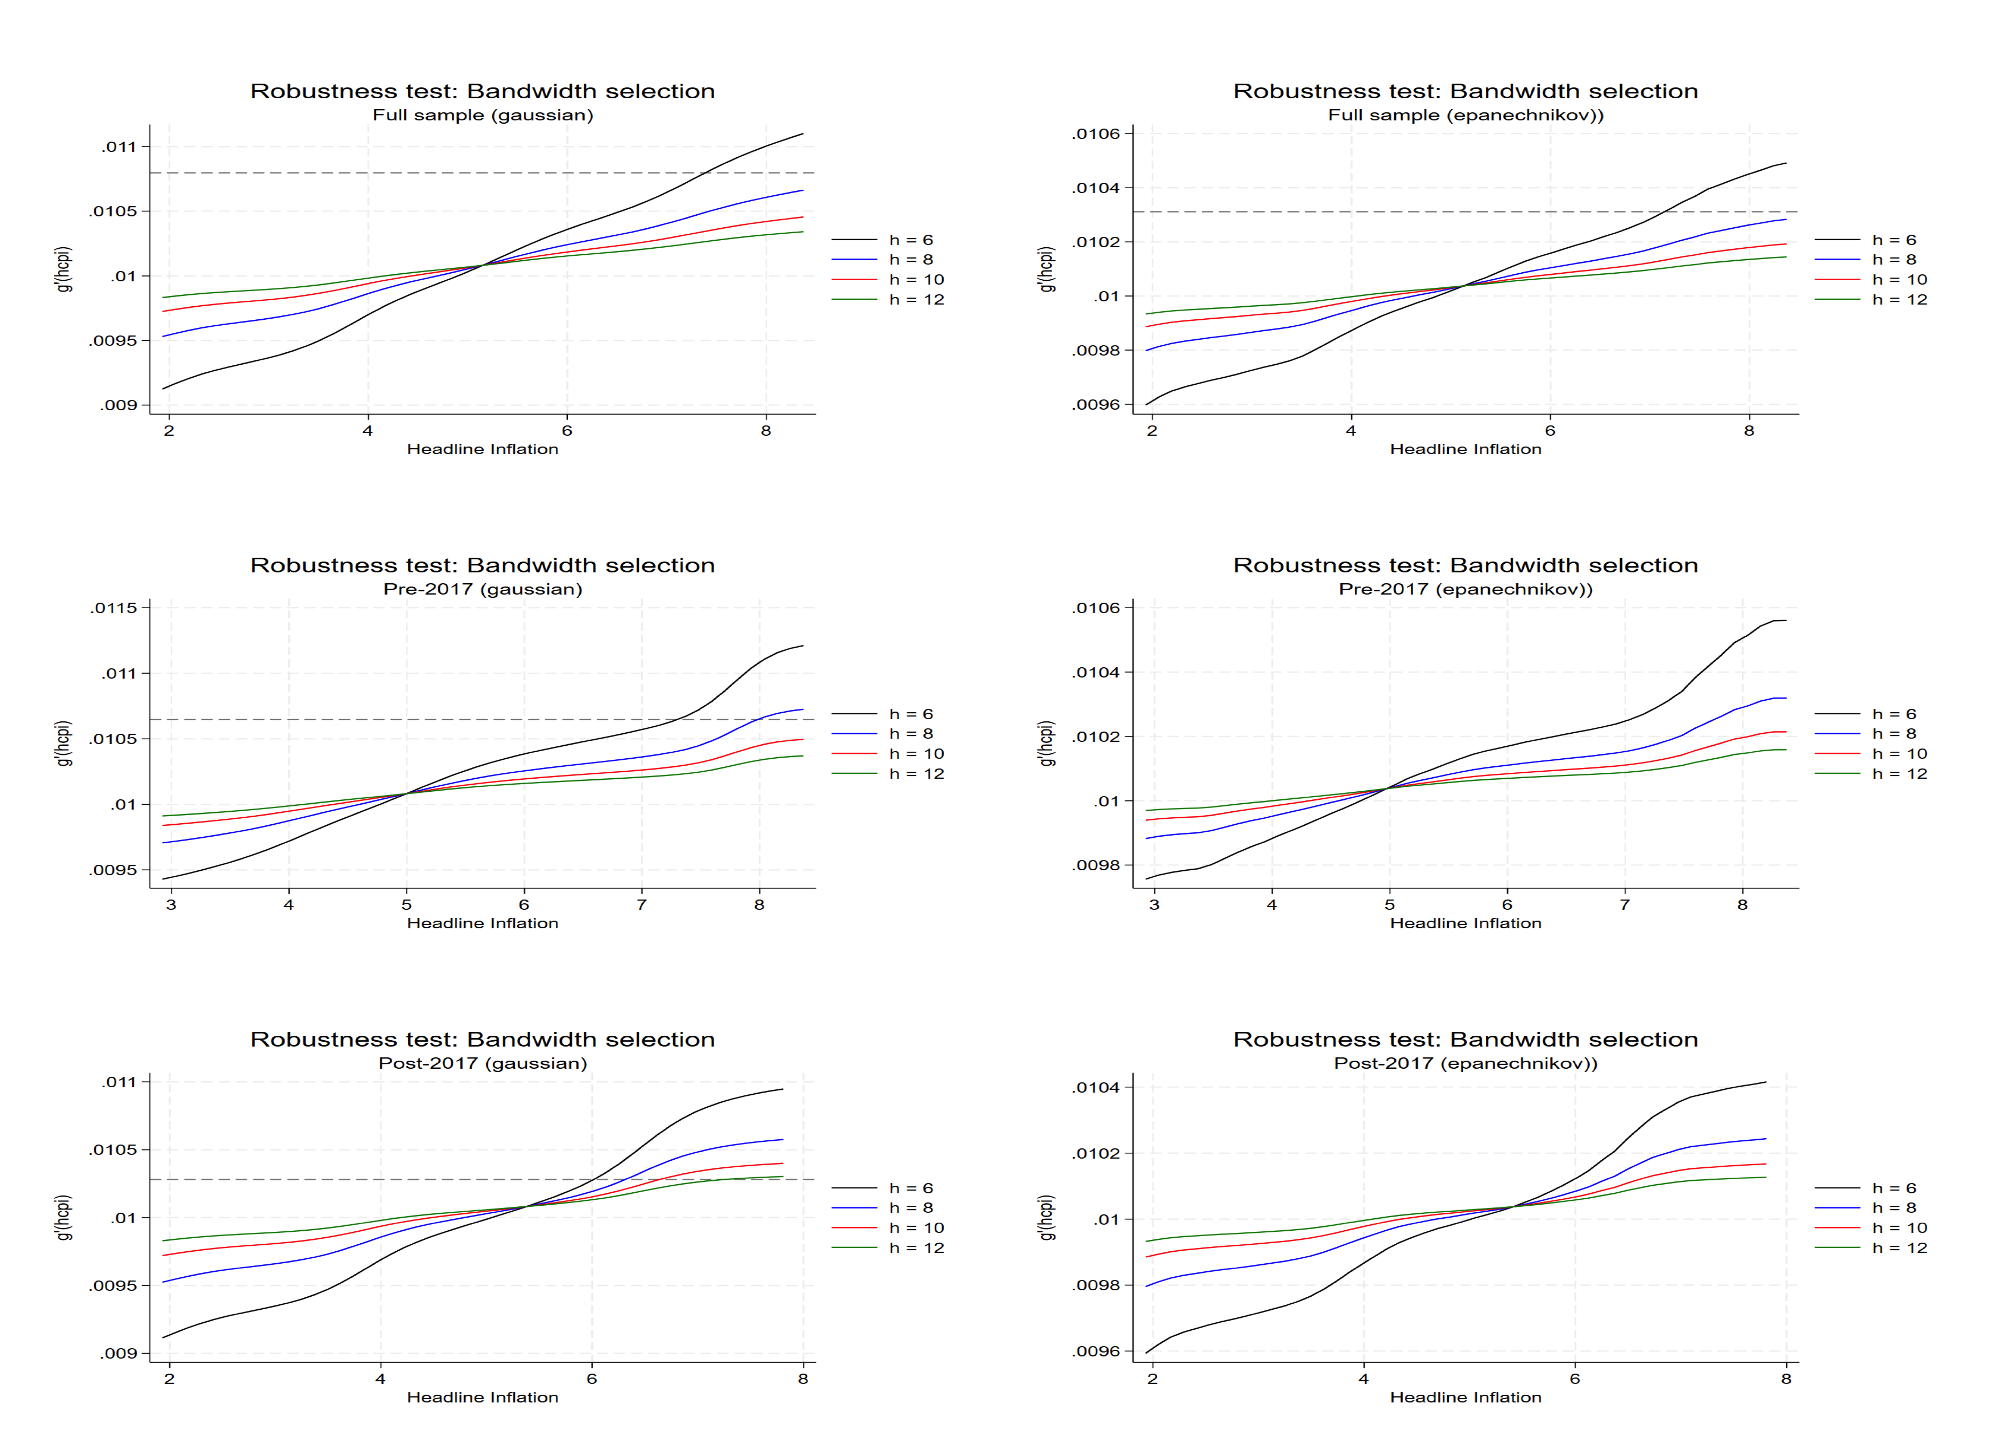
Results

Slide 35
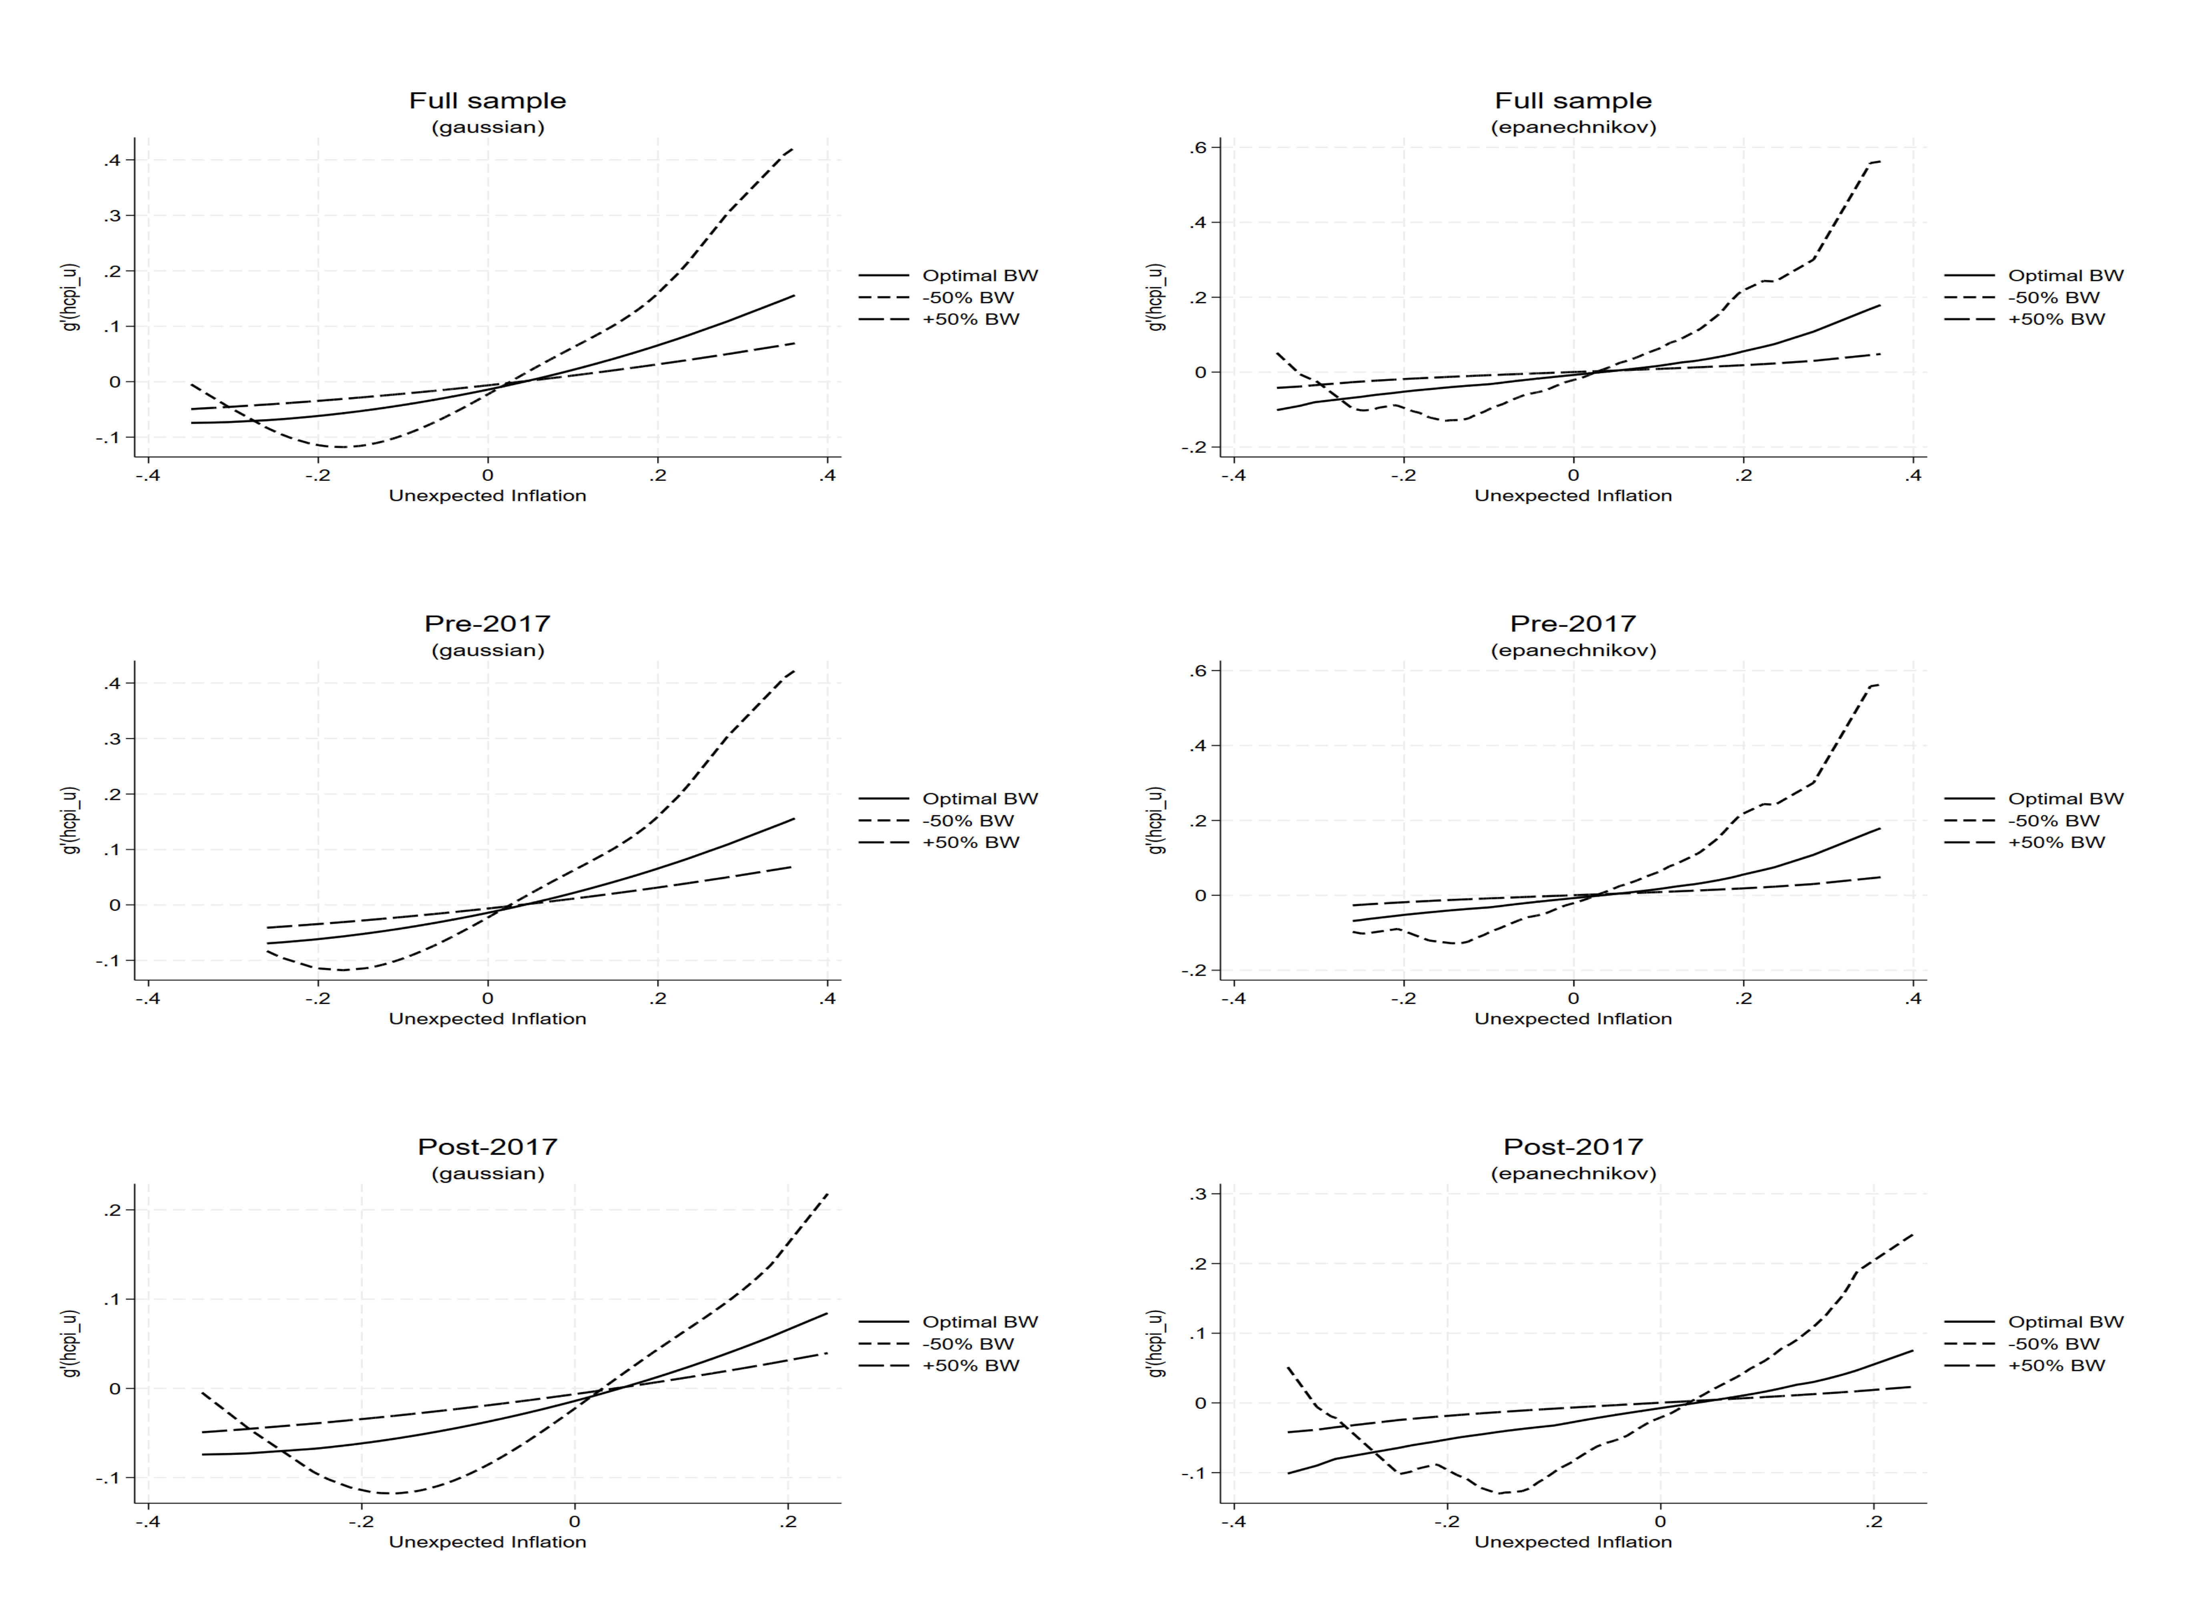
Results

Slide 36
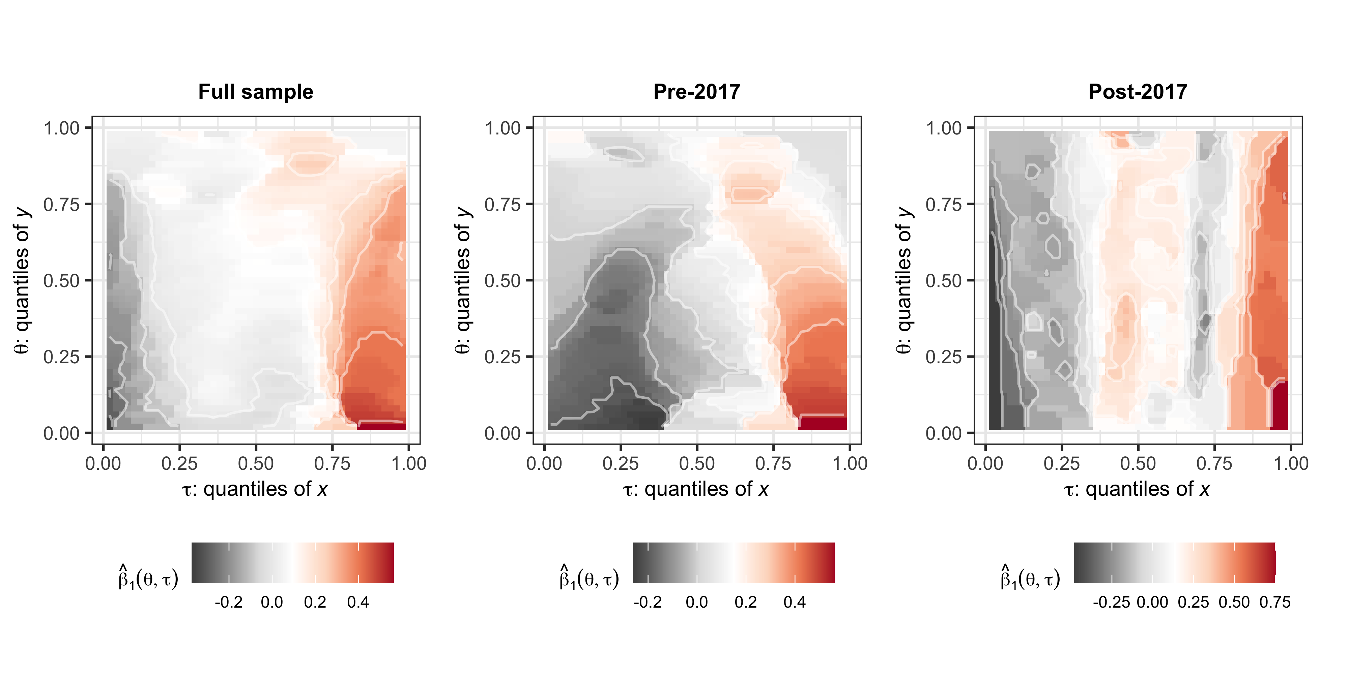
Results

Slide 37
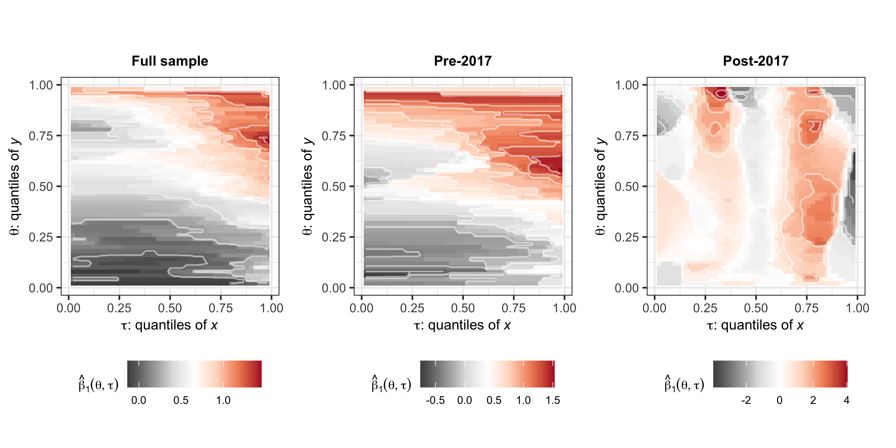
Results

Slide 38
Conclusions

Slide 39
Conclusion

Slide 40
Thank You!
Questions?

Slide 41
References
Caglayan, Mustafa, and Alpay Filiztekin. 2003. “Nonlinear Impact of Inflation on Relative Price Variability.” Economics Letters 79 (2): 213–18.
Choi, Chi-Young. 2010. “Reconsidering the Relationship Between Inflation and Relative Price Variability.” Journal of Money, Credit and Banking 42 (5): 769–98. https://doi.org/10.1111/j.1538-4616.2010.00307.x.
Cukierman, Alex. 1983. “Relative Price Variability and Inflation: A Survey and Further Results.” In Carnegie-Rochester Conference Series on Public Policy, 19:103–57. Elsevier.
Fielding, David, and Paul Mizen. 2000. “Relative Price Variability and Inflation in Europe.” Economica 67 (265): 57–78. https://doi.org/10.1111/1468-0335.00195.
Head, Allen, and Alok Kumar. 2005. “Price Dispersion, Inflation, and Welfare.” International Economic Review 46 (2): 533–72. https://doi.org/10.1111/j.1468-2354.2005.00333.x.
Hercowitz, Zvi. 1981. “Money and the Dispersion of Relative Prices.” Journal of Political Economy 89 (2): 328–56. https://doi.org/10.1086/260968.
Koenker, Roger. 2017. “Quantile Regression: 40 Years On.” Annual Review of Economics 9 (1): 155–76. https://doi.org/10.1146/annurev-economics-063016-103651.
Lach, Saul, and Daniel Tsiddon. 1992. “The Behavior of Prices and Inflation: An Empirical Analysis of Disaggregat Price Data.” Journal of Political Economy 100 (2): 349–89. https://doi.org/10.1086/261821.
Lucas, Robert E. 1973. “Some International Evidence on Output-Inflation Tradeoffs.” The American Economic Review 63 (3): 326–34. https://www.jstor.org/stable/1914364.

Slide 42
Notes
1. The data is available at: http://www.statssa.gov.za/ and the data was seasonally adjusted.

