Slide 1
Integration with the SDLC
Brandon Spruth – Sr. Security Analyst, Morningstar
Jeremy Brooks – WebInspect Engineering

Slide 2
Agenda
Mission with a Problem
Where to start?
Tipping the scales in our direction
Making it work for you!
Demos

Slide 3
Your Mission if you choose to accept it!
Develop an application security automation program to assist software development teams with iterative application security testing.

Slide 4

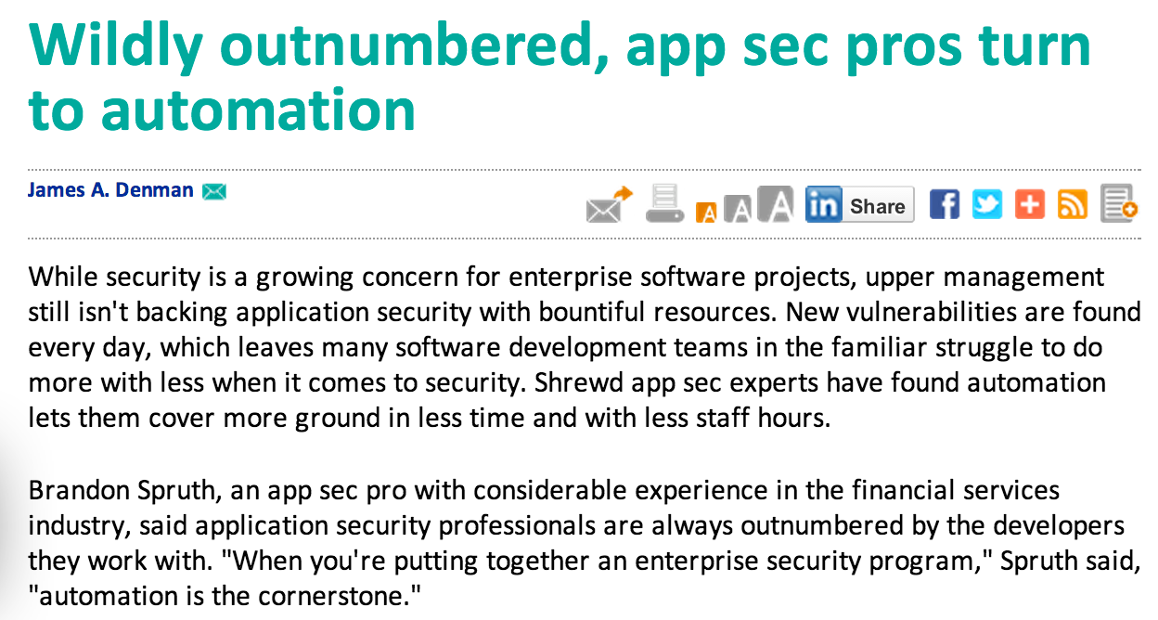
We have a problem … Houston!
Hundreds to thousands of developers
Too many applications with systemic issues
There is not enough qualified application security professionals.

Slide 5
There are only solutions!
Self service model for Developers and QA to build more secure applications
Iterative and collaborative security testing
Effective at identifying Data-Handling and Code Quality vulnerabilities
Enumerates vulnerabilities better than manual assessments.

Slide 6




Application Security Automation Stack
DAST & SAST Management Portal | Dynamic Automation Testing (DAST) | Static Automation Testing (SAST) | Continuous Integration

Slide 7
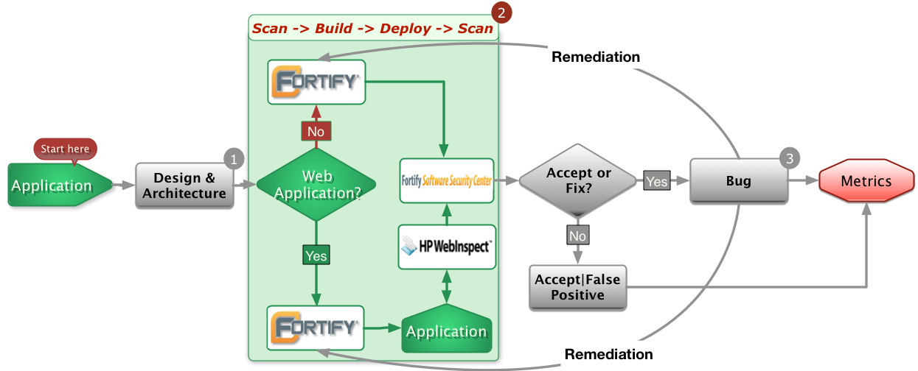
The Holy Grail of Application Security Automation

Slide 8
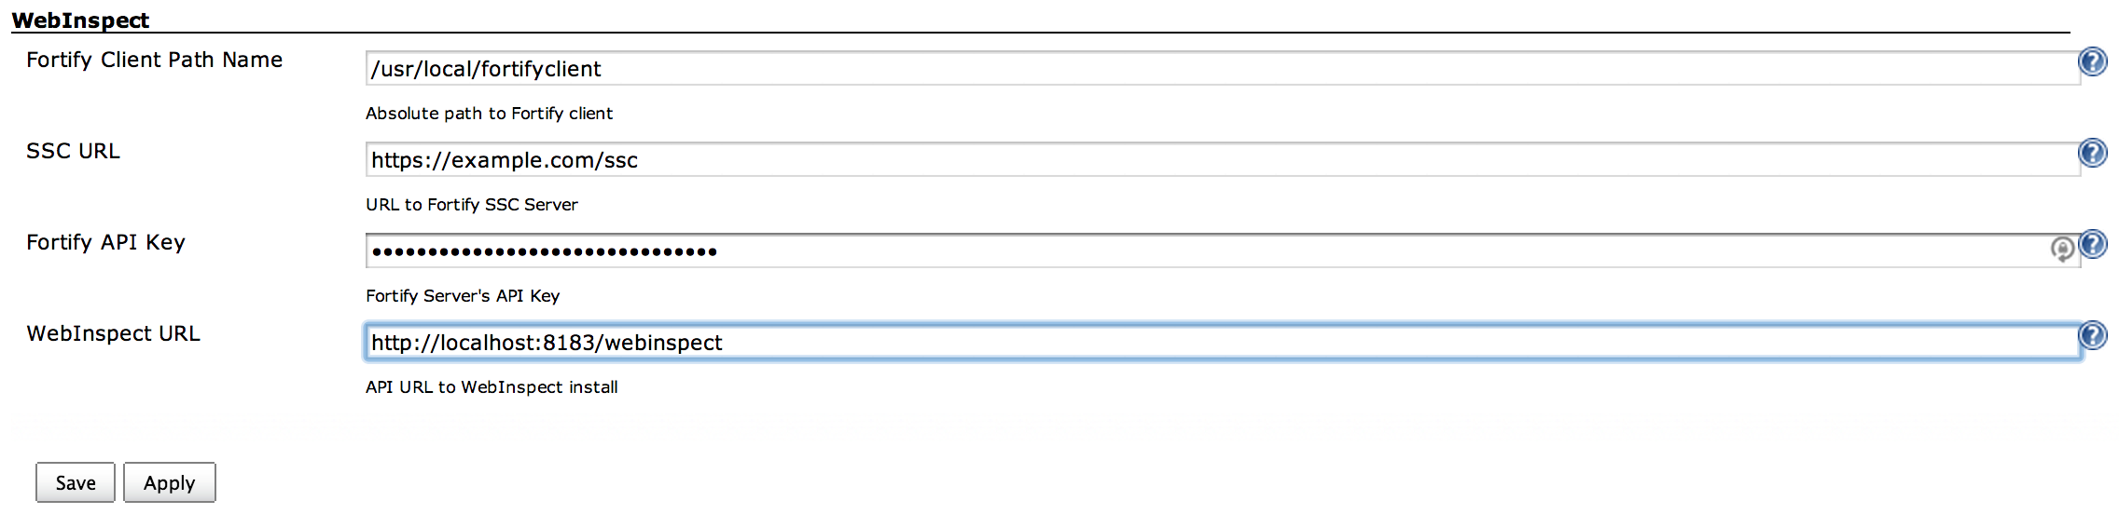
Configuring WebInspect with Jenkins

Slide 9
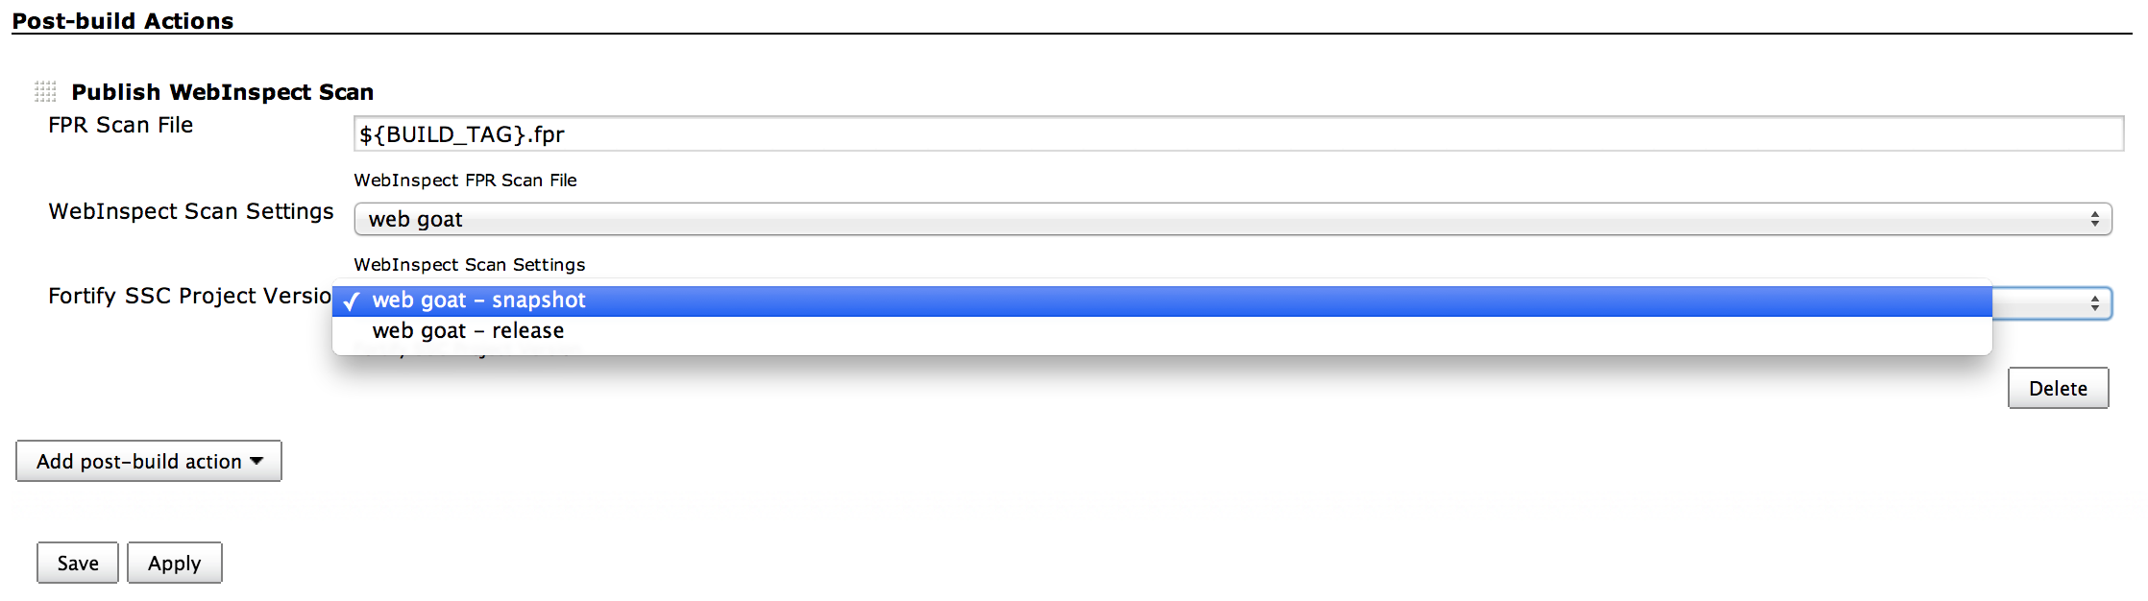
Configuring your WebInspect Scan in Jenkins

Slide 10
Demo

