Slide 1
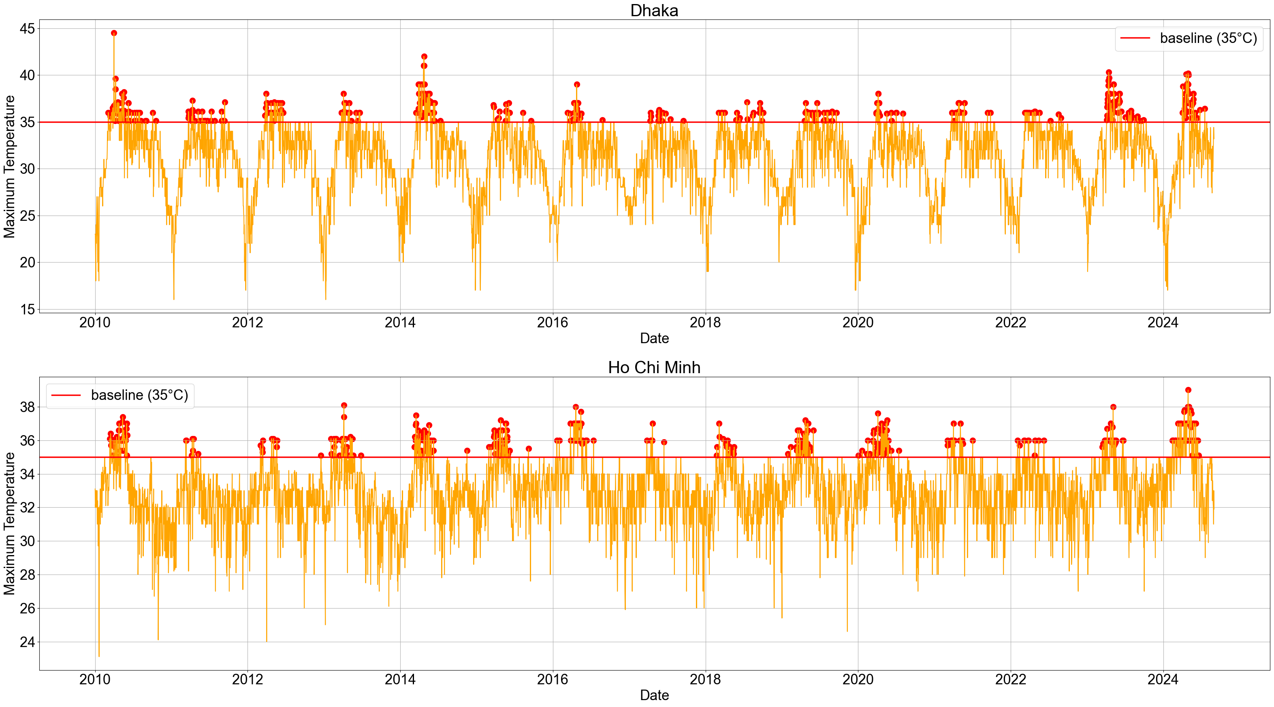

Slide 2
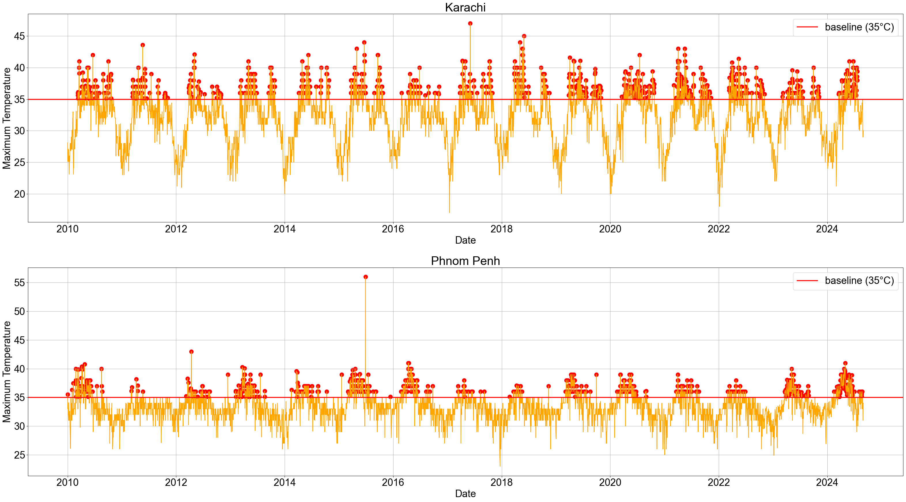

Slide 3
Historical temperature and heat wave demonstrations
Display: Daily maximum temperatures (y-axis) over the past 15 years: 2010/01/01~2024/08/31 (x-axis), with heat wave pinpointed.
Features: Each plot includes 2 subplots, each consists of orange lines as historical temperature trends, a red line at 35°C as the heat wave threshold, and red dots as heat waves, defined as 3 or more consecutive days with daily maximum temperatures above the thresholds.
Focus:
Height of red dots clusters: Indicate the overall temperature above the baseline, suggesting the extremeness of heat conditions.
Number of red dots clusters: Indicate the number of heat waves, suggesting the frequency and seasonal patterns of heat waves.
Density of each red dots clusters: Indicate the duration of each heat wave, suggesting prolonged heat wave conditions.

