Slide 1
Canada Revenue Agency IT Branch
CJ Vergel
Notes:
Good afternoon, everyone… I’m willing to bet most of you have either dealt with the CRA or heard of them to some extent… or got a scam call from someone pretending to be from the CRA. Most people complain about having to pay the CRA… but what if you could take money from them? As taxable income of course.

Slide 2

Agenda
CRA’s History
IT Branch
CRA Today
Benefits
I.T.A.P.
Notes:
Today we’ll be going over some things you might not have known about the CRA like their history, what their IT branch does, what they’re like as an employer these days, the benefits of working for them, and the Information Technology Apprenticeship Program.

Slide 3
History of CRA
In 1999, Canada Customs and Revenue Agency (CCRA) established
In 2003, split from Canada Border Services and formed CRA
Oversee tax assessment & collection
Provide info on tax system and benefit programs
Notes:
A bit of background on the government agency…
In 1999, the Canada Customs and Revenue Agency (CCRA) was established from what was previously known as the Department of National Revenue.
In 2003, the Canada Revenue Agency was formed after splitting from the Border Services Agency.
They’ve been responsible for overseeing the assessment and collection of taxes, while keeping Canadians informed about the tax system and its various benefit programs.

Slide 4
IT Branch
Protection of confidential information and systems network
Maintain a steady flow of information between departments
Working with employees and management to help solve technical issues
Integration of newest tech developments
Notes:
The CRA have many departments, but today we will focus on the IT branch.
All sensitive information handled within the agency must be kept safe, so it is important for the IT branch to ensure the information and systems network is protected.
They are also responsible for keeping things running smoothly through the different departments. And since they’re so reliant on thousands of computers, there’s bound to be some technical issues. They are also the ones helping those who might not know how to troubleshoot like employees and management. And lastly, with tech constantly evolving, it is their job to make sure the workplace is kept up to date.

Slide 5
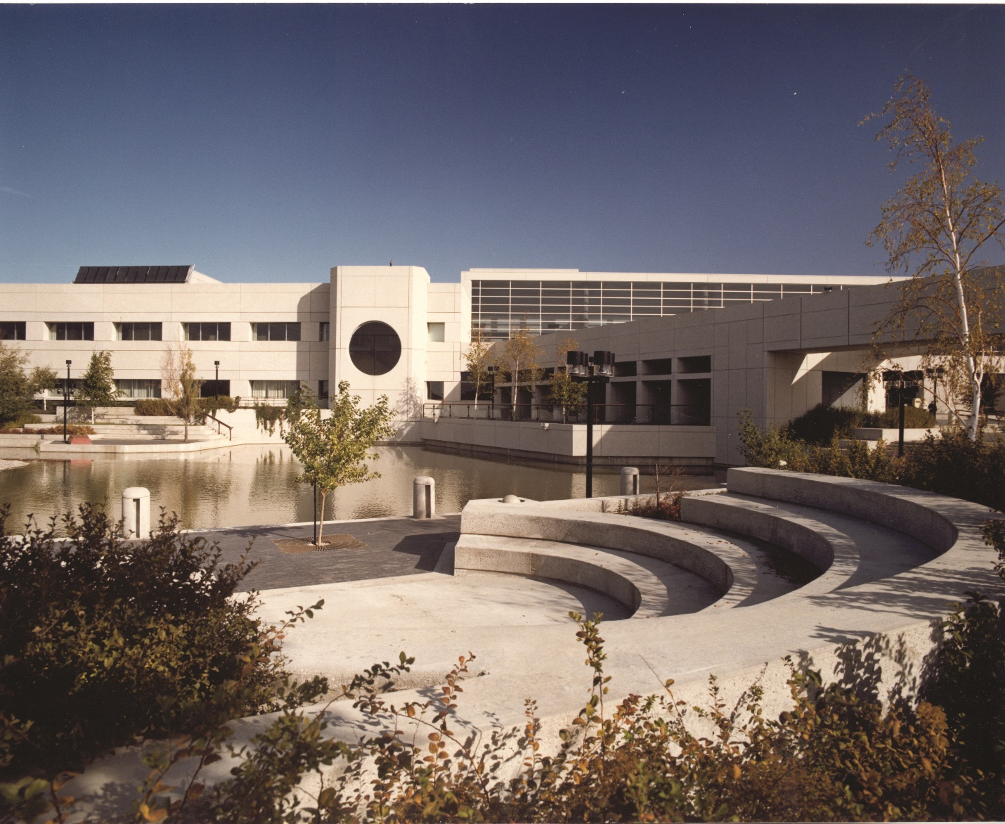
CRA Today
One of Canada’s Top 100 Employers
45,000+ currently employed
3,000+ in Winnipeg
Supports a diverse and inclusive workforce
Notes:
The media paints a negative image of the CRA, but they shouldn’t be overlooked as an employer.
They are currently listed as one of Canada’s Top 100 Employers.
These days they have over 45,000 people working for them, and over 3,000 working in Winnipeg.
And as employers they promote a diverse and inclusive work environment.

Slide 6

Benefits
Work-from-home accommodations
Bilingual bonus
Flexible work schedule arrangements
Public Service Health Care Plan
Notes:
Working for them can provide many benefits.
Due to the ongoing pandemic, they are supportive of work-from-home setups.
They provide a bilingual bonus for those who can speak French
And they can adjust your schedule to fit your lifestyle as they prioritize employee wellness.
They also provide health coverage through the Public Service Health Care Plan.

Slide 7
Information Technology Apprenticeship Program
I.T.A.P.
12-month recruitment program that allows eligible graduates to be hired into an entry-level position guided by experienced staff.
Notes:
I encourage BIT program graduates to look to the I.T.A.P. to try to get their foot in the door.
The I.T.A.P. is a 12-month recruitment program that will allow BIT graduates to obtain an entry level position while under the supervision of experienced staff.
You can find more about the program and when it might be opening on the CRA careers website.
Thank you for listening! And hopefully, your view of the CRA isn’t as bad as it was before.

Slide 8
Sources
https://www.canada.ca/en/revenue-agency/corporate/about-canada-revenue-agency-cra/ministerial-transition-2019/booktwo.html#toc32
GC InfoBase - Infographic for Canada Revenue Agency (tbs-sct.gc.ca)
Remaking the public service: After a year of COVID, what has the federal government learned about how it operates? - ProQuest (rrc.mb.ca)
Careers at the CRA – 1. Why work with us - Canada.ca
Information Technology Apprenticeship Program (ITAP) - Canada.ca
https://www.pxfuel.com/en/free-photo-oblhj
RTC0011.jpg (4200×3440) (winnipegarchitecture.ca)
https://pxhere.com/en/photo/689275?utm_content=shareClip&utm_medium=referral&utm_source=pxhere

