Slide 1
CGI.com
Style Guide

Slide 2
Colours
Cherry #E31937
Beet #991F3D
Pumpkin #FF6A00
Honey #F2A200
Cloud #A5ACB0
Ice # A1C4D0
Main text colour #333

Slide 3

Header & Footer styling
a 12px #666666 a:hover #E31937
#site-slogan 13px #000000
Input 10px #999999
Uppercase
H2 17px #ffffff
a #FFFFFF uppercase
a:hover #FFD8A6
14px #FFF uppercase
11px #ffffff
11px #FF9900 bold
a 11px #ffffff
a:hover #ffdba6

Slide 4

Navigation styling
12px #991f3d uppercase
#333
12px #ffffff

Slide 5

Homepage slider styling
360x119
740x360
Notes:
5

Slide 6

Landing page styling
#991F3D uppercase 13px

Slide 7
Content page styling
.nolink 11px #333333
a.active 11px #E31937
a 11px #991F3D
a:hover 11px #E31937
H3 arial-black 18px #333333
H1 20px #991F3D
H2 arial-black 24px #333333
p #333333 14px
H3 bold 16px #991F3D
H4 bold 13px #E31937
.first a 11px #991F3D
a #991F3D a:hover underline
p #333333 13px

Slide 8
Small masthead styling
Standard banner 1280x150
http://www.cgi.com/en/sites/cgi.com/themes/cgi/images/bck-nav-grey.png

Slide 9
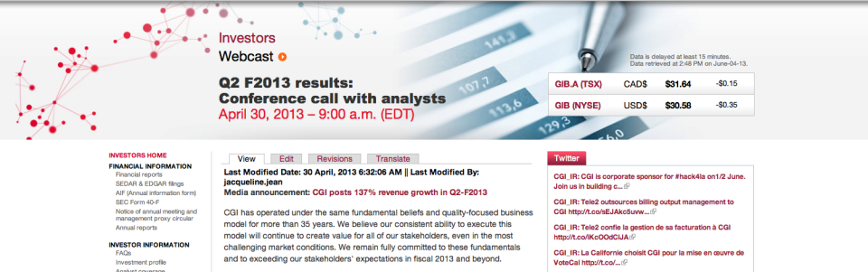
High masthead styling
http://www.cgi.com/en/sites/cgi.com/themes/cgi/images/bck-nav-grey.png
Bg colour #cccccc
Special banner 1440x240

Slide 10

Sidebar images styling
Image in left or right menu max 150px wide

