Slide 1
Front End Engineering-I Project
Student-Details:
Vishwas Chaurasia(2310992482)
Faculty :
Dr.Mohammad Shuaib Khan
:
Chitkara University Institute of Engineering and Technology,
Chitkara University, Punjab

Slide 2
Table of Contents:
Introduction
Problem Statement
Technical Details
Key Features
Project Highlights
Conclusion
Reference

Slide 3
Introduction:
Title of the Project: Portfolio Site
Team Members:
Vishwas Chaurasia(2310992482)
In the dynamic landscape of today's digital age, a personal portfolio serves as a powerful tool to showcase your skills, projects, and accomplishments. Whether you are a developer, designer, or a professional in any field, having an online presence is crucial for establishing your identity and making a lasting impression.

Slide 4

Problem Statement:
The primary challenge lies in crafting a portfolio that not only encapsulates the individual's expertise but also ensures an optimal user experience across desktops, tablets, and mobile devices. Traditional static portfolios often fall short in meeting these requirements, leading to a potential disconnect between the portfolio owner and their audience.

Slide 5
Technical Details:
Portfolio site is implemented using the following steps:
Step 1: Creating the HTML structure. The HTML code includes a form with various input fields for the username, email , a submit button etc. And a other file also includes a code for a portfolio.
Step 2: Styling the page with CSS. The CSS code is used to style the form, including the input fields, submit button, and div container. And used for styling the portfolio.

Slide 6
Key Features:
1. Responsive Design: In today's mobile-centric world, a responsive design is imperative. Learn how to use Python and its web frameworks to create a portfolio that looks great on any device, be it a desktop, tablet, or smartphone.
2. Dynamic Content: With Python's backend capabilities, we'll explore how to dynamically update your portfolio with new projects, skills, or achievements without manually editing the HTML files. This ensures that your portfolio is always up-to-date with your latest work.
3. Database Integration: Dive into the world of databases with Python and learn how to integrate one into your portfolio. This enables efficient data management, making it easier to handle and organize your projects, skills, and other relevant information.
4. Authentication and Security: Explore how to implement user authentication to secure your portfolio. You'll learn techniques to protect sensitive information and control access to certain sections of your portfolio.

Slide 7
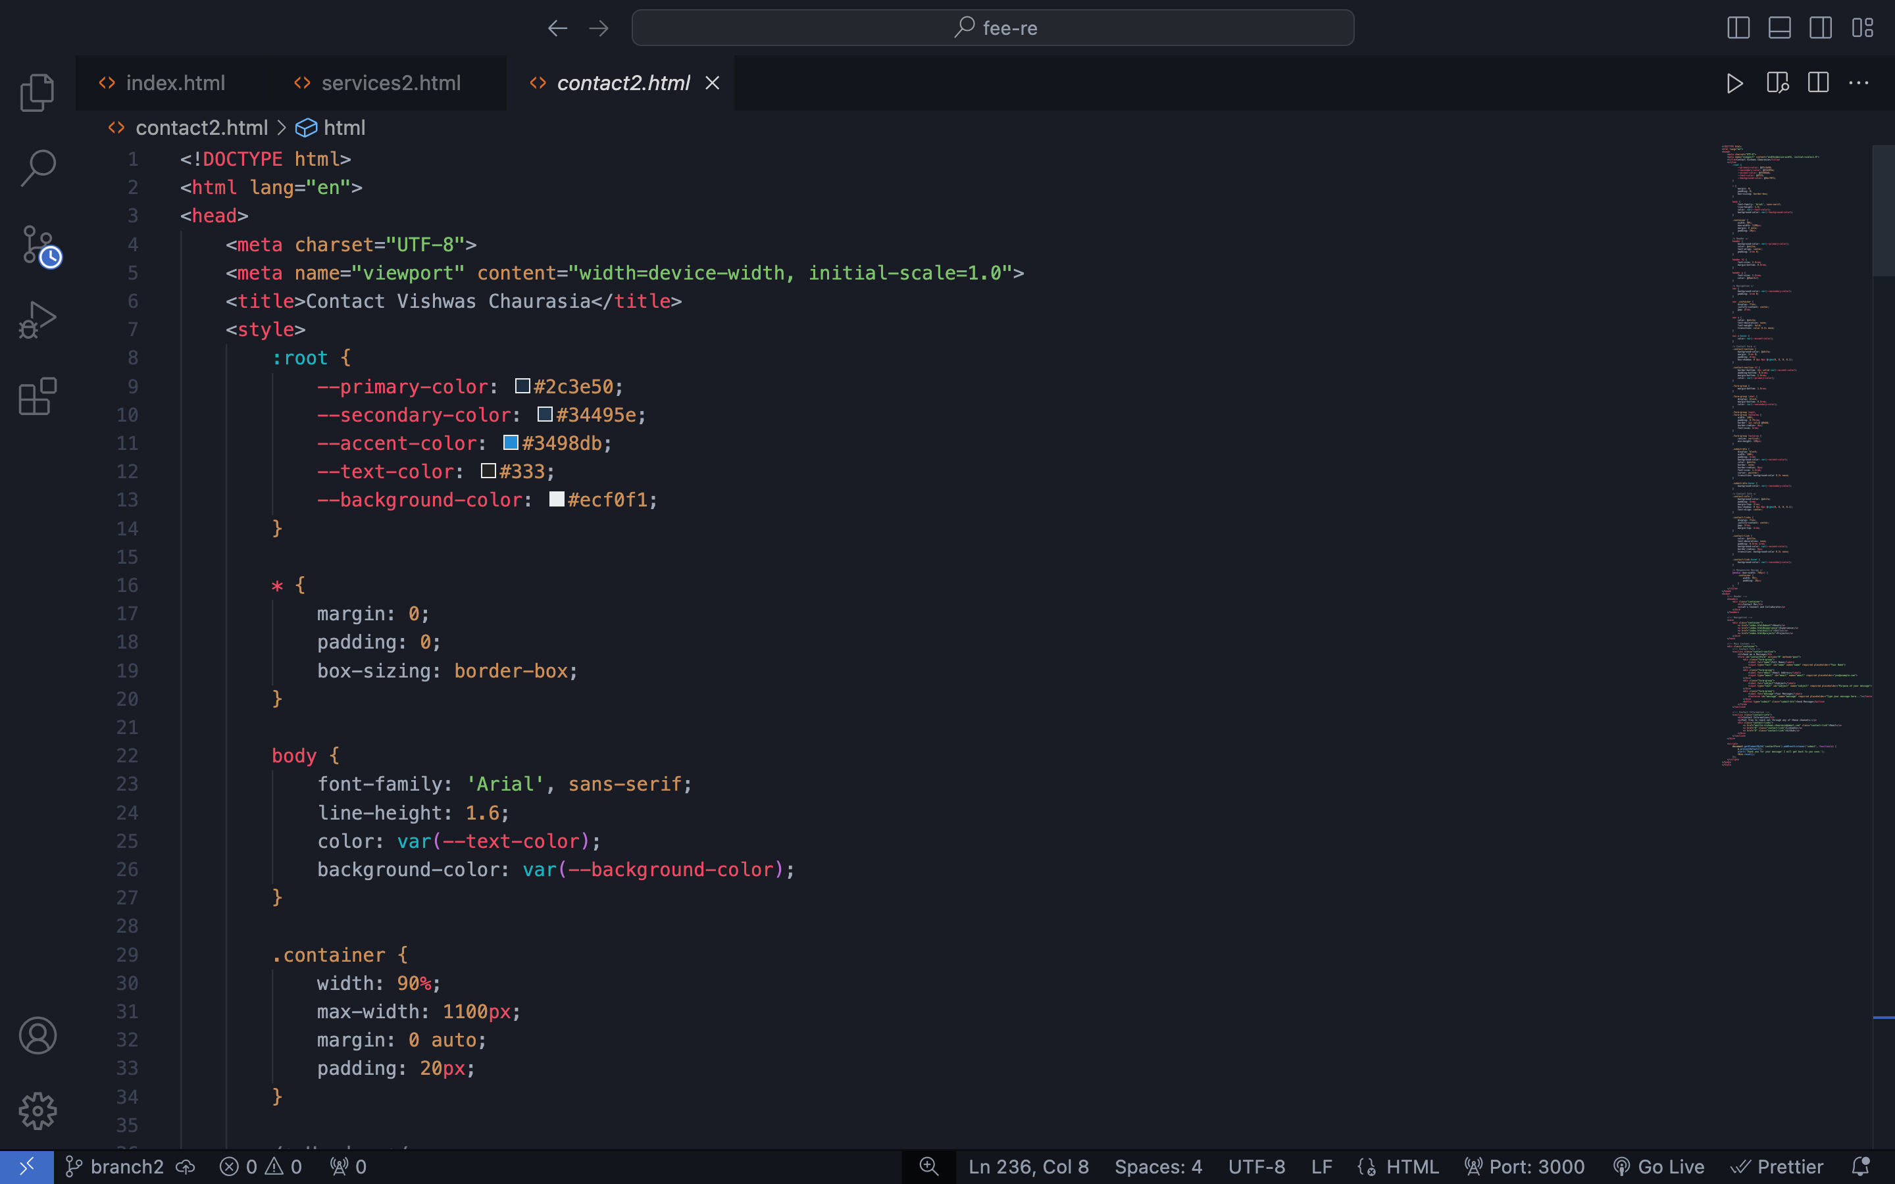
Project Highlights:

Slide 8
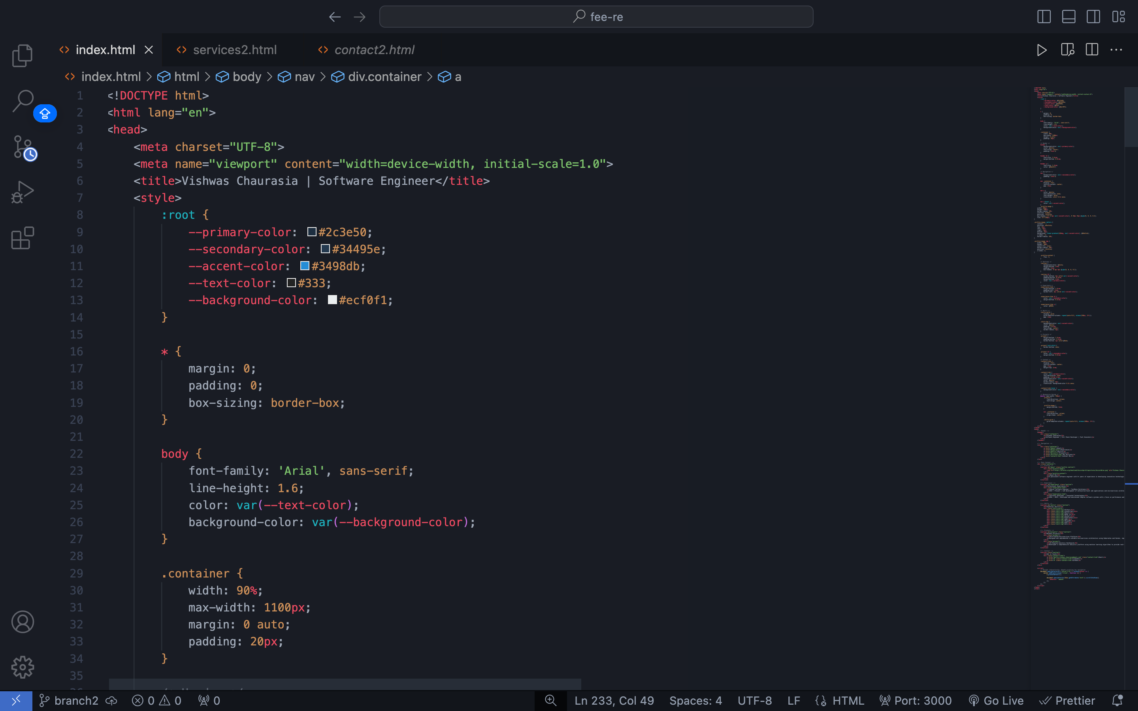

Slide 9
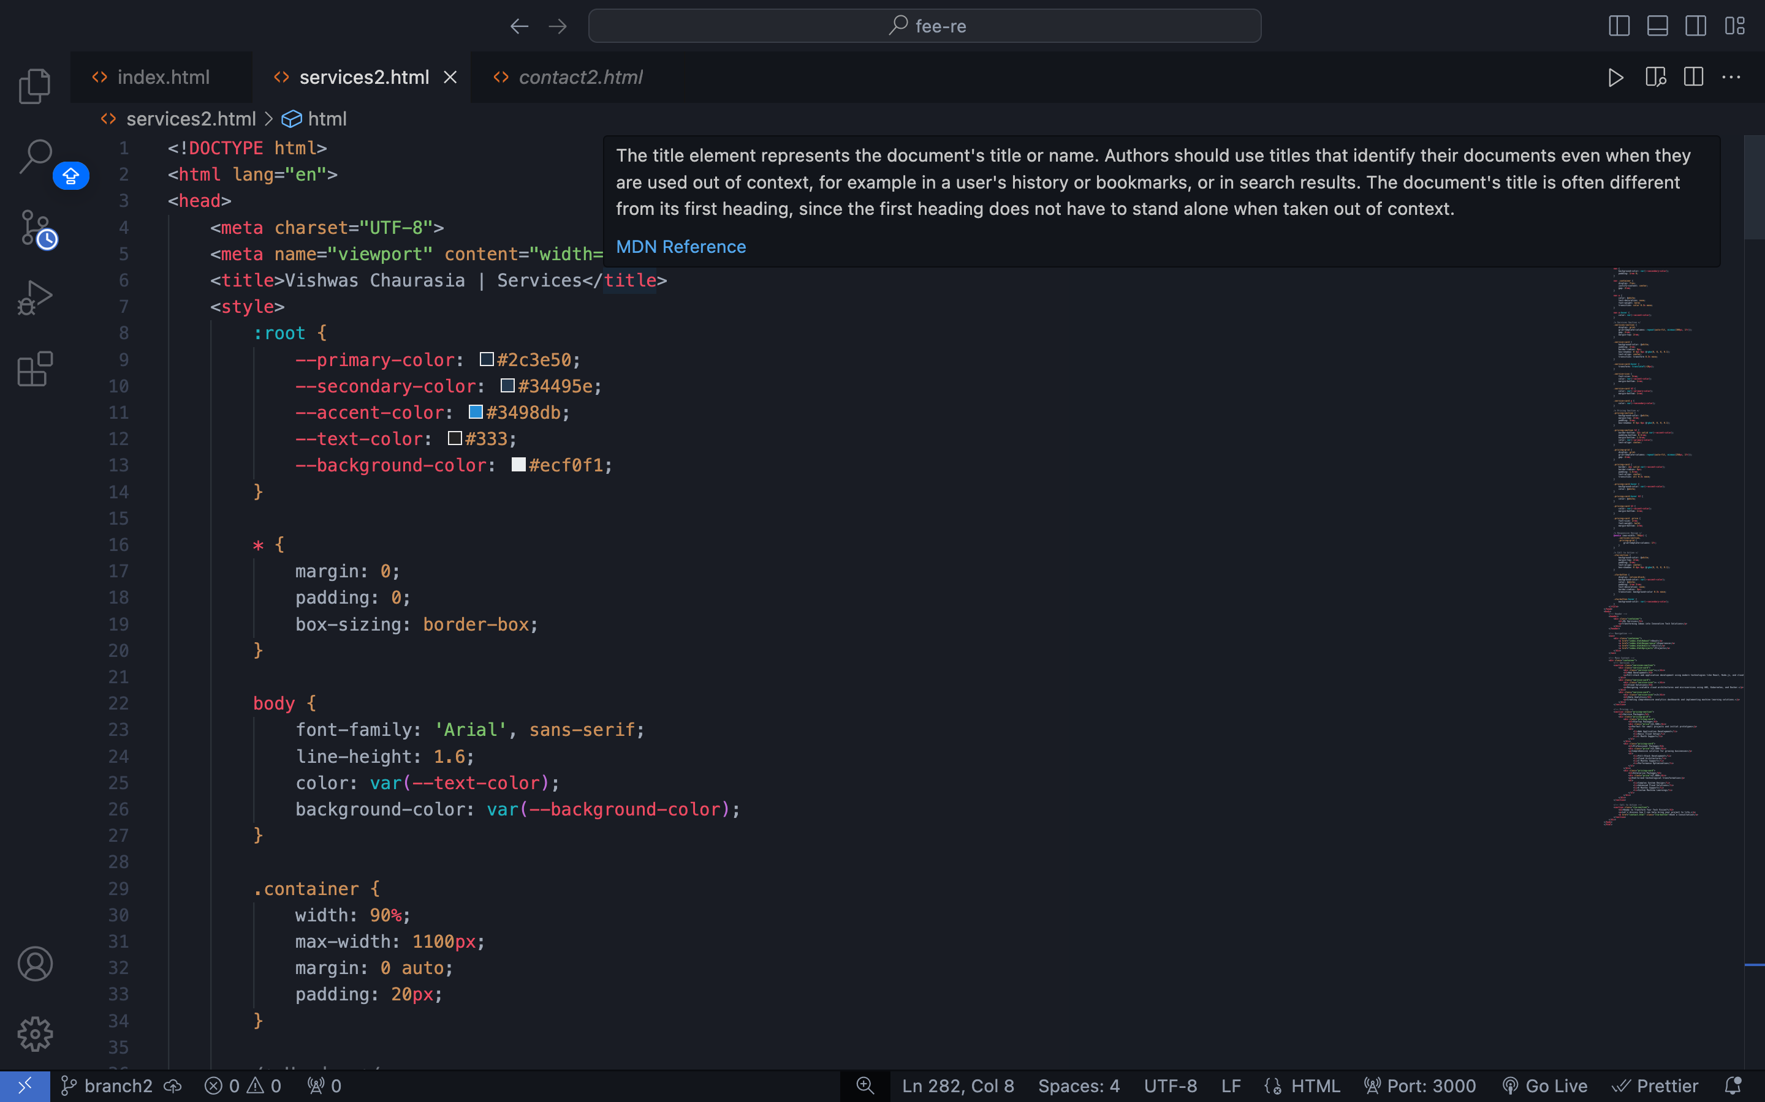
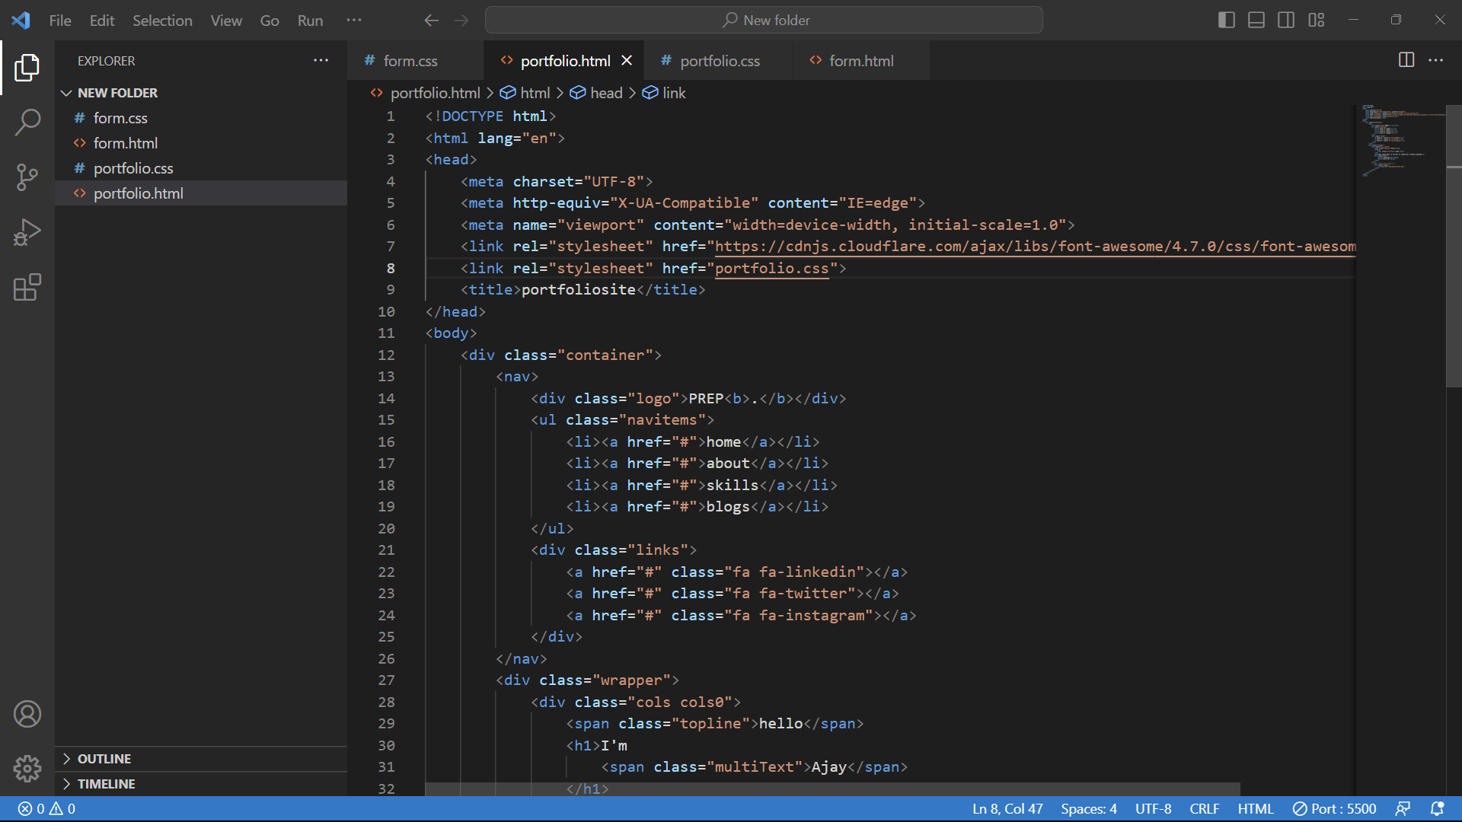

Slide 10
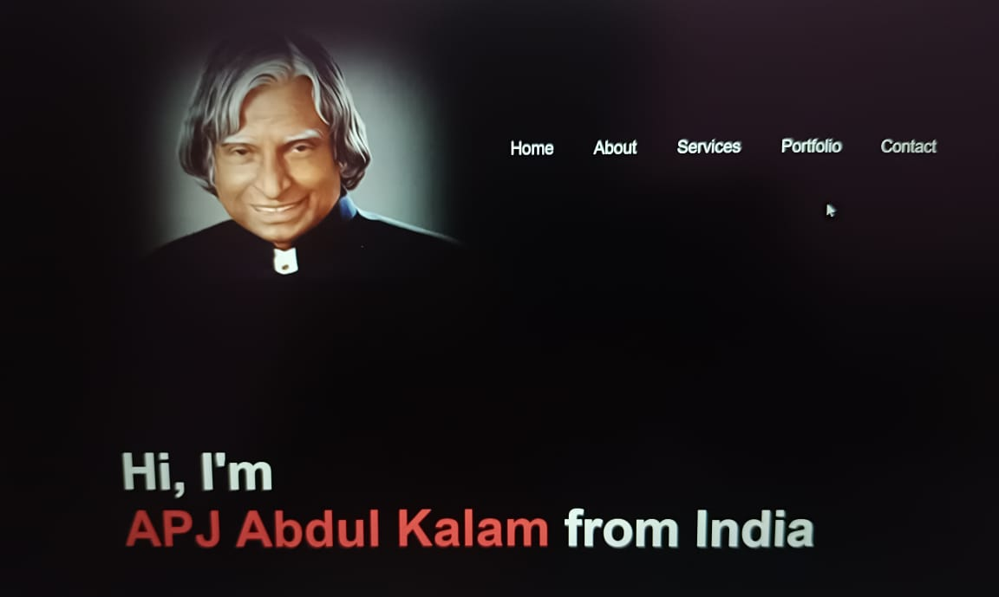
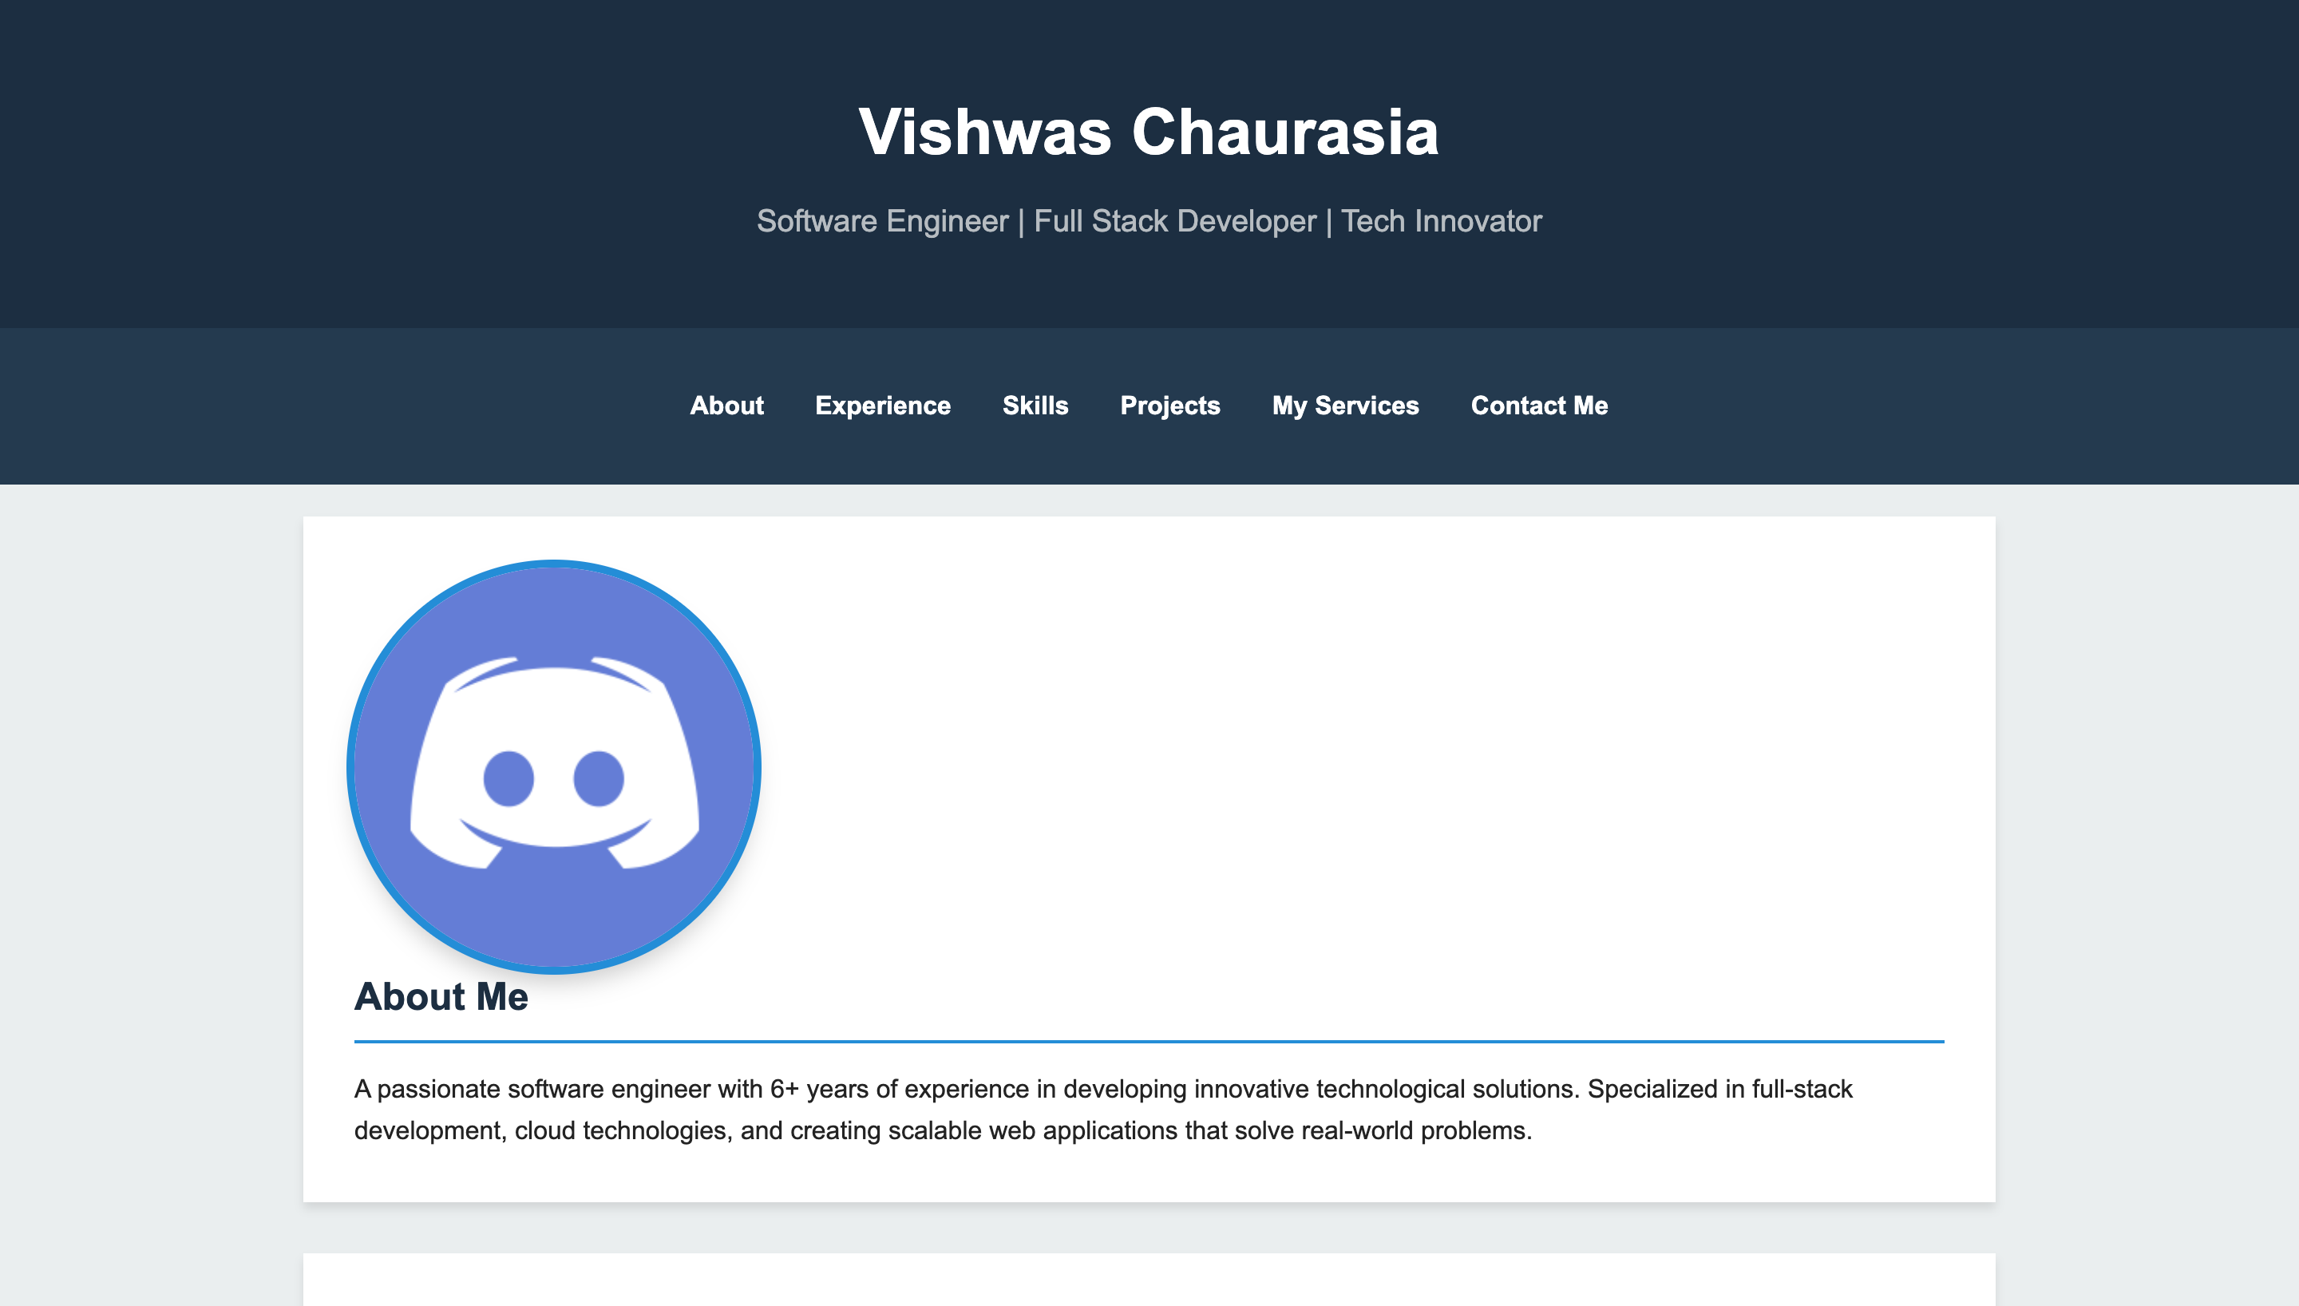
Output:

Slide 11
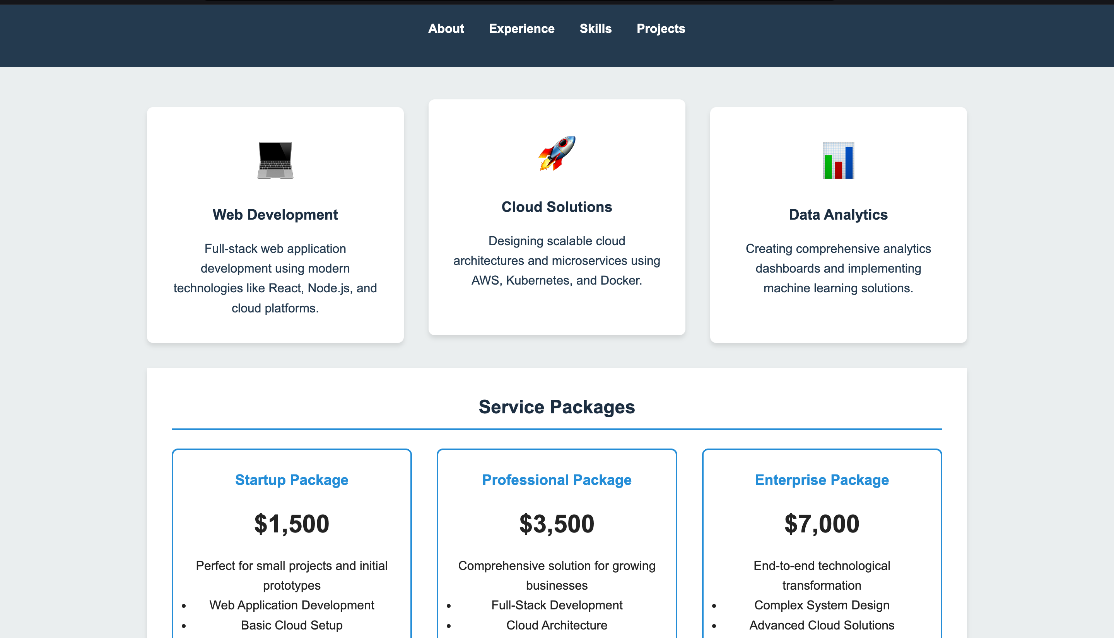
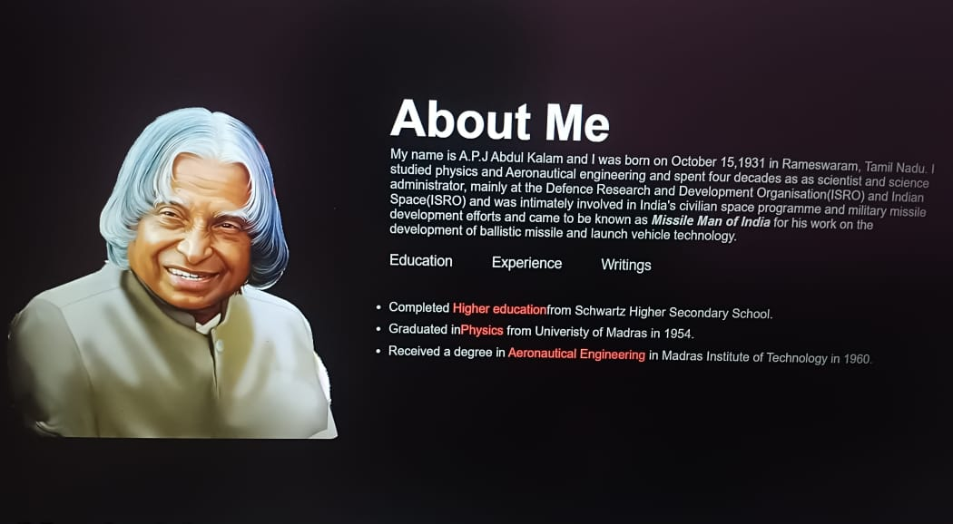

Slide 12
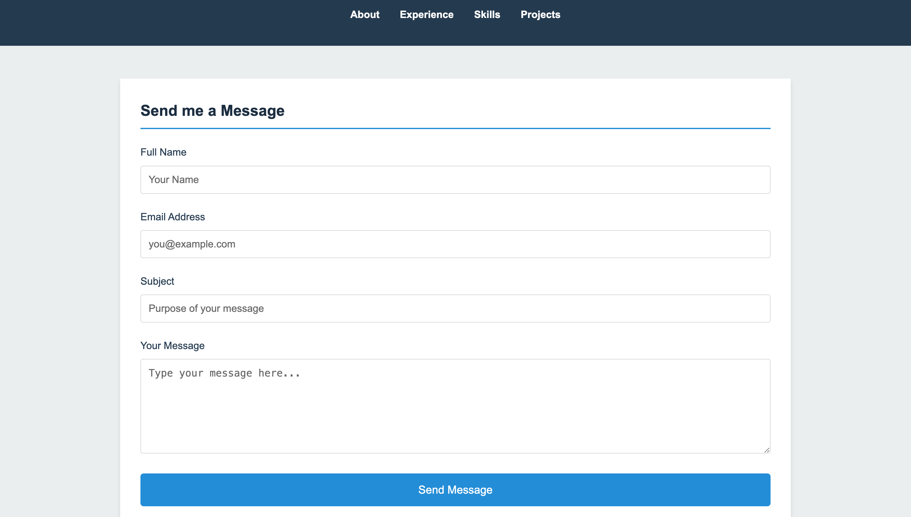

Slide 13
Conclusion:
Responsive design can help you solve a lot of problems for your website. It will make your site mobile-friendly, improve the way it looks on devices with both large and small screens. So using HTML and CSS code , we have designed a portfolio which is responsive and can adjust itself according to the width of the screen of any device successfully.

Slide 14
References Used:
Code With Harry (YouTube)
w3 School
Books

Slide 15


