Slide 1

AN EXPERIMENTAL OPERATING SYSTEM
An operating system project for junior year undergraduate computer science students.
Dr. K. Muralikrishnan
kmurali@nitc.ac.in
Sreeraj S
sreeraj.altair@gmail.com
Shamil C M
shamil.cm@gmail.com
Vivek Anand T Kallampally
vivekzhere@gmail.com

Slide 2
What is XOS?
A platform for students to build a simple operating system.
XOS is to be built from scratch by the students according to the specification provided.
Runs on a simulated machine hardware called XSM (Experimental String Machine).
The hard disk is simulated and uses a file system called XFS (Experimental File System)
Package includes machine simulator, system and application programming language compilers, file system interface, specification of components and a roadmap.

Slide 3
Why XOS?
Simple and Easy-to-understand: Only essential and important features for giving an elementary understanding and practical feel.
Conceptual Clarity: The operating system kernel completely resides in the machine memory, unlike popular instructional operating systems like Nachos.
Complete Package: A complete simulation environment, interfaces and programming language compilers are provided.
Well Documented: Every component is documented in detail and an implementation roadmap is provided.

Slide 4
What is not there?
Device Management or asynchronous devices
Interprocess Communication
File Caching and File Permissions
Limited support of process synchronization has been suggested as enhancements to XOS. This includes process sytem calls like Wait, Signal, Getpid and Getppid.

Slide 5
Components
Experimental String Machine (XSM) Simulator
Experimental File System (XFS) Interface
System Programmer's Language (SPL) Cross Compiler
Application Programmer's Language (APL) Cross Compiler
Experimental Operating System Specification and Roadmap

Slide 6
How they interact?
UNIX
Data Files
APL
Program
Text
Files
SPL
Compiler
SPL
Program
APL
Program
APL
Compiler
APL
Compiler
.xsm
Output
File
XFS
Interface
.xsm
Output
File
XSM
Simulator
XFS
Disk

Slide 7
Experimental String Machine (XSM)
XOS runs on a simulated machine hardware called XSM.
Smallest addressable unit is a word which is string of 16 characters.
Native 2-address instruction set architecture.
Components include timer, registers, memory and disk.

Slide 8
Experimental String Machine (XSM)
Timer in XSM occurs in fixed number of instructions.
Registers in XSM include
  Program Registers (R0 – R7) to be used by application programs
  Kernel Registers (S0 – S15) to be used by system routines
  Temporary Registers (T0 – T4) for compiling system programs
  Special Purpose Registers, BP, IP, SP, PTBR, PTLR and EFR.
  IP cannot be modified other than through IRET and jump / branching instructions
Memory of XSM has 64 pages, with page size 512 words.
Disk is simulated using a UNIX file.

Slide 9
Experimental String Machine (XSM)
Operation is simplified by using LOAD and STORE instructions and not using a DMA controller.
Machine supports multiprogramming and virtual memory.
Exceptions occur during page fault, invalid instructions or arguments, and invalid operations.
Upon encountering an exception, control is transferred to Exception Handler Routine.
Machine has two privilege modes, USER and KERNEL modes.

Slide 10
Experimental String Machine (XSM)
Privilege Modes
  Mode switching from USER to KERNEL occurs during interrupts and exceptions
  Mode switching from KERNEL to USER occurs with IRET instruction
  All addresses are physical or directly-mapped in KERNEL mode.
  All addresses are logical in USER mode. Address translation from logical to physical is done using page tables following a basic and simple address translation scheme.
  Privileged instructions can be invoked only in KERNEL mode.
  Interrupts are disabled in KERNEL Mode. Machine halts on exceptions in KERNEL mode.

Slide 11
XSM Simulator
A C program simulates XSM
The interval of timer can be varied in the simulator
The simulator can be run in the DEBUG mode which invokes a GDB-like debugger
  Pauses execution upon encountering a BRKP instruction
  Memory and register contents can be viewed.
  A register value can be watched whenever changes are made
  Instructions can be single stepped or execution can be continued at breakpoints.

Slide 12
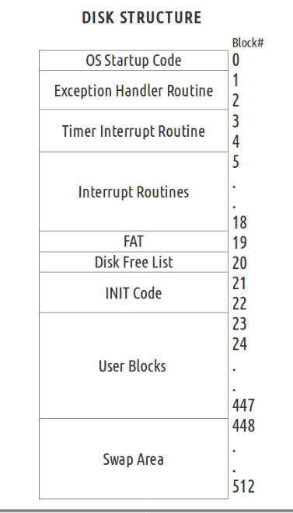
Experimental File System (XFS)
XFS is a simple filesystem with no directory structure.
Disk size is 512 blocks, with block size same as the page size in XSM (512 words).
Every file contains a basic block and a data block.
Two kinds of files, Executable and Data Files
INIT Code has no FAT entry

Slide 13
XFS Interface
XFS disk is simulated using a UNIX file, disk.xfs
XFS interface is provided as part of the development tools
XFS interface can be used to
  Create and Format the XFS disk
  Move files from UNIX machine to the XFS disk.
  Copy range of blocks from XFS disk and put it in a UNIX file.
  Commands like ls and cat are provided to display the list of files and the content of a particular file within the XFS disk.

Slide 14
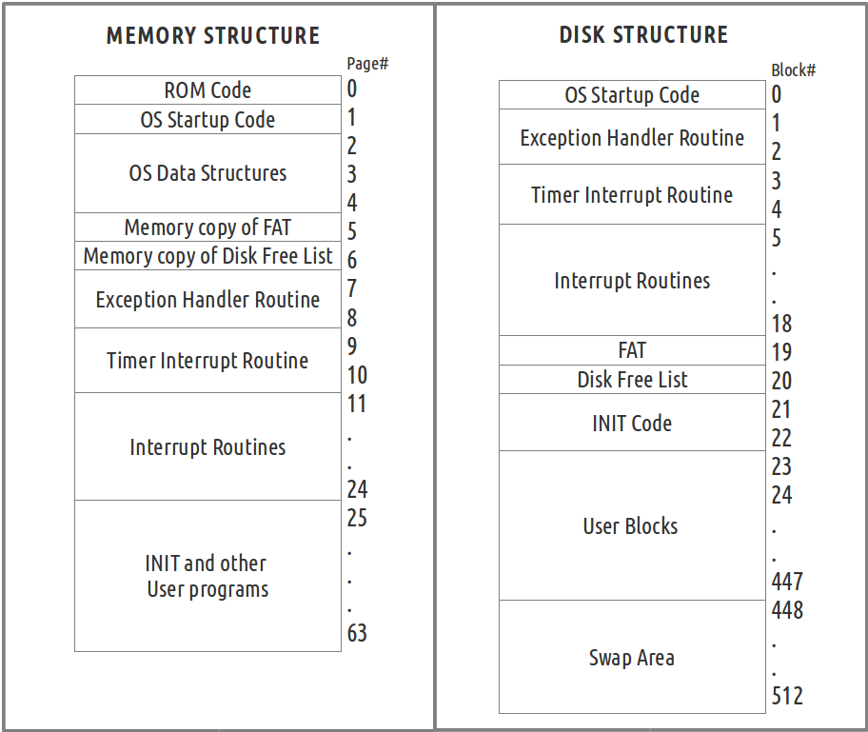
Experimental Operating System (XOS)

Slide 15
Experimental Operating System (XOS)
The various functionalities to be implemented in XOS are process management, file management and memory management.
The functionalities are implemented as system calls, scheduler and page fault handler.
XOS is capable of multiprogramming and demand paging.
In this project, XOS routines like OS Startup Code, the various interrupt routines including timer interrupt routine and the exception handler routine is to be programmed.

Slide 16
XOS Data Structures
Per-process page tables: used for address translation for each process in memory.
Memory Free List: Indicates if a memory page is used or not.
System Wide Open File Table: list of files opened by processes
Ready List of PCBs: list of task structures (PCBs) of processes in memory
PCB of a process contains its Process Identifier (PID), STATE information, register values, details about files opened by the process.
File Allocation Table: Disk data structure storing details of files on the disk. A memory copy is maintained by XOS.
Disk Free List: Disk data structure that indicates if a disk block is used or not. A memory copy is maintained by XOS.

Slide 17
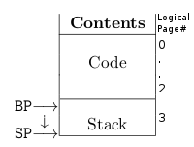
Process Structure
Code
  These are pages of the memory that contain the executable code loaded from the disk.
Stack
  This is the user stack used for program execution.
  The variables and data used during execution of program is stored in the stack.
  It grows in the direction of increasing word address.
  The location of the stack is fixed at the 4th page of the process.

Slide 18
OS Startup Code
The OS Startup Code should be programmed to load and initialize data structures like Page Tables, Memory Free List and memory copy of Disk Free List.
The OS Startup Code should also load the interrupt routines and exception handler routine from disk to the memory.
It must load disk data structures like FAT and Disk Free List from disk to memory.
It must setup the PCB and Page Tables of the INIT program, load it from disk to memory and start its execution.

Slide 19
Timer Interrupt Routine
Timer interrupt routine is invoked when a timer interrupt occurs at specific intervals of instructions
The scheduler is to be implemented within the timer interrupt routine.
The scheduler of XOS follows a round-robin scheduling technique.

Slide 20
Interrupt Routines 1 - 7
Implementation of various system call interfaces in XOS is to be done within software interrupt routines 1 – 7.
These are invoked using INT instructions.
The system calls to be handled by XOS include
  File System Calls like Create, Delete, Open, Close, Read, Write, Seek
  Process system calls like Fork, Exec and Exit
  System calls like Wait, Signal, Getpid and Getppid are suggested as enhancements.

Slide 21
Exception Handler Routine
The Exception handler routine must be programmed to exit the process on all exceptions except the page fault exception
Page Fault exception occurs when translation is attempted on an invalid logical page.
Upon a page fault exception, if its an accessible page, the page must be loaded from disk to memory.

Slide 22
Virtual Memory and Demand Paging
If memory for loading a page from disk to memory is not available, page replacement must be done to make space.
A page is swapped from the memory to the swap area of the disk and the required page is loaded.
For simplicity, XOS avoids swapping out the stack page and code pages shared by more than one process.
Page replacement is done using reference bits, by following the Second Chance Algorithm.

Slide 23
Structure
Memory
ROM
Code
User Programs
OS
Startup
Code
System Call Implentation
In Interrupt Routines 1 to 7
Scheduler
Timer Interrupt Routine
Exception
and Page Fault
Handler
XOS
FAT
In memory
Disk Free List
In memory
Process
Page Tables
Ready List
of PCBs
System-wide
Open File Table
Memory
Free List
Registers
Timer
Registers
XSM
Instruction
Set Architecture
XFS
Disk
Program Registers R0 - R7
Kernel Registers S0 - S15
Temporary Registers T0 - T3
PTBR
IP
BP
PTLR
EFR
SP

Slide 24
System Programmer's Langauge (SPL)
The System Programmer's Language is a programming language to write the operating system routines inorder to build XOS.
It is very closely related to XSM instruction set, and has statements to access machine registers and memory directly.
It is provided for convenience of the system programmer instead of directly using the machine instructions.
Registers can be aliased using meaningful identifiers.
Allows defining constants and has predefined constants for XOS.
SPL cross compiler is provided as part of development tools to generate .xsm output files. These files are loaded as system routines to the XFS disk.

Slide 25
Application Programmer's Langauge (APL)
The Application Programmer's Language is a high level language used to write user programs to be run on top of XOS.
It supports both string and integer data types.
It has system call interfaces corresponding to the various system calls available in XOS.
APL cross compiler is provided as part of development tools
Programs written in APL is compiled using the cross-compiler to XSM machine instructions.

Slide 26
ROADMAP
The roadmap helps to build XOS from scratch sequentially by carefully understanding every concept.
The roadmap is divided into stages including a stage to implement a few enhancements on XOS.
The roadmap contains theory points and explanations at every stage of implementation including links to other documents.
Its a source of obtaining elementary understanding to operating system concepts, by parallely building the operating system.

Slide 27
ROADMAP
STAGE 1: Setting up the system
  Helps set up and test the development tools.
  Elementary understanding of the various components of the project.
STAGE 2: Understanding the filesystem
  Introduces the XFS filesystem including disk data structures.
  Teaches how to use the XFS interface.
STAGE 3: Starting the machine
  Start the machine in kernel mode
  Run a kernel program to print odd numbers and run it as OS Startup Code.

Slide 28
ROADMAP
STAGE 4: Running a user program
  A user program to print primes is to be written in APL, compiled and loaded to disk.
  The OS Startup code is to be programmed to set up the INIT process and load the newly written program as the INIT program.
  The OS now runs in a single process mode.
STAGE 5:Interrupt Routines
  Introduces the concept of interrupts.
  A sample implementation of a software interrupt routine and timer interrupt routine is done.

Slide 29
ROADMAP
STAGE 6: Getting started with multiprogramming
  OS is made to run two programs concurrently.
  The scheduler is implemented in the timer interrupt routine to switch between the two programs.
STAGE 7: Creating Files
  The first system call 'Create' is to be implemented in the stage.
  System Calls and corresponding stack operations are explained in detail in this stage.
STAGE 8: Playing with Files
  This stage includes the implementation of the remaining file system calls.
  Test cases are provided for checking if the system calls are working properly.

Slide 30
ROADMAP
STAGE 9: Process System Calls
  Process system calls which includes Fork, Exec and Exit are to be implemented in this stage.
STAGE 10: Exception Handling and Demand Paging
  Virtual Memory managment is implemented in this stage
  Page replacement is also done in this stage.
  The process system calls are modified to incorporate demand paging and page replacement.
STAGE 11: Enhancements to XOS
  This stage includes implementing Wait, Signal, Getpid and Getppid system calls
  This stage also includes making a shell for XOS

Slide 31
Conclusions
The project is easier to implement compared to the existing instructional operating systems.
Simple system which is buildable from first principles
It will help to
  better comprehend the textbooks on operating systems
  get a practical feel of operating systems
  move on to more complex platforms later.
Limited set of features to be implemented in a 14 – 16 week semester.
Not intended to be scaled to implement complex features. Real platforms are suggested for advanced understanding of operating systems.

Slide 32
Resources
Website: http://xosnitc.github.com
Mailing lists:
  Users' Mailing List: xos-users@googlegroups.com
  Developers' Mailing List: xos-developers@googlegroups.com

