Slide 1
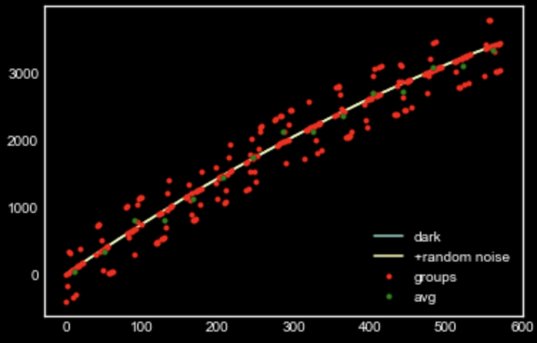
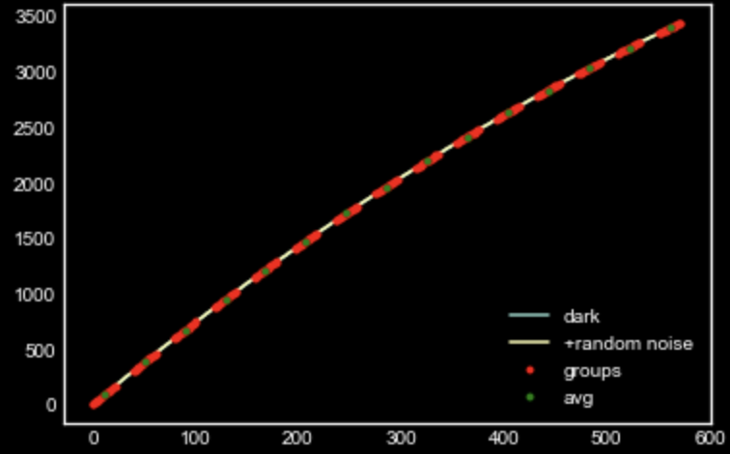
sample MAAC simulator with and without RTN

Slide 2
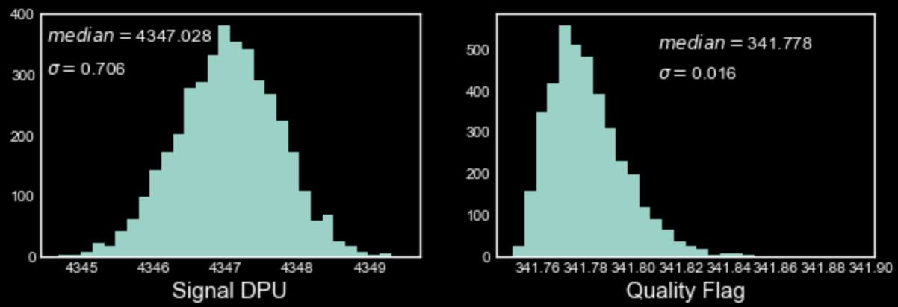
With NO NL and RTN, how stable the QF and DPU signal?

Slide 3
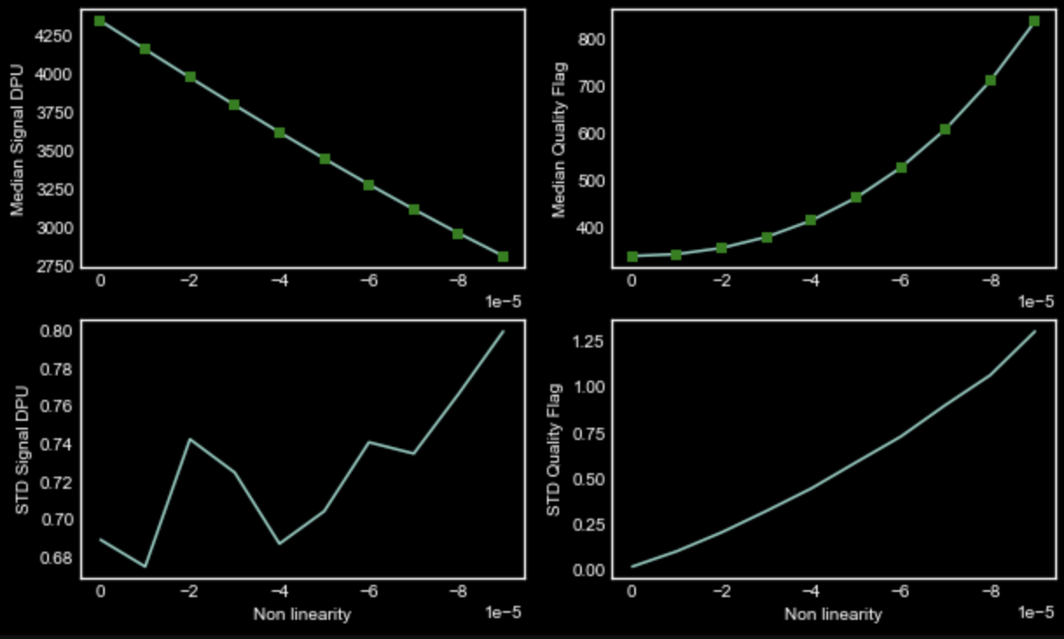
Change in signal and QF with Varying NL (no RTN)

Slide 4
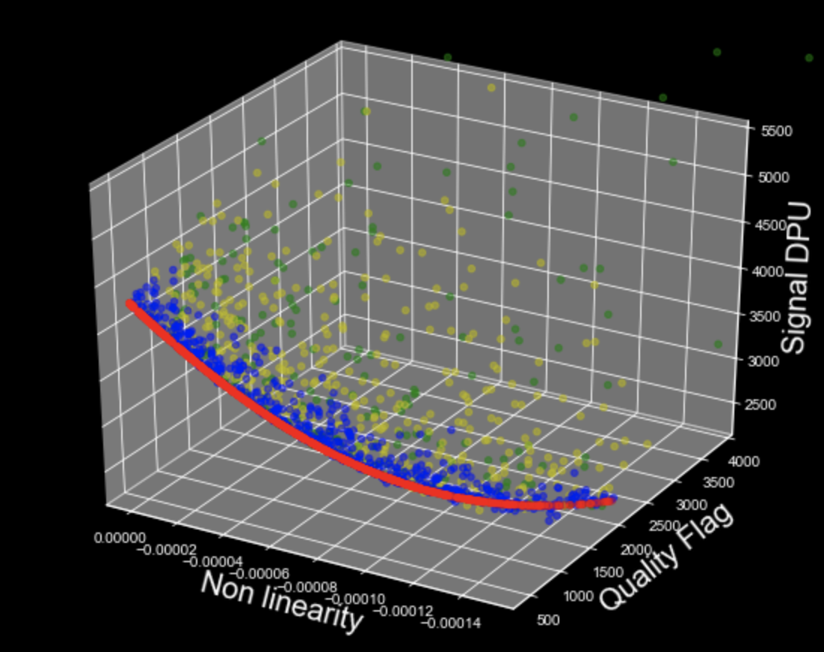
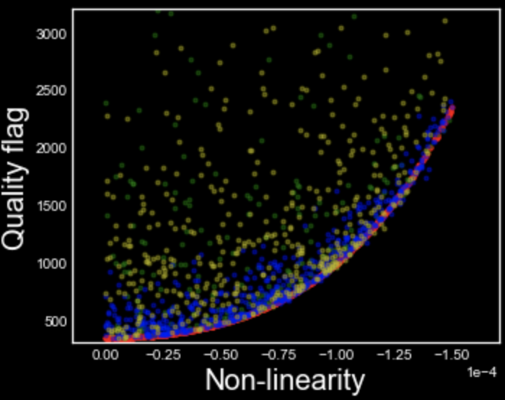
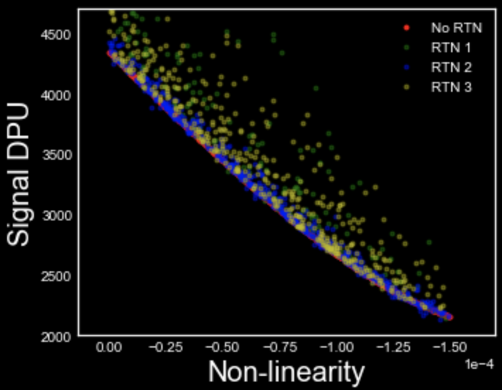
MCMC with 3 kinds of RTN and varying NL

Slide 5
