Slide 1
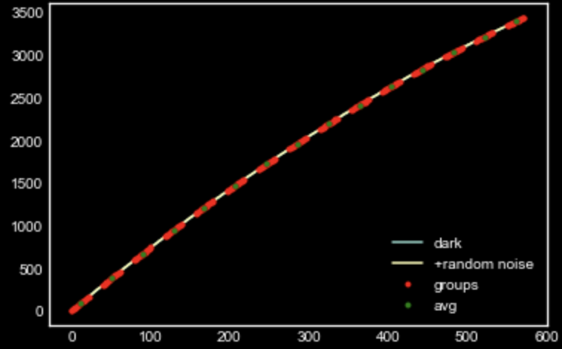
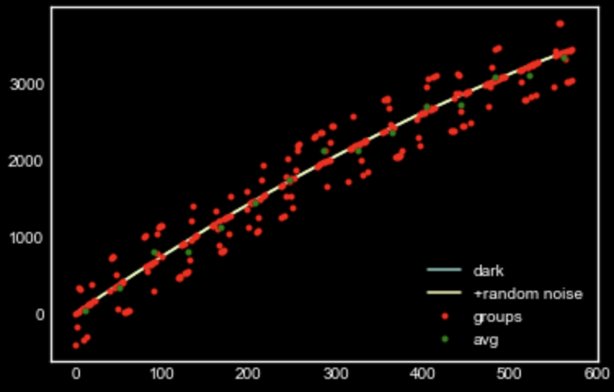
sample MAAC simulator with and without RTN Light current = 10.0, Dark current = 0.04, read noise = 9.0 and (ng=15, nf=16, nd=11)

Slide 2
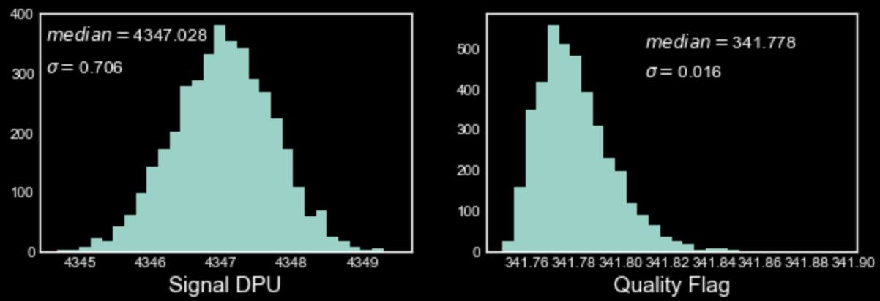
With NO NL and RTN, change in the QF and DPU signal

Slide 3
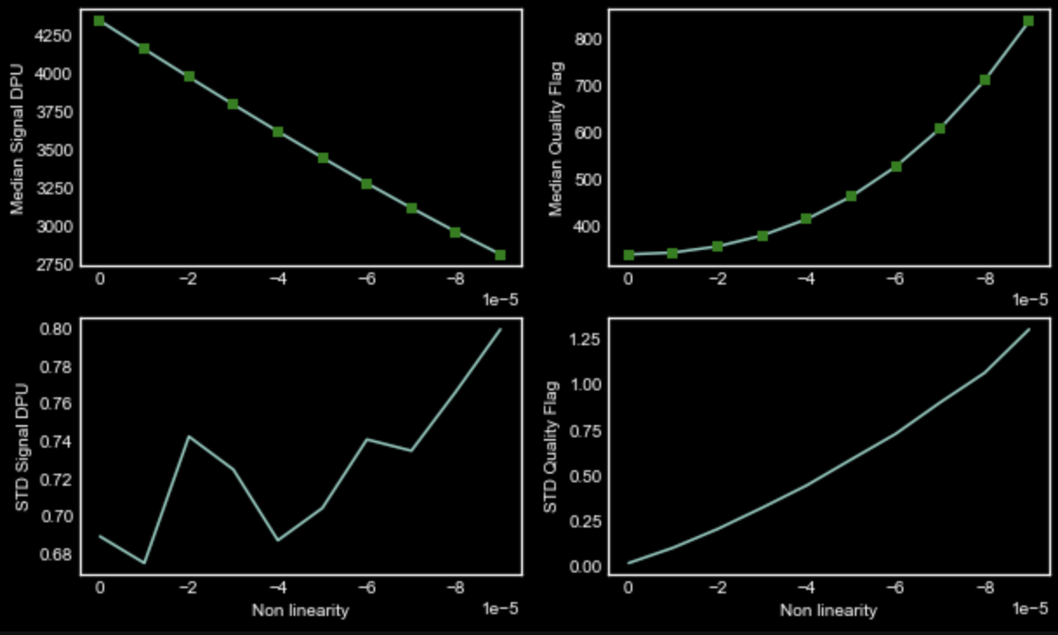
Change in signal and QF with Varying NL (no RTN)

Slide 4
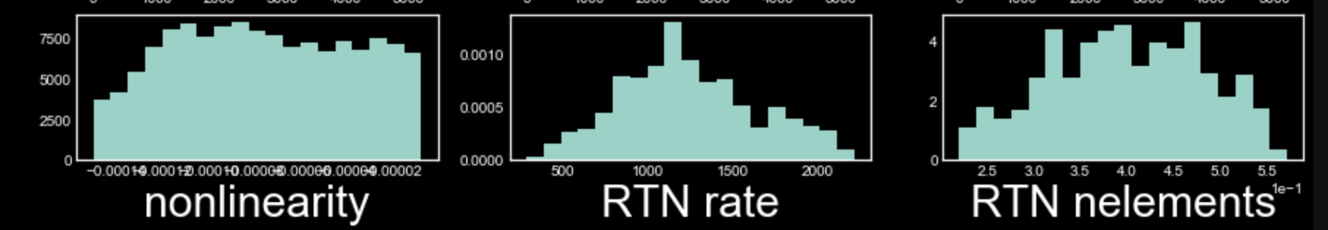
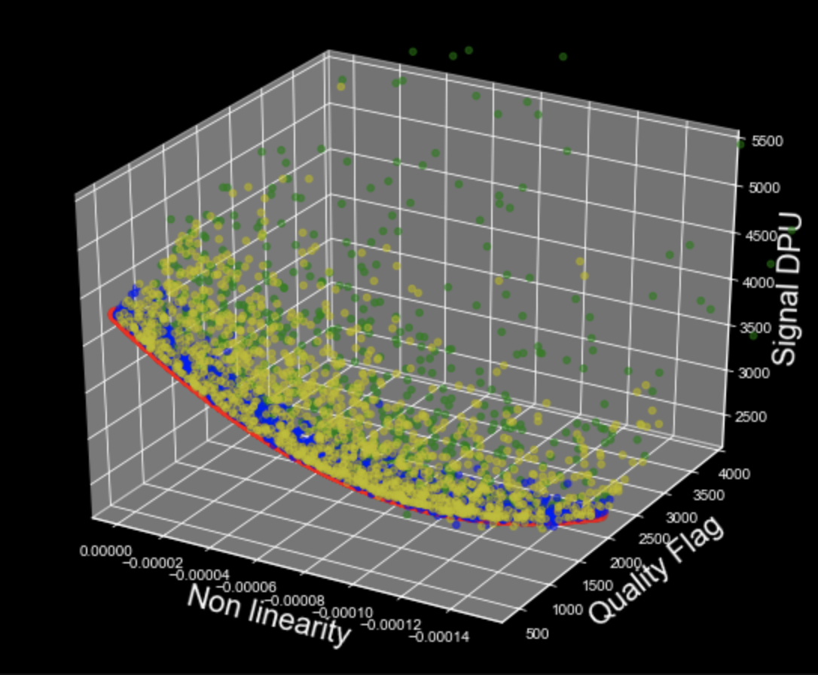
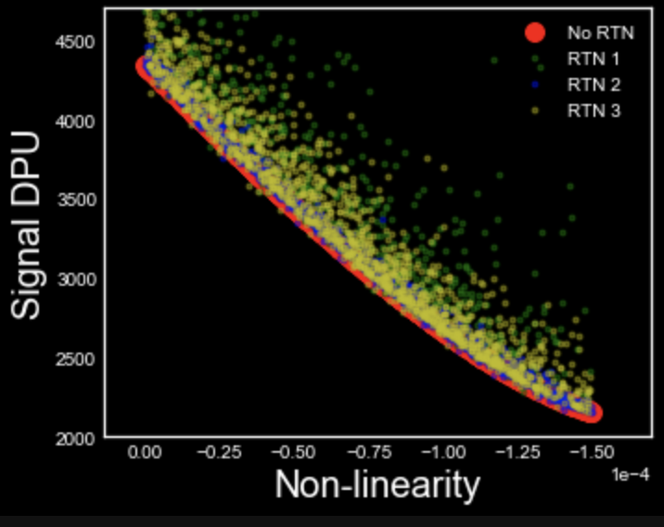
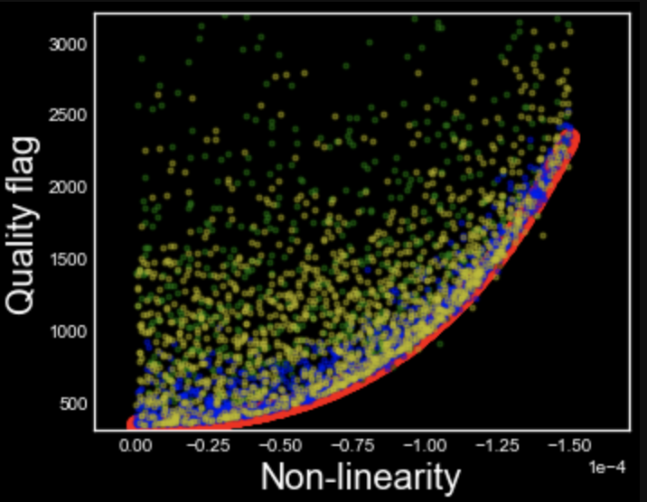
MCMC with 3 kinds of RTN and varying NL

Slide 5
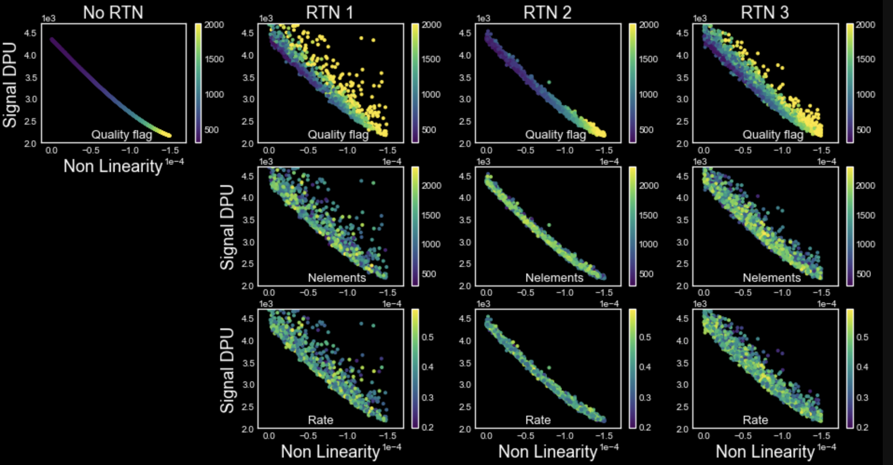

Slide 6
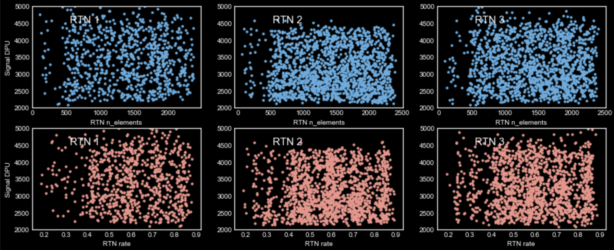
Almost no dependence of Signal on nelements and rate of RTN

Slide 7
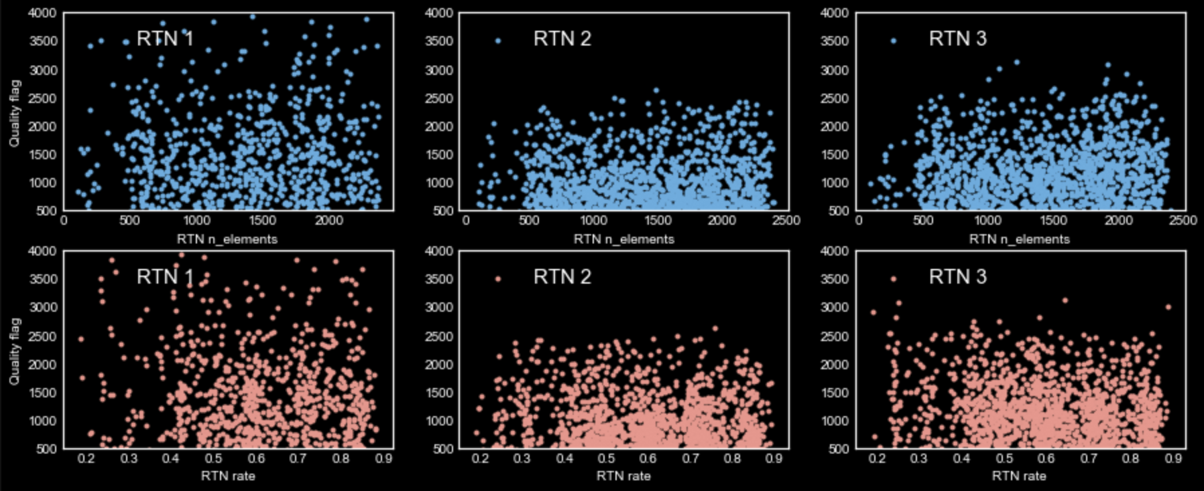
And no dependence of QF on nelements and rate of RTN

