Slide 1
AoA-Assisted Dynamic RTS Threshold Adaptation for Hidden-Node Risk Mitigation in Commodity Wi-Fi APs
Professor Chien-Chao Tseng
Department of Computer Science
National Yang Ming Chiao Tung University
cctseng@cs.nycu.edu.tw

Slide 2
Outline
Introduction
Background
AoA-Assisted Risk Score and RTS Threshold Adaptation
Evaluation
Conclusion

Slide 3
Outline
Introduction
Background
AoA-Assisted Risk Score and RTS Threshold Adaptation
Evaluation
Conclusion

Slide 4


Hidden Node Problem
The hidden node problem occurs when two nodes in a wireless network can communicate with a third node, but cannot communicate with each other directly due to obstacles or being out of range
This can lead to collisions at the third node when both nodes transmit simultaneously

Slide 5
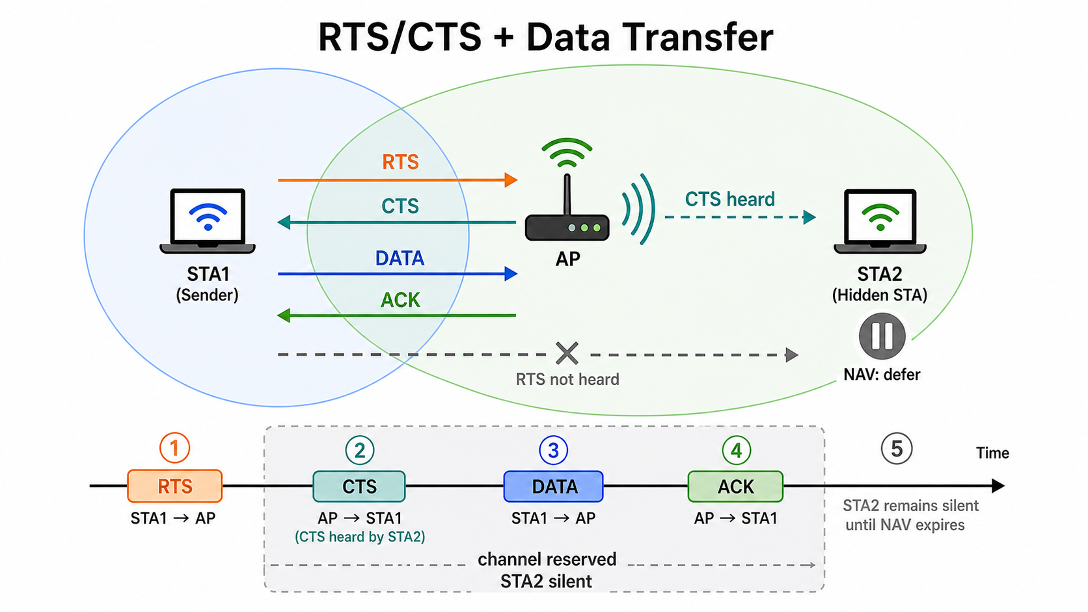
RTS/CTS Mitigation
RTS/CTS is an optional 802.11 mechanism used before data transmission
Sender first sends an RTS frame to request channel access
Receiver replies with a CTS frame to grant transmission permission
Nearby nodes that hear RTS or CTS update their NAV and defer transmission
Hidden nodes that cannot hear the sender may still hear the receiver’s CTS, so they remain silent
Sender sends real data
This reserves the channel around the receiver and reduces hidden-node collisions

Slide 6
Static RTS Threshold Limitation
In conventional 802.11, the RTS threshold is usually configured as a static value.
Because the threshold is fixed, it cannot adapt to STA physical location or hidden-node conditions.

Slide 7
Hidden-Node Risk-Aware RTS Threshold Control
State the thesis goal early: let the AP infer hidden-node risk from Angle of Arrival (AoA) and link observations, then tune the RTS threshold dynamically.
Notes:
只能控制 AP side的RTS threshold是問題嗎?

Slide 8
Outline
Introduction
Background
AoA-Assisted Risk Score and RTS Threshold Adaptation
Evaluation
Conclusion

Slide 9
WiFi OFDM CSI
CSI means Channel State Information
It describes how a WiFi signal changes from transmitter to receiver
CSI is not measured directly from random data.
The sender first sends a known signal pattern
Receiver measure CSI on each subcarrier and each transmit-receiver antenna pair
Each CSI value is complex:
Amplitude:
how strong the signal is
A larger amplitude means the signal is stronger
Phase:
how much the signal is shifted
Different paths or arrival directions create different phase shifts
Represent in e

Slide 10
Spatial Spectrum Estimation

Slide 11

Steering Vector
phase pattern across antenna array when signal arrives from specific angle θ
Physical origin from a plane wave reaches different antennas with different propagation distances dsinθ
θ
dsinθ
d

Slide 12
MUSIC
Motivate MUSIC for Wi-Fi APs because it can use existing multi-antenna CSI, provide higher angular resolution than other Spatial Spectrum Estimation algorithm without extra localization hardware
每一個收到的 CSI 是X_n 有多個 snapshot => X = [X_0, X_1, … X_n] 是 CSI Dimension * snapshot number 的矩陣
做 correlation Rx = 1/n X X ^H
Rx 做 eigenvalue decomposition 把 eigen value 小的eigen vector挑出來當 noise subspace 的 base
每一個角度都會有自己的 steering vector 每一個跟noise subspace 比對有沒有正交 愈是正交愈可能是 AoA

Slide 13
Steer Vector Math Presentation from antenna array
a(θ)=[1,e−jΔϕ,e−j2Δϕ,...,e−j(M−1)Δϕ]T
θ
dsinθ
d

Slide 14
LRG1 Ability for RTS threshold control and metric collection
Review the RTS threshold as the main AP-side control knob.
Describe AP-side measurements, including retry statistics, RSSI, CSI, AoA, and MCS.

Slide 15
Outline
Introduction
Background
AoA-Assisted Risk Score and RTS Threshold Adaptation
Evaluation
Conclusion

Slide 16
Risk scoring design goal
Present the overall design goal: use AP-side AoA and link observations to decide when RTS/CTS overhead is worthwhile.
Define the hidden-node risk score as the core decision variable for RTS threshold control.

Slide 17
AoA and link features for hidden-node risk
Use AoA estimates from AP-side multi-antenna CSI as the main spatial feature for judging whether two clients are likely to be hidden from each other.
Combine AoA-based spatial separation with retry behavior, RSSI, MCS, and traffic activity so the score reflects both geometry and observed collision symptoms.

Slide 18
RTS threshold adaptation rule
Present the RTS threshold adaptation rule: lower the threshold when hidden-node risk is high, and restore or raise it when risk is low to avoid unnecessary RTS/CTS overhead.
Include smoothing and hysteresis so the RTS threshold does not oscillate under noisy AoA or retry measurements.

Slide 19
Outline
Introduction
Background
AoA-Assisted Risk Score and RTS Threshold Adaptation
Evaluation
Conclusion

Slide 20
Evaluation scenarios, baselines, and metrics
Define test scenarios for hidden-node and non-hidden-node conditions.
Compare static RTS/CTS settings with the proposed AoA-assisted dynamic RTS threshold policy.
Measure throughput, retry rate, latency, MCS distribution, and fairness.

Slide 21
Performance analysis focus
Analyze when the proposed method improves performance and when it has limited benefit.

Slide 22
Outline
Introduction
Background
AoA-Assisted Risk Score and RTS Threshold Adaptation
Evaluation
Conclusion

