Slide 1
AoA-Assisted Dynamic RTS Threshold Adaptation for Hidden-Node Risk Mitigation in Commodity Wi-Fi APs
Professor Chien-Chao Tseng
Department of Computer Science
National Yang Ming Chiao Tung University
cctseng@cs.nycu.edu.tw

Slide 2
Outline
Introduction
Background
AoA-Assisted Risk Score and RTS Threshold Adaptation
Evaluation
Conclusion

Slide 3
Outline
Introduction
Background
AoA-Assisted Risk Score and RTS Threshold Adaptation
Evaluation
Conclusion

Slide 4


Hidden Nodes Cause Receiver-Side Collisions
Hidden node reaches AP but cannot sense other nodes using same AP
Nodes cannot hear each other
May transmit simultaneously
Simultaneous transmissions collide at AP
Reduces wireless network throughput

Slide 5
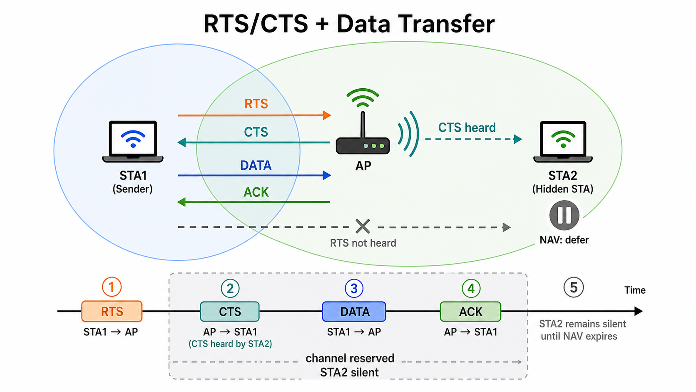
RTS/CTS Mitigates Hidden-Node Collisions
Optional 802.11 handshake before data transmission.
Sender sends RTS to request channel access.
Receiver sends CTS to grant transmission permission.
Nearby nodes that hear RTS or CTS update NAV and defer.
Hidden nodes may miss RTS but still hear CTS from the receiver.
Sender transmits data after the channel is reserved.
Reserving the receiver's neighborhood reduces hidden-node collisions.

Slide 6
Static RTS Thresholds Cannot Track Hidden-Node Risk
Conventional 802.11 usually uses a fixed RTS threshold.
A fixed threshold cannot adapt to station location or changing hidden-node conditions.

Slide 7
Hidden-Node Risk-Aware RTS Threshold Control
The AP infers hidden-node risk from Angle of Arrival (AoA) and link observations, then tunes the RTS threshold dynamically.
Notes:
只能控制 AP side的RTS threshold是問題嗎?

Slide 8
Outline
Introduction
Background
AoA-Assisted Risk Score and RTS Threshold Adaptation
Evaluation
Conclusion

Slide 9
Wi-Fi Channel State Information (CSI)
Describes propagation process of the wireless signal
therefore contains geometric information of the propagation space
Sender transmits a pattern known to receiver
The receiver estimates CSI for each subcarrier and transmit-receive antenna pair
Path 1
Path 2
Path 3

Slide 10
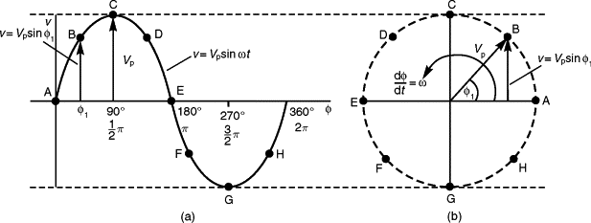

CSI Representation
Represented as a complex exponential $Ae^{Pi}$
A: Amplitude — signal strength relative to known transmitted wave
P: Phase — signal’s rotation relative to a known transmitted wave
Notes:
https://www.sciencedirect.com/topics/engineering/phasor-representation
CSI=transmitted reference signal / received signal​

Slide 11
Spatial Spectrum Estimation Estimates AoA

Slide 12

Steering Vector Encodes Angle-Dependent Phase
Phase pattern across the antenna array when a signal arrives from angle θ
Plane waves reach antennas at different distances, creating a dsinθ path difference
θ
dsinθ
d

Slide 13
MUSIC for AoA Estimation
MUSIC uses existing multi-antenna CSI and can provide high angular resolution without extra localization hardware.
Each CSI snapshot is x_n; multiple snapshots form X = [x_0, x_1, ..., x_n].
Compute the covariance matrix R_x = (1/n) X X^H.
Apply eigenvalue decomposition and use small-eigenvalue eigenvectors as the noise subspace.
For each candidate angle, compare its steering vector with the noise subspace; the most orthogonal vector indicates the most likely AoA.

Slide 14
Steering Vector Math from the Antenna Array
a(θ)=[1,e−jΔϕ,e−j2Δϕ,...,e−j(M−1)Δϕ]T
θ
dsinθ
d

Slide 15
LRG1 Provides AP-Side Control and Measurements
LRG1 exposes the RTS threshold as the main AP-side control knob.
AP-side measurements include retry statistics, RSSI, CSI, AoA, and MCS.

Slide 16
Outline
Introduction
Background
AoA-Assisted Risk Score and RTS Threshold Adaptation
Evaluation
Conclusion

Slide 17
Risk Score Guides RTS Threshold Decisions
The AP uses AoA and link observations to decide when RTS/CTS overhead is worthwhile.
The hidden-node risk score becomes the decision variable for RTS threshold control.

Slide 18
AoA and Link Features Capture Hidden-Node Risk
AoA estimates from AP-side multi-antenna CSI provide the main spatial feature for hidden-node risk.
The score combines AoA separation with retries, RSSI, MCS, and traffic activity to reflect geometry and collision symptoms.

Slide 19
RTS Threshold Adapts to Risk
Lower the threshold when hidden-node risk is high; restore or raise it when risk is low.
Smoothing and hysteresis prevent oscillation under noisy AoA or retry measurements.

Slide 20
Outline
Introduction
Background
AoA-Assisted Risk Score and RTS Threshold Adaptation
Evaluation
Conclusion

Slide 21
Evaluation Compares Static and Dynamic Policies
Test hidden-node and non-hidden-node scenarios.
Compare static RTS/CTS settings with the AoA-assisted dynamic RTS threshold policy.
Measure throughput, retry rate, latency, MCS distribution, and fairness.

Slide 22
Performance Analysis Separates Gains from Limits
Analyze when the method improves performance and when its benefit is limited.

Slide 23
Outline
Introduction
Background
AoA-Assisted Risk Score and RTS Threshold Adaptation
Evaluation
Conclusion

