Slide 1
AoA-Assisted Dynamic RTS Threshold Adaptation for Hidden-Node Risk Mitigation in Wi-Fi
Professor Chien-Chao Tseng
Department of Computer Science
National Yang Ming Chiao Tung University
cctseng@cs.nycu.edu.tw

Slide 2
Outline
Introduction
Background
AoA-Assisted Dynamic RTS Threshold Adaptation
Evaluation
Conclusion

Slide 3
Outline
Introduction
Background
AoA-Assisted Dynamic RTS Threshold Adaptation
Evaluation
Conclusion

Slide 4


Hidden Nodes Problem
Devices can communicate with AP but cannot detect each other
When they transmit at the same time, their signals collide at the AP
Causes packet loss and lower throughput

Slide 5
RTS/CTS Mitigates Hidden-Node Collisions
Optional 802.11 handshake before data transmission
RTS/CTS makes nearby nodes defer, reducing hidden-node collisions
Step:
Sender sends RTS to request channel access
Nearby node hearing RTS defers
AP sends CTS to grant transmission permission
Hidden node hearing CTS defers
Sender transmits data after the channel is reserved
Sender
AP
Hidden Node
1. RTS
1. RTS
2. CTS
2. CTS
Nearby Node
3. DATA
Request To Send / Clear To Send (RTS/CTS)

Slide 6
Limitations of Static RTS Thresholds
Conventional 802.11 usually uses a fixed RTS threshold
A static threshold cannot adapt to changing node locations

Slide 7
Spatially Aware Dynamic RTS Threshold Using AoA
AoA provides spatial cues about relative directions of stations
AP combines AoA with link information to estimate hidden-node risk
Estimated risk guides dynamic RTS threshold adjustment
Angle of Arrival (AoA)
Notes:
只能控制 AP side的RTS threshold是問題嗎?

Slide 8
Outline
Introduction
Background
AoA-Assisted Dynamic RTS Threshold Adaptation
Evaluation
Conclusion

Slide 9
Wi-Fi Channel State Information (CSI)
Describes propagation process of the wireless signal
Therefore, contains geometric information of the propagation space
Sender transmits a pattern known to receiver
The receiver estimates CSI for each subcarrier and transmit-receive antenna pair
Path 1
Path 2
Path 3

Slide 10



Steering Vector
Plane waves reach each antenna at different distances from angle $θ$
Path difference $dsinθ$
Formula
$$\text{a}\text{(}\text{θ}\text{) = }{\text{[}e^{0}\text{, }e^{\text{−}\text{j}\text{2}\text{π}\text{d}\text{·}\frac{\text{sin}\text{θ}}{\text{λ}}}\text{, ⋯ ,}e^{\text{−}\text{j}\text{2(}\text{M}\text{−1)}\text{π}\text{d}\text{·}\frac{\text{sin}\text{θ}}{\text{λ}}}\text{]}}^{T}$$
d: antenna spacing
λ: wavelength
M: number of antennas
θ
$$dsinθ$$
d

Slide 11
Multiple Signal Classification (MUSIC)
MUSIC is a spatial spectrum estimator built on CSI and steering vectors
Invented in 1979
Widely used in Wi-Fi localization

Slide 12
Outline
Introduction
Background
AoA-Assisted Dynamic RTS Threshold Adaptation
Evaluation
Conclusion

Slide 13
AoA-Assisted Dynamic RTS Threshold Adaptation
Estimate each STA's AoA from AP-side CSI
Combines AoA with RSSI, MCS, and traffic activity to assess hidden-node risk
Adjust RTS threshold based on the risk score
High risk → lower RTS threshold
Low risk → raise RTS threshold
Distribute updated threshold to all STAs

Slide 14
Outline
Introduction
Background
AoA-Assisted Dynamic RTS Threshold Adaptation
Evaluation
Conclusion

Slide 15
Evaluation
Scenarios
Hidden-node
Non-hidden-node
Threshold Control Policy
Static RTS threshold
Dynamic RTS threshold
Disable RTS/CTS
Metrics
Throughput
Retry rate
Latency
MCS

Slide 16
Outline
Introduction
Background
AoA-Assisted Dynamic RTS Threshold Adaptation
Evaluation
Conclusion

Slide 17
Next Steps
Adopt SpotFi's MUSIC variant for AoA estimation
SpotFi (ACM SIGCOMM CCR 45(4), Aug 2015)
Speed up eigen decomposition
Define risk scoring and score-to-threshold mapping
Reinforcement learning?
Define evaluation scenarios, baselines, and metrics

Slide 18
Appendix

Slide 19
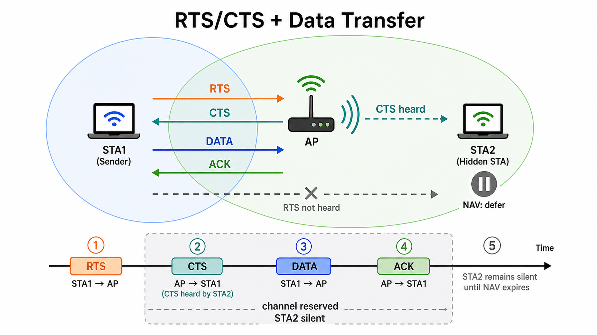
RTS/CTS Mitigates Hidden-Node Collisions
1. RTS
2. CTS
2. CTS
4. DATA
5. ACK

Slide 20
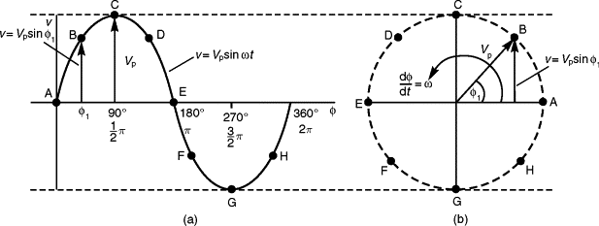

CSI Representation
Represented as a complex exponential $Ae^{Pi}$
$A$: Amplitude — signal strength relative to known transmitted wave
$P$: Phase — signal’s rotation relative to a known transmitted wave
Notes:
https://www.sciencedirect.com/topics/engineering/phasor-representation
CSI=transmitted reference signal / received signal​

Slide 21
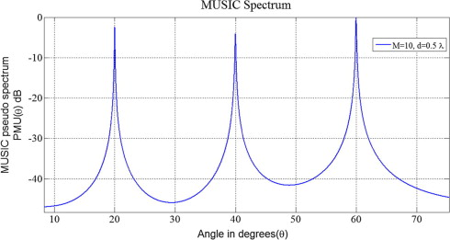
Spatial Spectrum Estimation Estimates AoA
Spatial spectrum estimation scores each angle by matching phase pattern to CSI
Phase pattern of each angle is called steering vector
Angle with the highest score is most likely signal's AoA
Multipath yields multiple peaks
Notes:
https://www.sciencedirect.com/science/article/pii/S209099771300031X

Slide 22
Classic Beamforming Hits a Resolution Wall
The straightforward scorer: shift each antenna's signal to align with a candidate angle, then sum - a true arrival from that angle adds up in phase (delay-and-sum beamforming)
Sweeping this listening beam across all angles gives the spatial spectrum - like turning an ear toward each direction
The beam's width is set by array size: with only 2-4 antennas it is roughly 60 degrees wide
Indoor paths arrive just 10-20 degrees apart, so they merge into one blob inside the wide beam
More antennas would sharpen the beam - but a commodity AP's antenna count is fixed

Slide 23
Why We Use MUSIC
MUSIC skips the beam entirely: it exploits the statistical structure of the received signal to test each angle directly, so resolution is not capped by antenna count
Faster alternatives fit poorly: ESPRIT's algebraic shortcut exists only for strictly regular arrays and degrades under heavy multipath; exhaustive-search ML is accurate but computationally infeasible
MUSIC works with any known antenna layout and stays robust in multipath; its heavier computation is affordable since localization does not need fast updates
Proven on our hardware class: SpotFi reaches ~40 cm median accuracy with 3 antennas using MUSIC
We therefore adopt MUSIC for AP-side AoA estimation

Slide 24
LRG1 Provides AP-Side Control and Measurements
LRG1 exposes the RTS threshold as the main AP-side control knob.
AP-side measurements include retry statistics, RSSI, CSI, AoA, and MCS.

Slide 25
Performance Analysis Separates Gains from Limits
Analyze when the method improves performance and when its benefit is limited.

