Slide 1

Safer APIs
Using Contract Based Testing
Peter Suggitt
Toby Weston
Ben Lithgow-Smith

Slide 2
Learning Objectives
How to defend against changing APIs
How to protect your consumers from your changes
How “contract” testing gives you confidence
Developing without expensive integration testing
When contract testing should not be used

Slide 3
Agenda
Talk a little about the topic
Explore an existing (multi-server) system
Make some code changes
Explore implicit and explicit relationships
Enforce these relationships through “contracts”

Slide 4
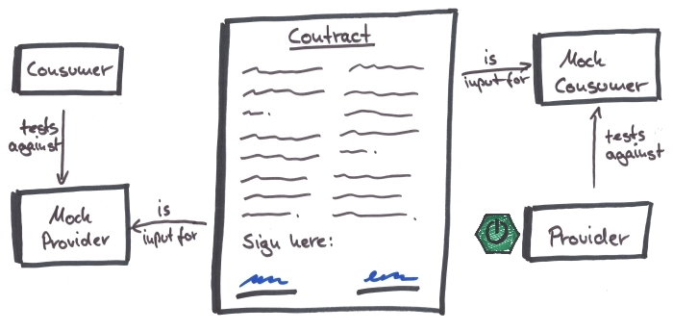
What are Contracts
Notes:
A contract is an agreement between two parties. In this case a consumer and a producer. Two sides of a client / server or API relationship

Slide 5
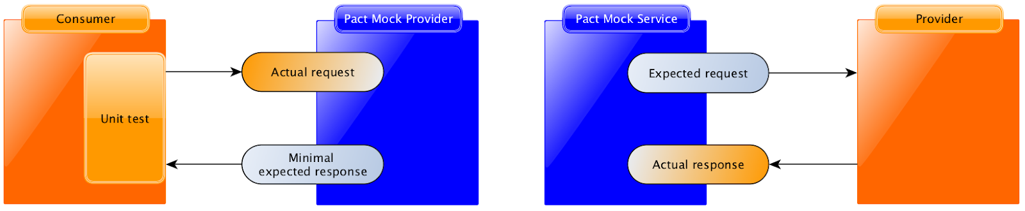
Under the (Pact) Covers

Slide 6
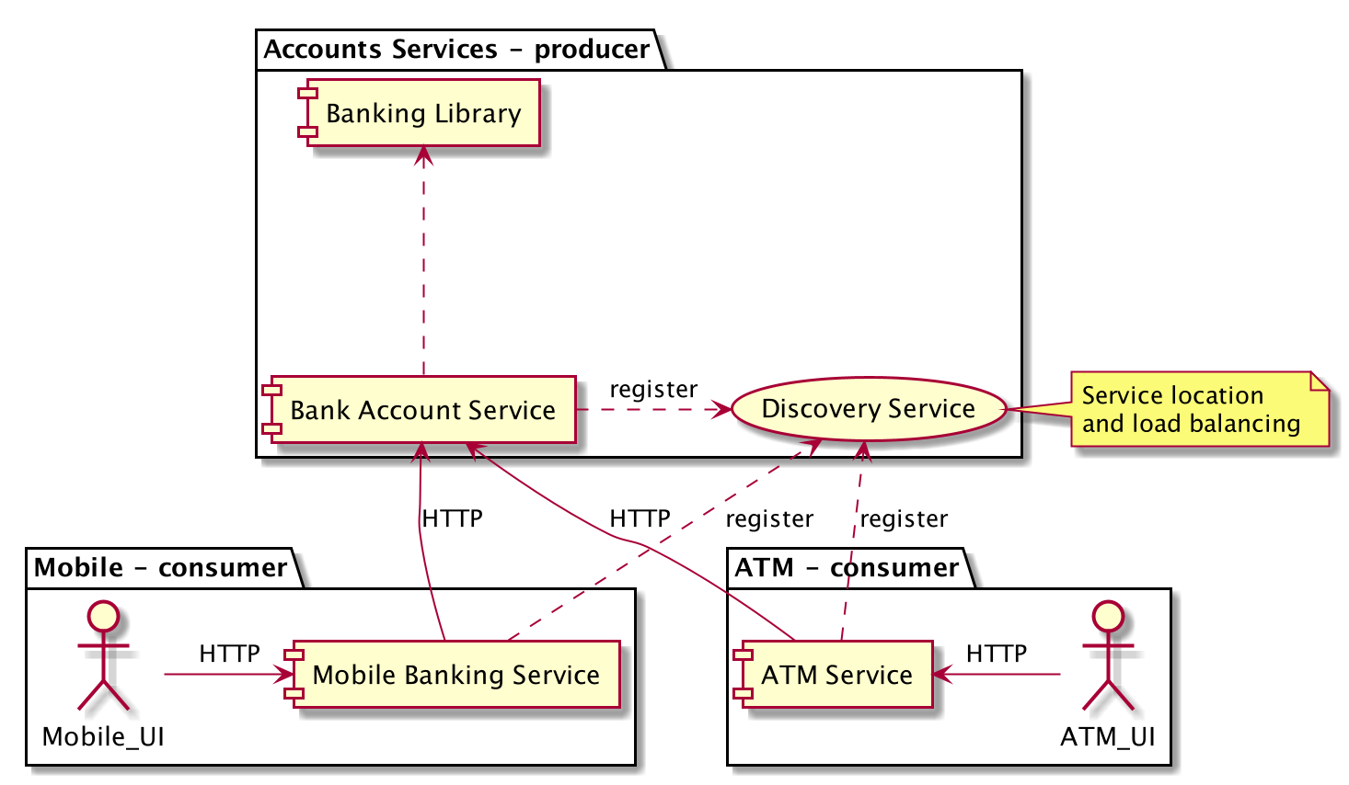
Existing System Architecture

Slide 7
Instructions
Setup the project (in your IDE)
Read the README.md and get the know the architecture
Update the mobile app to consume a new attribute
- Enshrine this in the contract
Implement a new data attribute across the other services
- working with the contracts as you go

Slide 8
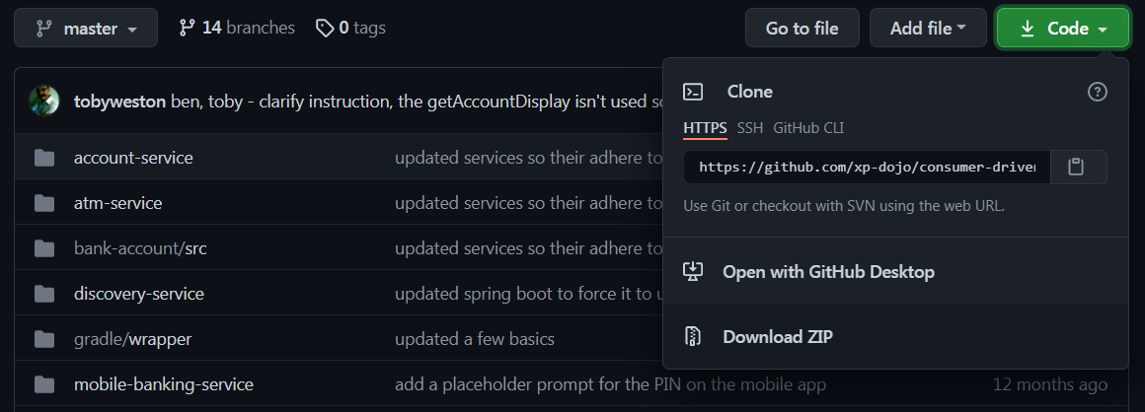
https://github.com/xp-dojo/consumer-driven-contracts
Notes:
Ok lets get coding
Last minute instructions (mention you can download the ZIP if you have problems)

Slide 9

Notes:
This Photo by Unknown Author is licensed under CC BY-SA

Slide 10
Wrap-up
How to defend against changing APIs
How to protect your consumers from your changes
How “contract” testing gives you confidence
Developing without expensive integration testing
When contract testing should not be used

