Slide 1
NTSC video circuit
Needed a device to scan through a memory chip and put an image on a screen
Wanted it to be universal so it could be adapted to an fgpa, arduino, appleii or whatever
I have an old 70s tv I wanted to use with a tv typewriter style system but didn’t want to use any specific custom impossible to find chips, instead wanted something that could be made out of VHDL or discrete components just as easy in either direction
Also had a number of extra 128k x 8-bit hitachi 70ns SRAM chips and built a project around this
Project can take two directions,
- either a single/multi display monochrome, or only 1 color display. Color info uses a lot more bits than monochrome
The output amplifier stage could be copied & pasted 8x and set each bit from the 1 byte memory to represent 8 different monochrome screens

Slide 2
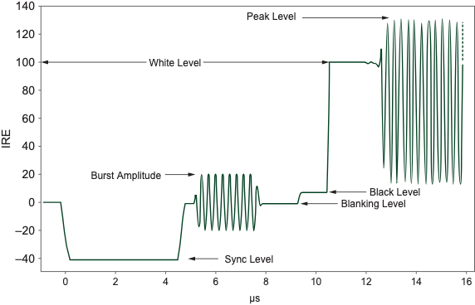
What is NTSC
Color Television Simplified Theory and Service Techniques ( Donald G Fink / Philco)
- https://web.archive.org/web/20240521005611/https://www.worldradiohistory.com/BOOKSHELF-ARH/Technology/Technology-General/Color-Television-Simplified-Theory-Philco-1956.pdf
There is a 300 page philco book about NTSC in great detail, I wont even attempt to repeat what is said in it
Its difficult to avoid discussing what NTSC is – when reviewing over an NTSC video card circuit and how it was built. There is a lot of information online about the history of NTSC, why it is the way it is. but as far as “What it is” – its all in this simplified waveform diagram
in summary:
Its a DC-biased high frequency analog signal , 1.4v peak-to-peak with a negative pulse to synchronize the receiver at roughly 15khz. The Receiving CRT tv aligns itself to this HSYNC pulse each horizontal row of pixels (each scanline) so it knows when its time start drawing & when to advance down the next row
Atop of this HSYNC period, if color is used, is a 2nd sync pulse (Colorburst) to start the timer of an analog circuit related to color in the receiver. When colorburst is present , a color receiver will look at the pixel pulses/signal, and depending on what the phase-shift is of that signal (in reference to its own timer that was just synchronized moments ago), it will “move” or position the drawing on the screen to overlap either the RGB phosphors
When the receiving tv sees this “hblank” pulse, it uses the levels right after to set its various analog circuits, so they know what their turn off levels are (full-dark). On this blanking level is where color magic is shoehorned in

Slide 3
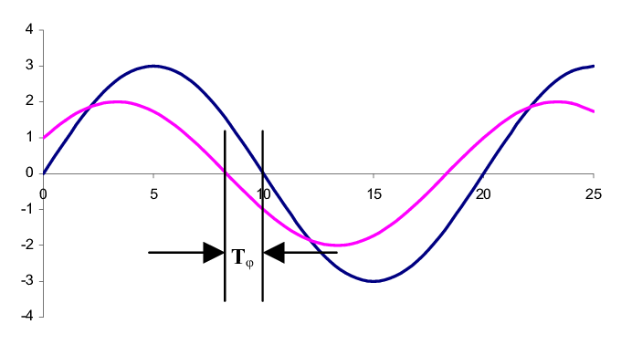
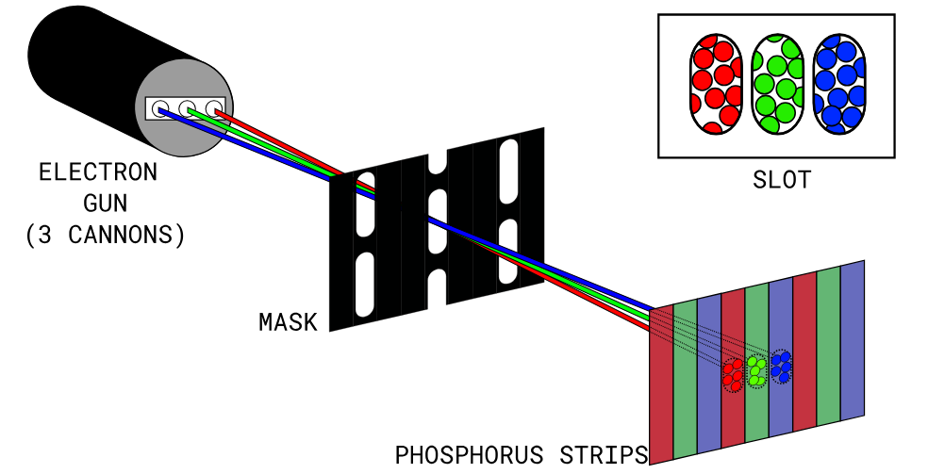
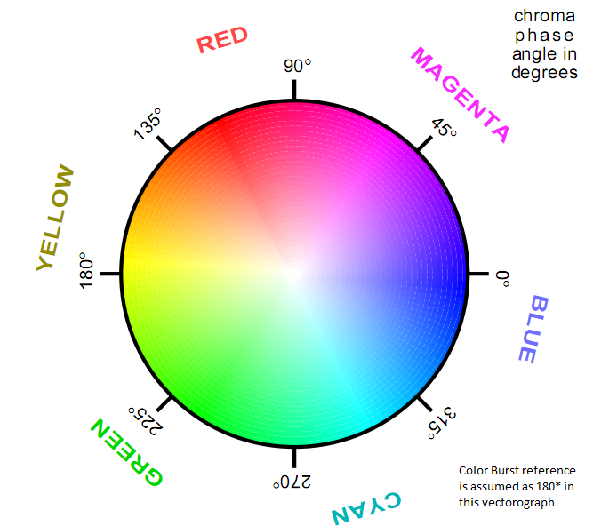
Color in NTSC is determined by the amount of phase-shift, between the colorburst reference signal and the signal received for a given pixel. NTSC doesn’t have concepts of pixels, its just a analog voltage appearing on a line and then decaying at set intervals which roughly correspond to different positions on the screen (which we can call pixels) but mechanically speaking its a stopwatch paired to a trio of R/G/B laserbeams. HSYNC starts the stopwatch1 (draw the pixels timer) , and colorburst starts stopwatch2 (bias the output voltages left or right)
this rise-and-fall of pixel data, is drawn against an oscillator previously locked to the colorburst reference and any phase shift here will be pushing the point of luminosity left-or-right , thus shifting the color in the pattern represented by the following “NTSC color wheel”. So, the phase-shift represents the HUE of the color we see (with 1:1 lock to the reference being equal red-green-blue, or what we would perceive as white)
to be clear the electron beam is not moved or altered by colorburst. It is simply that the voltage-peak is higher earlier-or-later, at the time when its no longer perfectly overlapping the 3 RGB cells, so a 90 degree shift will have 2 half-blues 1 red and 1 green illuminated in perspective from starting at white.
Phase shift of input pixel data changes appearance of timing of output to the electron guns so we are shifting left or right the intensity of the beam against phosphor **but not the beam itself**
Analogy: Imagine a person listening to an echo at a tunnel with a stopwatch on a gameshow. The show has a big wooden spinning color wheel which begin rotating by a motor when the show host fires a starting pistol (the colorburst timer). The longer the delay between the original sound and the echo, the more “time” translates to color shift and when the echo is herd the person stops the color wheel, and the color they land on is their score. The wheel never stops spinning, and the starting pistol is only fired once per round, so the contestant is reliant upon their stopwatch for good accurate scores
do this enough and can see that different colors happen at different exact predictable times (echos) given the tunnel length & wheel speed (clock frequency) stays the same. This is an analog way to convey lots of info (full color pallet)

Slide 4
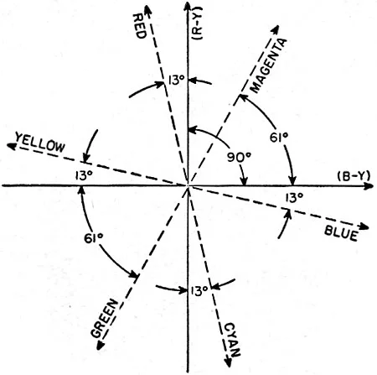
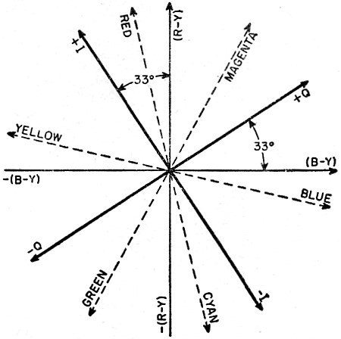
https://www.rfcafe.com/references/radio-news/color-tv-ntsc-system-radio-television-news-april-1954.htm
NTSC color wheel in references look like this
red is (BY) – 103, or (RY) - 13
Yellow is (BY) – 167
Yellow also (-BY) + 13
Green (-BY) -61
Blue (BY) – 13

Slide 5
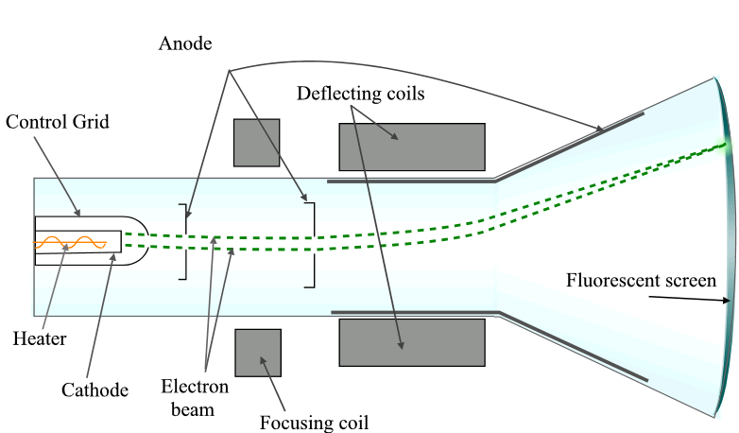
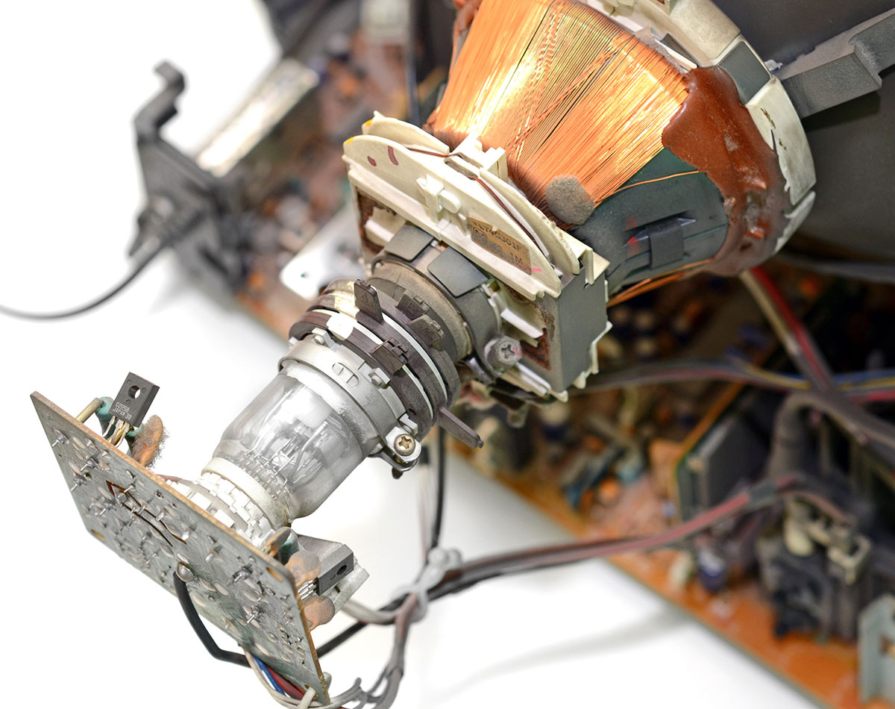
Emphasis on: “the electron beam is not moved or altered”
We can’t (thats not how it works)
The CRT uses electromagnetic deflection coils which are very heavy components electrically, these are cycled at roughly 15khz . “pixels” on the screen are nearly 4mhz, so if we want to influence anything to do with pixels and how they appear on screen we have to rely on only this:
- changing beam intensity at specific points in time (electron gun is tiny and fast)
NTSC was designed to accommodate CRT display tubes, this means every design consideration is there to accommodate the mechanical behaviors of CRTs
- electron beam, phosphor screen, timings, color levels
For those using a modern display : None of this is directly useful to an LCD screen, so an LCD screen with composite in will be using an analog-digital type circuit to read the voltages at specific times and determine what a pixel is and what color it probably is. The artifacting and accuracy of what is shown will vary

Slide 6
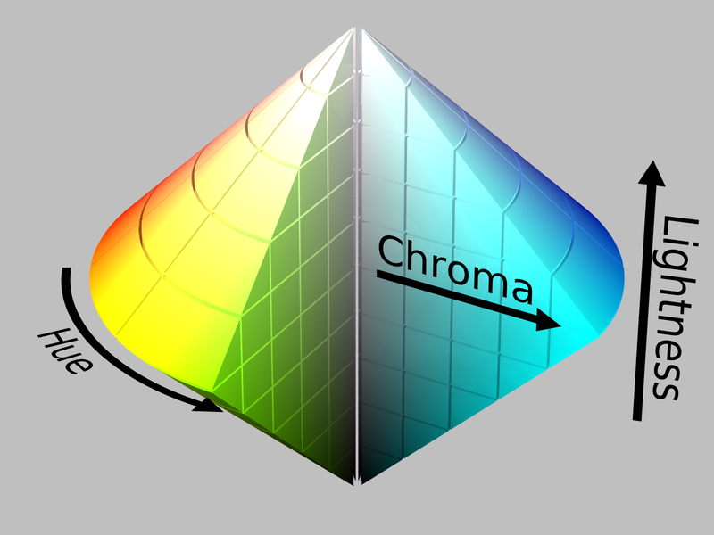
Ive shown the NTSC color wheel from a 2D view, but that isnt the full story. NTSC has the concepts of “brightness” and “Saturation” as representation of signal intensities. But in the 2d view notice it is brighter or more pastel in the center
Here im showing the 2D color view, and the 3D reality which happens with over-saturation or overdrive

Slide 7
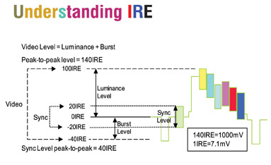
To discuss the 3d NTSC cone shape, need to go over the levels. More intensity doesn’t exactly mean “more of whatever color is happening right now”, it can mean (especially on a CRT set) color bleedover into adjacent cells as what might’ve been intended to be 50% cell1 50% cell2 illumination with proper biasing, too much intensity could result in 100% cell1 and 100% cell2 which results in the WRONG COLOR
With the HSYNC period having set the “black level” (which is the period at which the electron beam is turned off by its analog amplifier inside the receiver tv)
NTSC is originally a black and white concept with color added on as not a topic of levels, but one of phase-shift as we saw previously.
This is done by changing the MODULATION of the output signal, as in, keeping the peak voltage high but raising the DC bias upwards, reduces saturation and reduces the influence of this colorburst phase-shift making the image appear more gray and, well, less saturated.
So in review NTSC has these 3 key things:
HSYNC timing (start + stop time period, voltage level) – This sets when each new scanline starts and gets the show started and must be microsecond precise
Signal height (bias + peak to peak measurement) – translates to electron gun beam intensity or brightness. Its 0-1.4v
Signal amplitude (peak-to-peak, disregard bias) : More amplitude = less gray, less amplitude = more gray. controls amount of time/intensity electron beam is kept “away” from turnoff point and results in color cells always getting some intensity, which ‘grays’ out the image

Slide 8
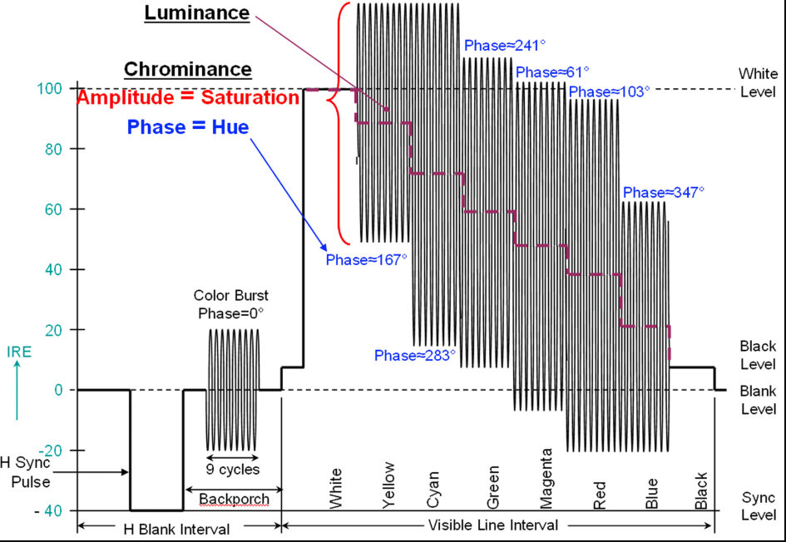
Going further into saturation & levels, different colors have requirements for both biasing the DC floor upwards (reduce saturation) or lowering it below black levels.
Red, Blue need to be modulated less than yellow or cyan, but have a lower starting point – this translates to less intensity on the electron beam and is nearly turning off, has to do with how the colors on a CRT phosphors are blending in
yellow and cyan are red + blue but need to keep the electron guns drive hot and vibrant almost white, so these colors are “biased upwards”
When you look at things like this, color on NTSC really seems like someone just slapped in a phosphor grid into a B&W set and used a few tricks to make the beam blink in the right spot at the right time.
Its clever but there are a lot of layers of cleverness to unpack

