Slide 1
Prediction about Telecom Users’ Behaviors
Presented by: Siao Chen, Jiayue Zhang, Lingyun Yi, Rongrong Su
Stat 841/ CM 763 Final Project Presentation

Slide 2


Project Motivation
The traditional telecommunication companies are facing huge pressure (Google and Facebook).
In fact, it costs 5 times as much to attract a new customer than to keep an existing one.
This project is aim to provide insights for the company in predicting

Slide 3
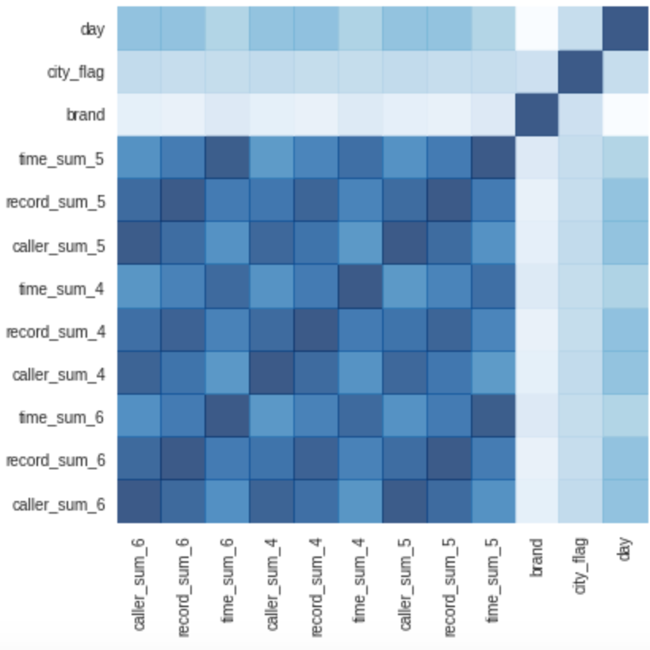
Data Preprocessing
1. Data transformation
43 GB, including about 9 million users with 2 billion call records in a 3-month duration.
Combine all the call records by caller ID
For each caller ID, sum callers contacted number, calling records number and calling duration by month.
The correlations between any two of the variables

Slide 4
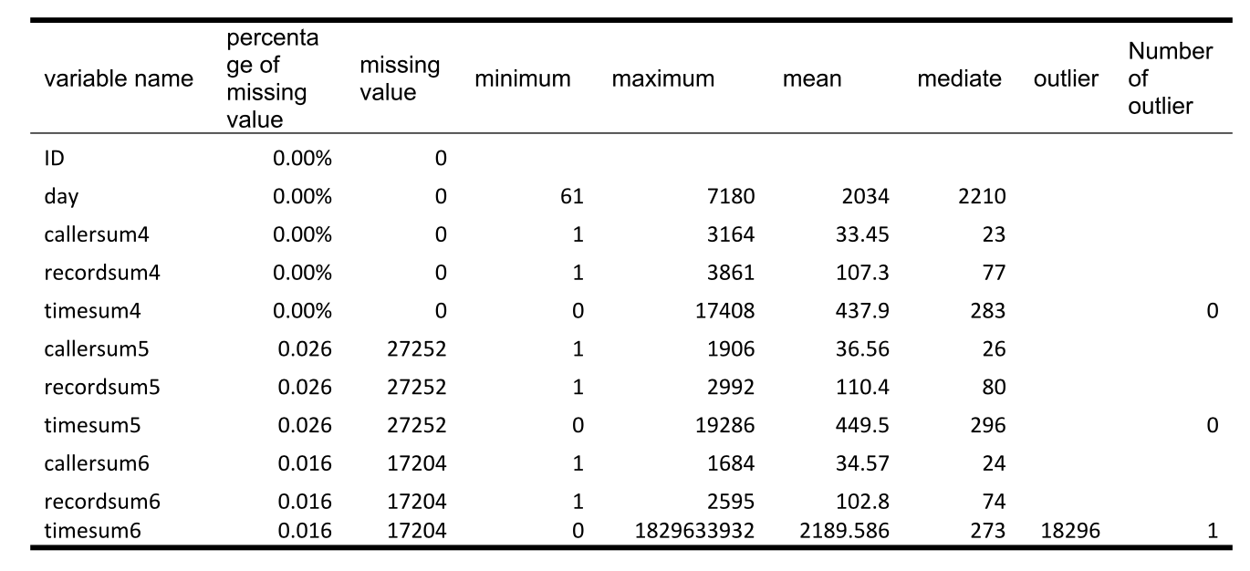
Data Preprocessing
2. Data Cleansing
Validity - Keep the correct ones
Missing Value – Delete
Outliers – Delete

Slide 5
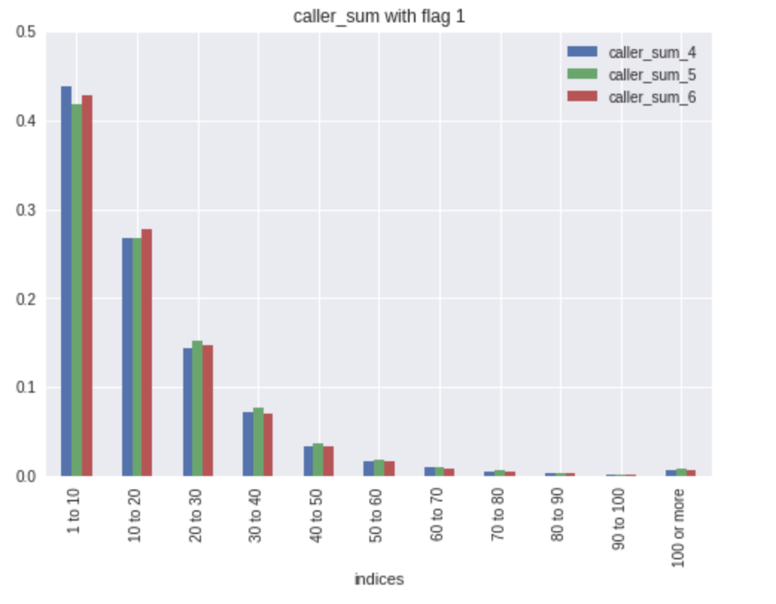
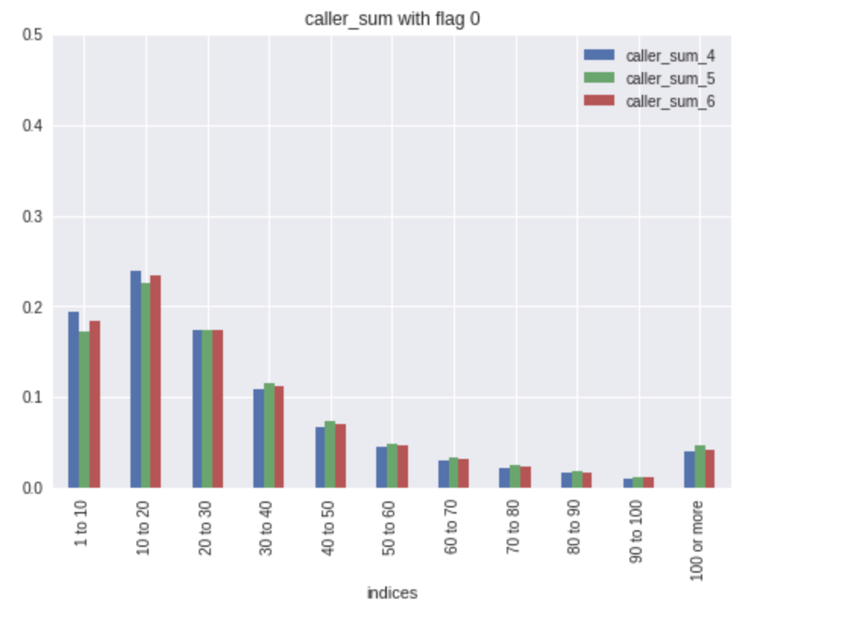
Data Preprocessing
3. Features
Features are ‘day’, ‘brand’, ‘city_flag’, along with ‘recordsum’, ‘timesum’, ‘callersum’ for 3 consecutive months. There are in total 12 features.

Slide 6
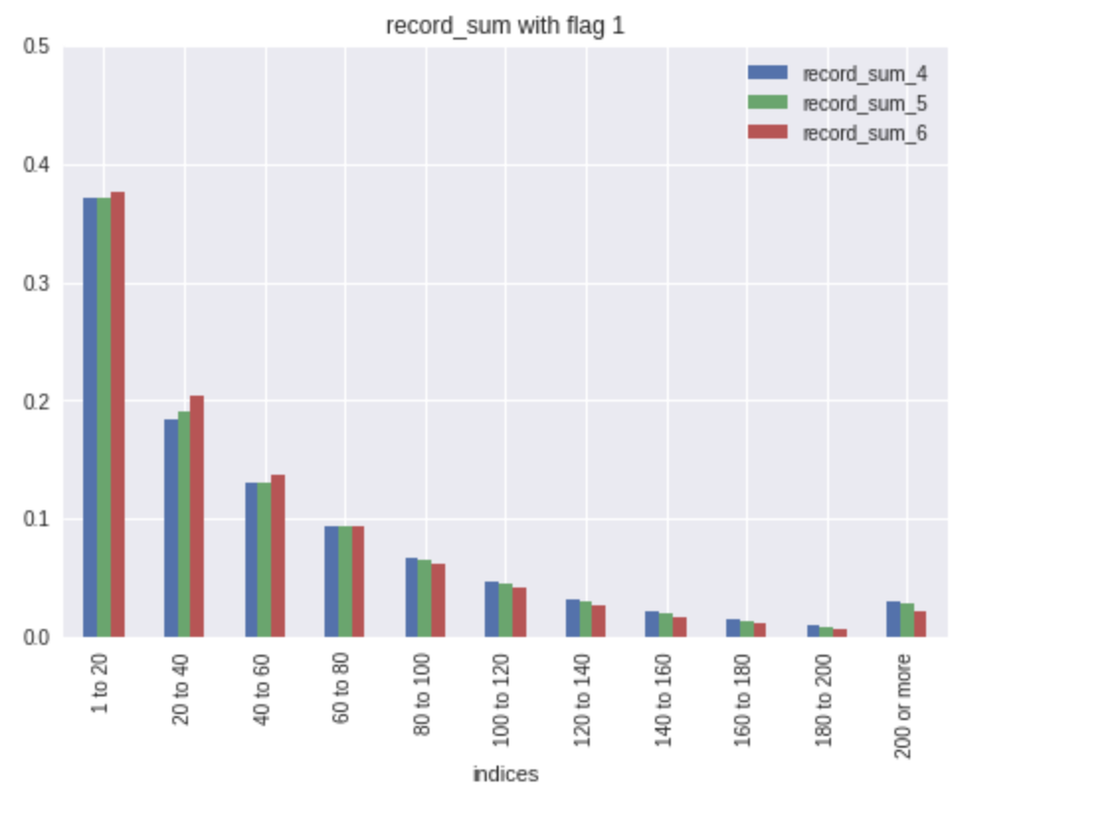
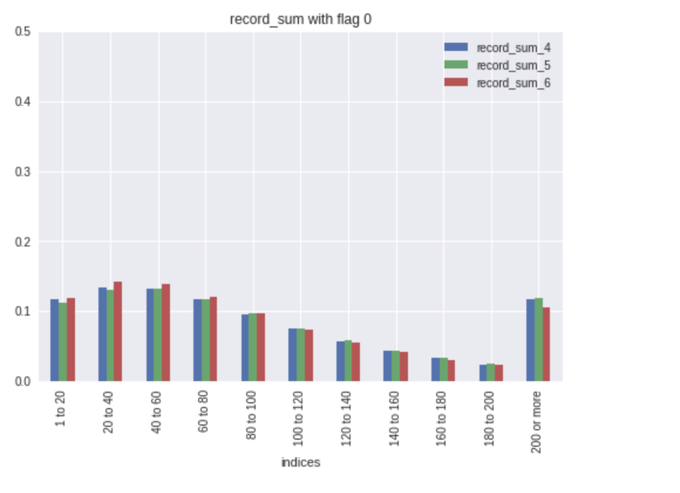
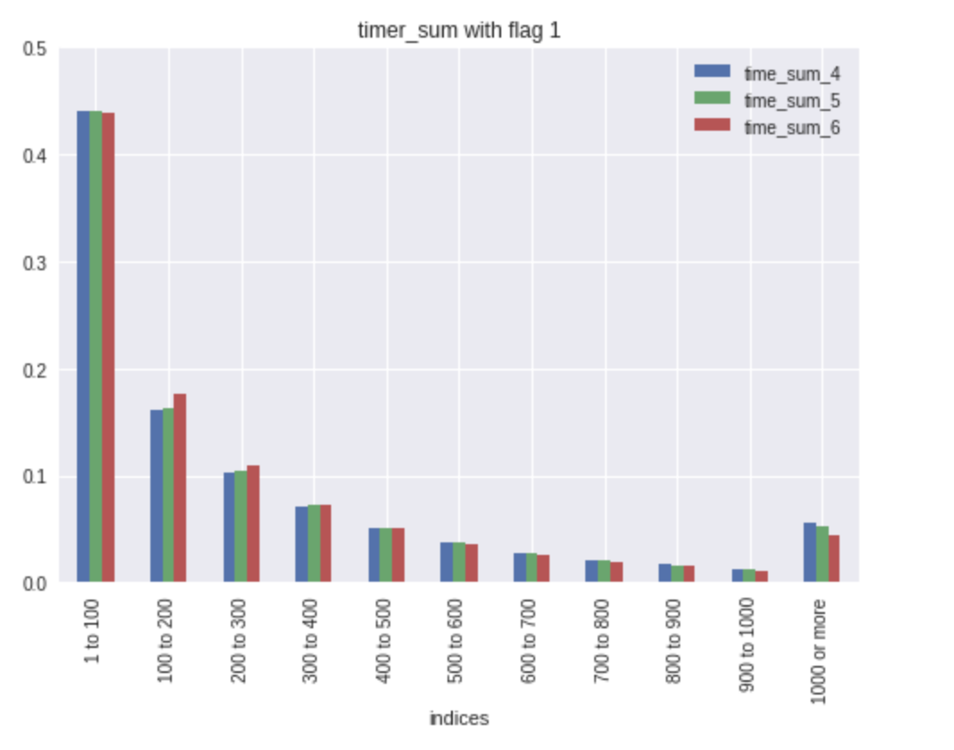
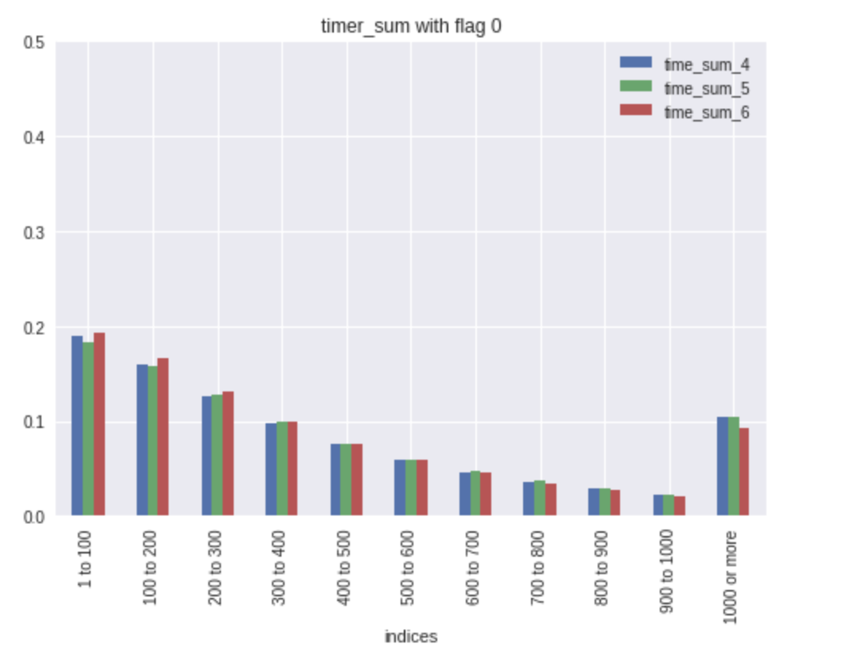

Slide 7
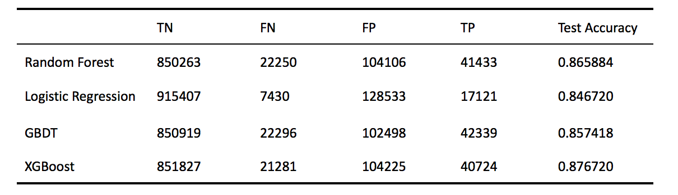
Models Building -- Original Models
(1) Models without weight adjustment

Slide 8
Models Building -- Original Models
(2) Models with weight adjustment
Dataset is imbalanced: 16% of the data points belong to class 1,
whereas about 84% of the data points belong to class 0
Assign weights for different class

Slide 9
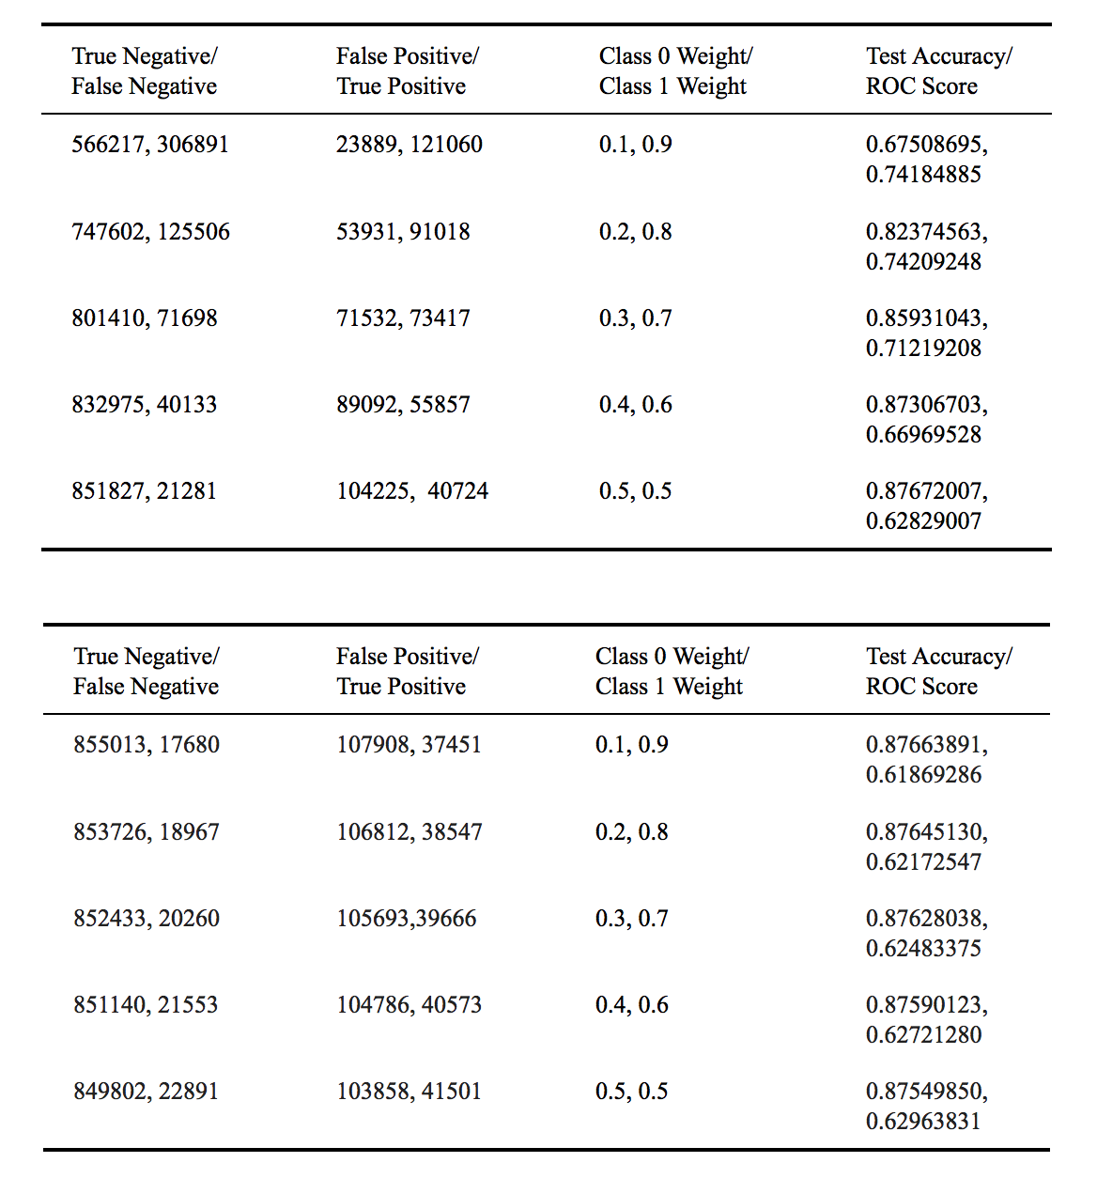
XGBoost
Random Forest

Slide 10
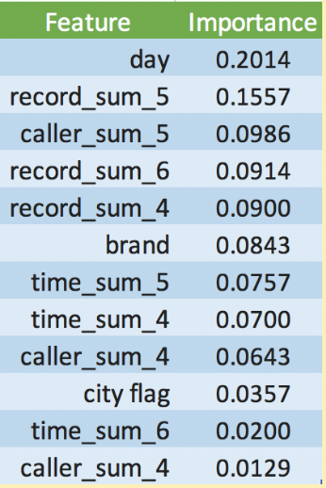
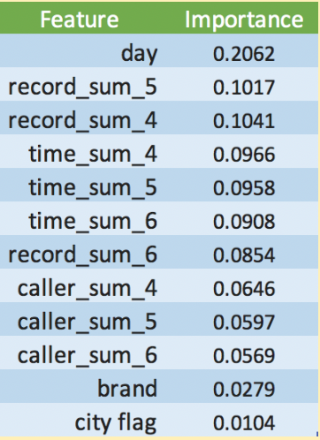
Models Building -- Feature Selection
(2) Based on Random Forest
(1) Based on XGBoost
‘XGBRegressor’ and ‘RandomForestClassifier’ from Scikit-Learn were used.

Slide 11
Models Building -- Feature Selection
(1) Test Accuracy Difference
XGBoost and Random Forest algorithm perform better with features selected by ‘XGBRegressor’
(2) Runtime
XGBoost algorithm : (Class 0 weight = 0.2 ; Class 1 weight = 0.8),
Runtime was about 452.905s
After using the 10 features selected by ‘XGBRegressor’, the runtime decreased to 359.208s

Slide 12
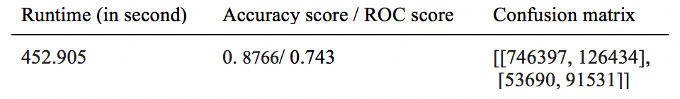
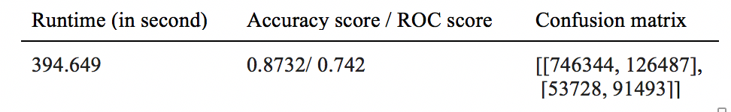
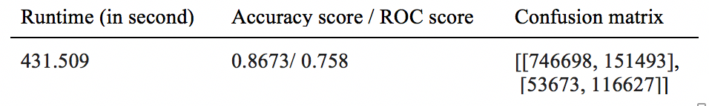
Models Building -- Missing Data Handling
XGBoost
Without missing values and outliers
After feature selection
Keep NA in the dataset
XGBoost does
well in NA

Slide 13
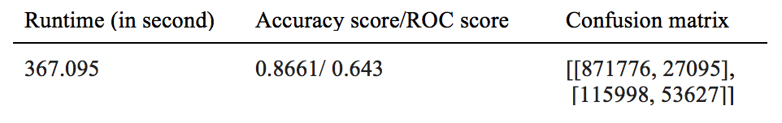
Models Building -- Feature Selection
Random Forest
Inputed the data with mean of the corresponding feature;
ROC is really low ;
Confusion Matrix performs badly ;
XGBoost does well in Missing Value

Slide 14
Conclusion
(1) Feature Selection
Feature can reduce the runtime while maintaining a high accuracy score
(2) Imbalanced Data
Imbalanced data can significantly affect the end result if it was not handled properly.

Slide 15
Conclusion
(3) XGBoost
XGBoost can indeed handle missing value very well by comparing its accuracy and runtime
(4) Further analysis ……
Possible existence of clustering phenomenon for customers leaving the service
Study the relation between each customer in a graph with weighted edge

