Slide 1


Narratives of AI Innovation: A Textual Analysis of Western Social Media’s View on ChatGPT and DeepSeek
March 9th, 2025
Presentation Video Link: https://www.youtube.com/watch?v=eMbICh3nlS8
Xinyue ‘Yolanda’ Pan
MACSS, Social Science Division

Slide 2

Content
Project Overview
Data Processing and EDA
Model Exploration
Emotional Narratives
Topic Modeling
Clustering
Data Analysis
Discussion

Slide 3
Project Overview

Slide 4
Project Overview
Motivation
The rise of DeepSeek and other large language models (LLMs) marks both a technological milestone and an opportunity to explore the geopolitical and cultural tensions in the global AI landscape. This study examines how predominantly English-speaking social media platforms, particularly Reddit, shape perceptions of AI models like ChatGPT (developed in the U.S.) and DeepSeek (developed in China).
Research Question
What narratives emerge from Western Reddit communities’ discussions about ChatGPT and DeepSeek, and how do these narratives reflect user perceptions of AI innovation?
Machine Learning Task Formulation
(1) emotion/sentiment labeling with RoBERTa-base-go_emotions (supervised), (2) topic modeling with BERTopic (unsupervised) to identify narrative themes, and (3) clustering (unsupervised) of BERTopic probability outputs to group similar narratives and answer the research question.

Slide 5
Theory of Orientalism
Edward Said’s theory of Orientalism (1977) provides a critical framework for understanding how the West constructs the "Other," often framing Chinese AI technologies like DeepSeek as exotic, inferior, or threatening, while portraying Western models like ChatGPT as symbols of innovation and superiority. This study explores how Western social media users on Reddit (e.g., r/ChatGPT and r/DeepSeek) reinforce these Orientalist narratives, reflecting broader geopolitical tensions and cultural biases. While the Reddit community is predominantly tech-savvy and Western-centric, it offers valuable insights into how power dynamics shape global AI discourse, particularly in the context of rising competition between the West and China.
Hypothesis
H1: Sentiment towards DeepSeek will be more negative and emotionally charged compared to ChatGPT, reflecting cultural stereotypes about Chinese LLMs. ‘
H2: Discussions about Chinese LLMs will frequently feature terms like "surveillance" or "authoritarianism," while Western LLMs will emphasize "freedom," "creativity," and "leadership."
H3: Clustering of DeepSeek discussions will group granular topics into broader themes, with "geopolitical risks" exhibiting more negative sentiment than "technical capabilities."

Slide 6
Data Processing & EDA

Slide 7
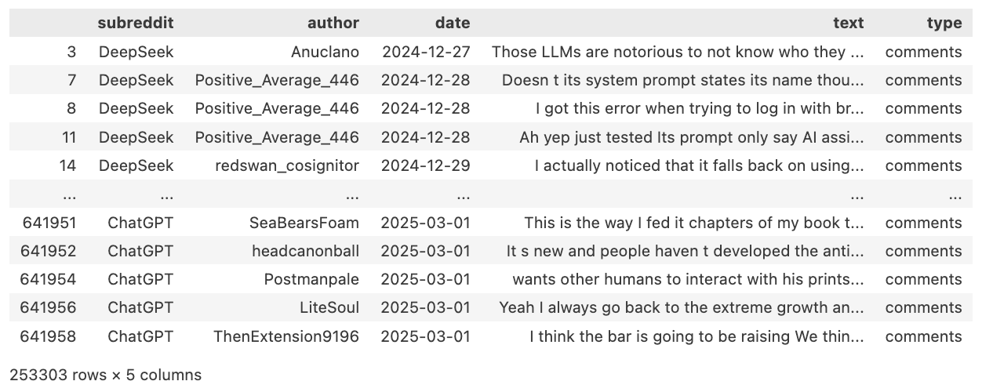
Data Processing & EDA
Data Preparation
Data Collection
Source: arctic-shift
Subreddits: r/ChatGPT, r/DeepSeek
Size: 641, 961 in total
Time Range: 2024/12/27 - 2025/03/03
Preprocess data:
Remove comments that below 12 words (medium quartile) and above 96 words (95th percentile)
Remove mentions, special characters, URLs, bot replies
Convert the unix timestamp to readable date

Slide 8
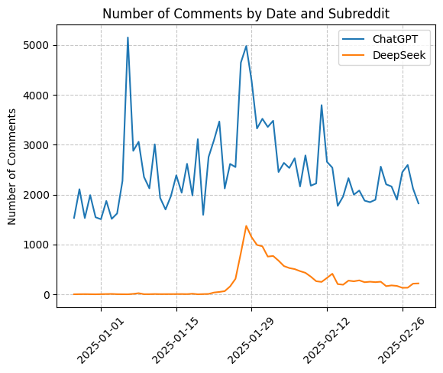
Exploratory Data Analysis
Important dates:
2024/12/26: DeepSeek-V3 release date
2024/12/27: First comment appear on r/DeepSeek
2025/1/20: DeepSeek-R1 release date

Slide 9
Model Exploration/Interpretation

Slide 10
Emotional Narratives
Model: SamLowe/roberta-base-go_emotions
Widely used and trained based on Reddit data with 28 emotion labels
Evaluation: Randomly sampled 50 input to check its label emotion
Data Processing:
Drop emotion category with less than 5 posts
Drop neutral emotions
Map emotions into sentiment of ‘positive’, ‘negative’, ‘neutral, and ‘ambiguous’

Slide 11
Topic Modeling
Model: BERTopic
Traditional clustering methods (like K-Means) rely on Euclidean distance, which does not capture semantic similarity well.
BERTopic converts documents into embeddings using transformer models (e.g., sentence-transformers), which better represent meaning.
Model Tuning:
Set stop words
Start without setting number of topics (too many identified topics and too large to run)
Set number of topics to 50, and reduced to 20, rearrange outliers
Stratified by date and random sampling from r/ChatGPT (1/10) to benchmark number of r/DeepSeek
Model Evaluation:
Using LLM to assign themes
Topic-document distribution
Topic Coherence Score
Topic Diversity

Slide 12
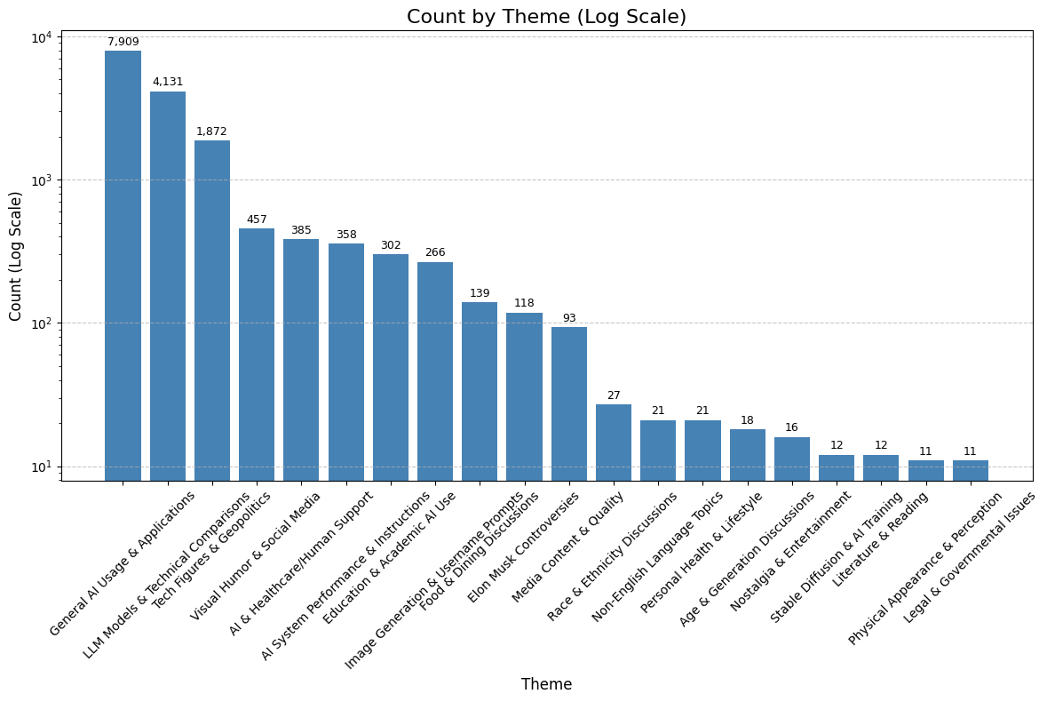
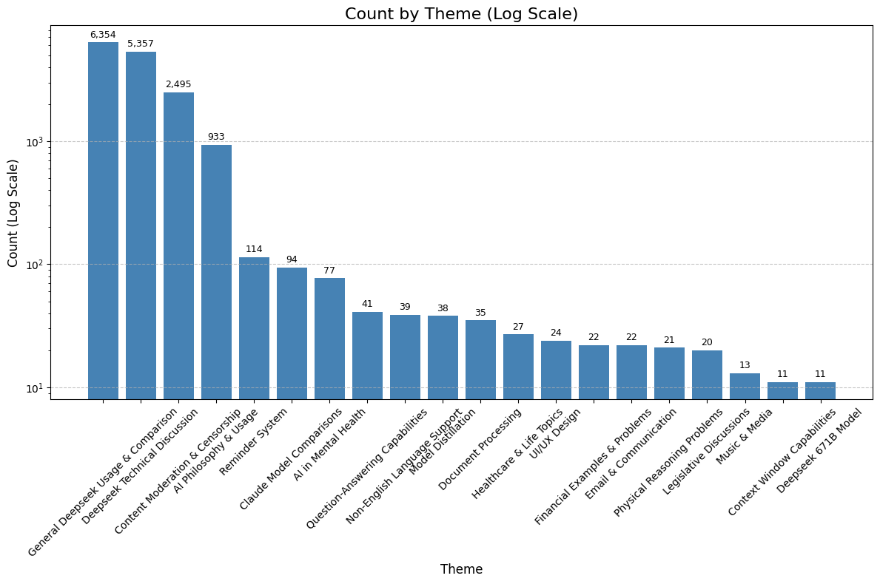
Themes
Topic Modeling - Model Evaluation
Topic-document distribution
ChatGPT
DeepSeek

Slide 13
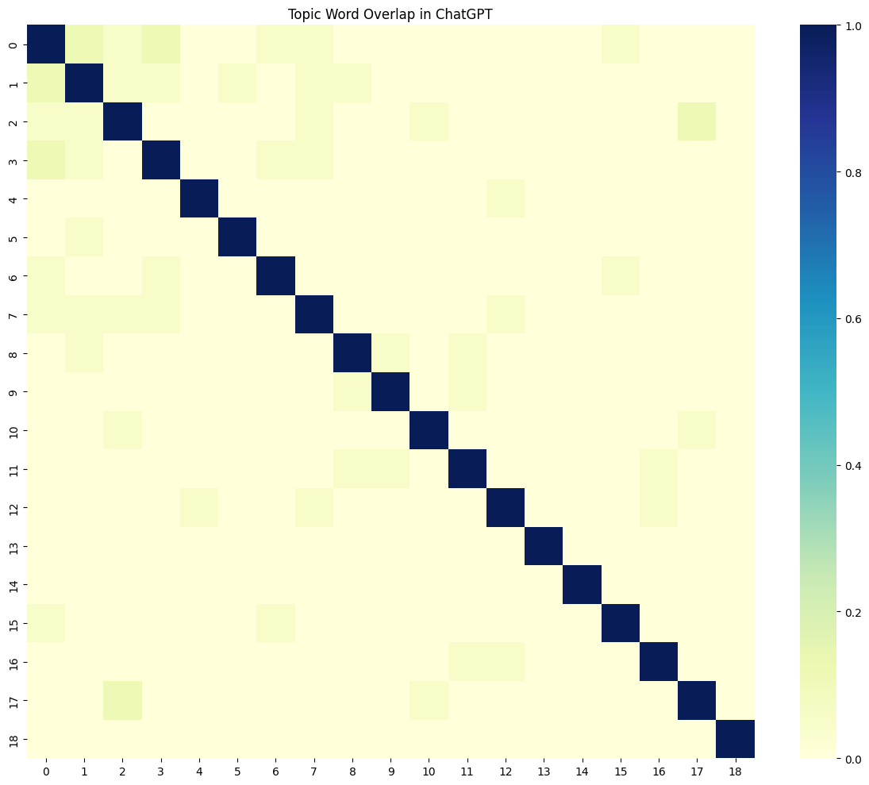
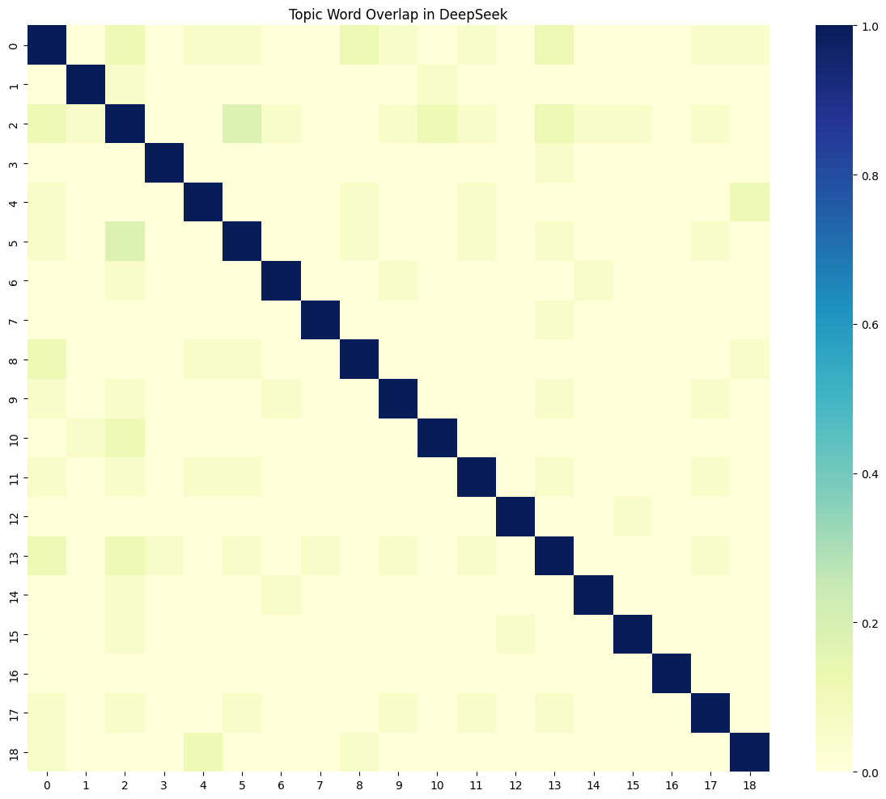
Themes
Topic Modeling - Model Evaluation
Topic Coherence Score & Topic Diversity
ChatGPT
DeepSeek
Average topic overlap: 0.0087 (lower is better)
'num_topics': 19,
'diversity': 0.8842105263157894,
'avg_overlap': 0.008720631989330044
Average topic overlap: 0.0145 (lower is better)
{'num_topics': 19,
'diversity': 0.8526315789473684,
'avg_overlap': 0.0144720245746806,

Slide 14
Clustering (r/DeepSeek)
Model:
- K-Means applied to sentence embeddings from BERT (e.g., sentence-transformers’ all-MiniLM-L6-v2)
- Hierarchical clustering
Process:
Generate embeddings for all posts.
Determine optimal k (e.g., 5–10 clusters) using elbow method or silhouette score.
Cluster posts and label clusters by analyzing top keywords and representative texts (e.g., "geopolitical threat" cluster).

Slide 15
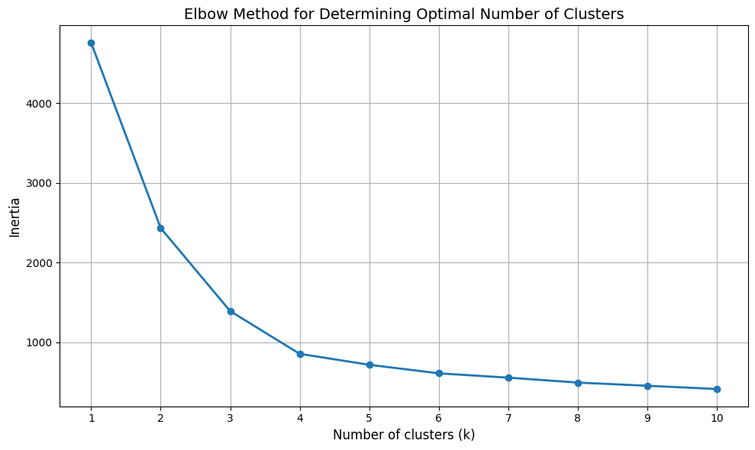
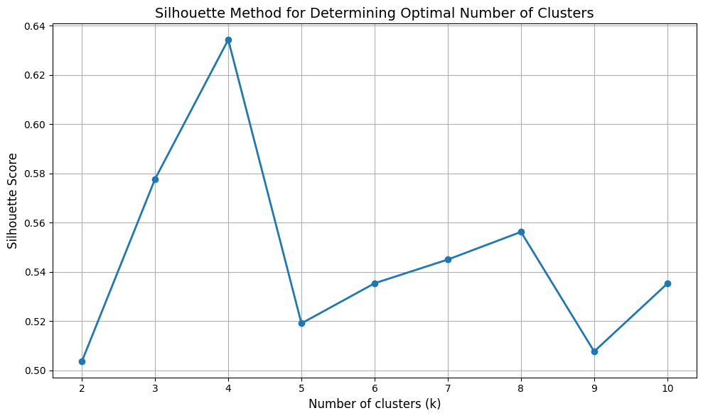
Finding k (k-means)
K-Means

Slide 16
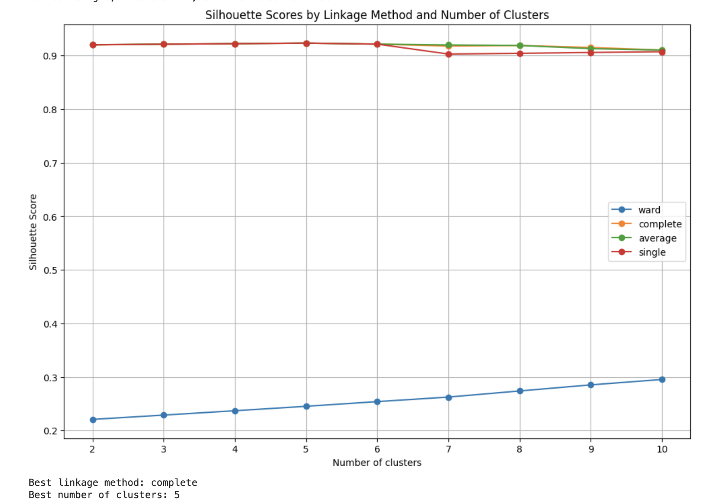
Finding k (hierarchical)
K-Means

Slide 17
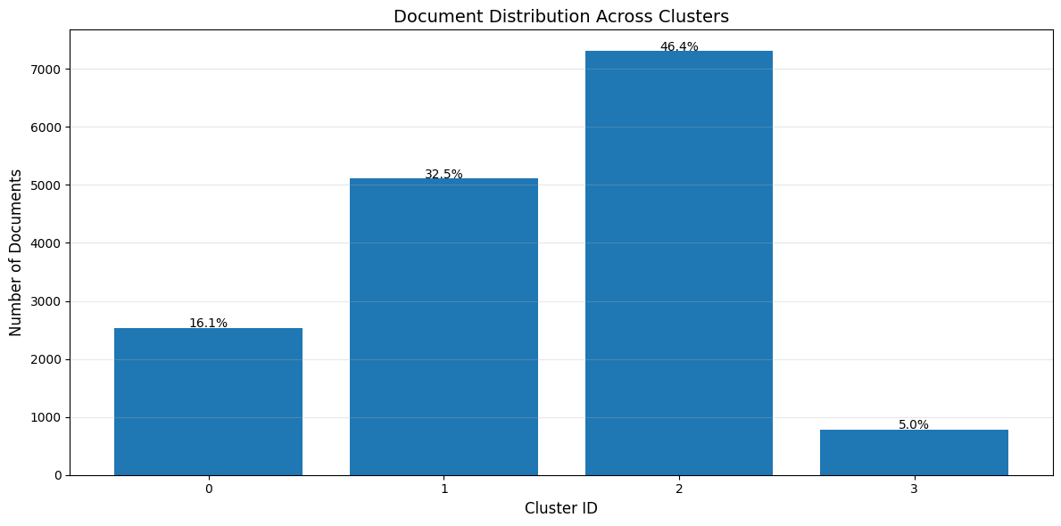
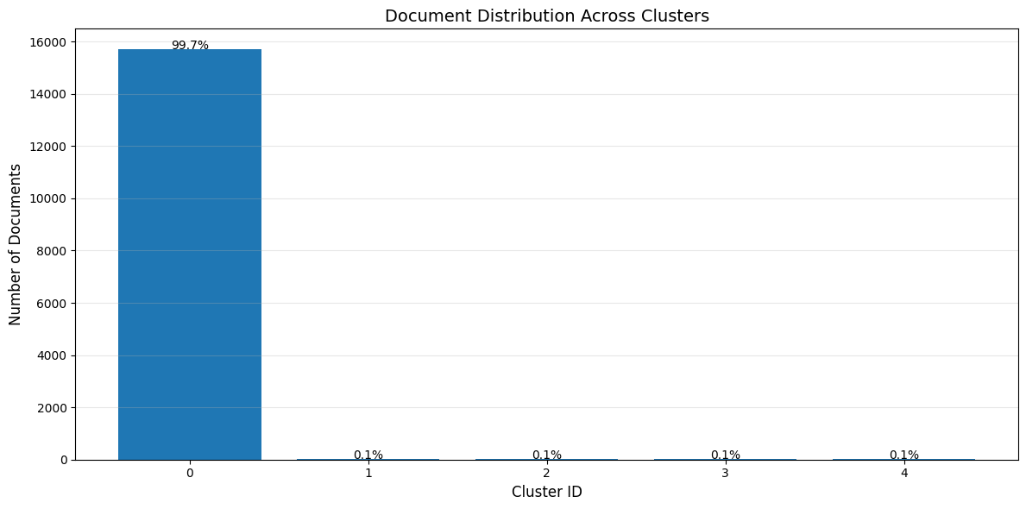
Topic Distribution (k-means vs hierarchical)
Topic Distribution (k-means vs hierarchical)

Slide 18
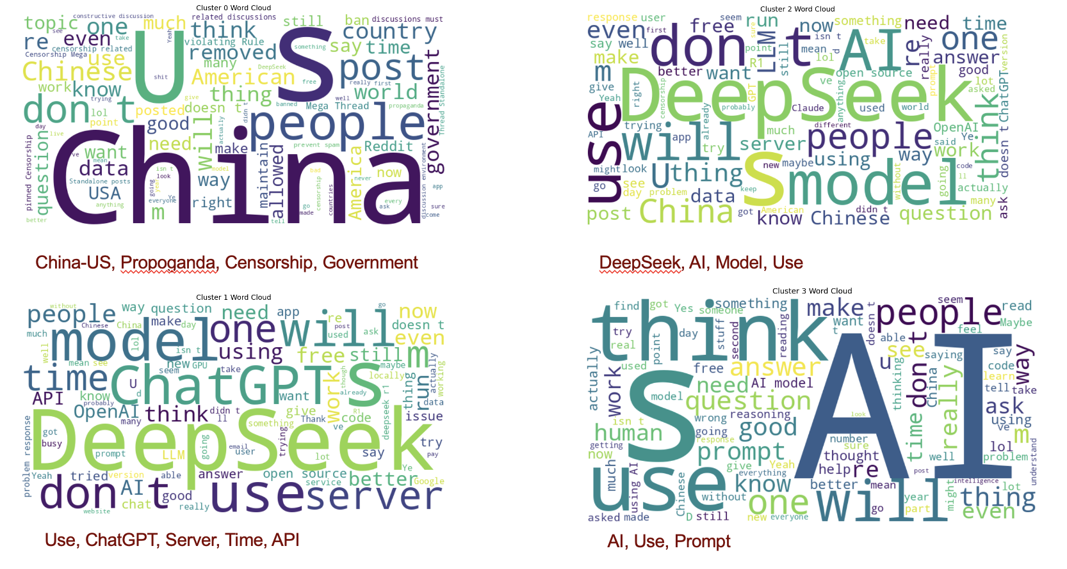
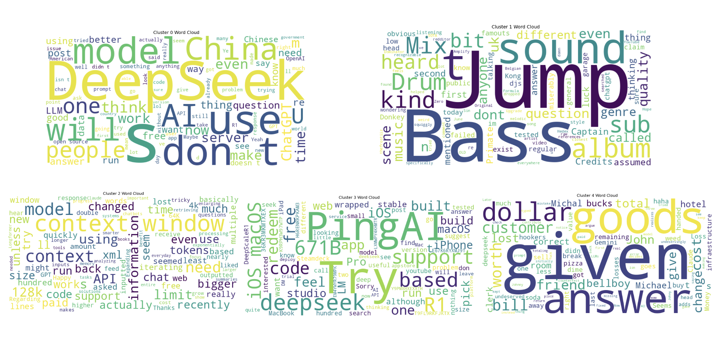
Word Cloud (k-means vs hierarchical)
K-Means

Slide 19
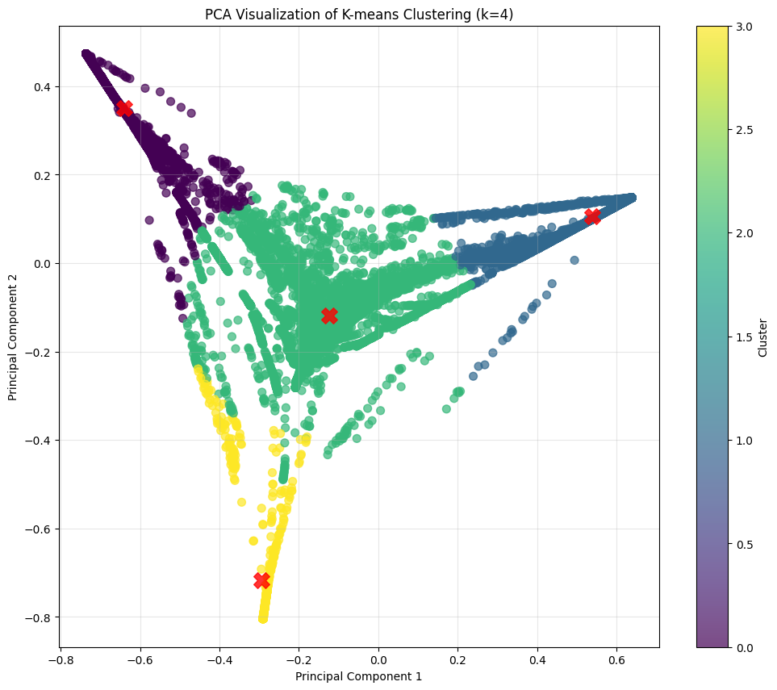
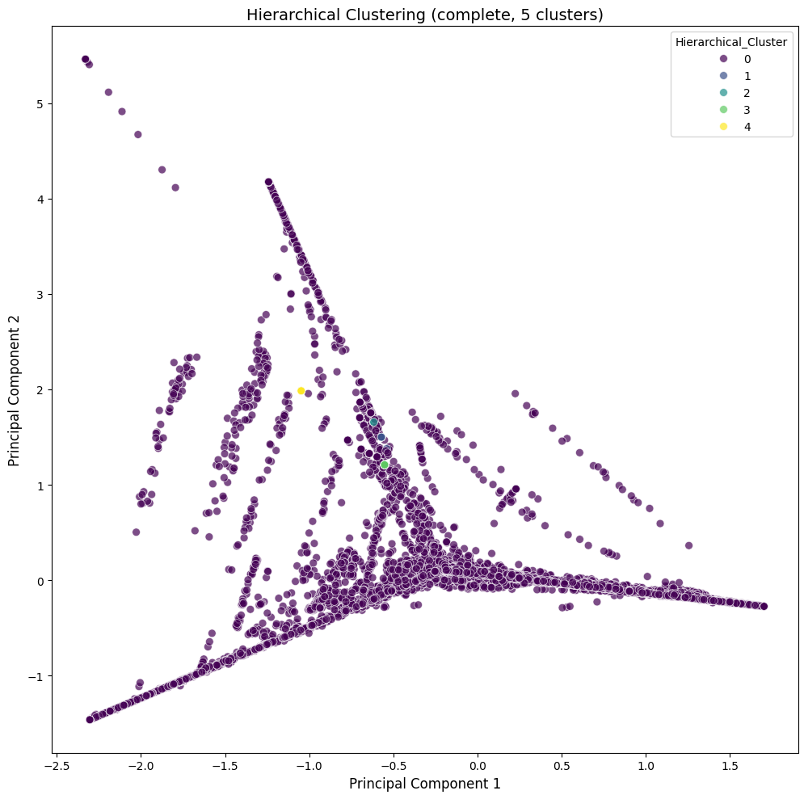
Cluster Overviews (k-means vs hierarchical)
K-Means

Slide 20
Data Analysis

Slide 21
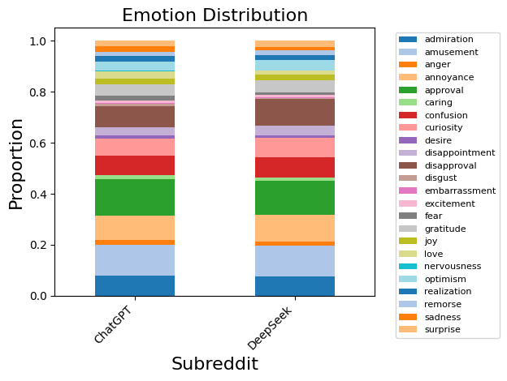
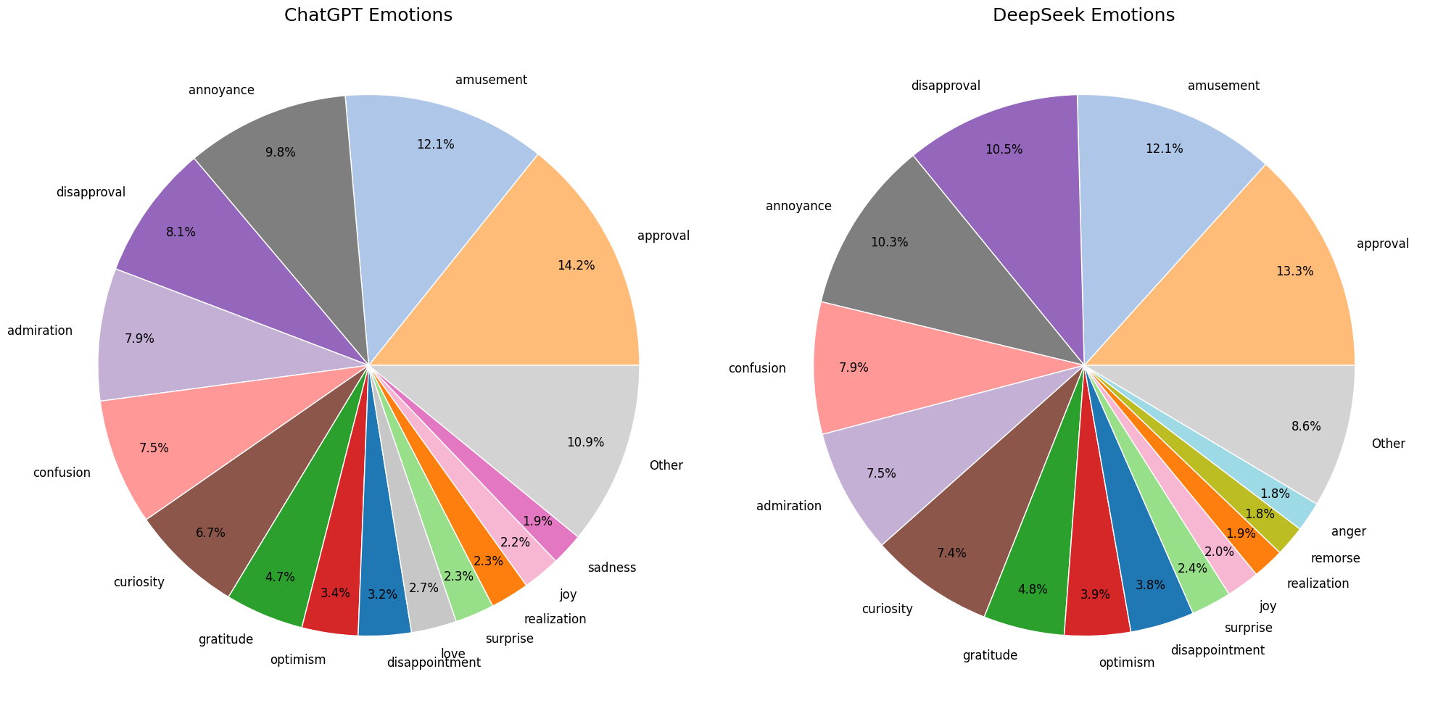
Emotion Distribution
* Note: Emotions with red box on legend are different between r/ChatGPT and r/Deepseek statistically significant

Slide 22
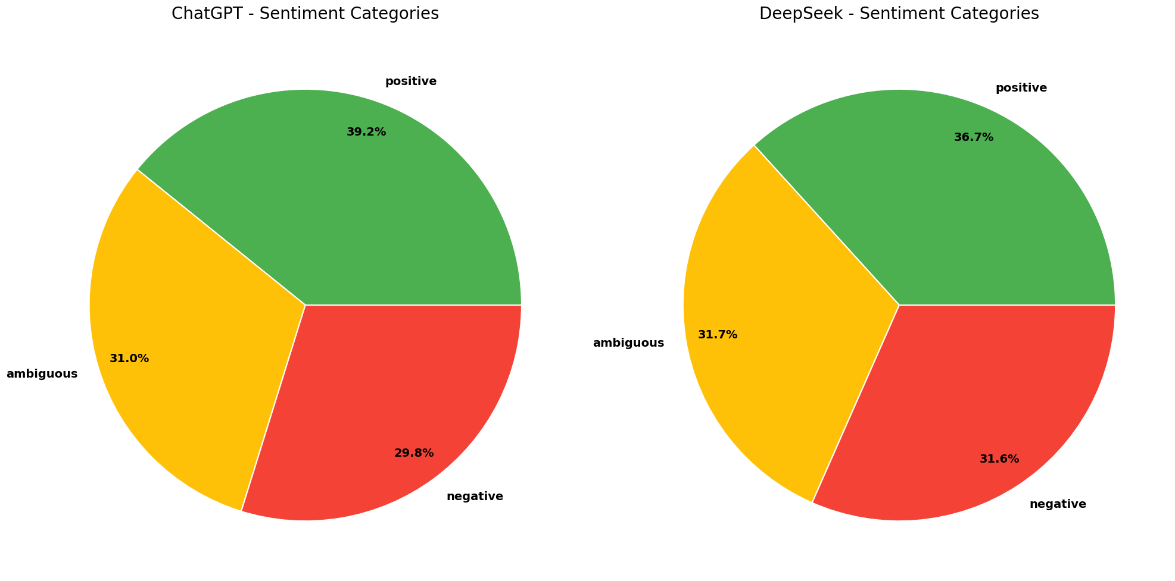
Sentiment Distribution
Sentiment: negative
{'chi2': 9.033476394352363, 'p_value': 0.0026507989413307215, 'is_significant': True}
{'z-stat': -3.019824603192709, 'p_value': 0.0025292110778380953, 'is_significant': True}
Sentiment: positive
{'chi2': 14.893010644253074, 'p_value': 0.00011378378002645242, 'is_significant': True}
{'z-stat': 3.872527356323686, 'p_value': 0.00010771258170140623, 'is_significant': True}

Slide 23
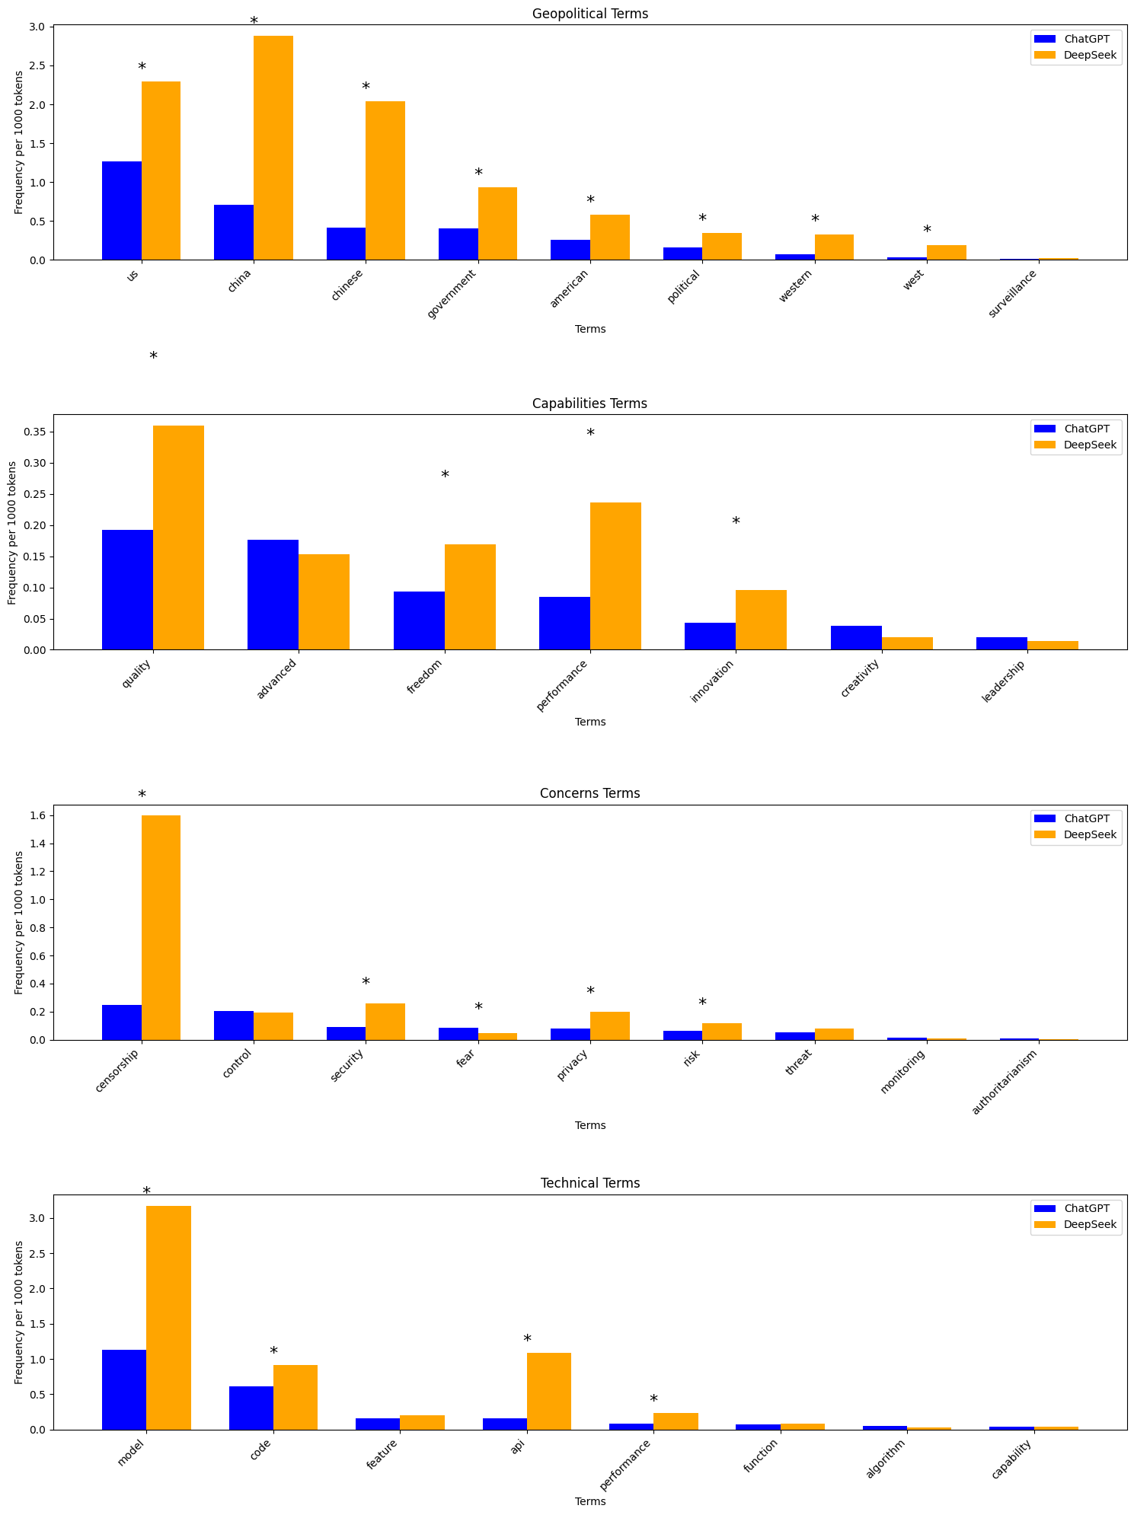
Terminology Usage

Slide 24
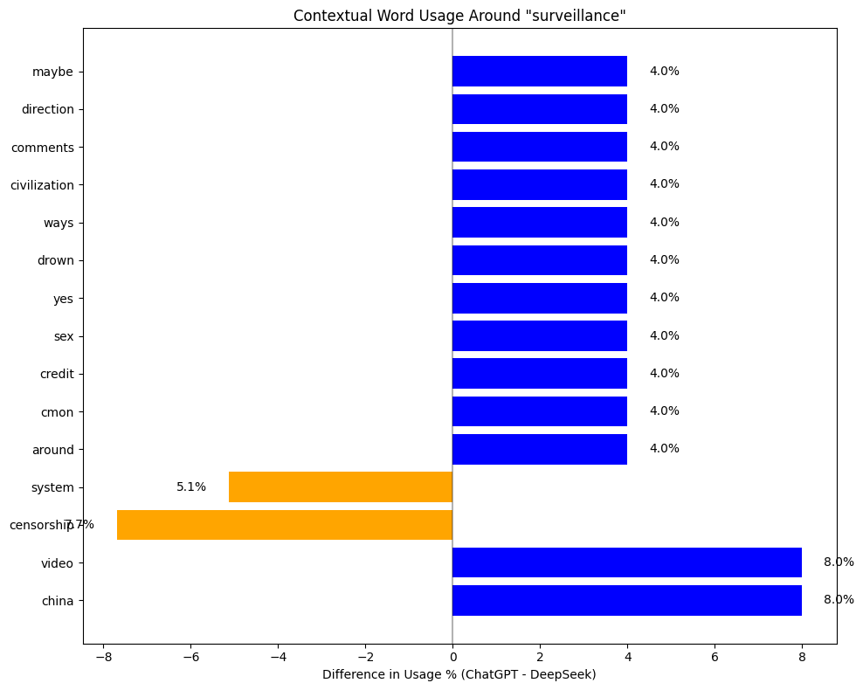
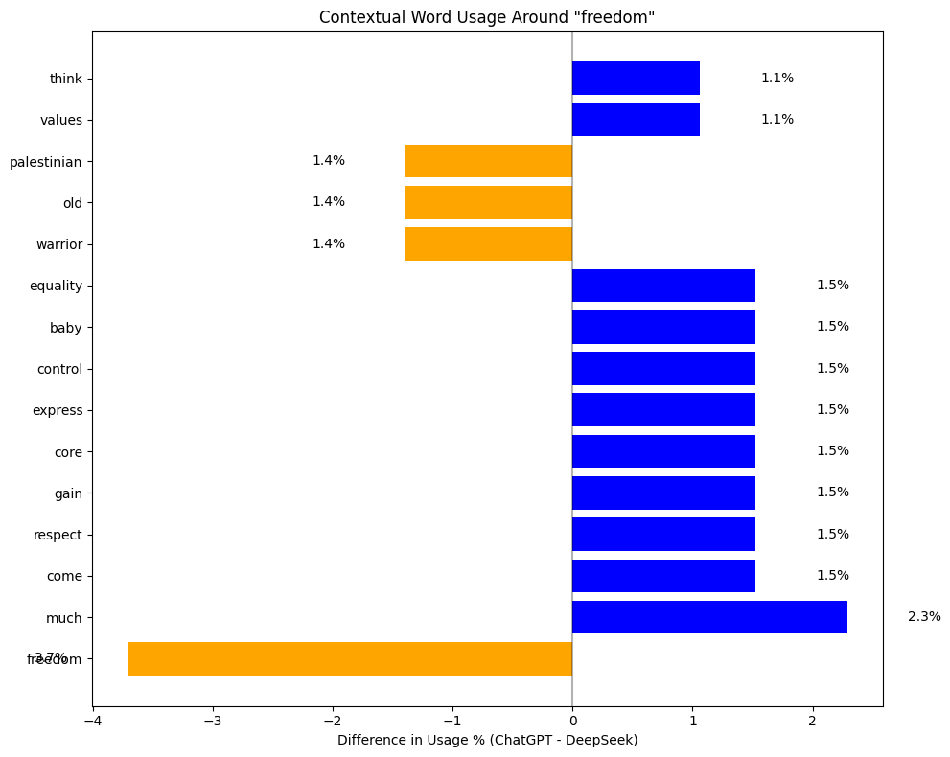
Word Analysis
Word Analysis

Slide 25
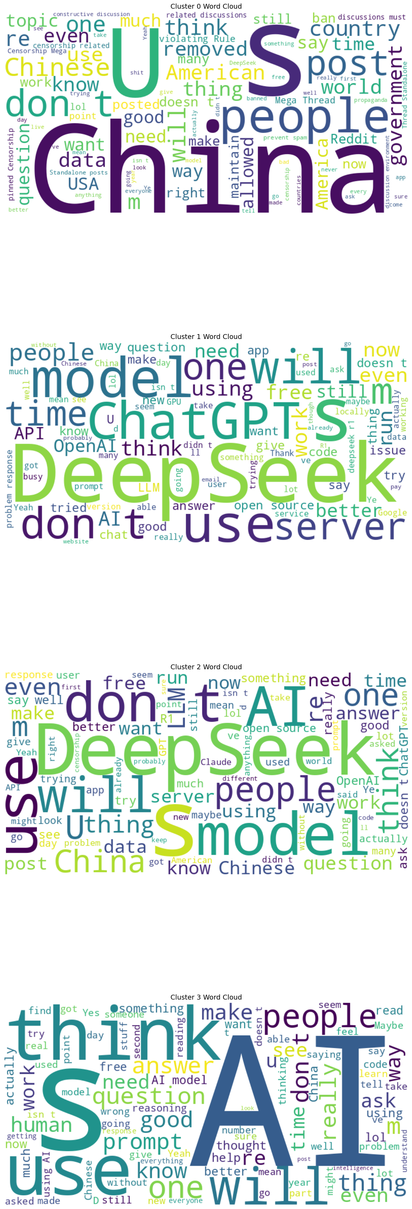
Thematic Clustering (k-means)
geopolitical concerns
General Usage
Technical Implementation
UI/UX, prompt engineering

Slide 26
Discussions
Limitations:
Reddit sample represents tech-savvy Western users, not general population
Limited time frame (3 months) may not capture long-term trends
Clustering may oversimplify nuanced discussions
Outlook:
Comparative analysis with more AI models like Claude, Grok, Gemini, Qwen, etc.
Improved temporal modeling to capture impact of external events
Visual content and meme analysis could enrich understanding
Comparative analysis with Chinese-language discussions would provide balance
Clustering framework could support recommendation systems to diversify content exposure

Slide 27

THANK YOU!

Slide 28
References
Papers:
Fast, E., & Horvitz, E. (2017). Long-Term Trends in the Public Perception of Artificial Intelligence. Proceedings of the AAAI Conference on Artificial Intelligence, 31(1). https://doi.org/10.1609/aaai.v31i1.10635
Said, E. W. (1977). Orientalism. The Georgia Review, 31(1), 162-206.
Said, E. W. (2023). Orientalism. In Social theory re-wired (pp. 362-374). Routledge.
Models:
https://huggingface.co/SamLowe/roberta-base-go_emotions
https://maartengr.github.io/BERTopic/index.html

Slide 29
Appendix

Slide 30
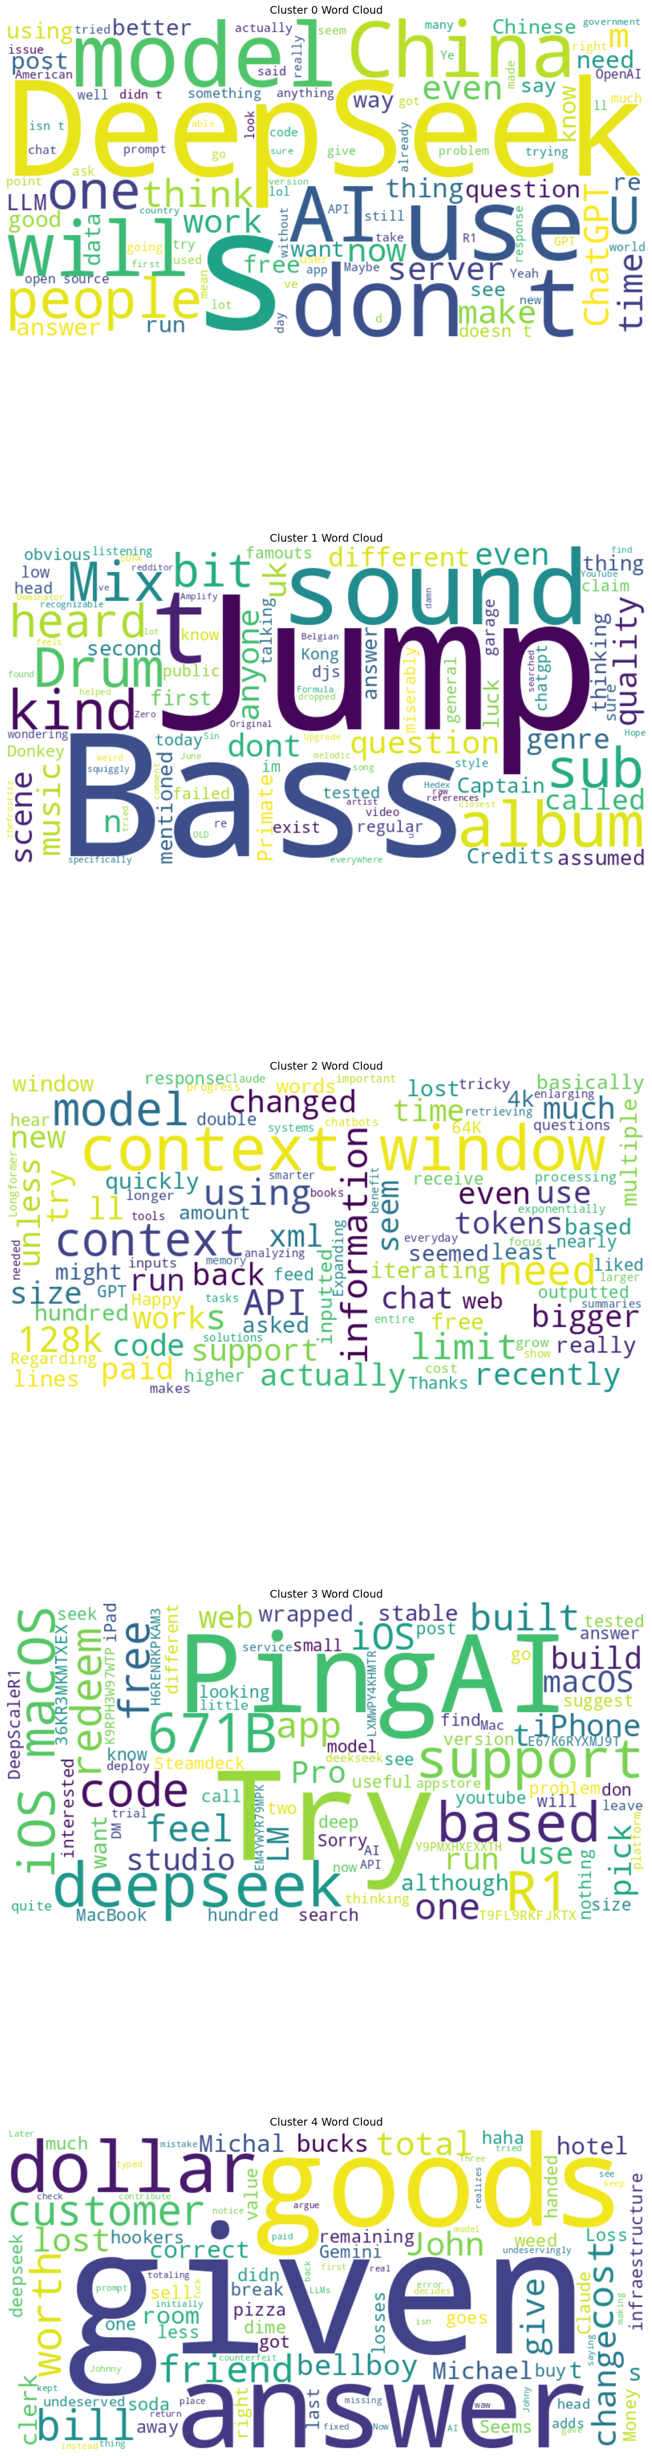
Word Distribution (hierarchical clustering)

Slide 31
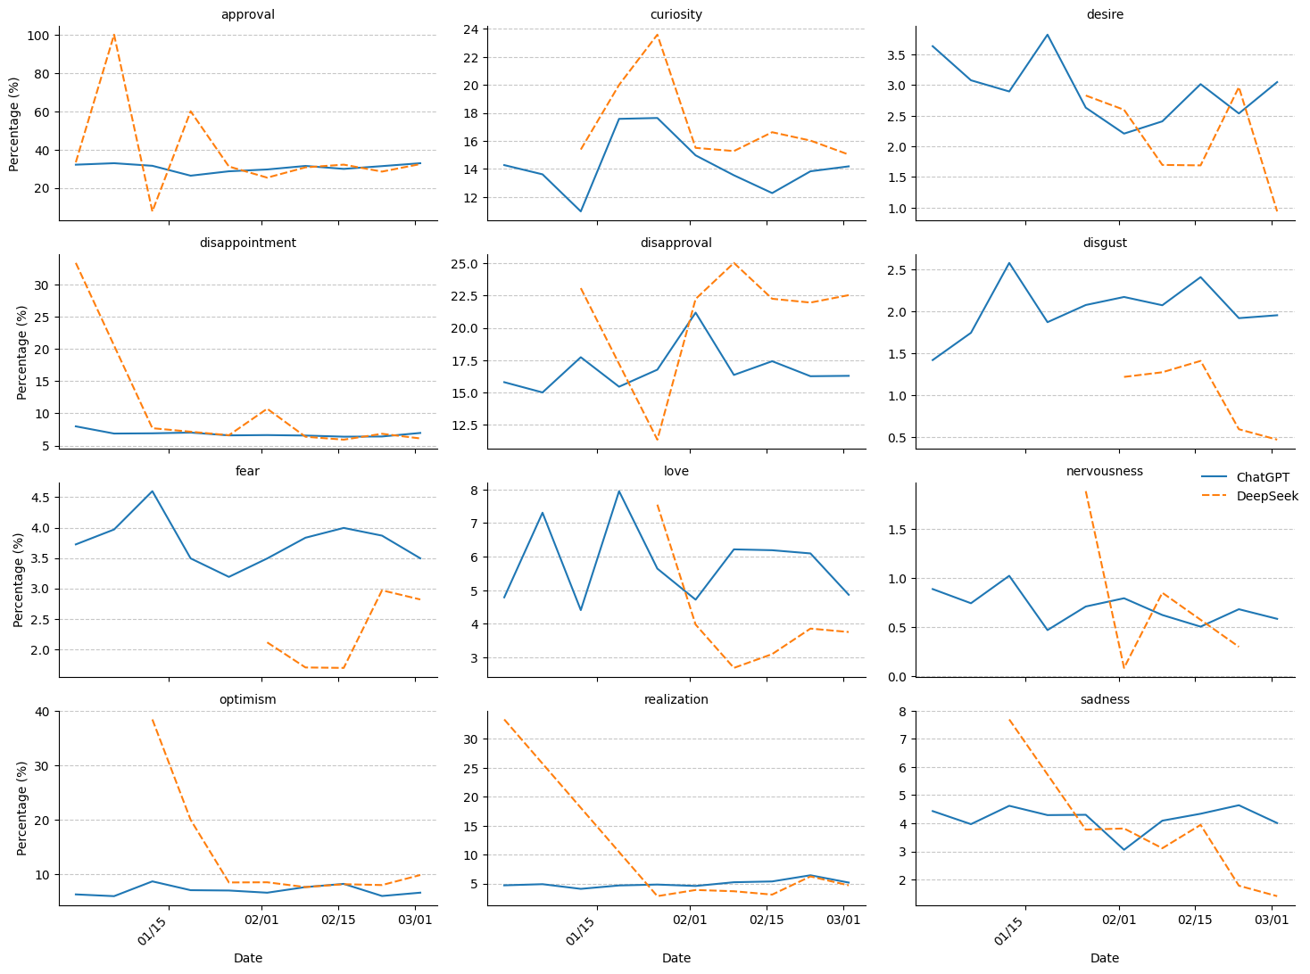
Temporal
Analysis
Of Emotions

Slide 32
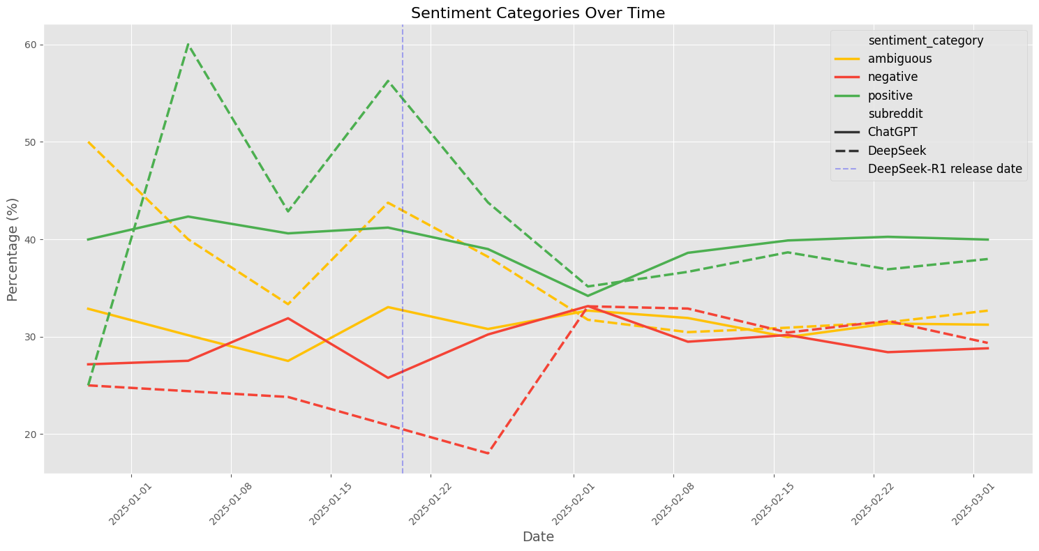
Temporal Analysis of Sentiment
Notes:
The temporal analysis of sentiment categories reveals interesting patterns. After the DeepSeek-R1 release (marked by the blue vertical line), there's a notable divergence in sentiment trends. While ChatGPT maintains relatively stable sentiment distributions, DeepSeek experiences both a sharp decline in positive sentiment and an increase in negative sentiment before eventually stabilizing.

Slide 33
Emotions Distribution

Slide 34
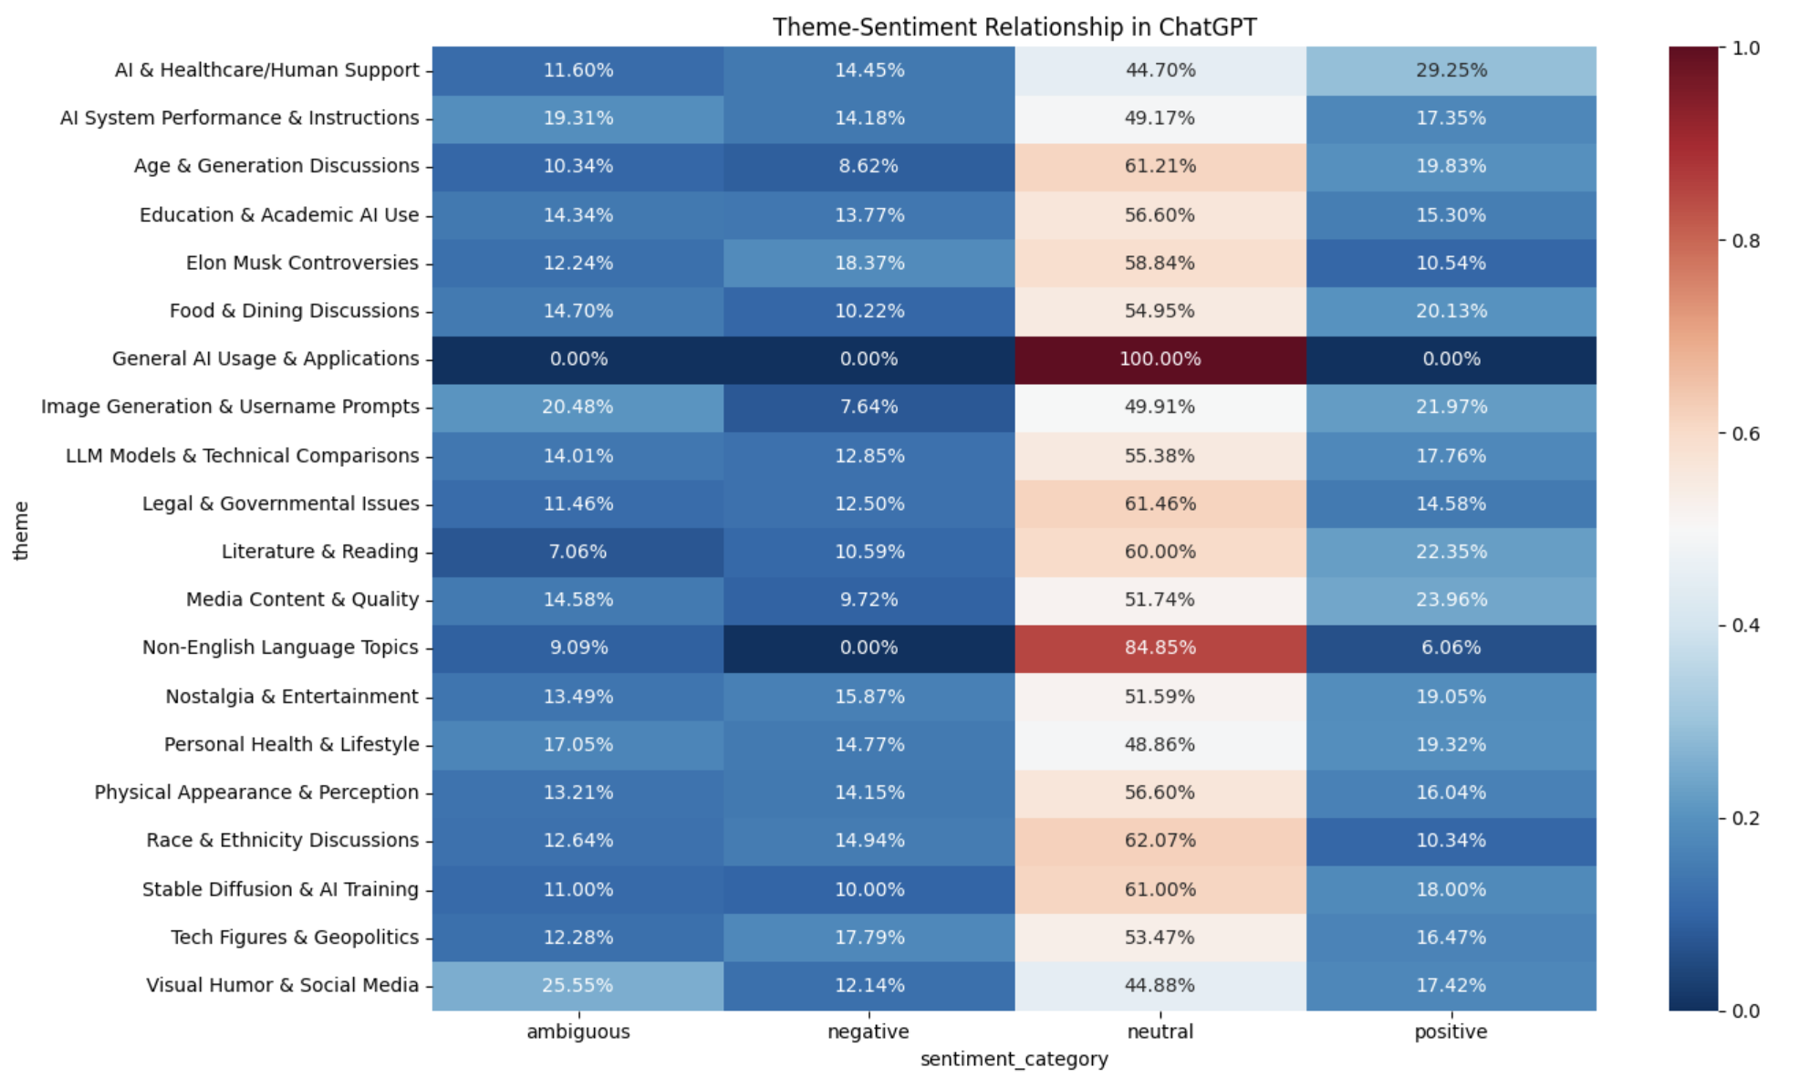
Theme-Sentiment Relationship of ChatGPT

Slide 35
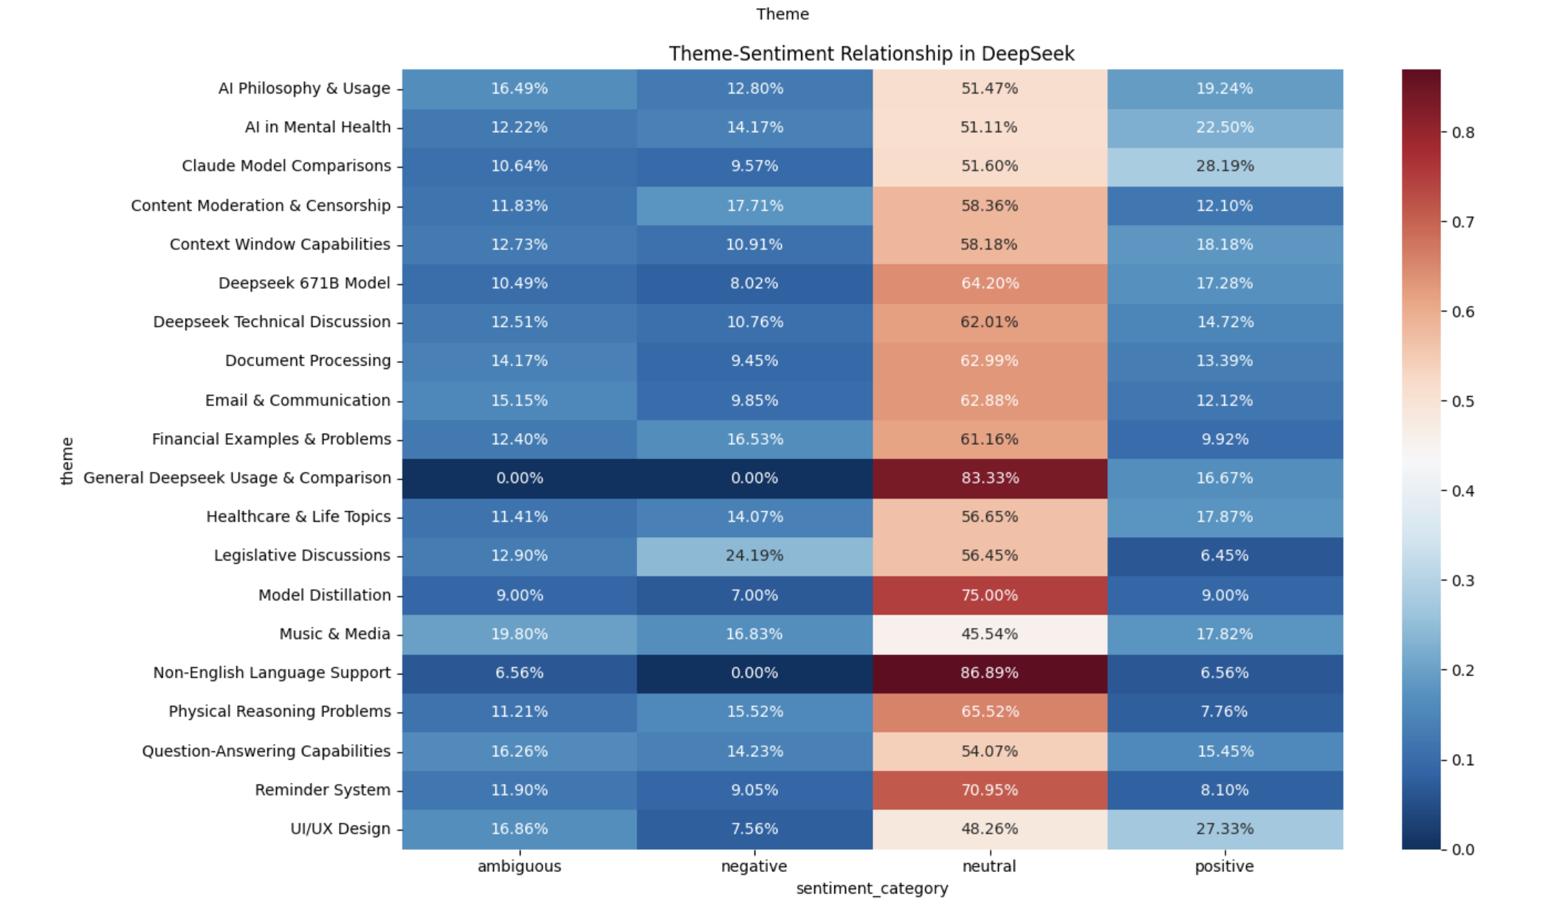
Theme-Sentiment Relationship of DeepSeek

Slide 36
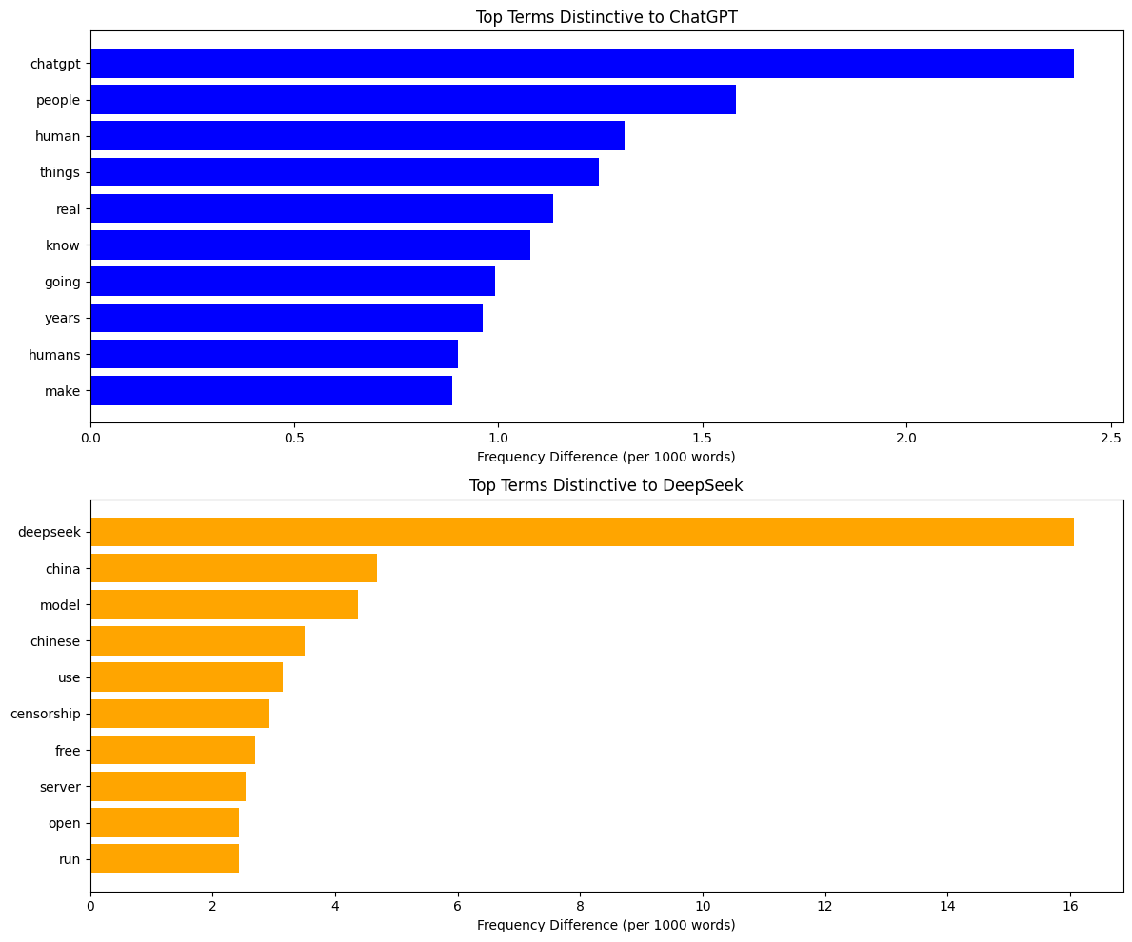
Top Terms Distribution

Slide 37
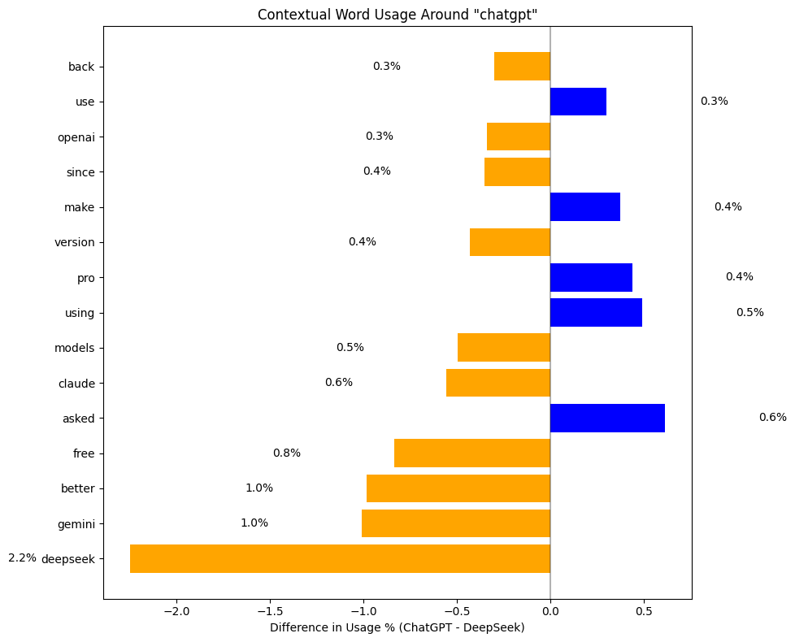
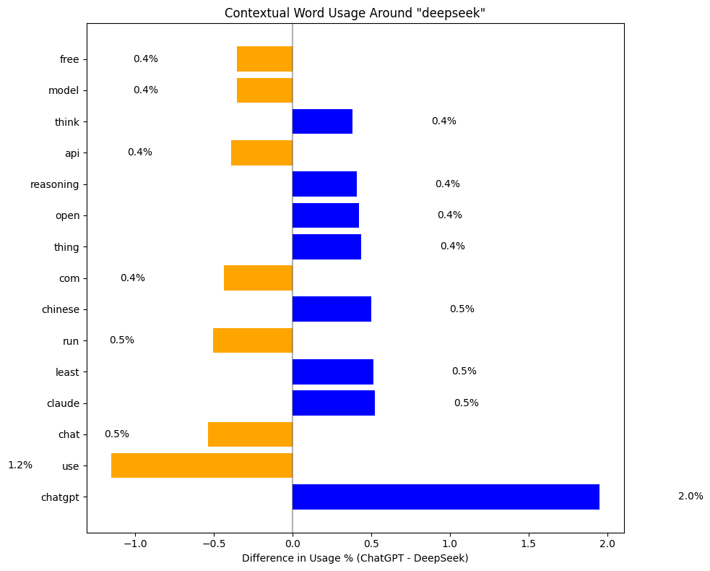
Contextual Word Usage of ‘ChatGPT’ and ‘DeepSeek’
Word Analysis

