Slide 1

Hand-Held Environment Monitor
Hackathon IoT Project
Pan Hu
Tester
Tieto
pan.hu@tieto.com

Slide 2
Background
With health we are interested in both indoor and outdoor air quality beside us. Though so many official monitoring station exist, they can’t offer more accurate value for our office place.
Take this opportunity we use powerful arduino open-source resources to provide a cheapest solution of nongovernmental environment monitoring.

Slide 3
Overview
Hand-Held Environment Monitor(HHEM) is comprised of three parts:
Sampling Part
multiple sensors to supply accurate value
Analyzing Part
calculate sampling value to output value
Displaying Part
multiple ways to display monitor value

Slide 4
Sampling
HHEM

Slide 5
Sensors
Temperature and Humidity Sensor
Dust Sensor
Gas Sensor(MQ2)
HCHO Sensor

Slide 6
Analyzing
HHEM

Slide 7
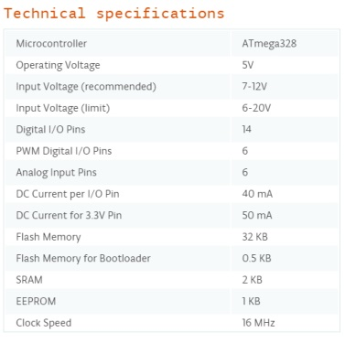
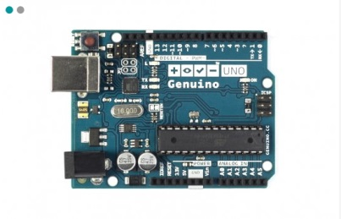
Main Control Board

Slide 8
Displaying
HHEM

Slide 9
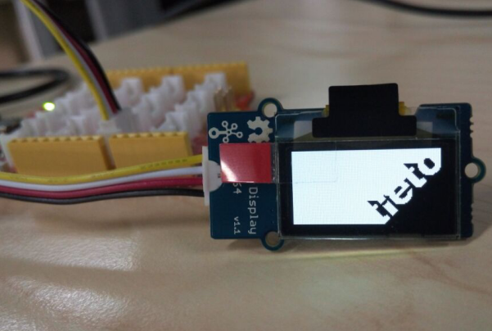
OLED
LED 128×64 Display module is an OLED monochrome 128×64dot matrix display module with Grove 4pin I2C Interface.Comparing to LCD, OLED screens are way more competitive, which has a number of advantages such as high brightness, self-emission, high contrast ratio, slim / thin outline, wide viewing angle, wide temperature range, and low power consumption.

Slide 10
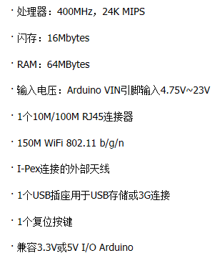
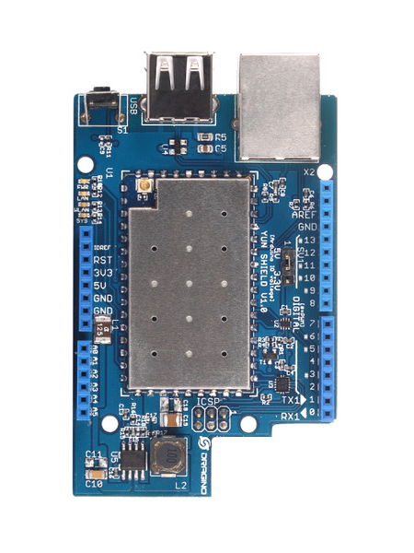
Yun Shield

Slide 11
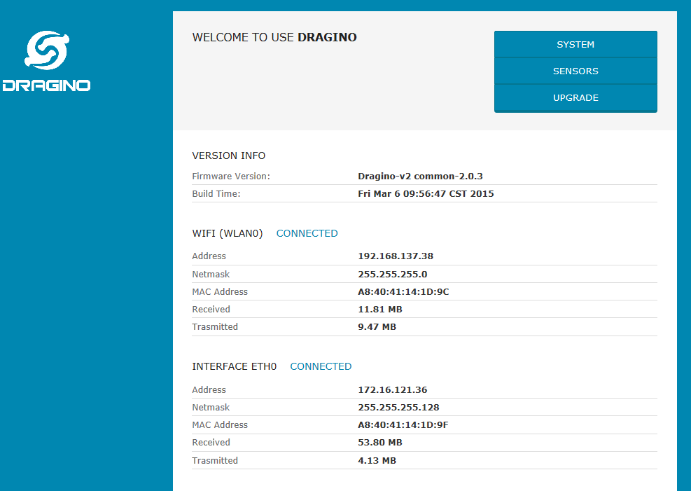
Yun Shield Management

Slide 12
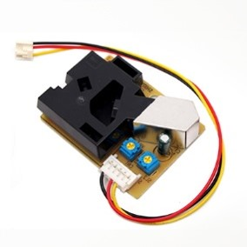
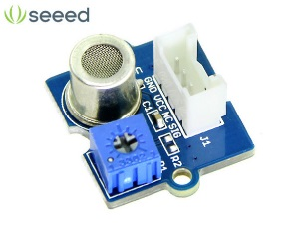
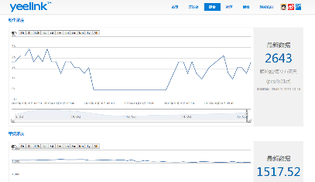
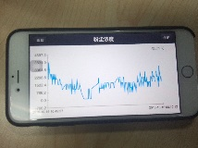
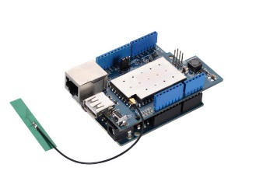


Yun Shield in Data Transfer
Cloud Server
Yun Shield
Mobile
Sensors
Board
PC

Slide 13
Monitor Indicator
HHEM

Slide 14
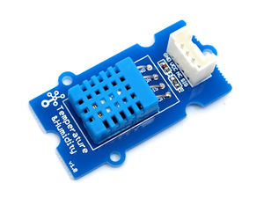
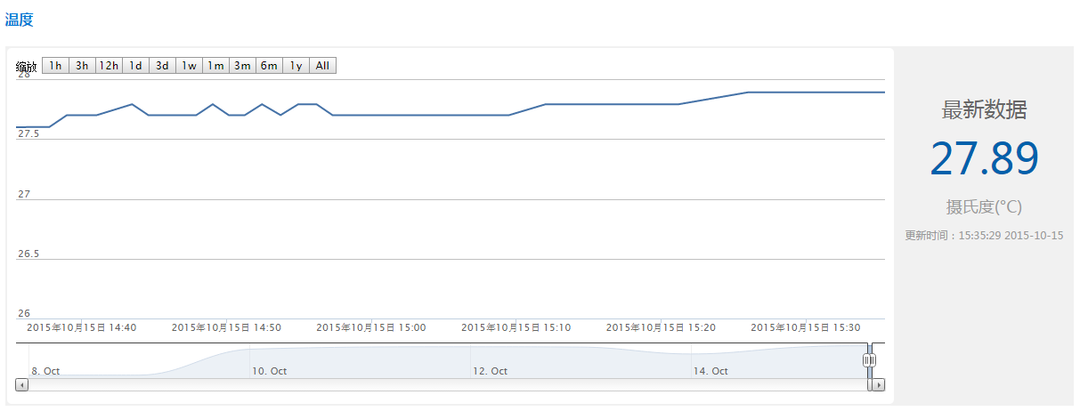
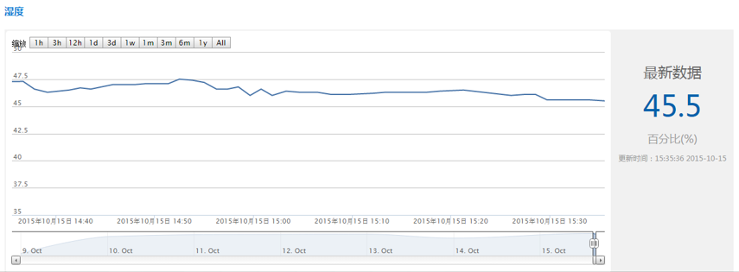
Temperature and Humidity
This is a multifunctional sensor that gives you temperature and relative humidity information at the same time. It utilizes a DHT11 sensor that can meet measurement needs of general purposes. It provides reliable readings when environment humidity condition in between 20% RH and 90% RH, and temperature condition in between 0°C and 50°C, covering needs in most home and daily applications that don't contain extreme conditions.

Slide 15

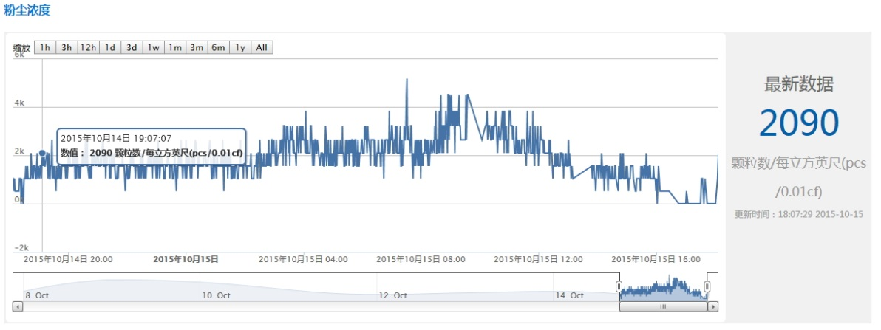
Dust
This Dust Sensor measures the Particulate Matter level in air by counting the Lo Pulse Occupancy time(LPO time) in given time unit. LPO time is in proportion to PM concentration. This sensor can provide you pretty reliable data for air purifier system because it's still responsive to particulates whose diameter is 1um.

Slide 16
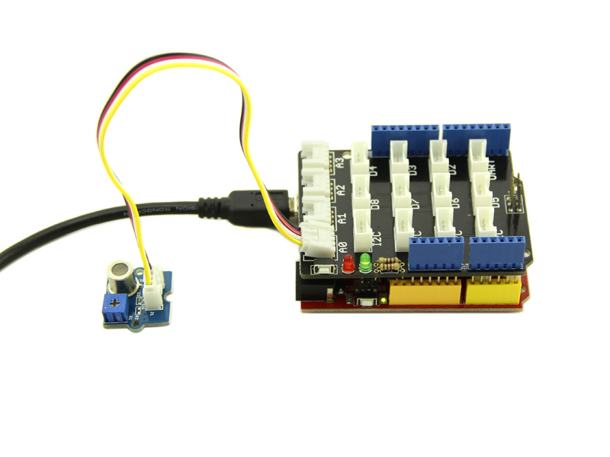
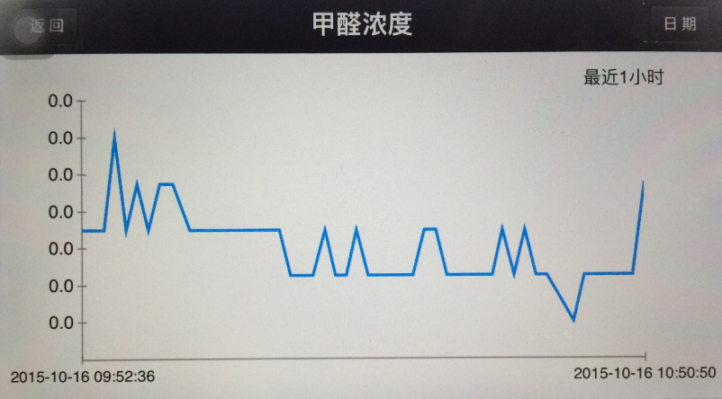
HCHO
HCHO Sensor is a semiconductor VOC gas sensor, which covert the circuit conductivity to the output signal that corresponding to the gas concentration. It has a very high sensitivity and stability, can be used to detect harmful HCHO in the home environment. Therefore, it’s a good assistant for you to improve indoor environment quality of life.

Slide 17
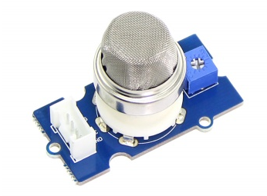
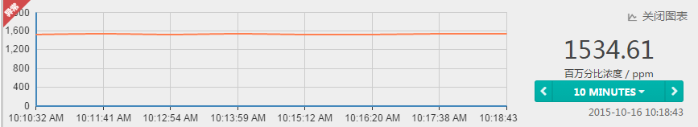
CH4
The Grove - Gas Sensor(MQ2) module is useful for gas leakage detection (in home and industry). It is suitable for detecting H2, LPG, CH4, CO, Alcohol, Smoke or Propane. Due to its high sensitivity and fast response time, measurements can be taken as soon as possible. The sensitivity of the sensor can be adjusted by using the potentiometer.

Slide 18
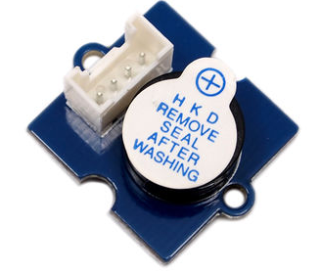

Buzzer
Buzzer, or Piezo speaker, is being used as an alarm or indicator.

Slide 19
Enhancement
HHEM

Slide 20
Improvement & Enhancement
Air Quality Sensor compatibility
Cloud Control enhancing
Power improving
Multi-IoT Web supporting（e.g: Xively）

Slide 21
Team
HHEM

Slide 22
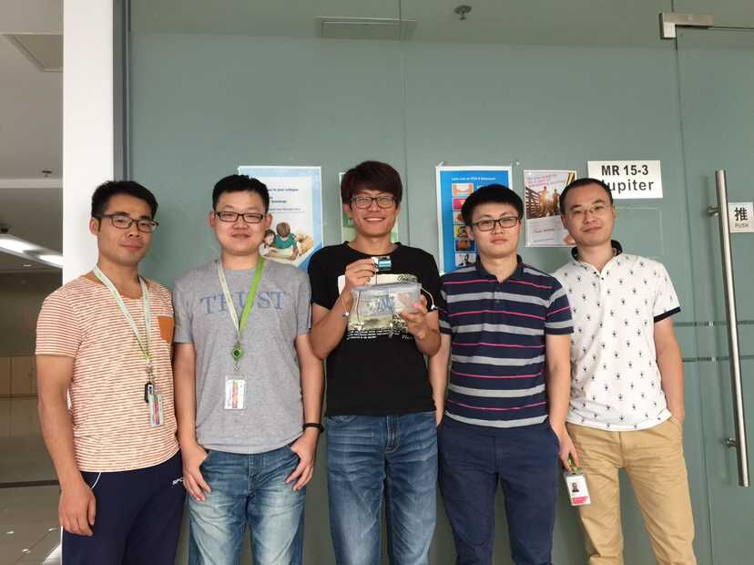
Team Members
Liu MingYuan
Hu Pan
Han Qiankun
Feng Wei
Fan Dewei

Slide 23
Pan Hu
Tester
Tieto
pan.hu@tieto.com

