Slide 1
Task 4: Data Analytics Dashboard
Designed in Power BI using Online Sales Data

Slide 2
Objective
Design an interactive Power BI dashboard for business stakeholders to analyze online sales performance.
- Visualize KPIs like Total Revenue, Units Sold
- Enable regional and product insights
- Explore trends over time using slicers and charts

Slide 3
Dataset Used
File: Online Sales Data.csv
Columns:
- Transaction ID
- Date
- Product Category
- Product Name
- Units Sold
- Unit Price
- Total Revenue
- Region
- Payment Method

Slide 4
Dashboard Structure (4 Pages)
1. Sales Overview:
- KPI Cards: Total Revenue, Units Sold
- Bar Chart: Revenue by Product Category
- Date Slicer
2. Regional Analysis:
- Map & Pie Chart: Revenue by Region
- Slicer: Payment Method
3. Product Performance:
- Stacked Column Chart: Units Sold by Product
- Matrix: Revenue by Product & Region
4. Time-Based Trends:
- Line Chart: Revenue over Time
- Bar Chart: Units Sold by Month

Slide 5
Key Features
- Interactive Slicers (Date, Region, Payment Method)
- Time-Series Analysis with drill-down
- Region-wise and Product-wise breakdowns
- Clean, consistent visual layout
- Easy to understand insights for stakeholders

Slide 6
Tools Used
- Power BI Desktop
- Microsoft Excel (for CSV handling)
- GitHub (for submission)
- Dataset Source: Provided / Simulated for Task 4

Slide 7
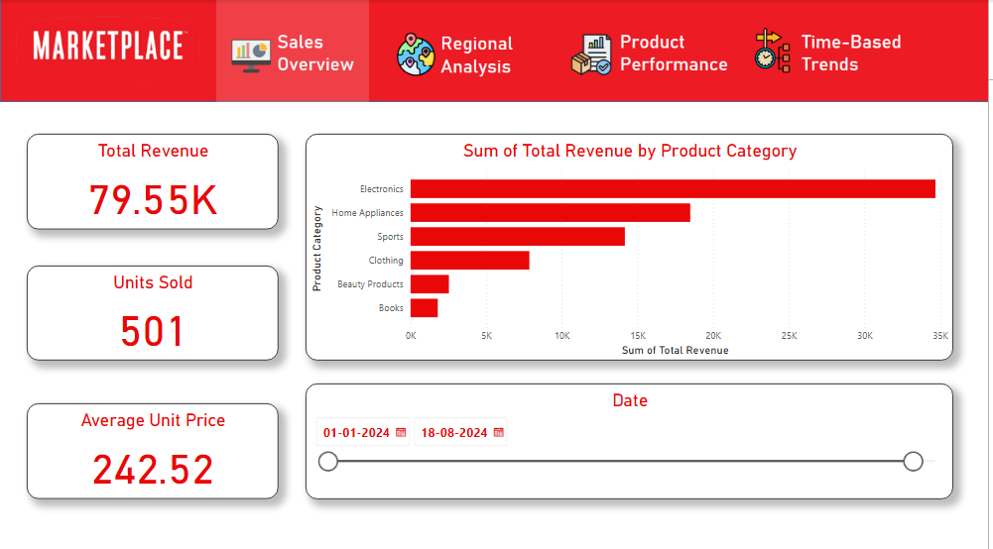
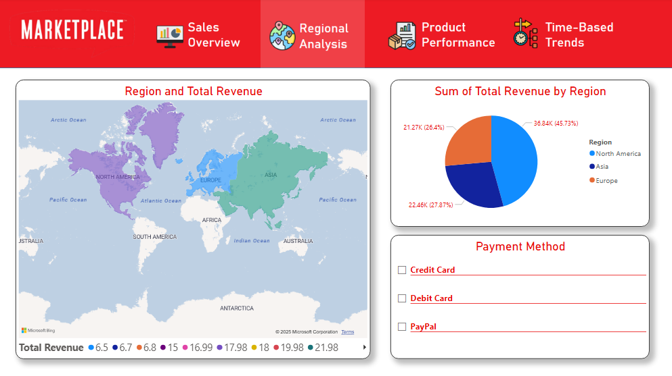
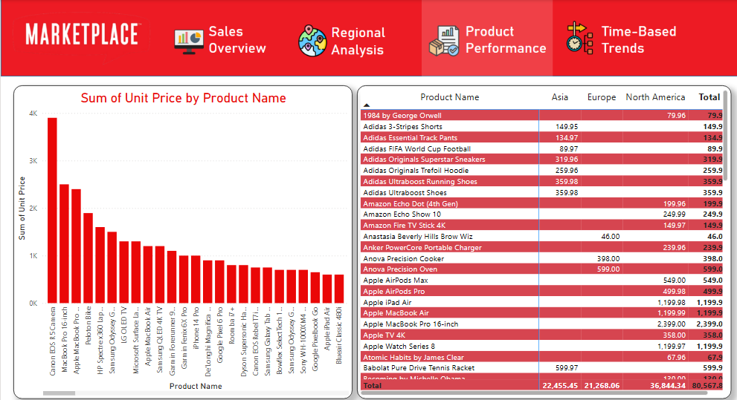
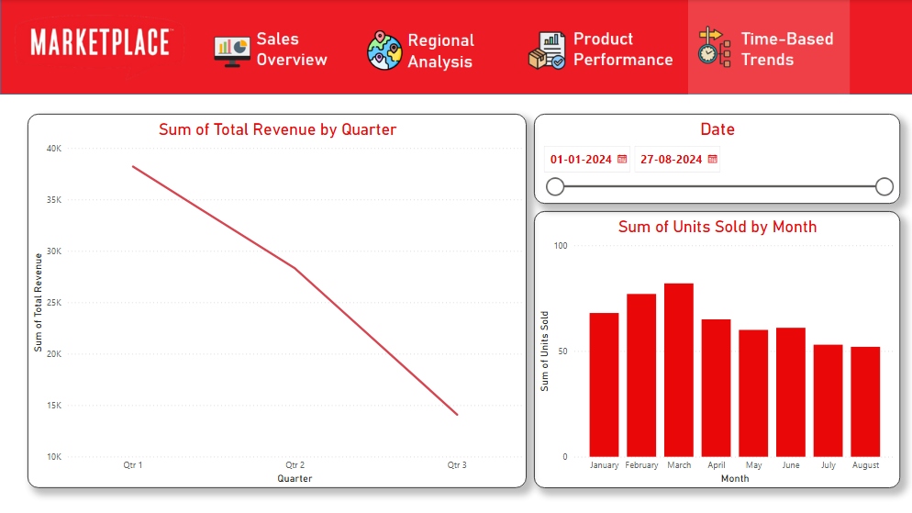
Output DashBoard

