Slide 1
XPAYR / GASOK
TRACK 04 / AI / WEB3
Verified AgentPay for GIWA
Policy-controlled, non-custodial escrow for AI-agent work — with retained GIWA Sepolia evidence.
GIWA Sepolia • Chain 91342 • Human release authority • Canonical receipts

Slide 2
AI agents can pay. Trust still breaks between systems.
FRAGMENTED TODAY
TRUST BOUND TO THE PAYMENT
Counterparty identity Spend authority Delivery status Release approval
One intent. One policy decision. One canonical receipt.
AgentPay makes identity, authorization, escrow state, delivery proof, and human release reviewable as one transaction-bound evidence trail.
Each answer usually lives in a different wallet, policy service, workflow, or audit log.
02

Slide 3
Guarded workflow binds policy, escrow, and evidence.
REQUEST → VERIFY → POLICY → FUND → SUBMIT → RELEASE / REFUND
01 IDENTIFY
02 CONTROL
03 SETTLE
Verify the parties
Constrain the agent
Finish canonically
Merchant creates a job. Payer and provider are checked through Dojang testnet attestations.
XPAYR returns ALLOW, HOLD, or DENY. Only an allowed intent can fund the non-custodial escrow.
Provider submits a delivery hash. Human approval releases—or a bounded terminal path refunds—and XPA2 seals the evidence.
03

Slide 4
GIWA is part of the product logic—not a network toggle.
01 DOJANG VERIFIED ADDRESS
02 GIWA SEPOLIA ESCROW
Participant checks are bound to the job. Current proof is a TESTNET_FAUCET attestation with test_only=true—not KYC.
The lifecycle executes on chain 91342 in an XPAYR escrow contract, preserving participant and human-release authority.
03 FLASHBLOCKS FEEDBACK
04 GIWA WALLET PATH
A fast signal can improve pending UX. Completion is claimed only after the canonical transaction receipt is verified.
Pending jobs, approve, release, refund, and dispute are designed for a native wallet surface. Integration is the next phase—not a shipped claim.
GIWA Sepolia • Chain 91342 • Escrow 0x7b0630cBb92be8E11512cb331b8D1aef94cEEc53
04

Slide 5
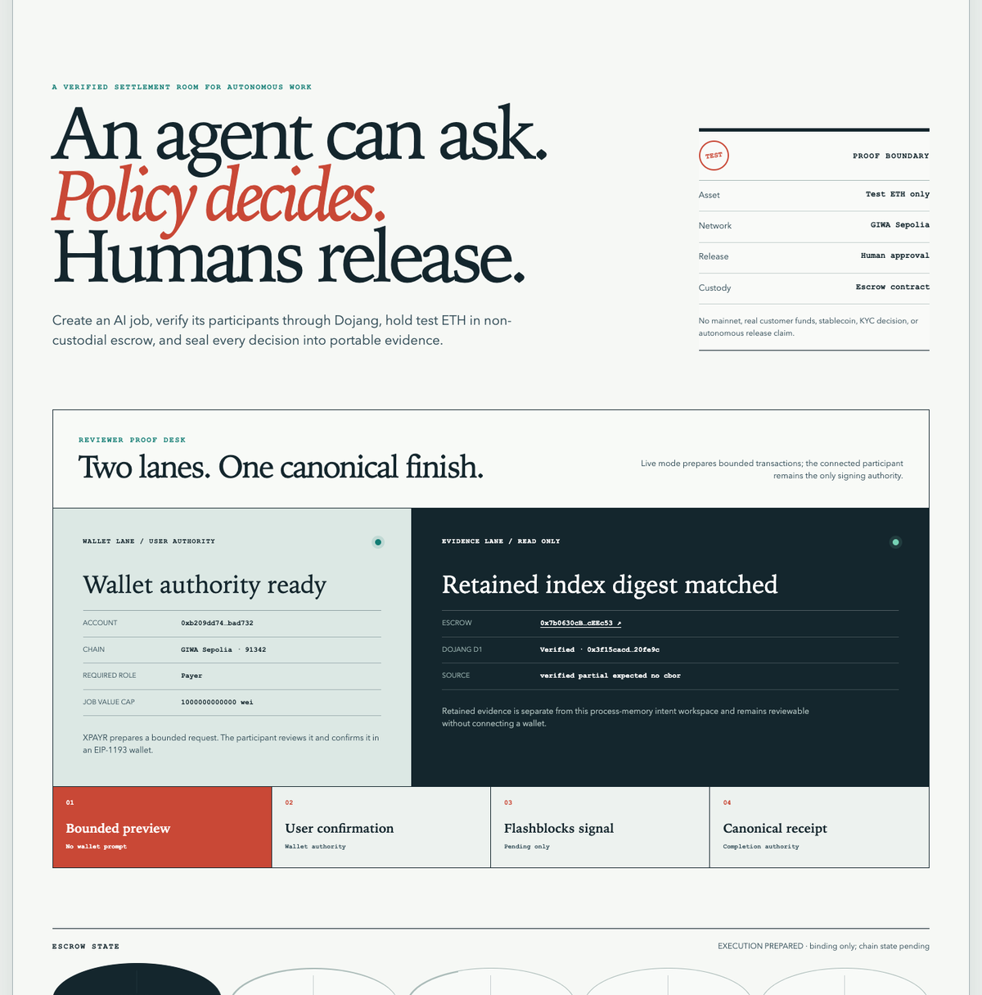
The shipped MVP shows the full reviewer flow.
AVAILABLE NOW
Create a bounded agent intent Verify payer and provider Return ALLOW / HOLD / DENY Fund and control non-custodial escrow Open retained evidence and explorer links
Scope boundary Testnet only—no mainnet, real funds, stablecoin claim, autonomous evaluator release, GIWA Wallet implementation, or grant-outcome claim.
Reviewer UI • retained-evidence mode
05

Slide 6
The testnet proof is repeatable, bounded, and reviewable.
Two canonical terminal paths are retained with authenticated XPA2 envelopes. Source verification: verified_partial_expected_no_cbor — never presented as FULL.
Historical source run 221/221 • Public package 107/107 • Reviewer 11/11 • Foundry 36/36
5 / 5
4 / 4
2 / 2
RELEASE LIFECYCLE
REFUND LIFECYCLE
AUTH-V2 CASES
RELEASED terminal state XPA2 receipt authenticated
REFUNDED terminal state XPA2 receipt authenticated
Producer signature checked Anchor binding checked
Manifest • 81 files • 1,557,591 bytes • 0x943a30124f5219d34ef0043aeebaea4a60b349a8c0f15649bb31b91239e779ad
06

Slide 7
A five-month path compounds market evidence.
PRE-PILOT WEDGE / translation, research, and digital-service jobs
TESTNET MVP
PRIVATE MAINNET + KBW
GROWTH STAGE
Validate job intent → human release with demo users. Track completion, refund paths, and evidence usability.
Integrate agent platforms and service marketplaces. Add session keys and paymasters only after security and authority gates.
Harden policy, authority, and monitoring. Demonstrate wallet interaction and report success, time-to-release, retry, and refund KPIs.
Proof already shipped Canonical release + refund
Target outcome Wallet-ready reviewer demo
Scale signal Successful jobs + user growth
MVP
PRIVATE MAINNET
KBW → GROWTH
07

Slide 8
GASOK DECISION
TRACK 04 / AI / WEB3
Choose XPAYR to advance a proven GIWA agent-payment path.
Engineering + security review GIWA Wallet integration guidance Private-mainnet and KPI support
READY NOW
Testnet MVP + canonical retained evidence
NEXT WITH GASOK / wallet-ready UX + private-mainnet KPIs

