Slide 1
CIC Global 2025
Cadence Innovation Conference
June 17-20

Slide 2
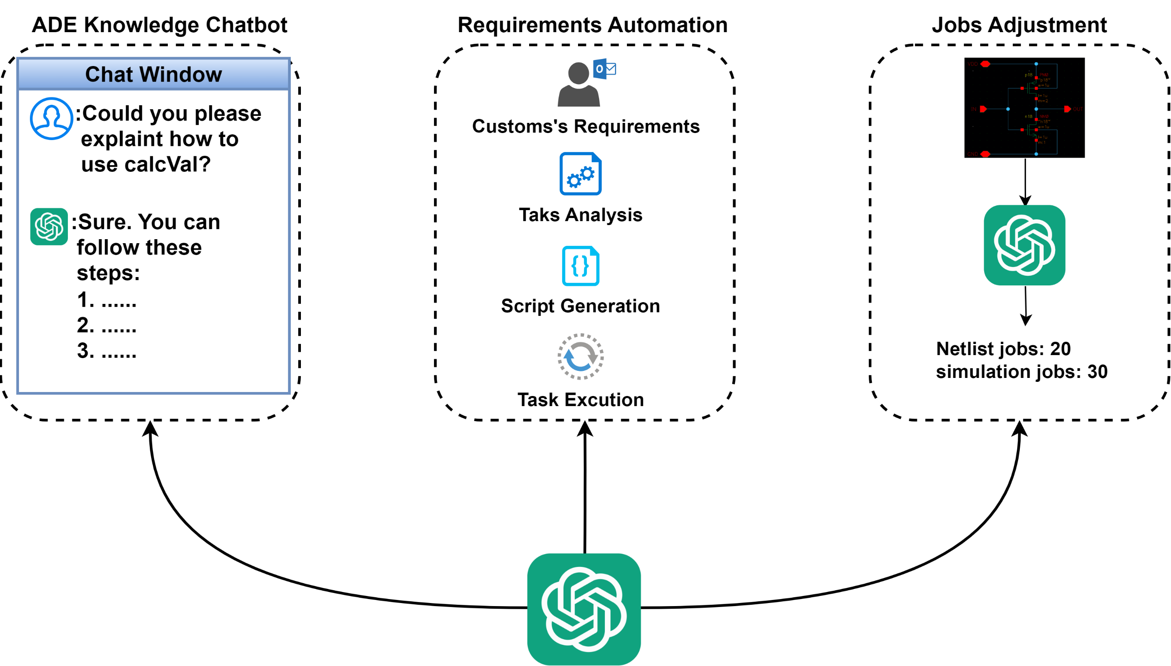
What ADE Copilot can do

Slide 3
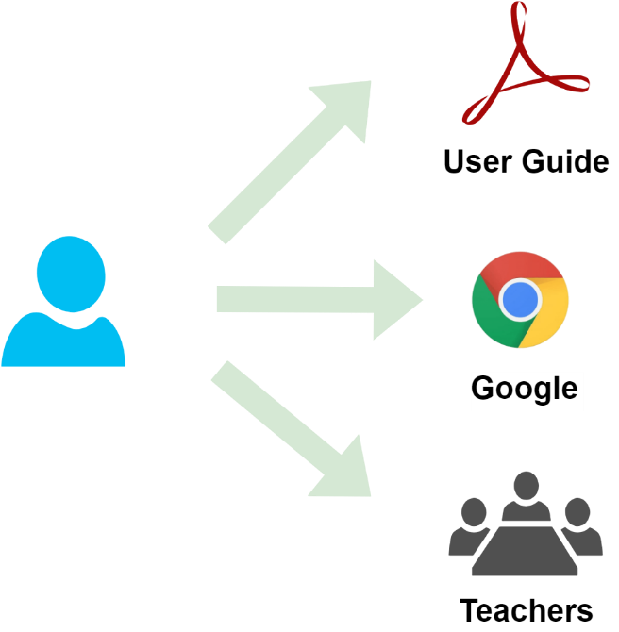
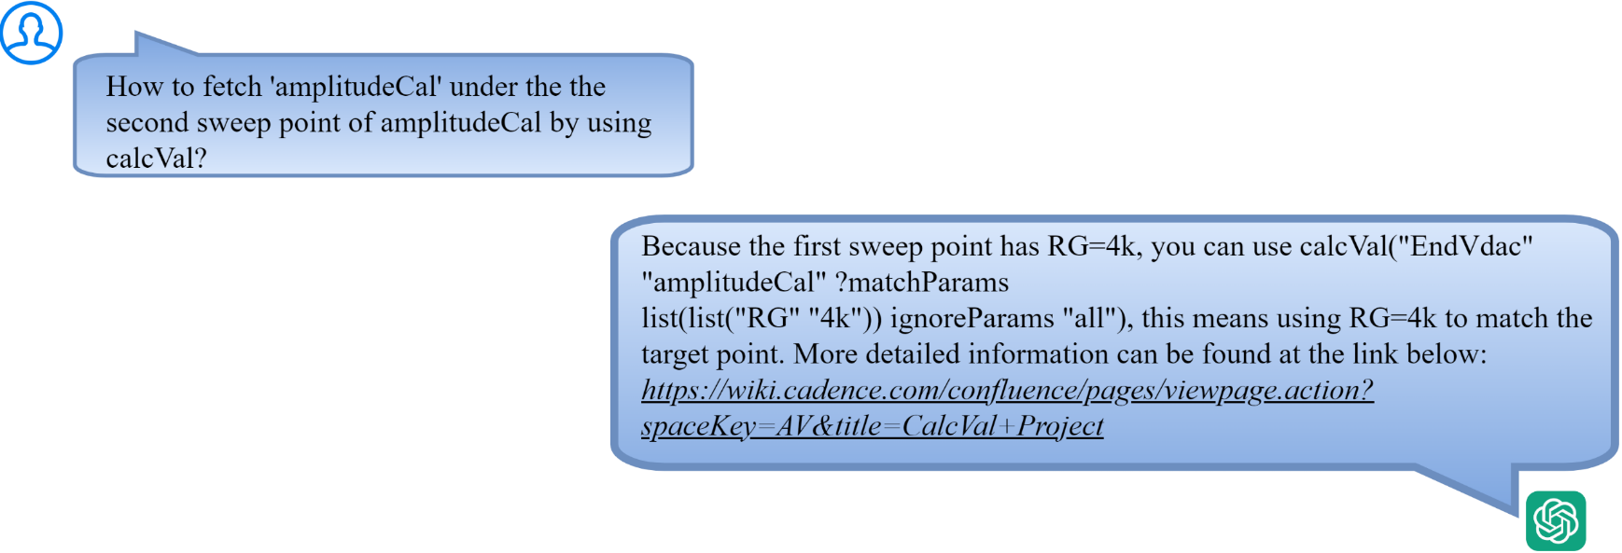
Assistant Chatbot
Problem to resolve
ADE has many complex features and are related to each other.
Traditional learning methods can no longer meet the needs
An interactive engineering assistant based on LLM is a better choice
Traditional Learning Methods
Interactive Engineering Assistant

Slide 4
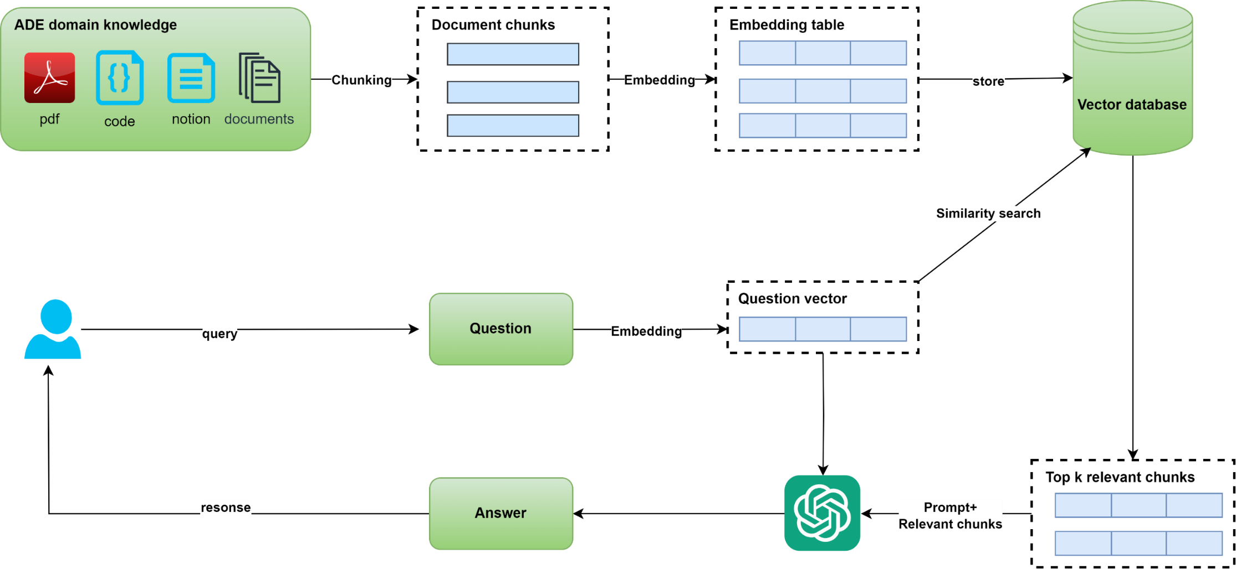
Assistant Chatbot
How ADE Copilot solves this problem
Implement interactive engineering assistant based on pre-trained LLM(Large Language Model) and RAG(Retrieval Enhancement Generation)

Slide 5
Verifier Requirements Automation
Problem to resolve
Fine Tune Pre-trained LLM based on skill source code

Slide 6
Verifier Requirements Automation
Problem to resolve
Fine Tune Pre-trained LLM based on skill source code

Slide 7
Verifier Requirements Automation
How ADE Copilot solves this problem
Improper setting of job policy leads to waste of resources

Slide 8
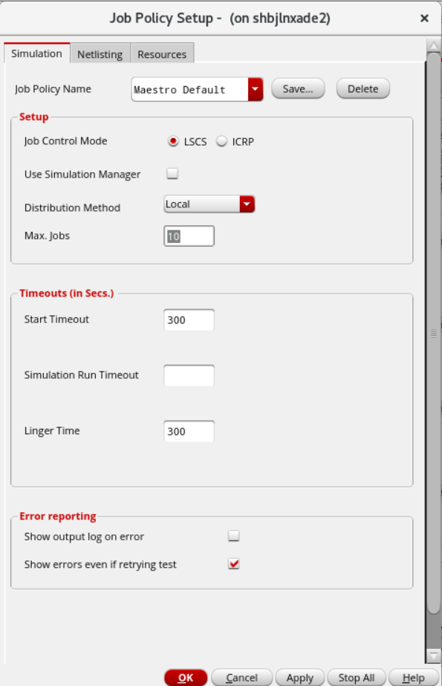
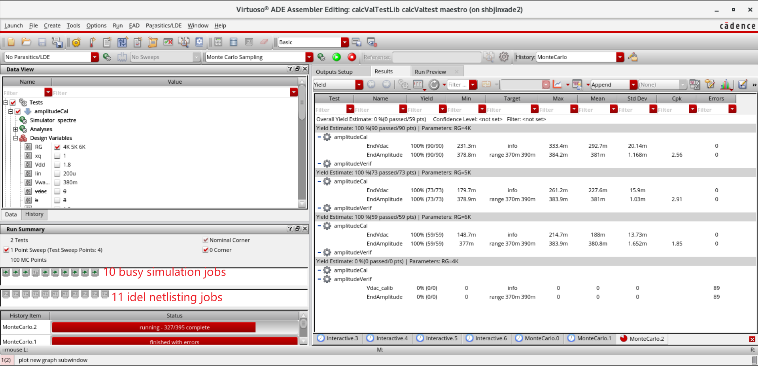
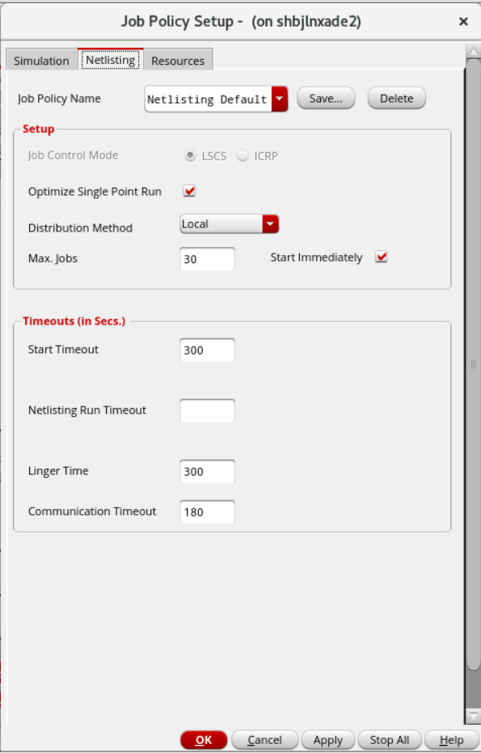
Job Policy Optimization
Problem to resolve
Improper setting of job policy leads to waste of resources

Slide 9
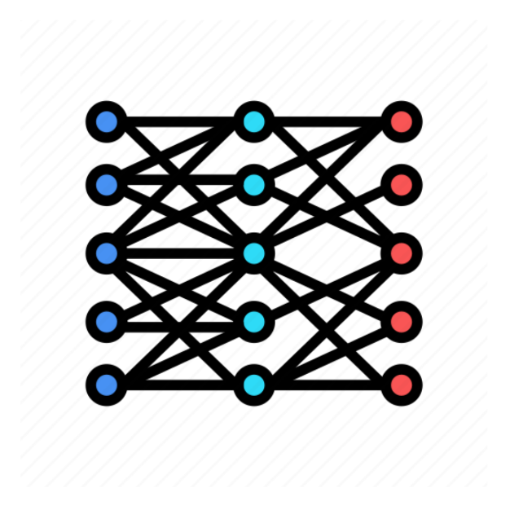
Job Policy Optimization
How ADE Copilot solves this problem
ID | Circuit | Tran analysis stop time | Simulation points
1 | 1-stage common-source amplifier | 10s | 1000
2 | 3-stage common-source amplifier | 100s | 600
3 | common-drain amplifier | 80s | 500
… | … | … | …
X
ID | Netlist jobs | Simulation jobs
1 | 10 | 12
2 | 20 | 46
3 | 40 | 16
… | … | …
ADE Copilot training
Y
Data Set

Slide 10
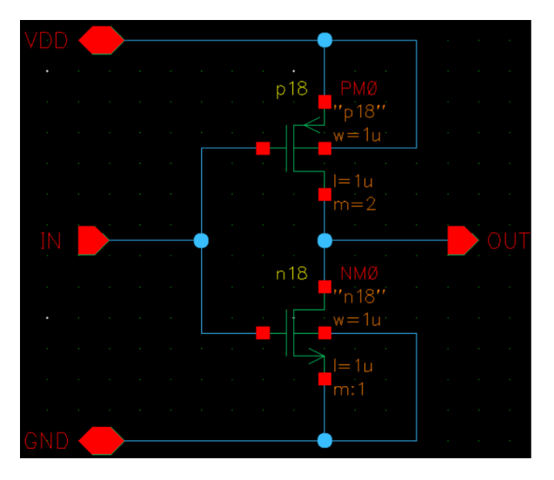
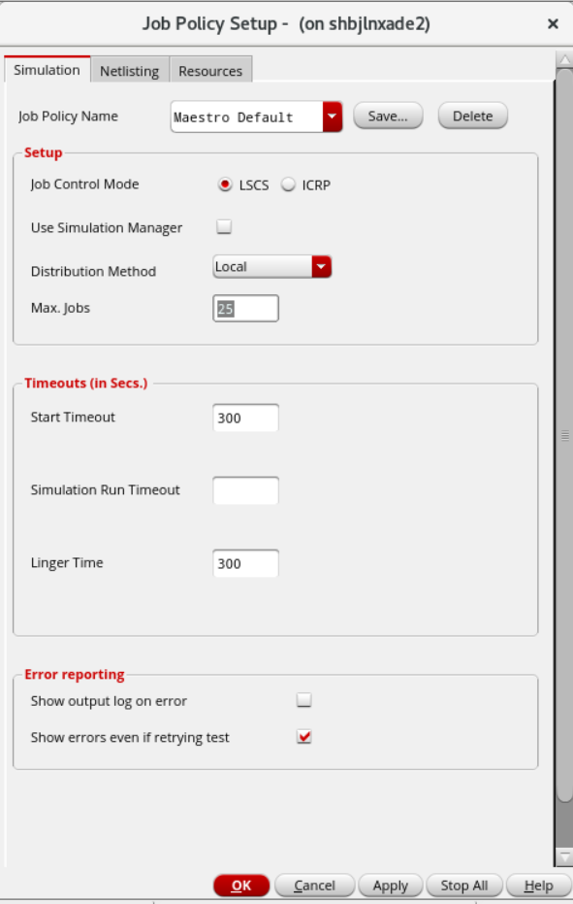
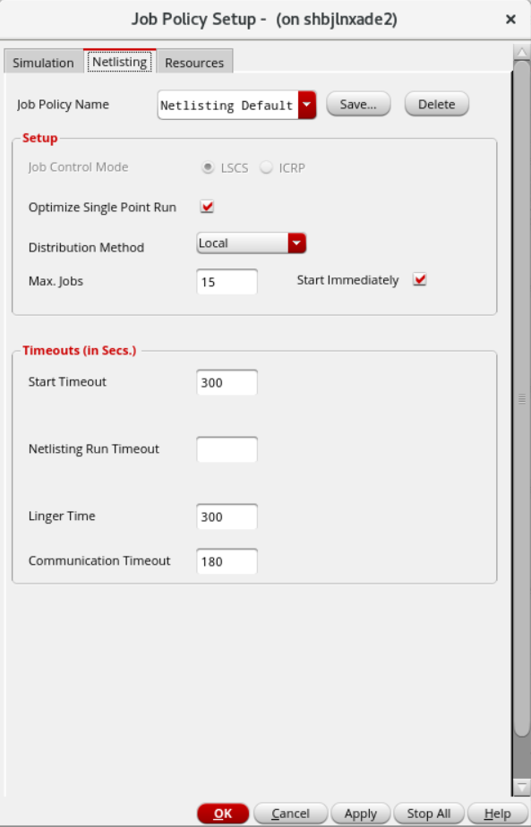
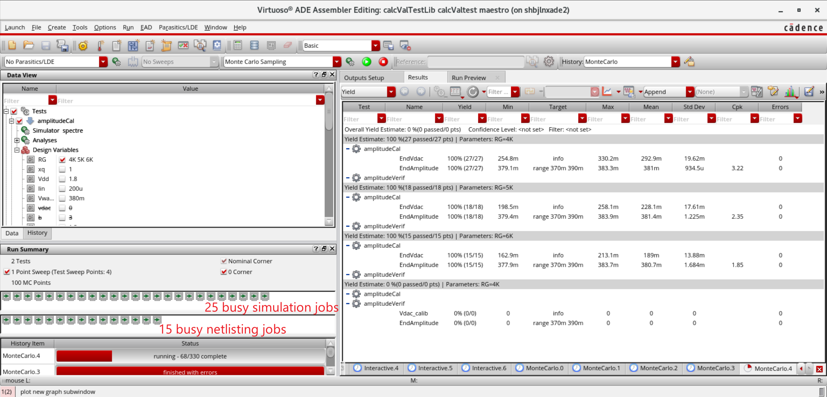
Job Policy Optimization
How ADE Copilot solves this problem
ADE Copilot Inference
Schematic Design
Setting Job Policy Automatically
Reasonable Allocation of Resources

