Slide 1
CIC Global 2025
ADE Copilot
Pengcheng Xin

Slide 2
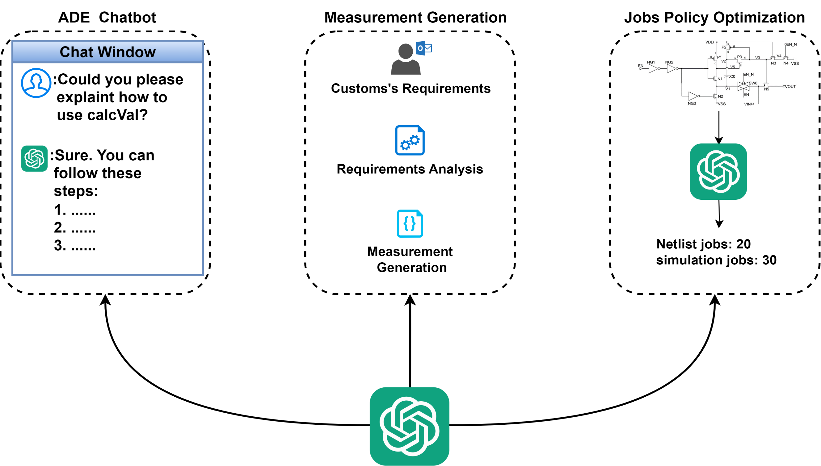
What ADE Copilot can do

Slide 3
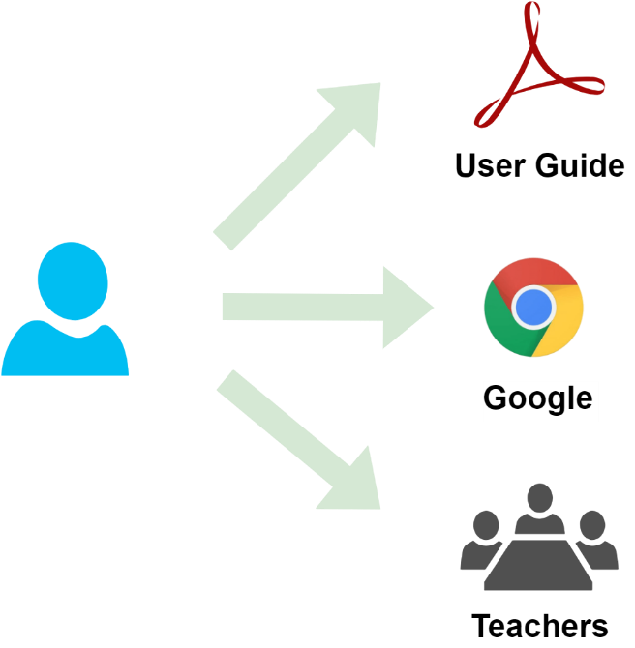
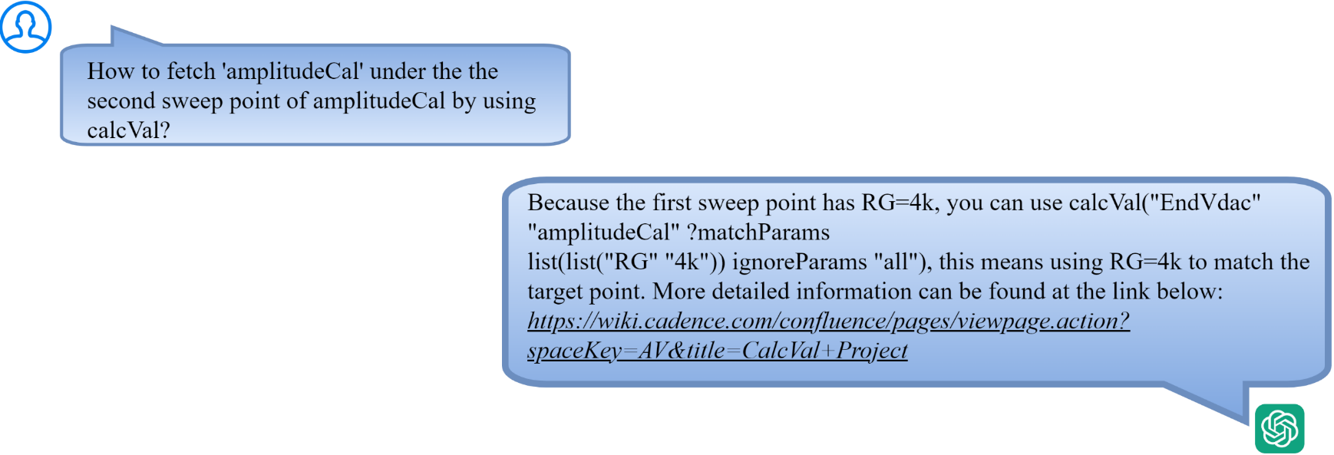
Assistant Chatbot
Problem to resolve
ADE has many complex features and are related to each other.
Traditional learning methods can no longer meet the needs
An interactive engineering assistant based on LLM is a better choice
Traditional Learning Methods
Interactive Engineering Assistant

Slide 4
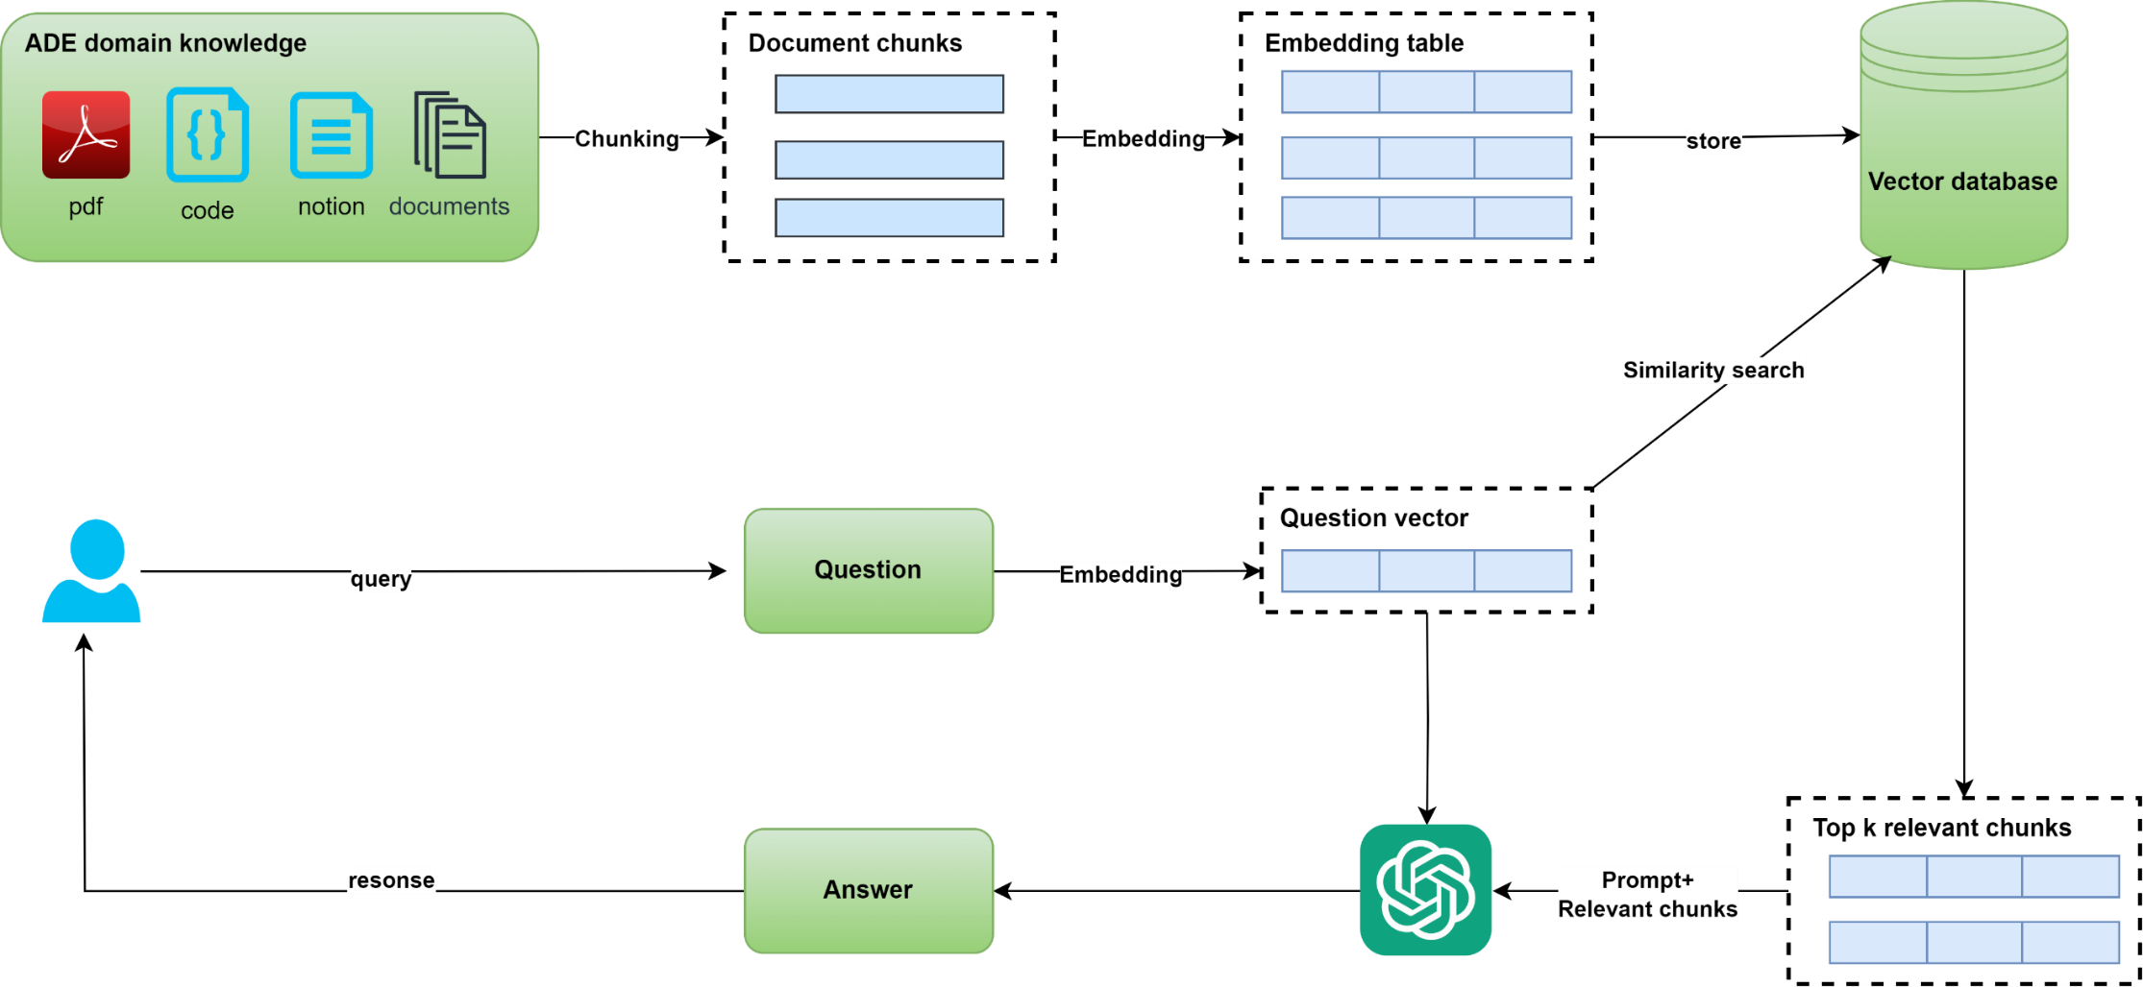
Assistant Chatbot
How ADE Copilot solves this problem
Implement interactive engineering assistant based on pre-trained LLM(Large Language Model) and RAG(Retrieval Enhancement Generation)

Slide 5

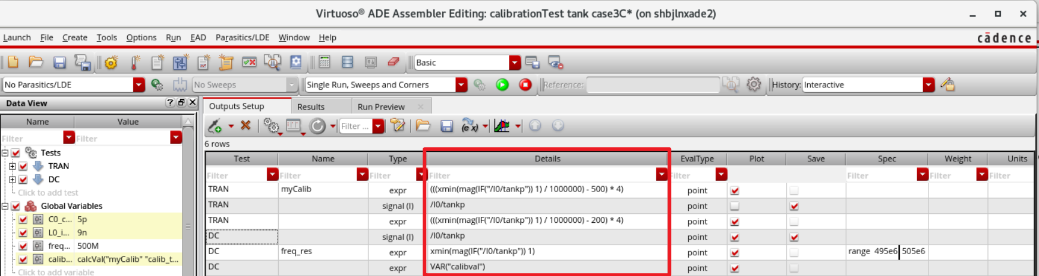

Verifier Requirements Automation
Problem to resolve
Designer need to manually edit expression according to requirements
Priority | Sim Type | Simulation Name | Simulation Description | Measurements | Corners
2 | TRAN | Functional | Verification of all functional modes | – Check diff amp and CMOS modes – Check SE vs Differential mode of operation – Effect of POC signal – Effect of RX_DQ_EN – ATB functionality - Effect of POC* signals | SS, FF, extreme VT
1 | DC | Power | Active power in all modes; leakage in disabled modes. Power is measured using a 110011 bit pattern at 533Mbps | Measure current/power for each supply Tstart | Power corners
2 | … | … | … | … | …
Natural Language Processing And Skill expression Generation
AI Way
Heavy Manual Effort
Traditional Way

Slide 6
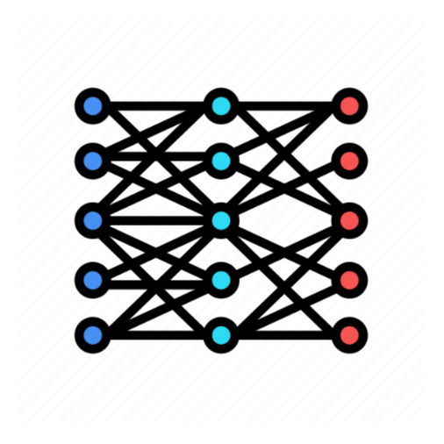
Verifier Requirements Automation
How ADE Copilot solve this problem
Fine Tune Pre-trained LLM based on skill source code
ID | Instruction
1 | Returns the X value where a signal crosses the threshold Y value
2 | Computes the average of a waveform over its entire range
3 | Stores the output value from one test and passes it on to another test.
… | …
X
ID | Ref Method
1 | cross(v("1" ?result "tran") 2.5 1 "either" t "time" )
2 | average(v("out" ?result "tran-tran"))
3 | calcVal(“trim” “myTest”)
… | …
ADE Copilot Training
Y

Slide 7
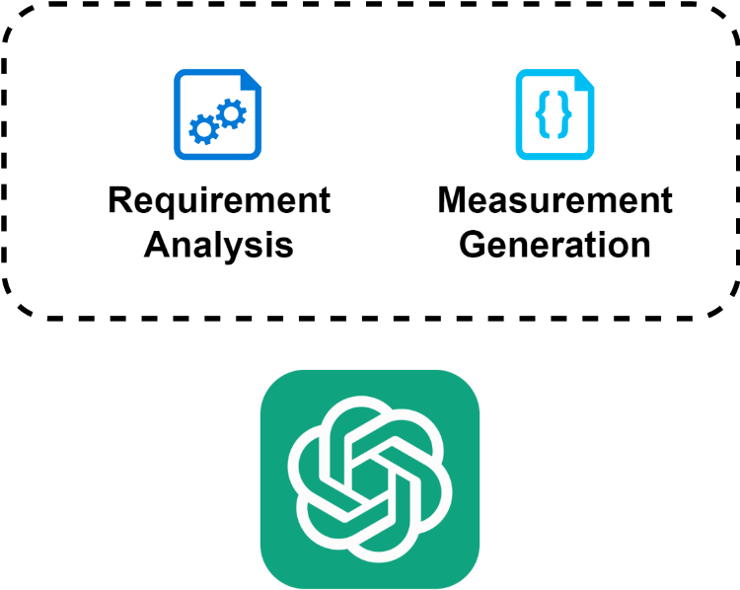
Verifier Requirements Automation
How ADE Copilot solve this problem
Task analysis and measurement generation
ID | Requirements
1 | High pulse width at vdd/2.0 / period
2 | Measure the peak current on each supply and ensure that it meets project targets
… | …
ID | Requirements
1 | fallTime(VT("/net12") 0 nil 0 nil 10 90 nil "time" )-riseTime(VT("/net12") 0 nil 0 nil 10 90 nil "time" )
2 | ymax(IT("/M1/D"))
… | …

Slide 8
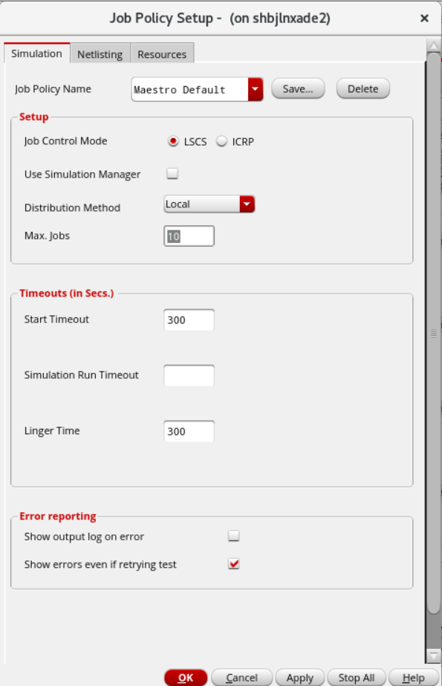
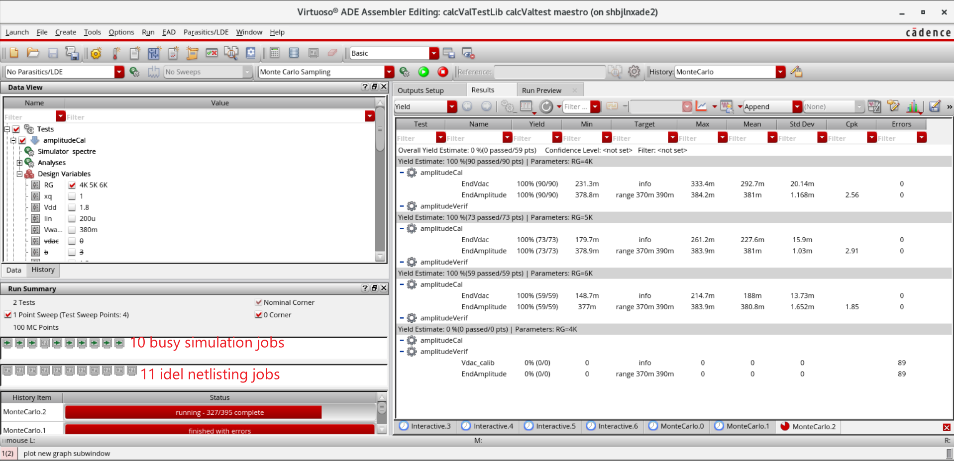
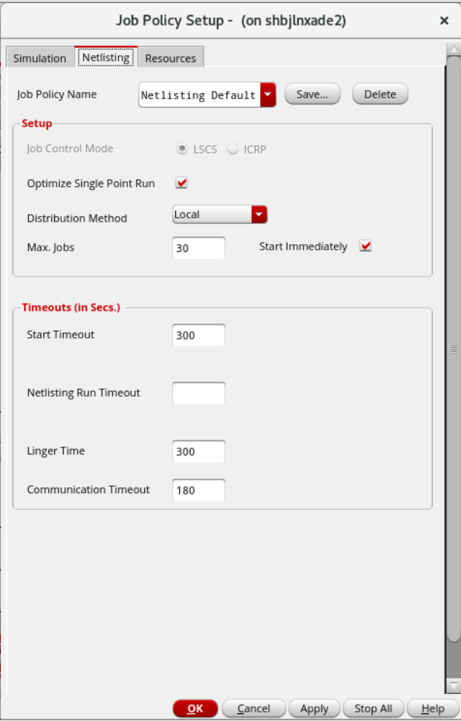
Job Policy Optimization
Problem to resolve
Improper setting of job policy leads to waste of resources

Slide 9
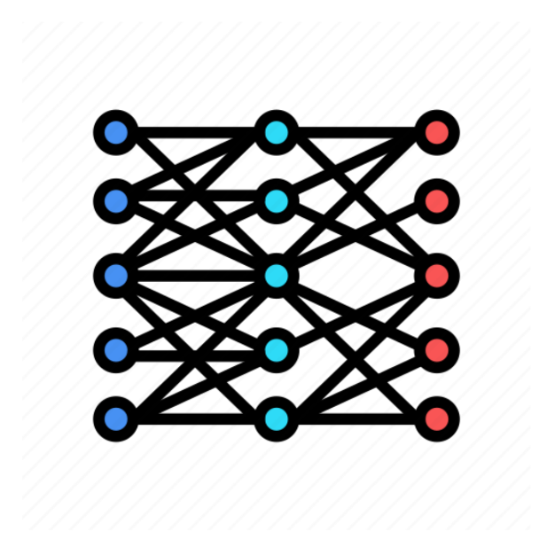
Job Policy Optimization
How ADE Copilot solves this problem
Fine Tune pre-trained LLM based on circuit dataset
ID | Circuit | Tran analysis stop time | Simulation points
1 | 1-stage common-source amplifier | 10s | 1000
2 | 3-stage common-source amplifier | 100s | 600
3 | common-drain amplifier | 80s | 500
… | … | … | …
X
ID | Netlist jobs | Simulation jobs
1 | 10 | 12
2 | 20 | 46
3 | 40 | 16
… | … | …
ADE Copilot training
Y
Data Set

Slide 10
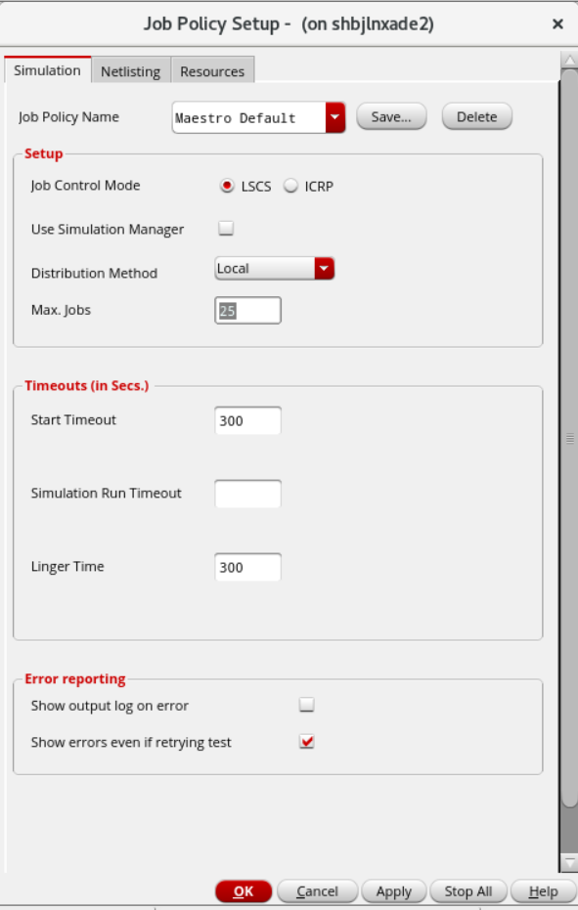
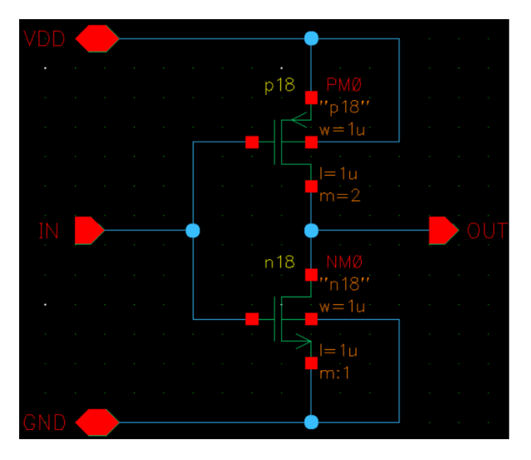
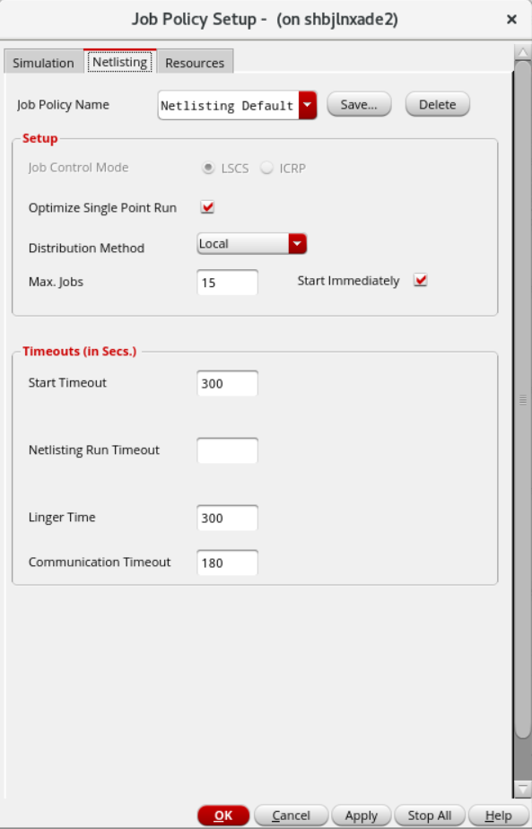
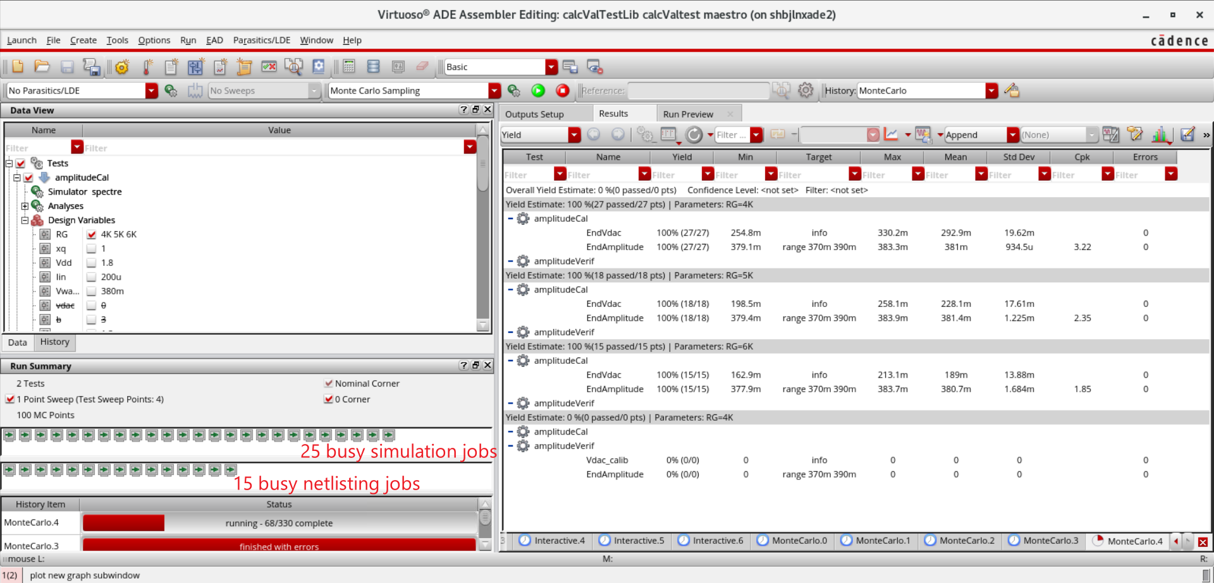
Job Policy Optimization
How ADE Copilot solves this problem
Get the optimal settings for job policy
ADE Copilot Inference
Schematic Design
Setting Job Policy Automatically
Reasonable Allocation of Resources

