Slide 1
CIC Global 2025
Cadence Innovation Conference
June 17-20

Slide 2
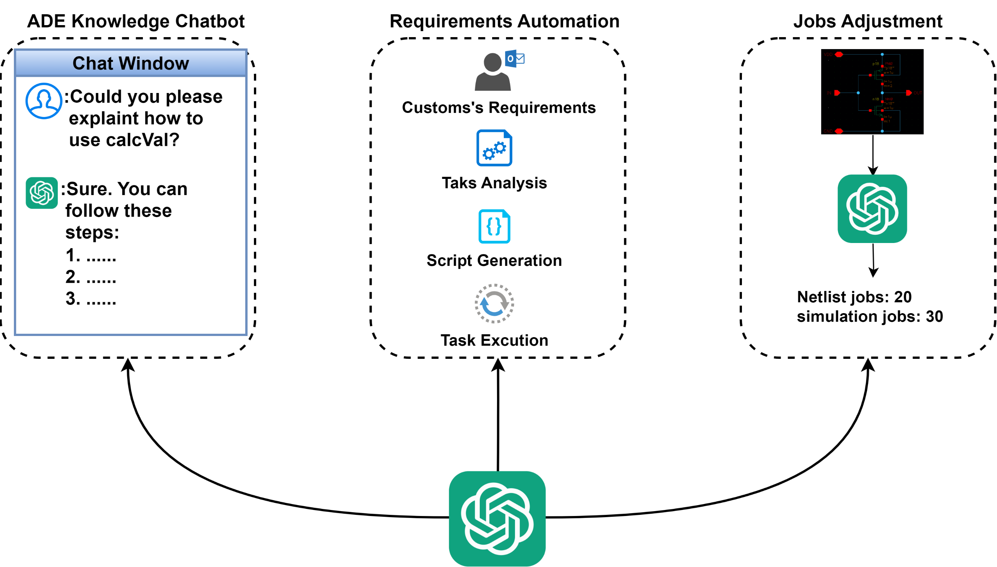
What ADE Copilot can do

Slide 3
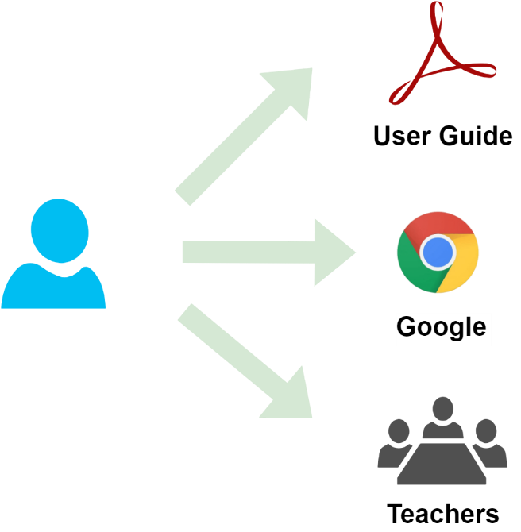
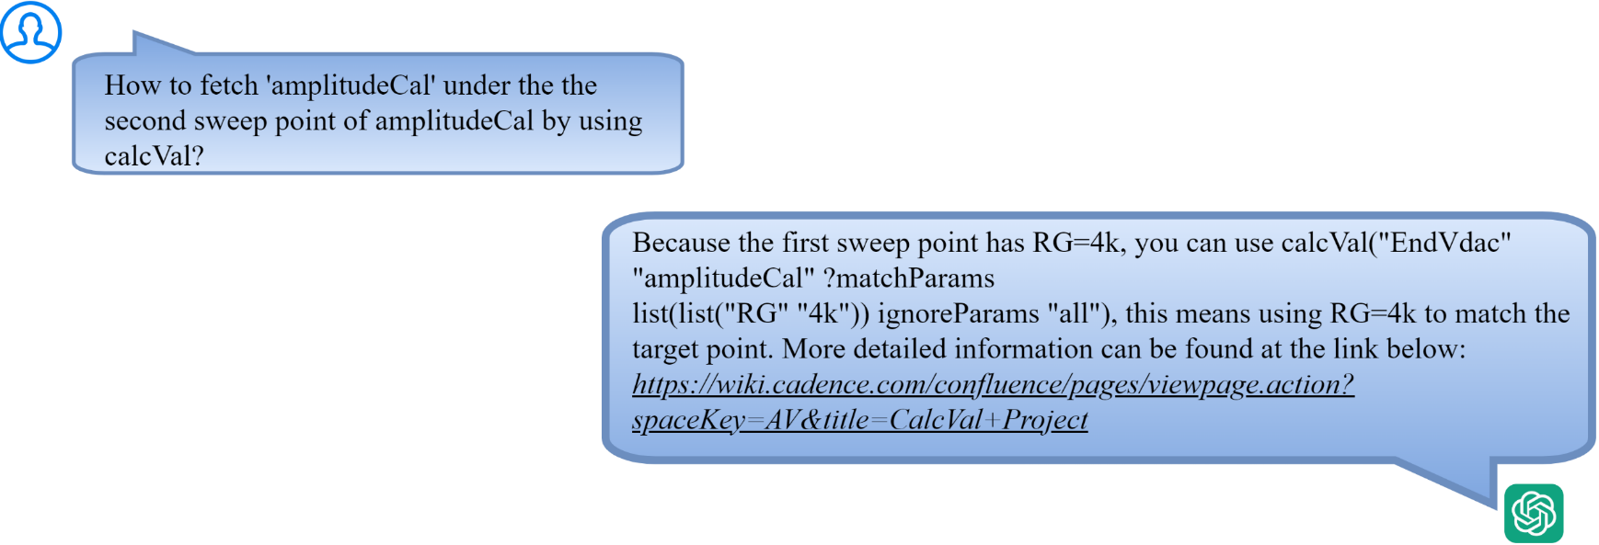
Assistant Chatbot
Problem to resolve
ADE has too many features
Traditional learning methods can no longer meet the needs
An interactive engineering assistant based on LLM is a better choice
Traditional Learning Methods
Interactive Engineering assistant

Slide 4
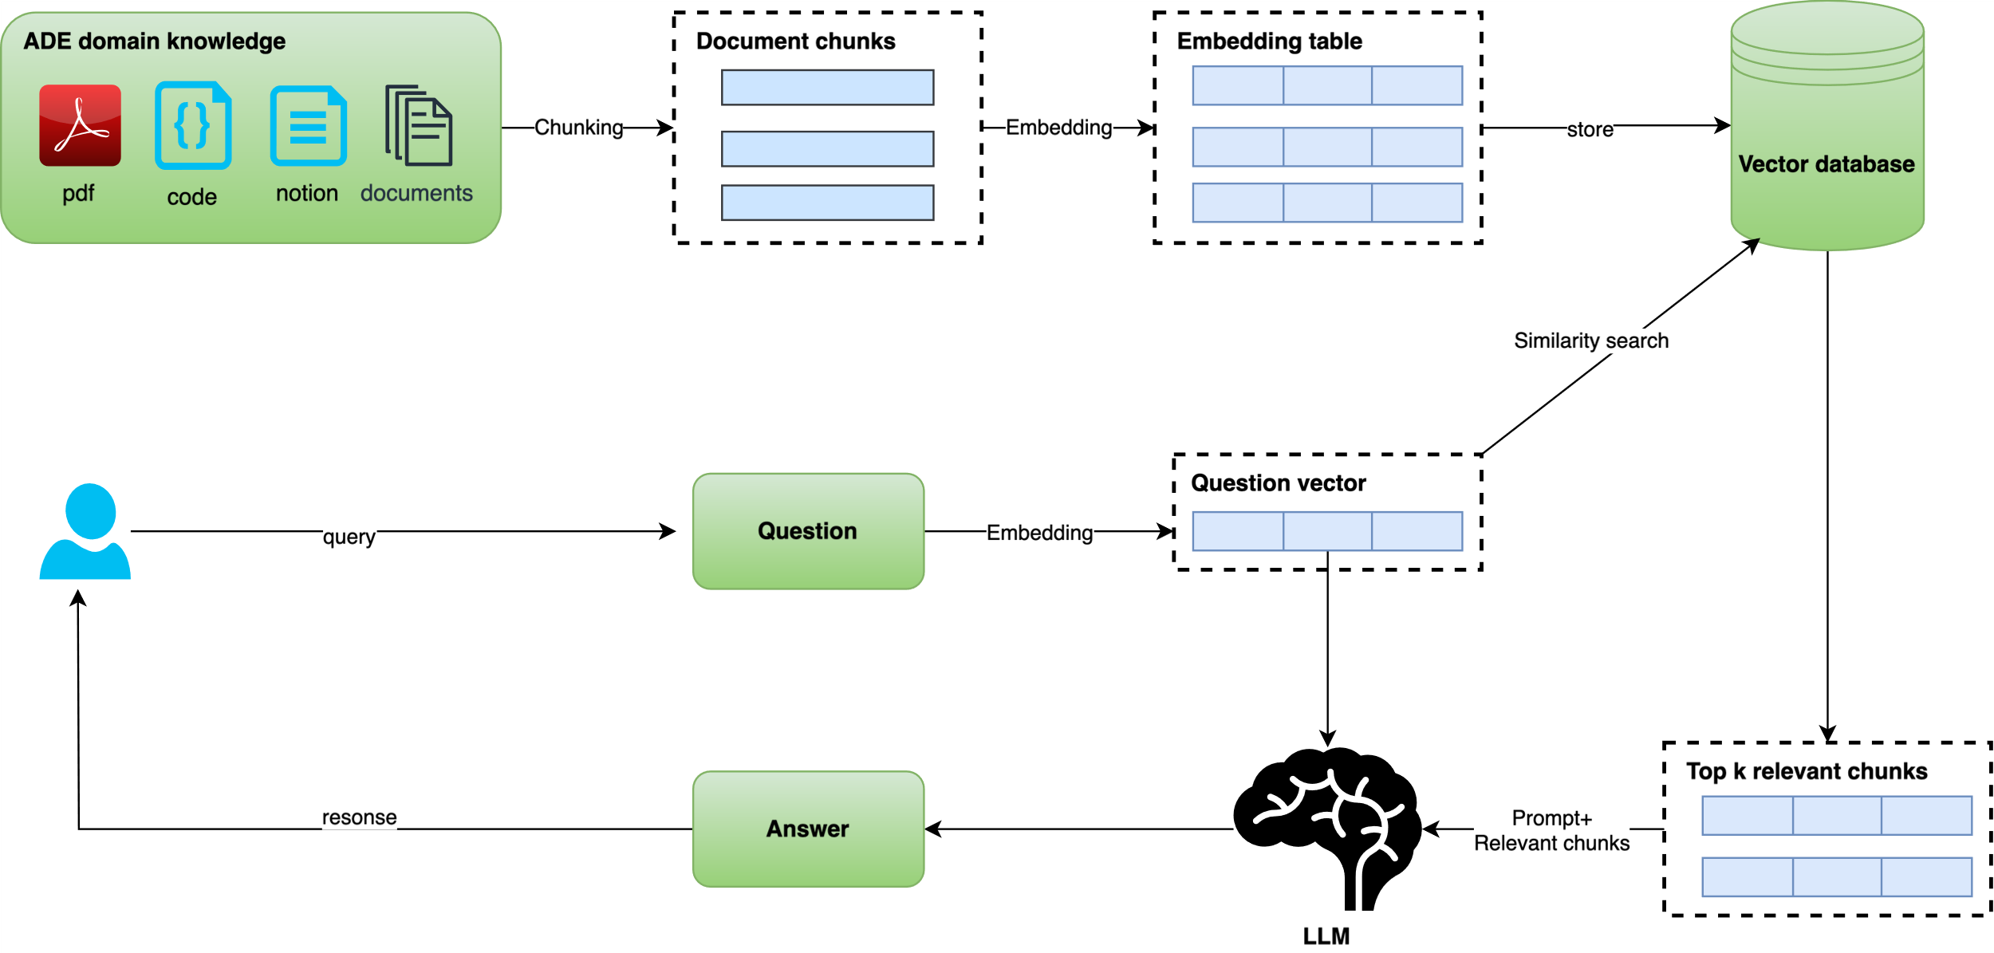
Assistant Chatbot
How ADE Copilot solves this problem
Implement interactive engineering assistant based on pre-trained LLM(Large Language Model) and RAG(Retrieval Enhancement Generation)

Slide 5
Verifier Requirements Automation
Problem to resolve
Improper setting of job policy leads to waste of resources

Slide 6
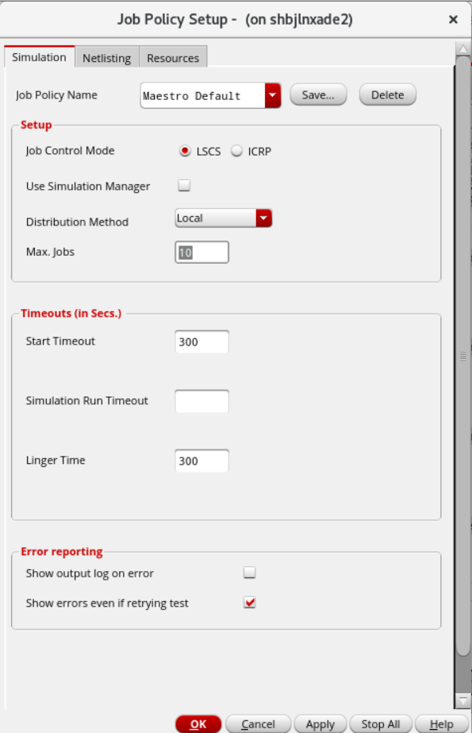
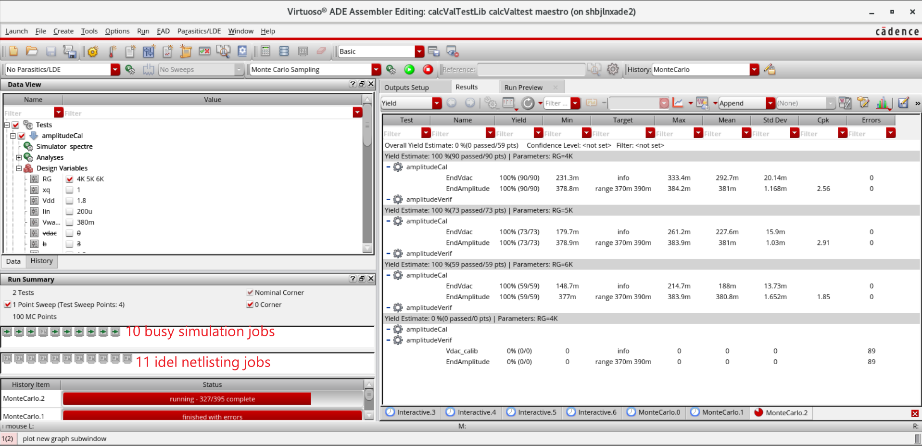
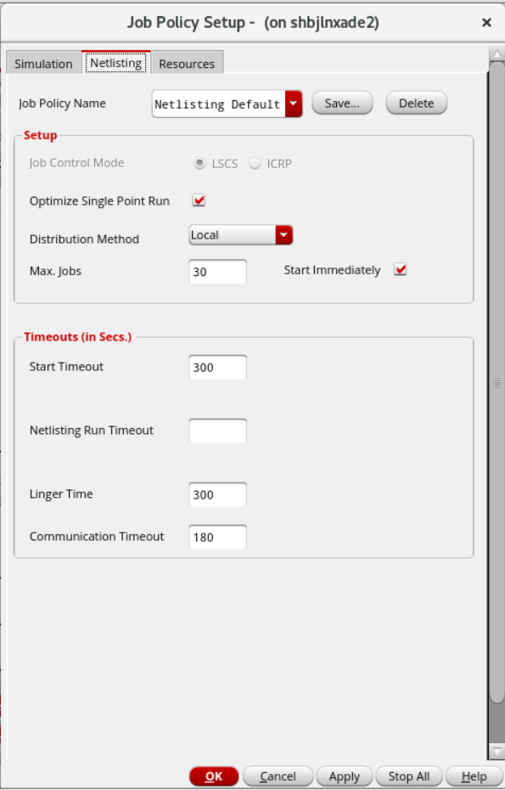
Job Policy Optimization
Problem to resolve
Improper setting of job policy leads to waste of resources

Slide 7
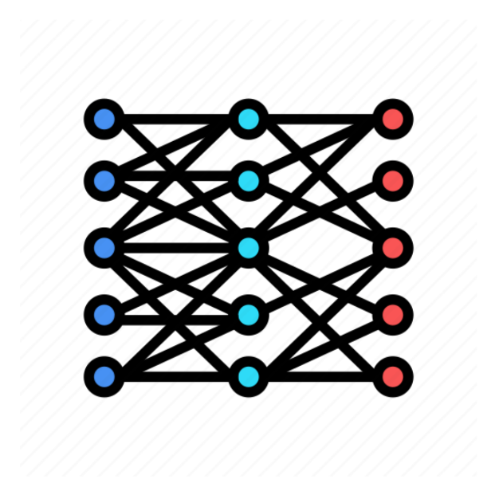
Job Policy Optimization
How ADE Copilot solves this problem
ID | Circuit | Tran analysis stop time | Simulation points
1 | 1-stage common-source amplifier | 10s | 1000
2 | 3-stage common-source amplifier | 100s | 600
3 | common-drain amplifier | 80s | 500
… | … | … | …
X
ID | Netlist jobs | Simulation jobs
1 | 10 | 12
2 | 20 | 46
3 | 40 | 16
… | … | …
ADE Copilot training
Y
Data Set

Slide 8
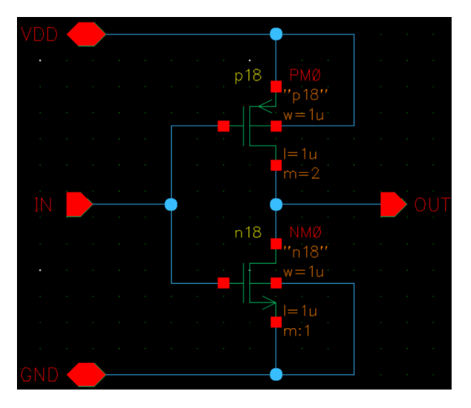
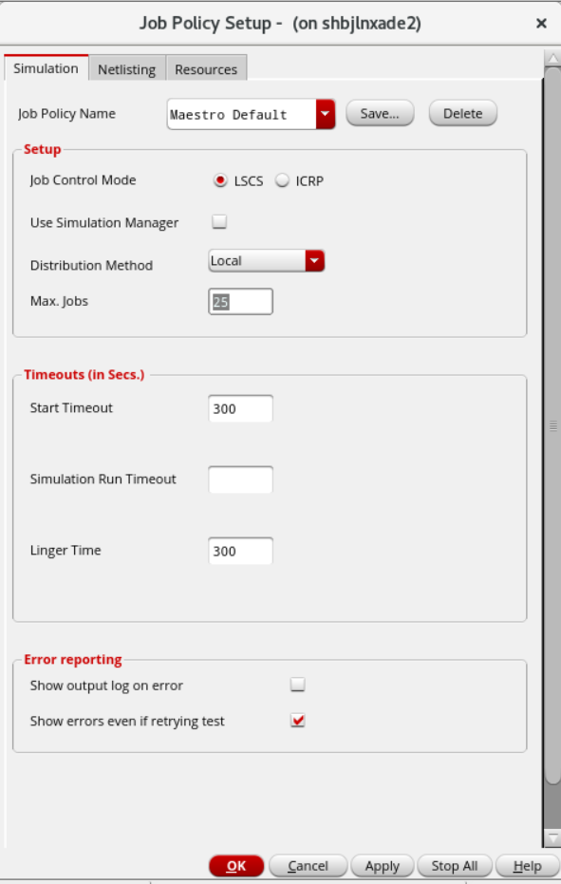
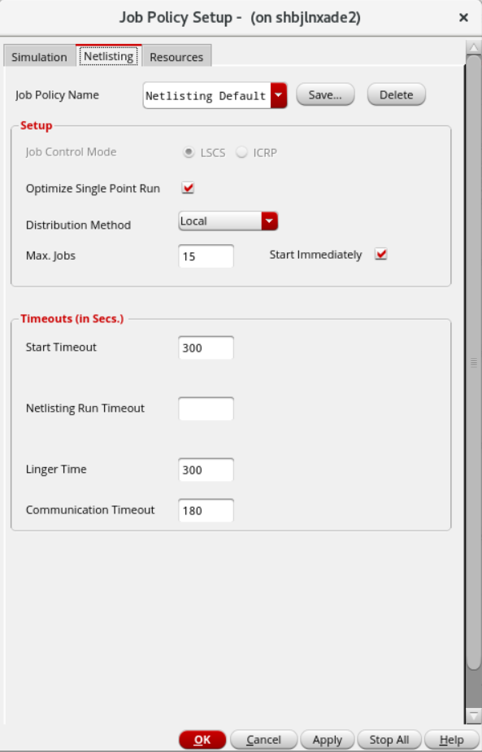
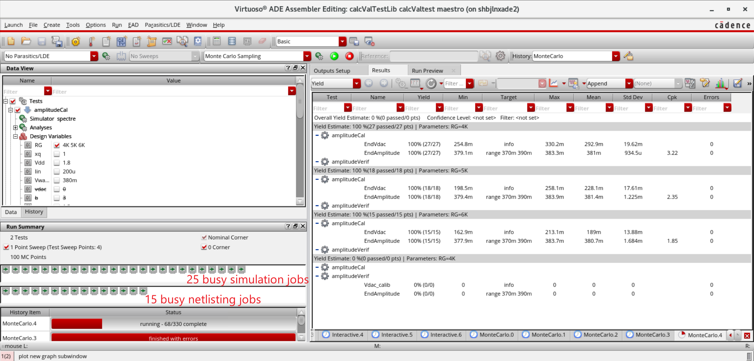
Job Policy Optimization
How ADE Copilot solves this problem
ADE Copilot Inference
Schematic Design
Setting Job Policy Automatically
Reasonable Allocation of Resources

