Slide 1
CIC Global 2025
Cadence Innovation Conference
June 17-20

Slide 2
What ADE Copilot can do

Slide 3
Assistant Chatbot
Problem to resolve
Improper setting of job policy leads to waste of resources

Slide 4
Verifier Requirements Automation
Problem to resolve
Improper setting of job policy leads to waste of resources

Slide 5
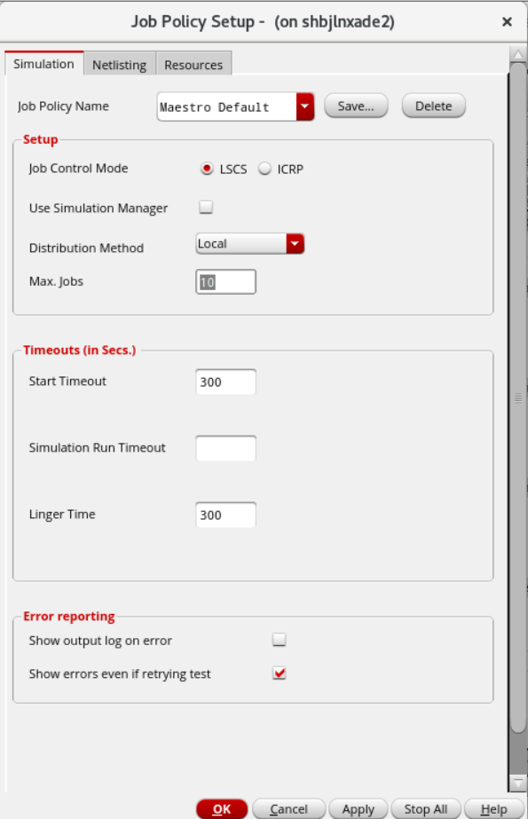
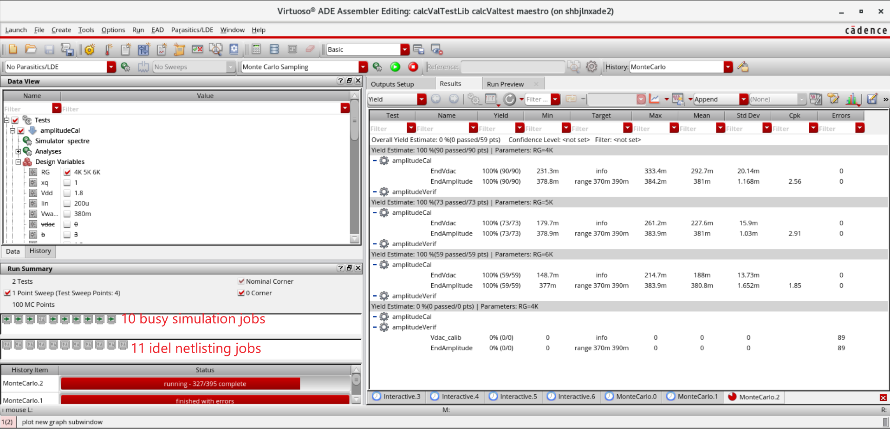
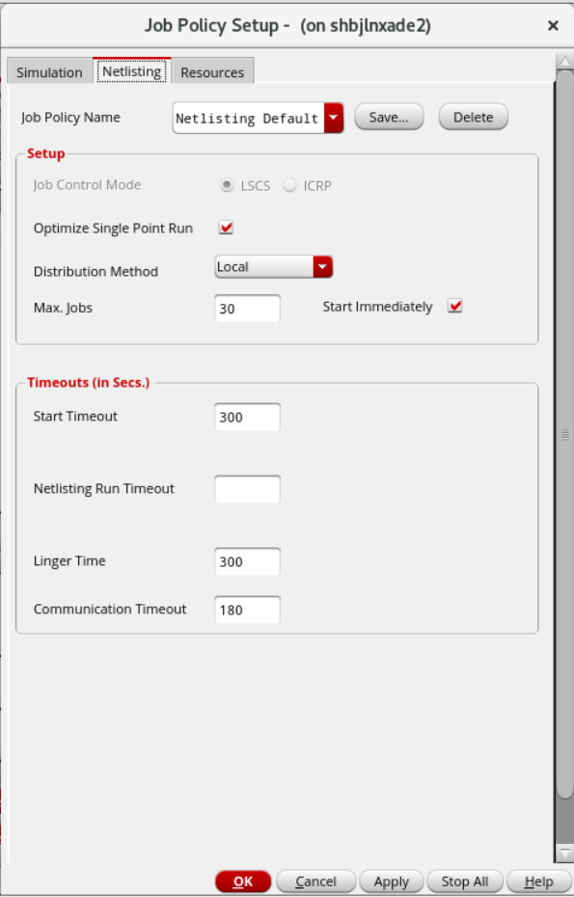
Job Policy Optimization
Problem to resolve
Improper setting of job policy leads to waste of resources

Slide 6
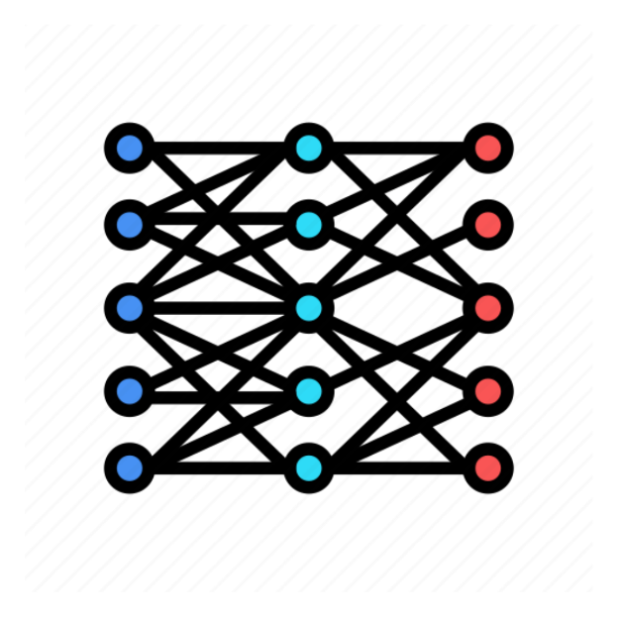
Job Policy Optimization
How ADE Copilot solves this problem
ID | Circuit | Tran analysis stop time | Simulation points
1 | 1-stage common-source amplifier | 10s | 1000
2 | 3-stage common-source amplifier | 100s | 600
3 | common-drain amplifier | 80s | 500
… | … | … | …
X
ID | Netlist jobs | Simulation jobs
1 | 10 | 12
2 | 20 | 46
3 | 40 | 16
… | … | …
ADE Copilot training
Y
Data Set

Slide 7
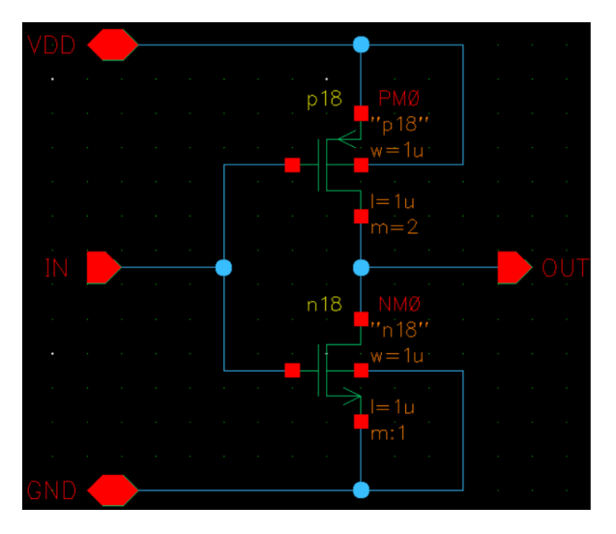
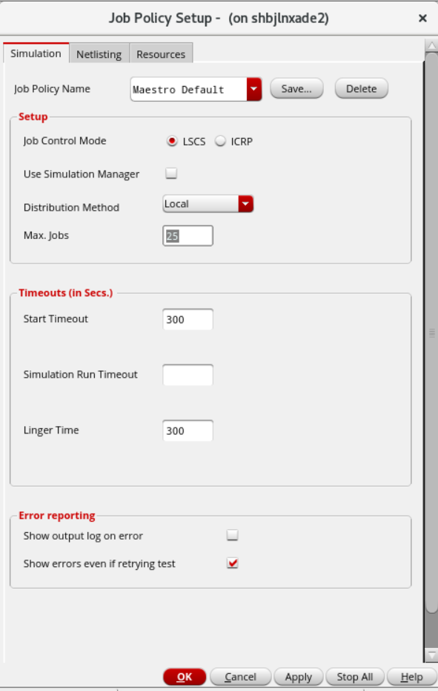
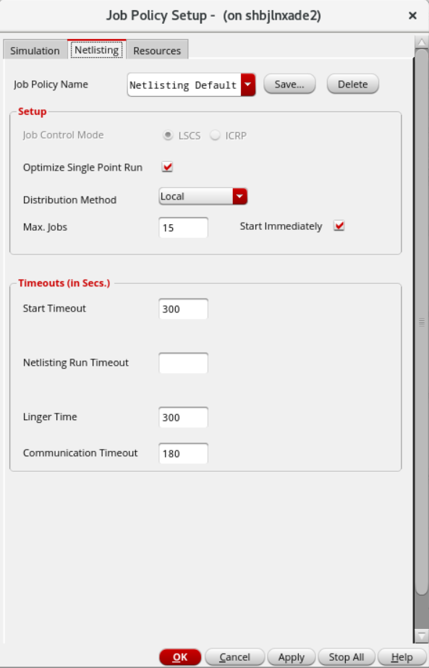
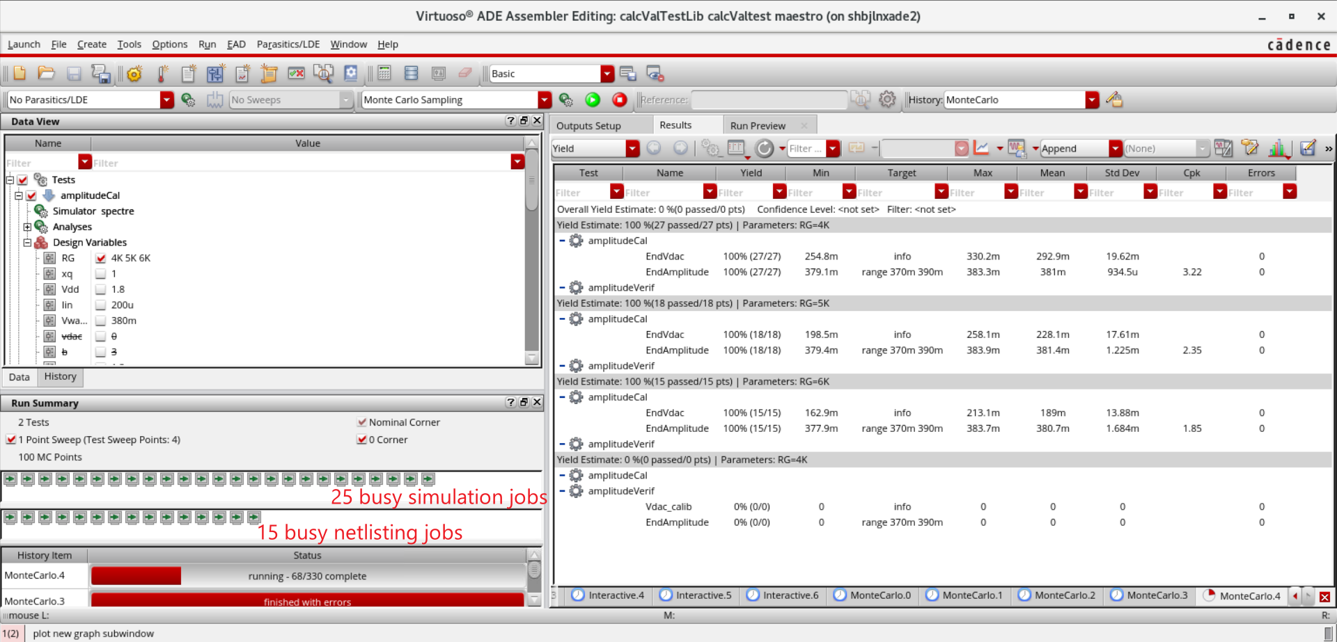
Job Policy Optimization
How ADE Copilot solves this problem
ADE Copilot Inference
Schematic Design
Setting Job Policy Automatically
Reasonable Allocation of Resources

