Slide 1
Mini Project- Travel Management System
Presenter:Group-5
Location:Talawade,Pune
Date:07/01/2019
Notes:
Copyright © 2011 IGATE Corporation (a part of Capegemini Group). All rights reserved.
No part of this publication shall be reproduced in any way, including but not limited to photocopy, photographic, magnetic, or other record, without the prior written permission of IGATE Corporation (a part of Capegemini Group).
IGATE Corporation (a part of Capegemini Group) considers information included in this document to be confidential and proprietary.

Slide 2
Team Members
Vedashri Joshi
Vidya Rameshwar Honde
Ratika Gupta
Meher Lakshmi Indukuri
Aniket Shrirang
Kundan Ganesh Shankar Maurya

Slide 3
Project Details
Travel Management System allows employees to make Travel Requests and process expense claim settlement on a secure website.
This will include management of Travel/Movement Request raised by employees and followed by raising travel expenses against travel made and management of expense claim settlement made to the employees.
Technologies Used:
Sql Server 2012
C# 5.0
Windows Presentation Foundation(WPF) 4.5
Entity Framework 6.0x

Slide 4
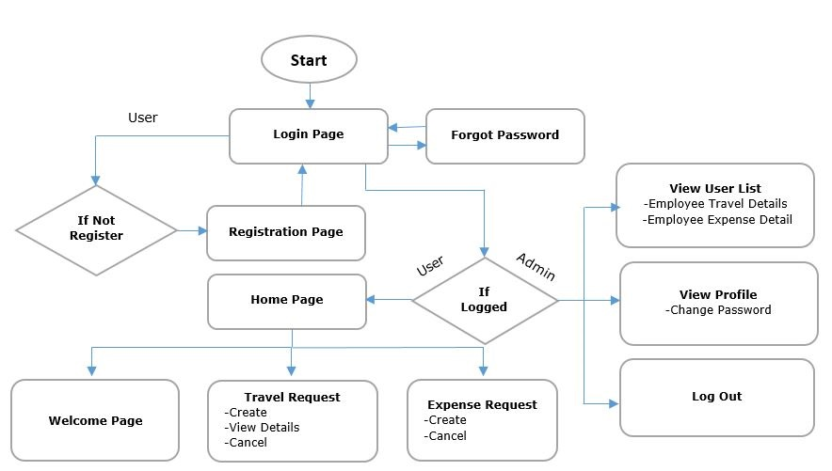
Diagram Depicting Entire Project
Figure -1

Slide 5
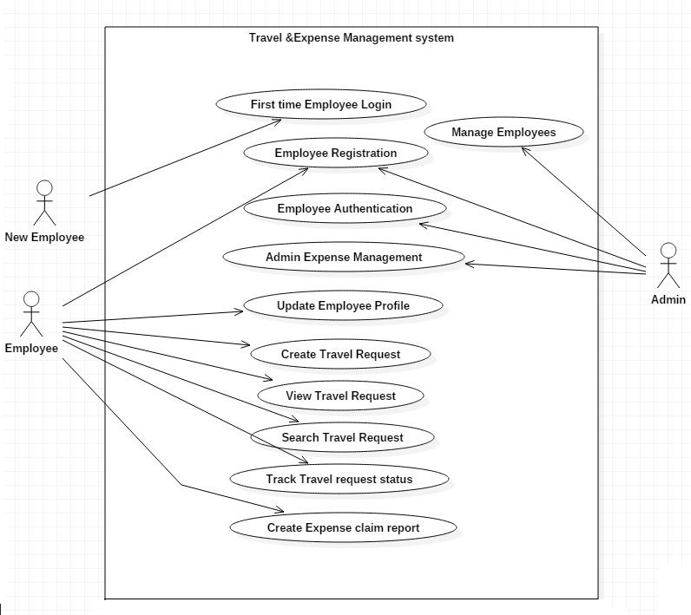
Use Case Diagram
Employee Registration
Employee Login
View Profile
Figure -2

Slide 6
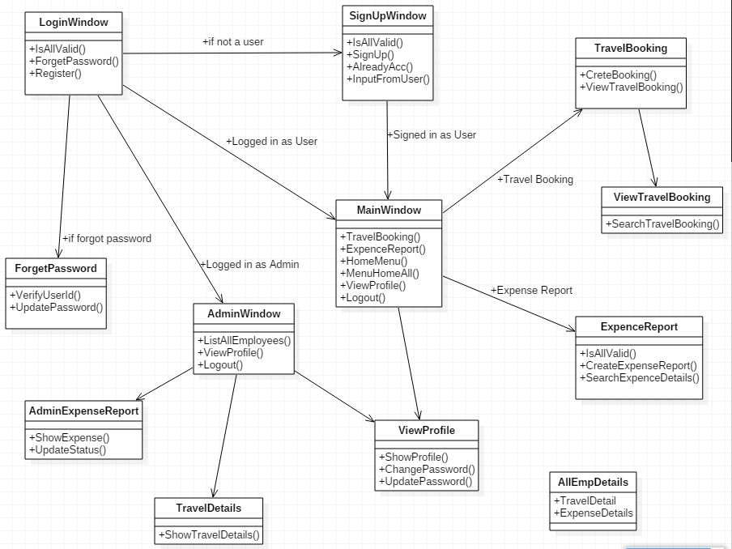
Class Diagram
Figure -3

Slide 7
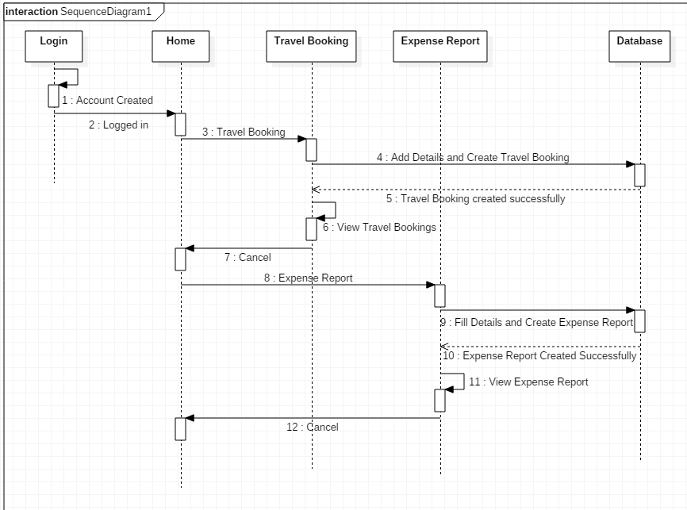
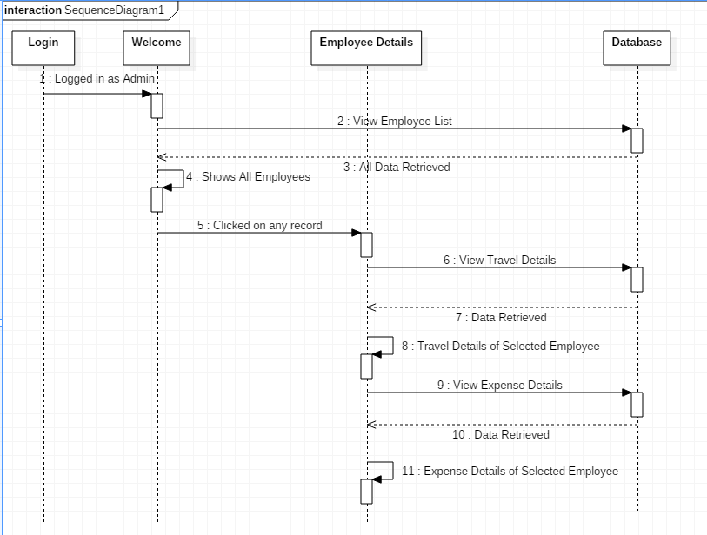
Sequence Diagram
Figure 4-User Sequence
Figure 5-Admin Sequence

Slide 8
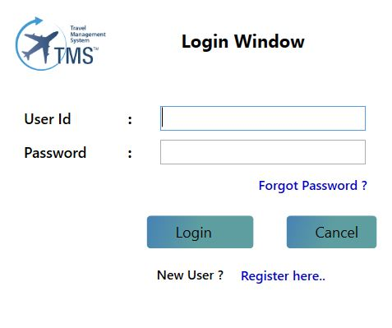
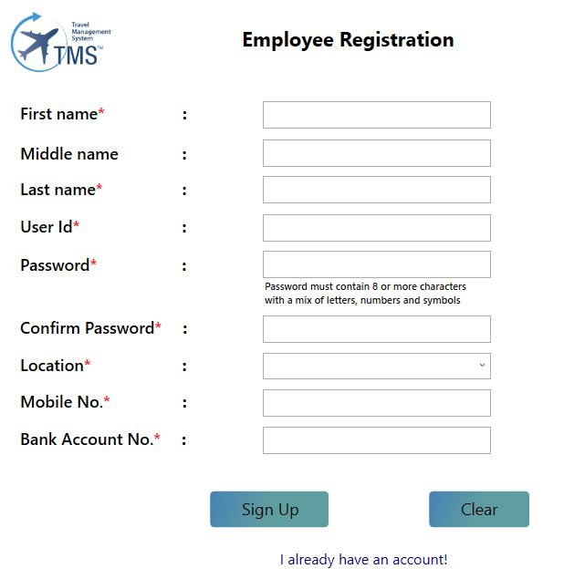
Screen shots
Figure 6-Login Page
Figure 7-Registration Page

Slide 9
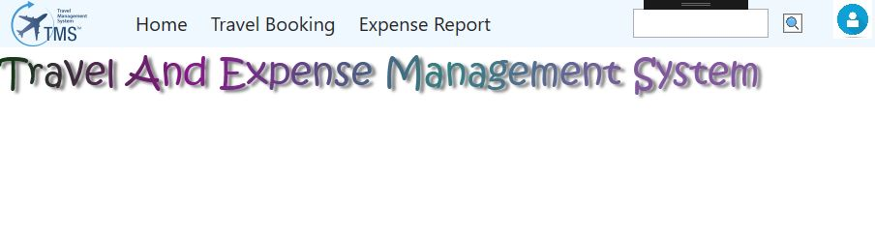
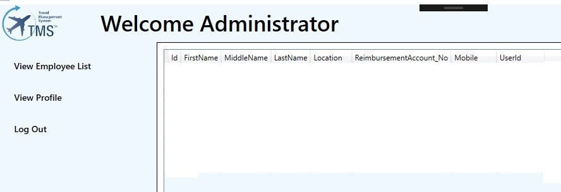
Screen shots
Figure 8-User Welcome Page
Figure 9- Admin Welcome Page

Slide 10
Future Enhancements
Instant Claim Settlement.
Development of User friendly Mobile Application.
Status of Claim at any stage.
Use of ASP.Net & ASP.Net MVC Technology so that user can use any browser for better view.

Slide 11
Thanks

