Slide 1
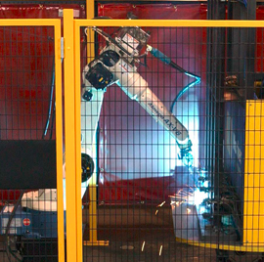
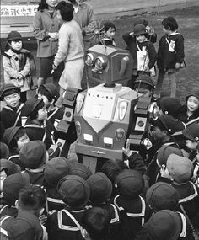
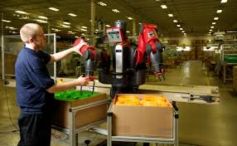
Introduction
Robots have historically worked away from humans, set apart in safety “cages”
Newer collaborative robots can work alongside humans under favorable conditions
What if conditions are not favorable?

Slide 2
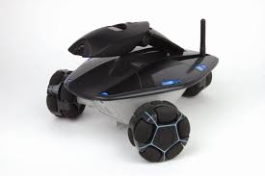
Introduction
Mobile robots making way through a crowd cannot avoid bumping into humans
Need to “negotiate” path by sensing how the crowd pushes back
Omni-directional wheels make possible to counter incoming forces from any direction
However force-based algorithms are still required for proper control

