Slide 1

ROS and Gazebo utilities for Yamabico robots
Helio Perroni Filho (HEL)

Slide 2
Introduction
Problem: developing robot movement routines
  Trial and error process
  Needs access to target environment or close approximation
  Setup may be expensive / time consuming
  Mistakes may result in property damage / personal injury
Solution: simulated test environments
  First develop movement routine in virtual world
  Later setup real-world test for final checks / adjustments
  Quicker and cheaper setup and retrial
  Reduced physical risks

Slide 3
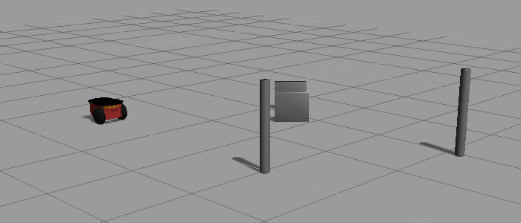
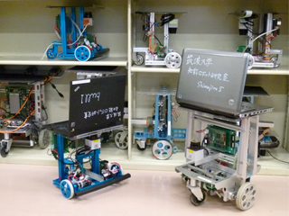
Introduction
YumebROS
YamabROS
Simulated robot
ROS navigation
Application
Control client
Yamabico robot
ypspur

Slide 4
YamabROS
ROS / Gazebo utils for Yamabico
Tools
  Movement server (spur_server)
  Movement action client (spur_client)
Example settings
  Simulation environment (Gazebo)
  ROS navigation stack
  Hokuyo laser range finders
  Visualization tools (rviz, rqt)

Slide 5
Movement server – spur_server
Based on ypspur_ros_bridge
Embedded ypspur-coordinator control
ROS parameter support
rosconsole log messages
High-level action API
Three modes of operation (navigator / motion planner)
  ypspur - ypspur-coordinator / libypspur
  ypspur_ros - ypspur-coordinator / ROS navigation stack
  ros - external movement server / ROS navigation stack

Slide 6
Movement client – spur_client
High-level C++ API
Synchronous / asynchronous operation modes
Server mode agnostic
// Start client in synchronous mode
Spur spur(true);
// Blocks until target achieved
spur.approach(0.5, 0.0, 0.0);
// Commands given in robot-centric coordinate frame
spur.approach(0.5, 1.0, M_PI_2);

Slide 7
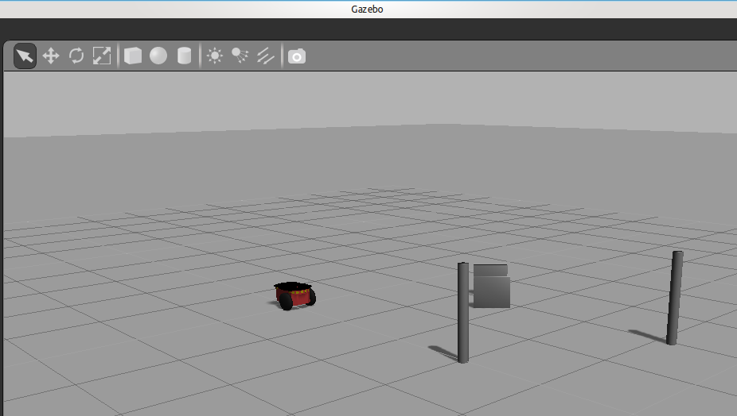
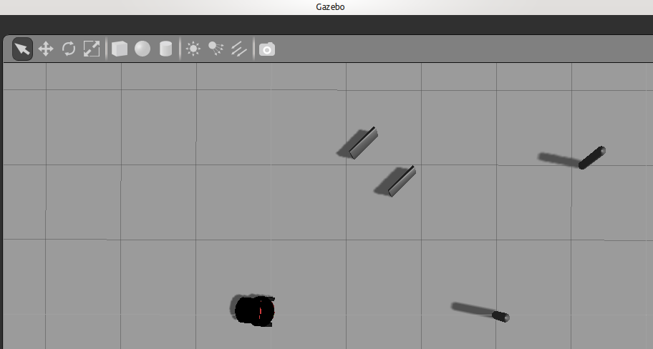
YumebROS
Collection of ROS-enabled models for Gazebo
Example launch files
Programming demos

Slide 8
Motion routine development workflow
Design simulated environment in Gazebo
Run spur_server in ros mode (connected to Gazebo)
Develop control program using the spur_client API
Test control program on Gazebo simulation
Once finished, test control program on Yamabico robot

Slide 9
The End
Questions?

