Slide 1
Gluon Helicity
Methun Kamruzzaman
Raza Sabbir Sufian

Slide 2
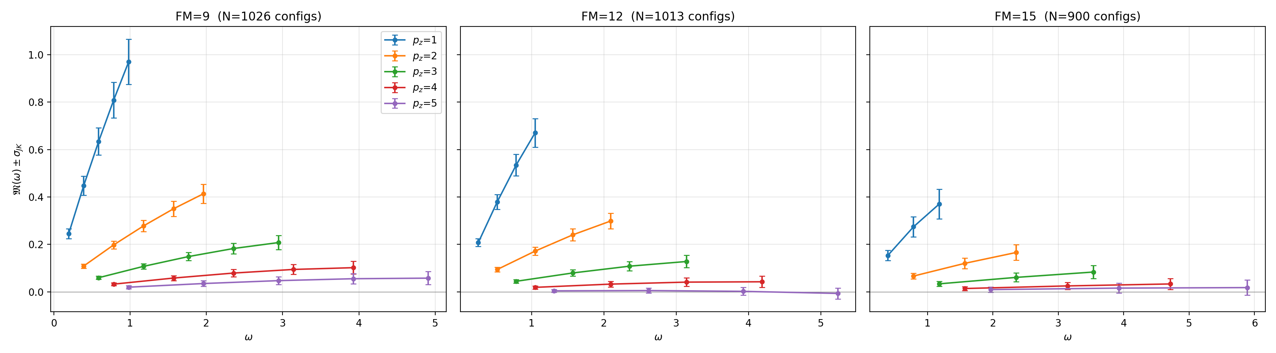
Dataset
Spacing (FM) | #P | #Z | # distinct W | # observations
a=0.09 fm | 5 | 5 | 14 | 1026
a=0.12 fm | 5 | 4 | 13 | 1013
a=0.15 fm | 5 | 3 | 11 | 900

Slide 3
Questions
How to extrapolate M(w, p) curve for large w values
What will be the shape of 𝛥I_{g}
We have data for three a (0.09, 0.12, 0.15) values. What will be the shape of 𝛥I_{g} when a→0.

Slide 4
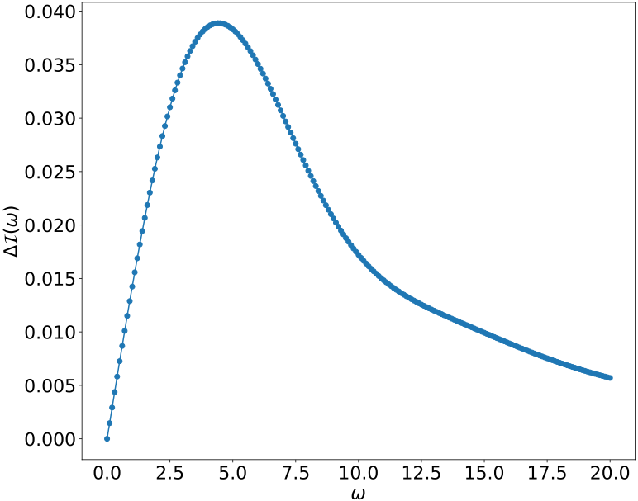
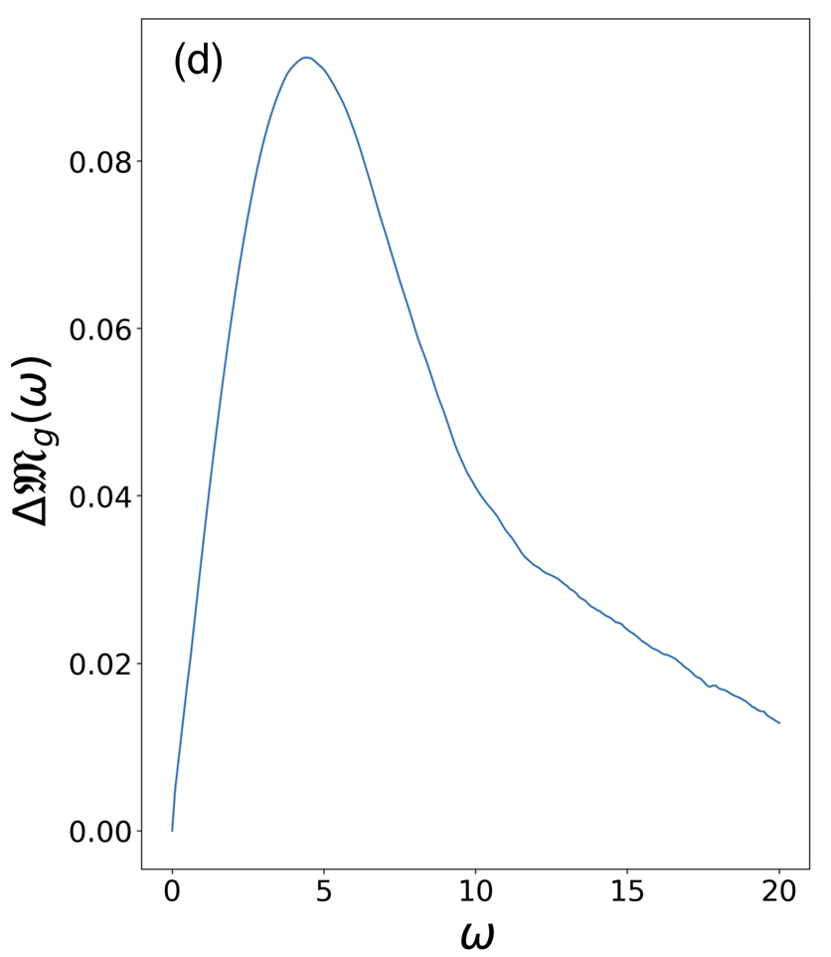
Previous pipeline
Gradient descent
Estimate M_{i}, M_{j} that best fit 𝛥I_{g}
Test on real data, find best model and use that to generate 𝛥I_{g}
Use the synthetic M values to train ML models

Slide 5
Problem with current solution
Biased with the initial I(w) values
ML is more ornamental, not real use case
Hard to predict when real data changes

Slide 6
Curve fitting
Model | Form | Parameters (k) | How it differs
M1 | A ω e^{−sω} P^{−γ} e^{c z²} | A, s, γ, c (4) | Baseline
M2 | A ω e^{−sω} | A, s (2) | No P dependence
M3 | A ω e^{−sω} P^{−γ} | A, s, γ (3) | M1 without the z² term
M4 | A ω e^{−sω} e^{c z²} | A, s, c (3) | M1 without the P power
M5 | A ω e^{−sω} P^{−γ} (1 + c z²) | A, s, γ, c (4) | Linear O(z²) correction instead of an exponential
M6 | A ω^a e^{−sω} P^{−γ} e^{c z²} | A, a, s, γ, c (5) | Free power of ω (a=1 gives M1)
M7 | A ω / (1 + (ω/ω₀)²) P^{−γ} e^{c z²} | A, ω₀, γ, c (4) | Rational shape in ω
M8 | A ω e^{−(ω/ω₀)²} P^{−γ} e^{c z²} | A, ω₀, γ, c (4) | Gaussian fall-off in ω

Slide 7
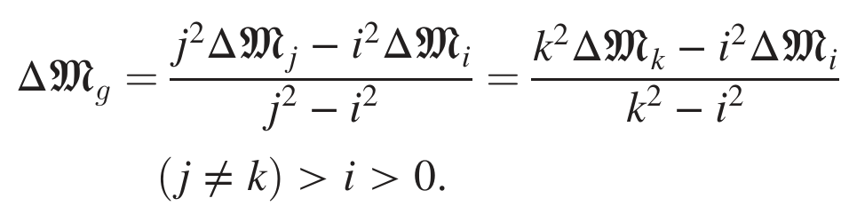
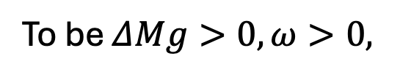

Required equations
To be $ΔMg>0, ω>0,$
$$M_{i} / Mj < j2 / i2, p=i<p=j$$

Slide 8
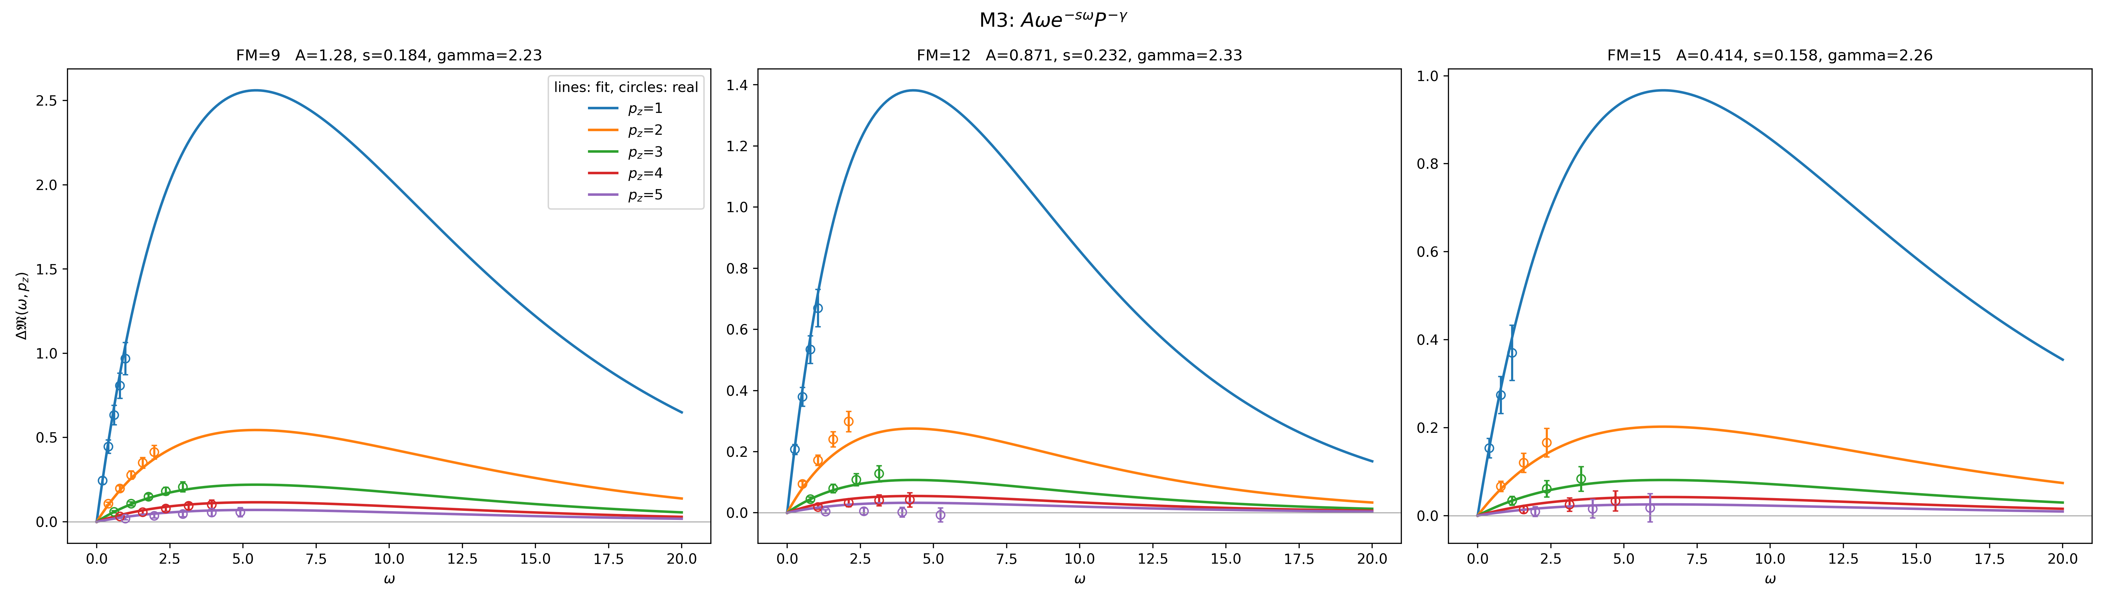
Curve fitting model
Fit 8 models M1…M8, find the best one using QAIC
For each FM, find the best matching M(w) curve for p=1…5
Test on real data, find best model and use that to generate 𝛥I_{g}
Use linear interpolation to generate 𝛥I_{g} when a→0
Use the best matching M_{k}(w) value (for p=k), find Mi(w) and M_{j}(w) (i<j<k) using GD
Use the synthetic M values to train ML models

Slide 9
Best three model outputs a=0.09

Slide 10
Best three model outputs a=0.12

Slide 11
Best three model outputs a=0.15

Slide 12
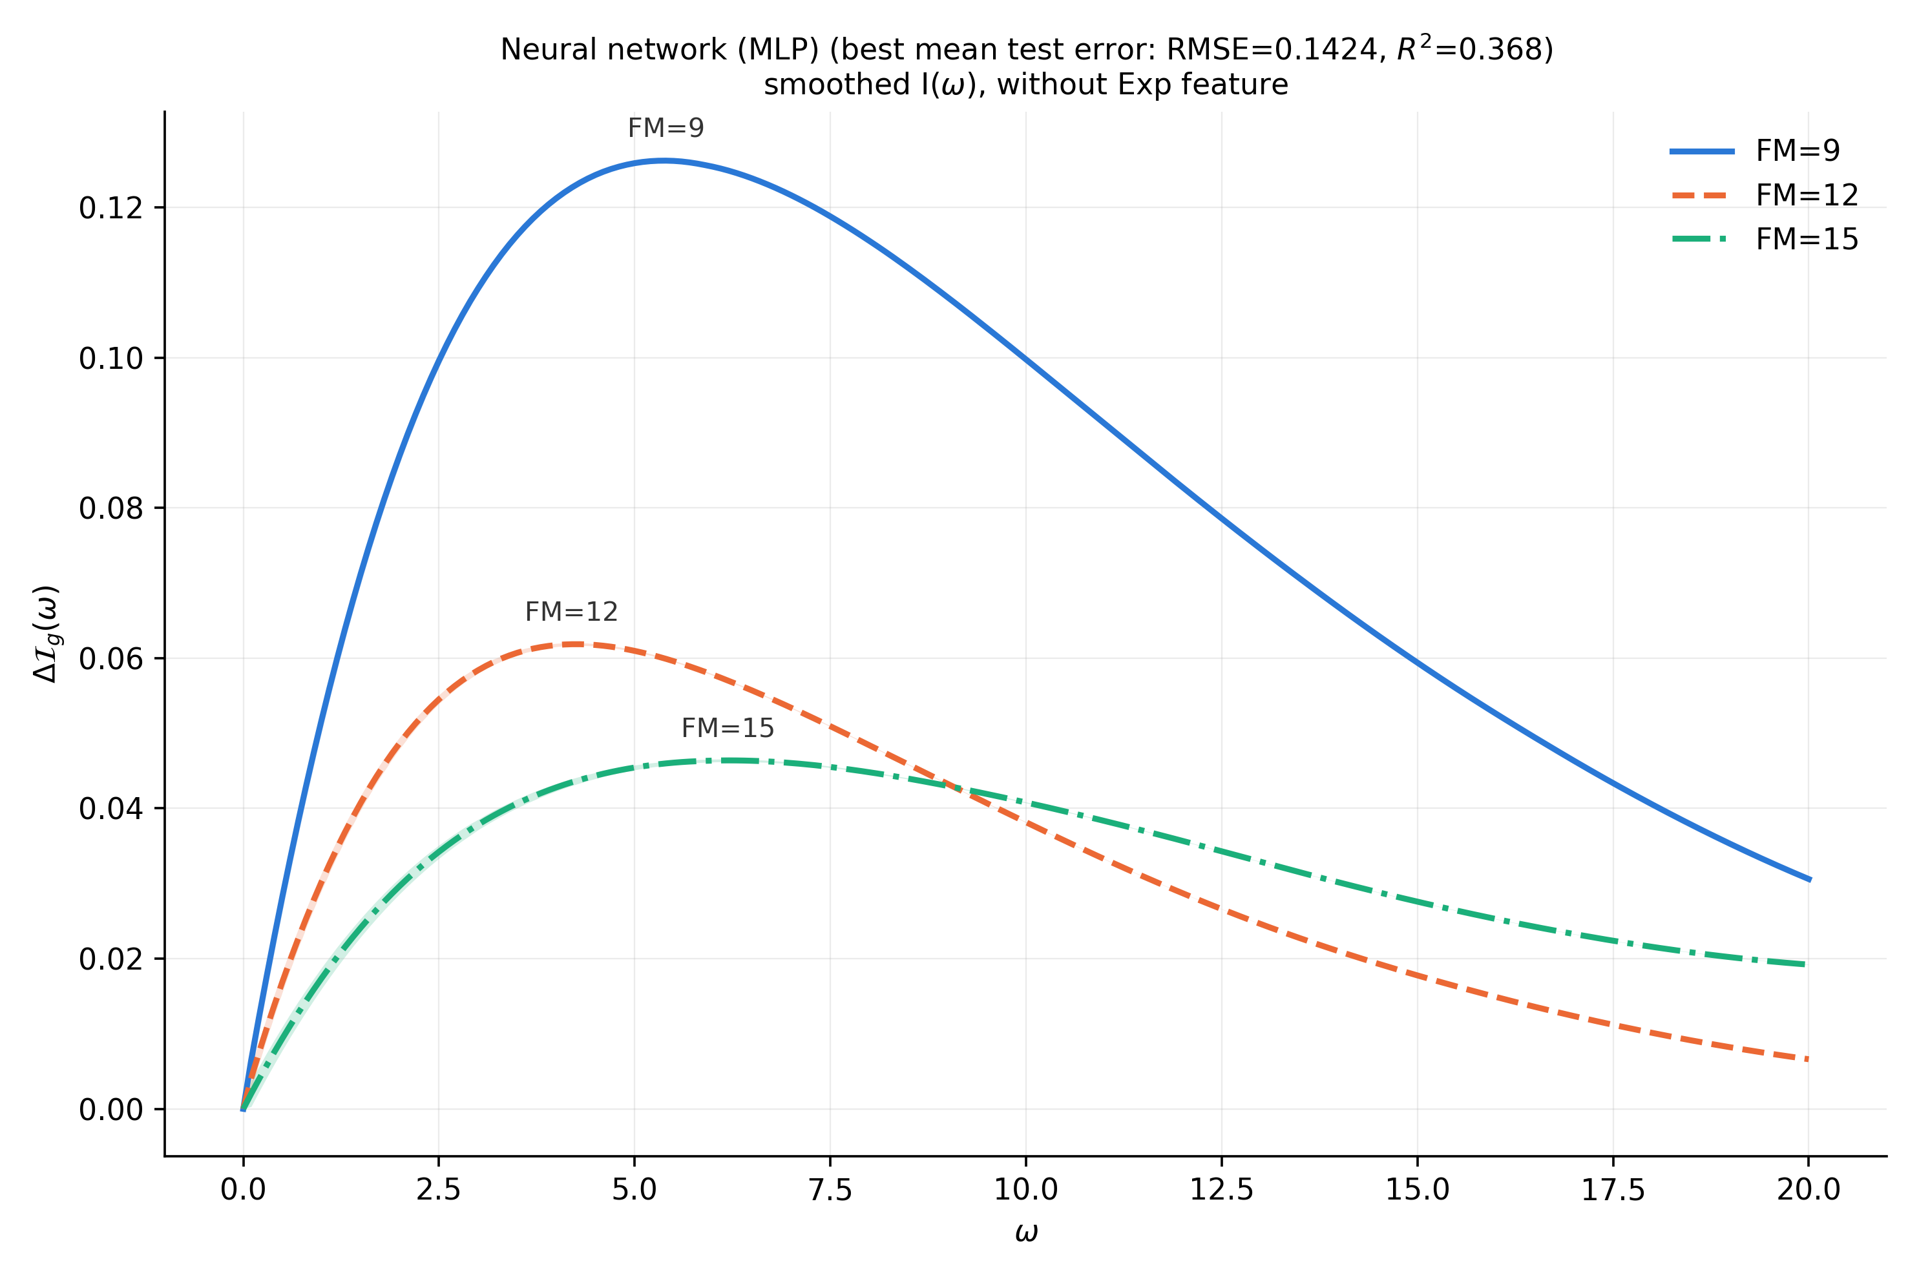
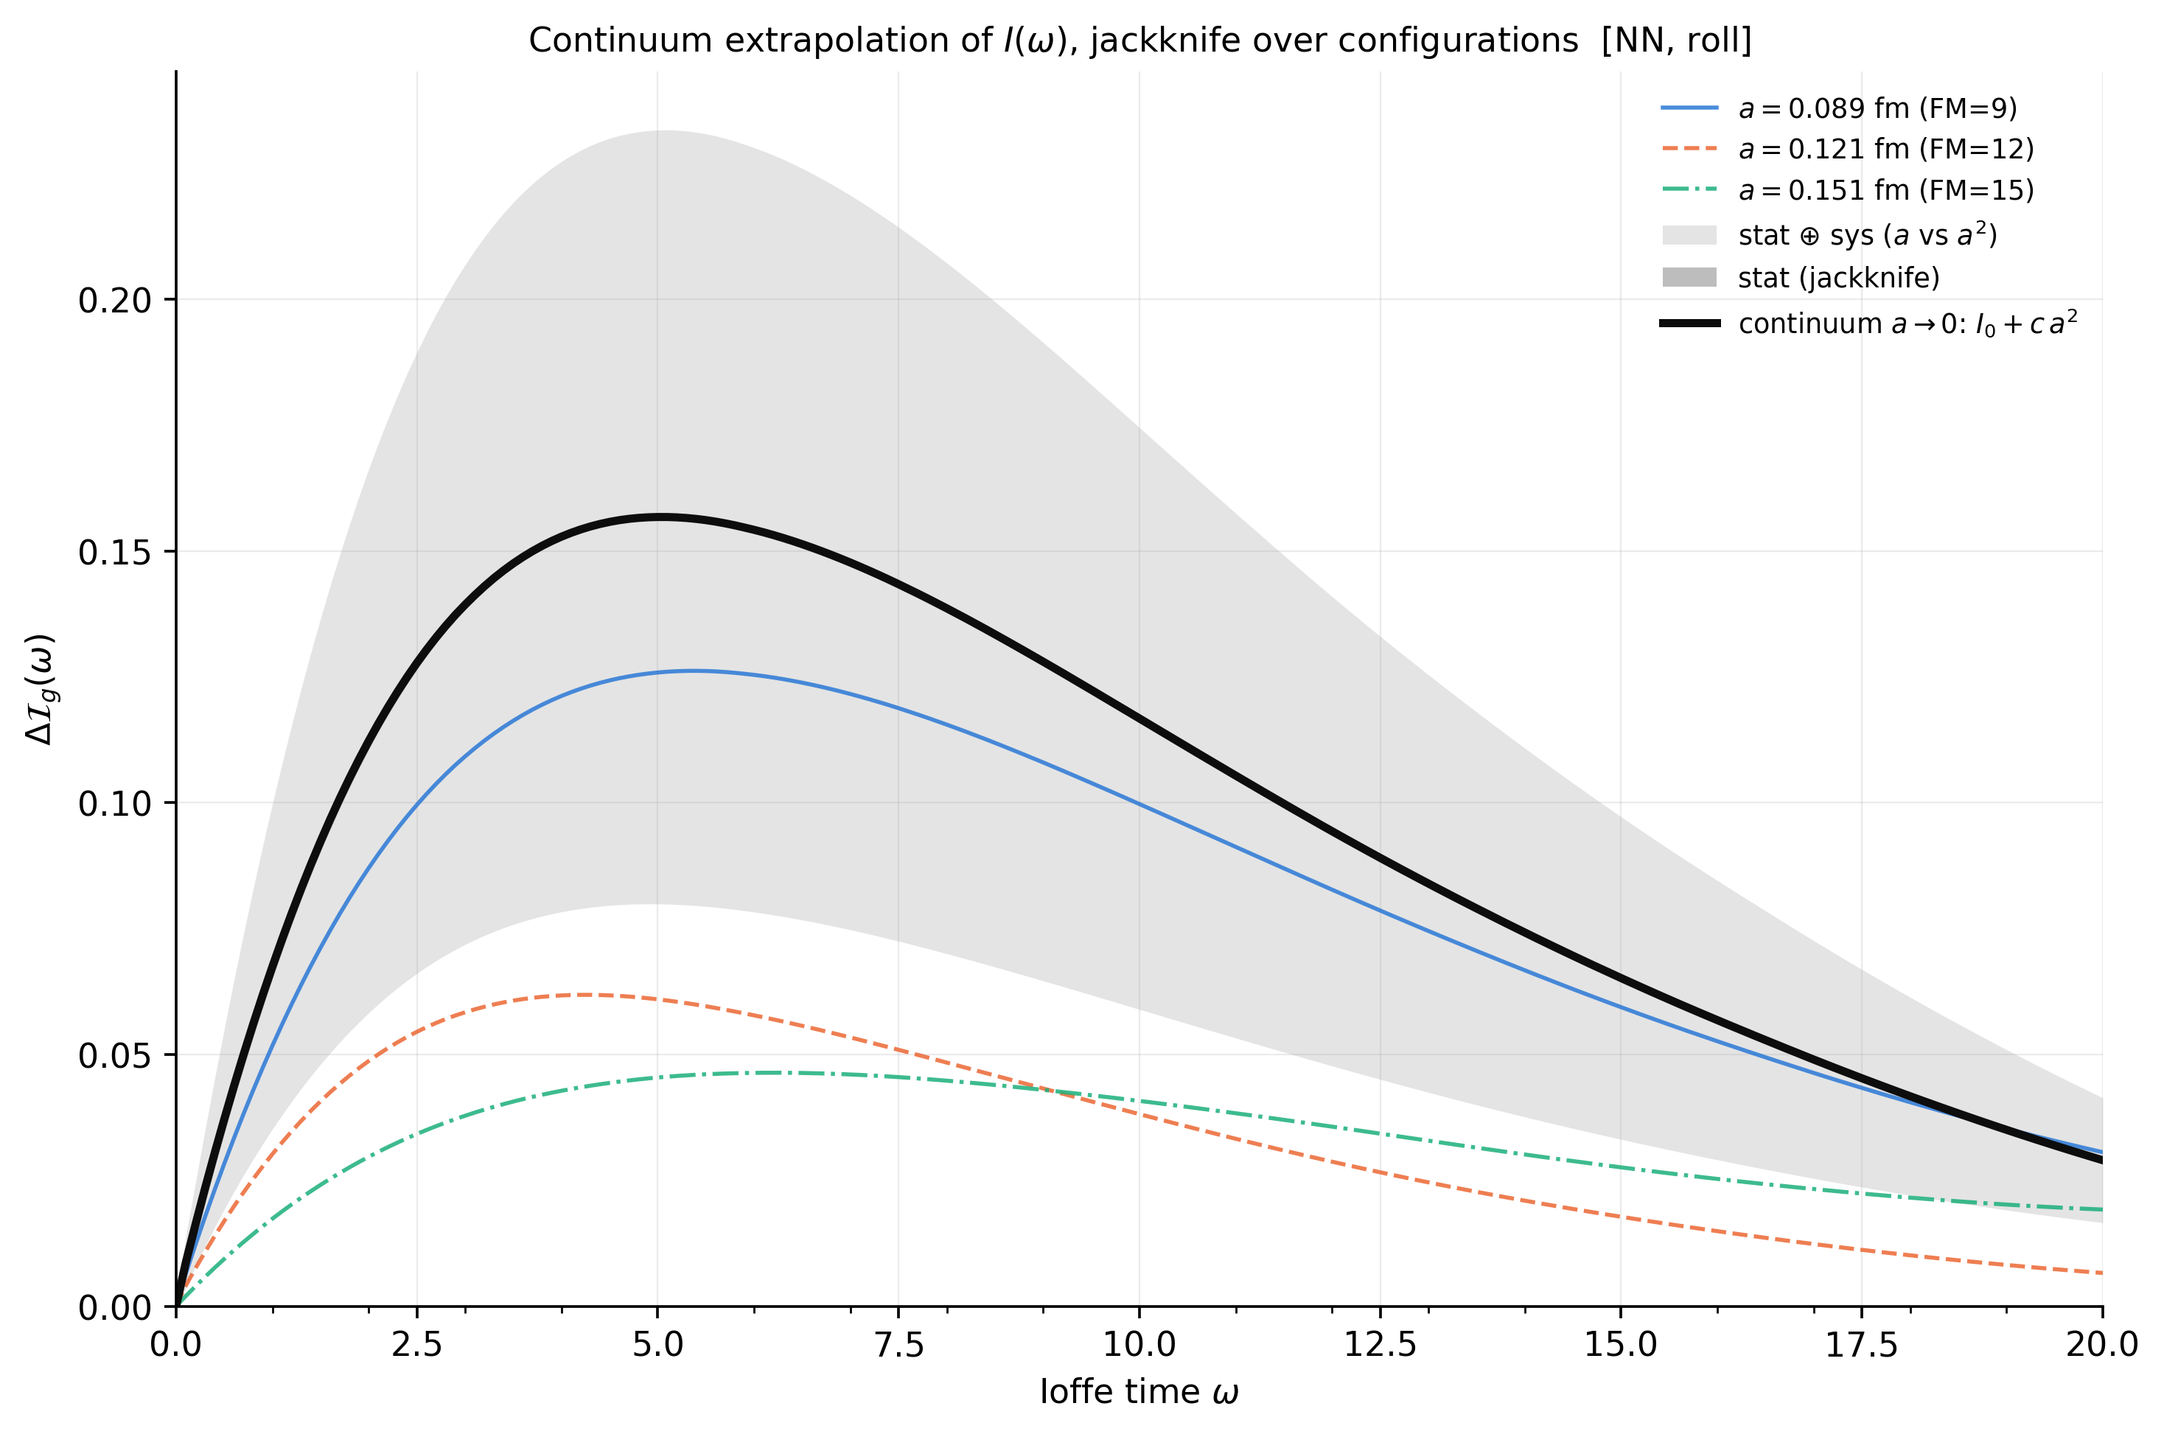

Slide 13
Problem
Not a generic solution
Model does not capture the variability of changes in a

Slide 14
Deep Learning model
Synthetic data (generated in previous step using model fitting) for all a (.09, 0.12, 0.15) is used to train the model.
Test on real data and extrapolate M(w, p) and I(w) for large w values

Slide 15
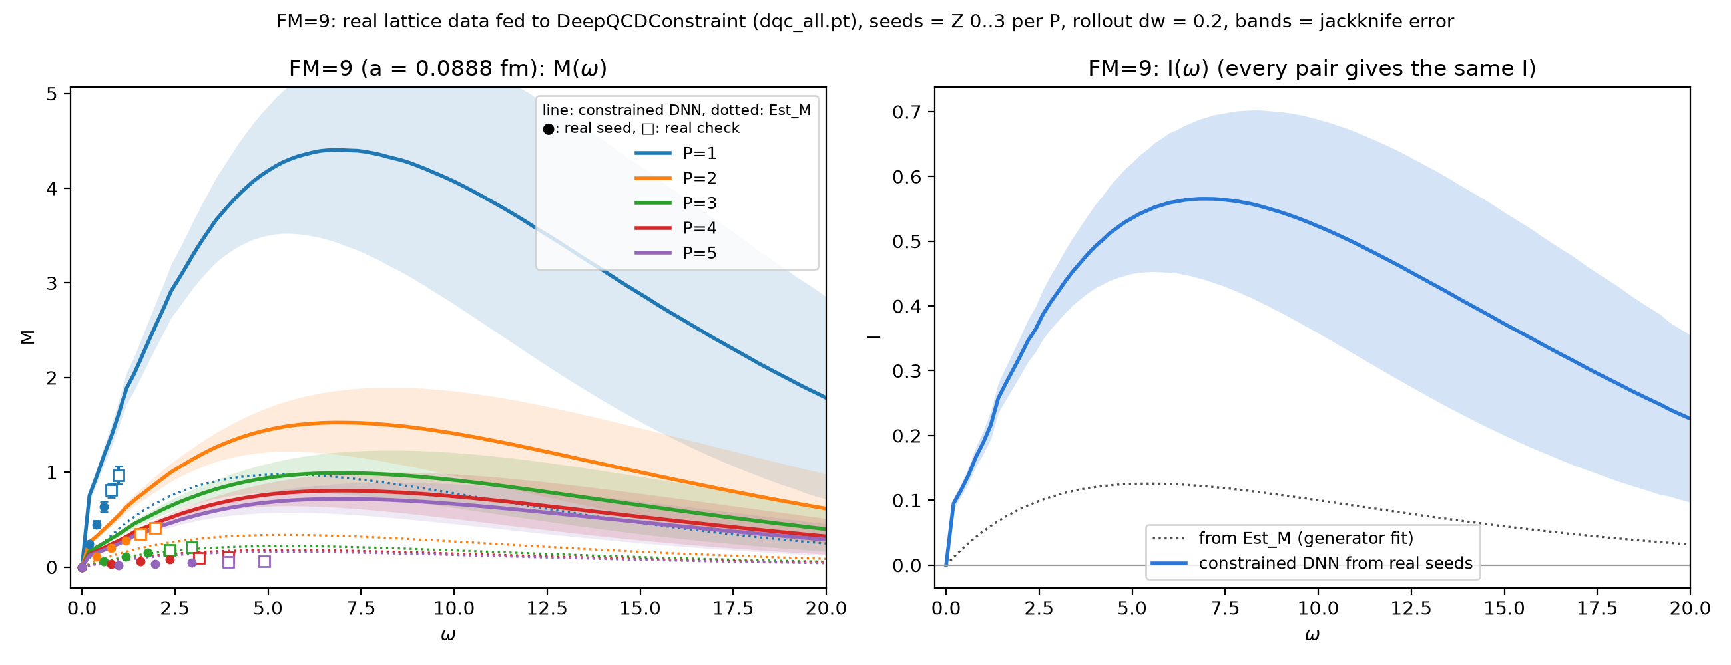
M(w, p) and I(w) for a=0.09

Slide 16
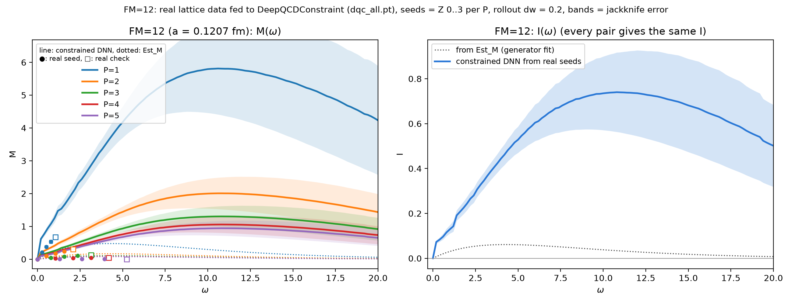
M(w, p) and I(w) for a=0.12

Slide 17
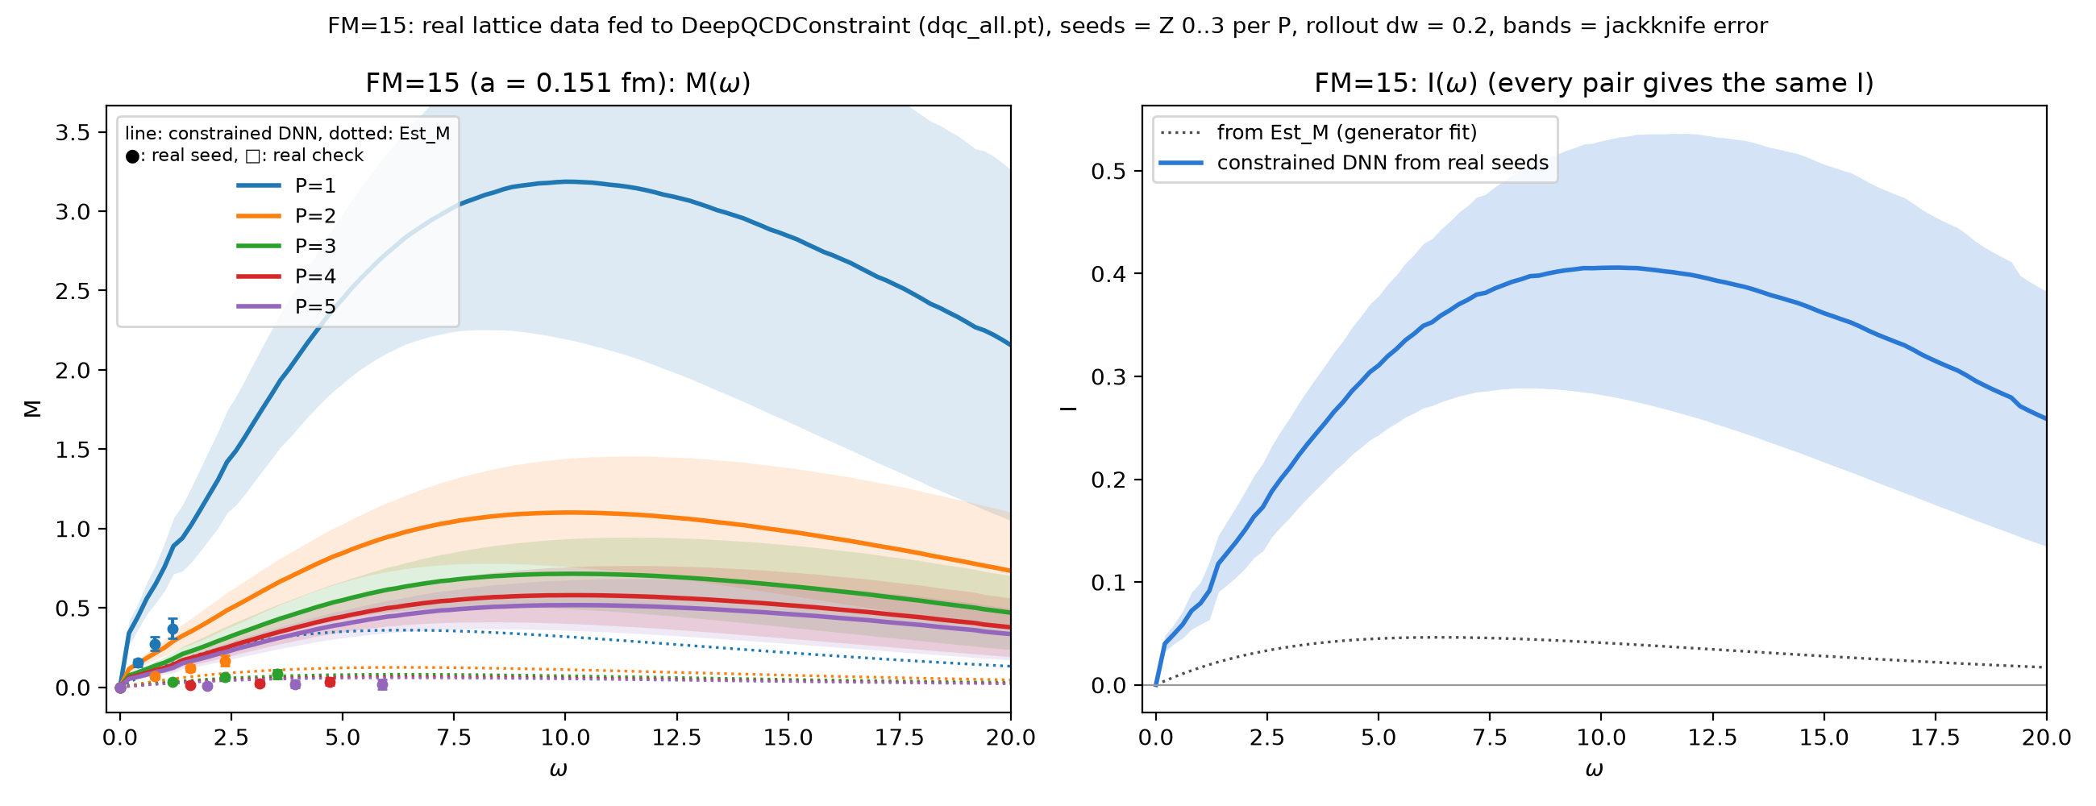
M(w, p) and I(w) for a=0.15

Slide 18
Estimate M(w) and I(w) from real data

Slide 19
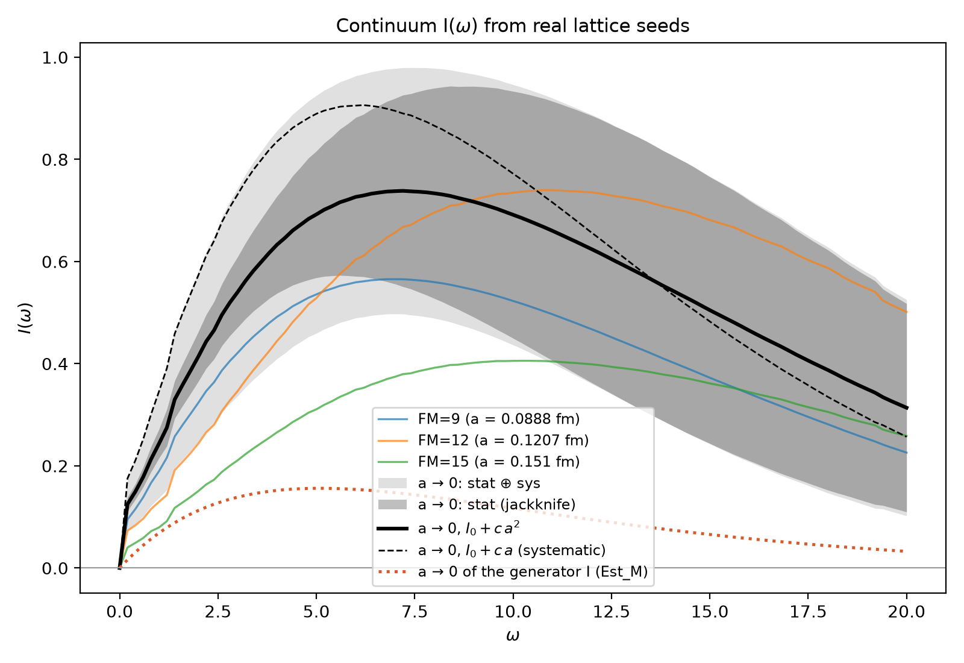
Main result using:
I(ω, a) = I₀(ω) + c₂(ω) a²
Systematic check using:
I(ω, a) = I₀(ω) + c₁(ω) a

Slide 20
Thanks
Q & A

