Slide 1
E(p)
+
K₁
K₂
S(p)
-
0,0099

Slide 2
E(p)
+
K₁
S(p)
-
+
K₂
-
0,09
0,09

Slide 3
E(p)
S(p)
+
K₁
+
F(p)
-
-
R(p)

Slide 4


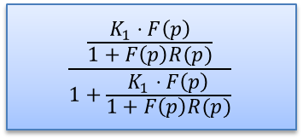
E(p)
$$\frac{F\left(p\right)}{1+F\left(p\right)R(p)}$$
S(p)
+
$$K1$$
-
$$\frac{\frac{K_{1}⋅F\left(p\right)}{1+F\left(p\right)R(p)}}{1+\frac{K_{1}⋅F\left(p\right)}{1+F\left(p\right)R(p)}}$$
E(p)
S(p)

Slide 5
E(p)
S(p)
+
H₁(p)
+
H₂(p)
-
-
R₂(p)
R₁(p)

Slide 6


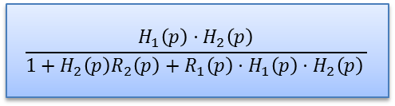
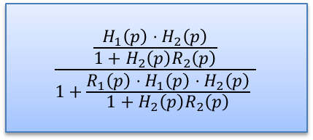
E(p)
$$\frac{H_{1}\left(p\right)⋅H_{2}\left(p\right)}{1+H_{2}\left(p\right)R_{2}\left(p\right)}$$
S(p)
$$\frac{\frac{H_{1}\left(p\right)⋅H_{2}\left(p\right)}{1+H_{2}\left(p\right)R_{2}\left(p\right)}}{1+\frac{R_{1}\left(p\right)⋅H_{1}\left(p\right)⋅H_{2}\left(p\right)}{1+H_{2}\left(p\right)R_{2}\left(p\right)} }$$
+
-
E(p)
S(p)
R₁(p)
E(p)
$$\frac{H_{1}\left(p\right)⋅H_{2}\left(p\right)}{1+H_{2}\left(p\right)R_{2}\left(p\right)}$$
S(p)
+
-
E(p)
$$\frac{H_{1}\left(p\right)⋅H_{2}\left(p\right)}{1+H_{2}\left(p\right)R_{2}\left(p\right)+R_{1}\left(p\right)⋅H_{1}\left(p\right)⋅H_{2}\left(p\right) }$$
S(p)
R₁(p)

Slide 7
E₁(p)
H₁(p)
E_{α}(p)
-
S(p)
+
H₀(p)
+
H₂(p)
-
R(p)

Slide 8
E(p)
-
S(p)
+
H₁(p)
+
H₂(p)
+
H₃(p)
H₄(p)
-
-
R(p)

Slide 9
E(p)
-
S(p)
+
H₁(p)
+
H₂(p)
+
H₃(p)
H₄(p)
-
-
R(p)
G₂(p)
G₁(p)
E(p)
-
S(p)
+
H₁(p)
+
H₂(p)
+
H₃(p)
H₄(p)
-
-
R(p)/H₄(p)

