Slide 1
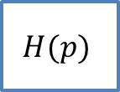




$$E_{2}\left(p\right)$$
$$E_{1}\left(p\right)$$
$$\frac{1}{p}$$
+
$$H(p)$$
$$S\left(p\right)$$
+
+
-

