Slide 1






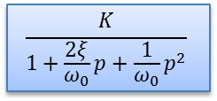











$$E\left(p\right)=\frac{ω_{0}}{ω_{0}^{2}+p^{2}}$$
$$K$$
$$S\left(p\right)$$
$$E\left(p\right)=\frac{ω_{0}}{ω_{0}^{2}+p^{2}}$$
$$\frac{1}{p}$$
$$S\left(p\right)$$
$$E\left(p\right)=\frac{ω_{0}}{ω_{0}^{2}+p^{2}}$$
$$p$$
$$S\left(p\right)$$
$$E\left(p\right)=\frac{ω_{0}}{ω_{0}^{2}+p^{2}}$$
$$\frac{K}{p}$$
$$S\left(p\right)$$
$$E\left(p\right)=\frac{ω_{0}}{ω_{0}^{2}+p^{2}}$$
$$\frac{K}{1+τp}$$
$$S\left(p\right)$$
$$E\left(p\right)=\frac{ω_{0}}{ω_{0}^{2}+p^{2}}$$
$$\frac{K}{1+\frac{2ξ}{ω_{0}}p+\frac{1}{ω_{0}}p^{2}}$$
$$S\left(p\right)$$

Slide 2
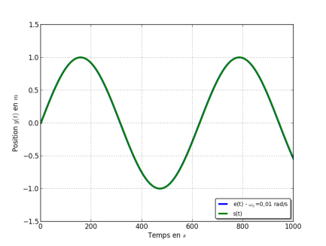
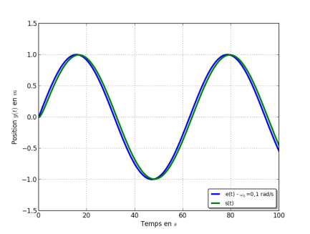
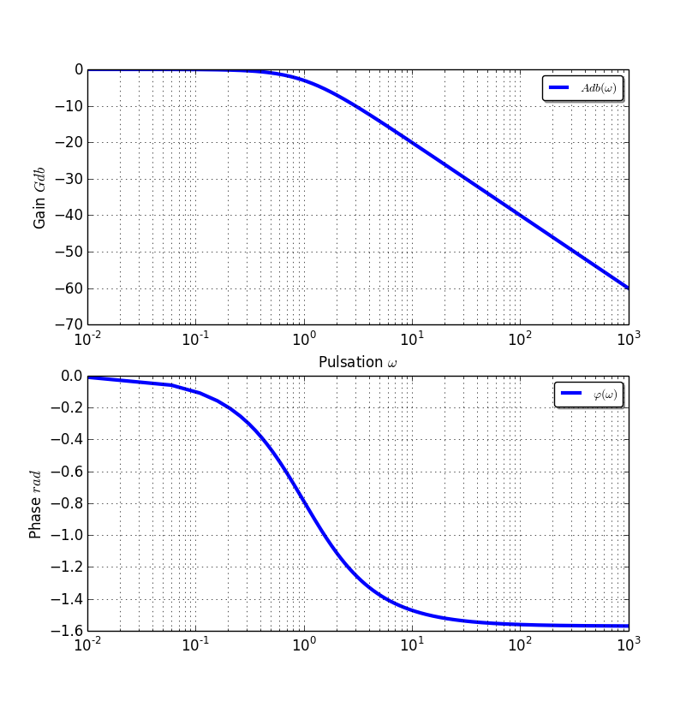
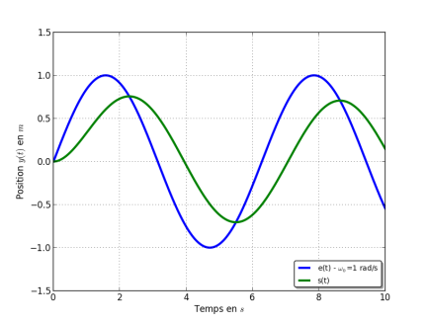
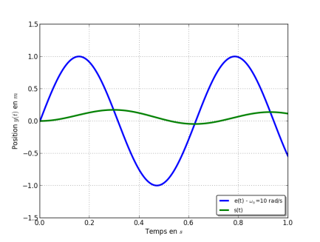

Slide 3
