Slide 1
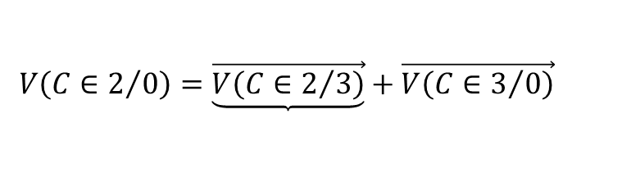
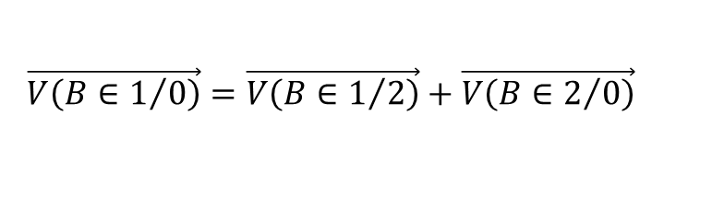
$$V\left(C∈2/0\right)=\underbrace{\vec{V\left(C∈2/3\right)}}+\vec{V\left(C∈3/0\right)}$$
$$\vec{V\left(B∈1/0\right)}=\vec{V\left(B∈1/2\right)}+\vec{V\left(B∈2/0\right)}$$

Slide 2
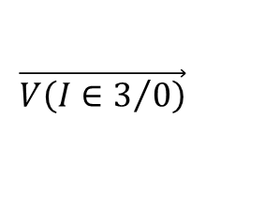
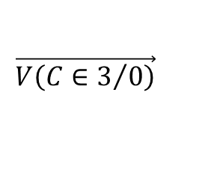
$$\vec{V\left(C∈3/0\right)}$$
$$\vec{V\left(I∈3/0\right)}$$

Slide 3
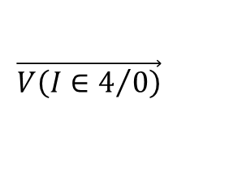
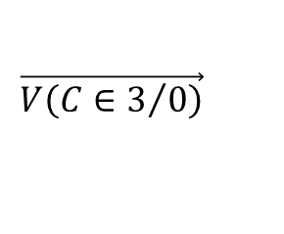
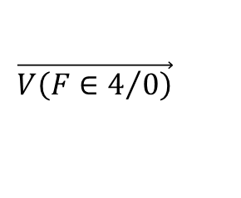
$$\vec{V\left(F∈4/0\right)}$$
$$\vec{V\left(C∈3/0\right)}$$
$$\vec{V\left(I∈4/0\right)}$$

Slide 4
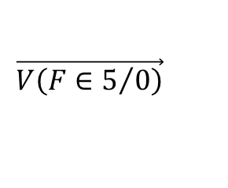
$$\vec{V\left(F∈5/0\right)}$$
$$\vec{V\left(C∈3/0\right)}$$
$$\vec{V\left(I∈4/0\right)}$$

