Slide 1


B
A
3
E
5
J
2
O
D
C
4
1
$$\vec{y}$$
F
$$\vec{x}$$

Slide 2
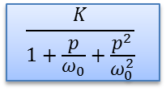

$$H(p)$$
$$\frac{K}{1+\frac{p}{ω_{0}}+\frac{p^{2}}{ω_{0}^{2}}}$$
+
-

