Slide 1





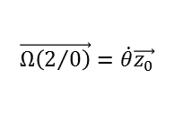












$$\vec{y_{0}}$$
1
$$O$$
$$\vec{x_{0}}$$
$$\vec{y_{1}}$$
$$\vec{y_{0}}$$
$$C$$
$$\vec{Ω\left(2/0\right)}=\dot{θ}\vec{z_{0}}$$
$$\vec{x_{1}}$$
$$λ(t)$$
$$θ(t)$$
$$\vec{x_{1}}$$
$$\vec{OC}=e\vec{x_{1}}$$
0
$$\vec{CI}=−R\vec{y_{0}}$$
$$\vec{z_{0}}=\vec{z_{1}}$$
$$\vec{x_{0}}$$
$$I$$
$$A$$
$$\vec{AO}=λ(t)\vec{y_{0}}$$
2

