Slide 1


Tangage
Roulis

Slide 2
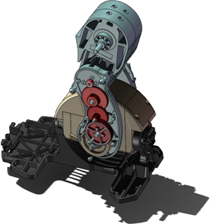
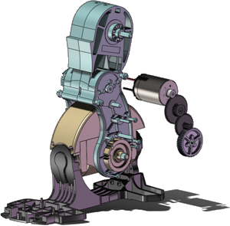
Mobile Tangage Inf 1
Roue
Pignon
Mobile Tangage Inf 2
Mobile Tangage Inf 3

Slide 3
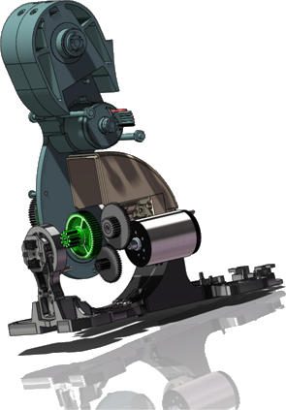
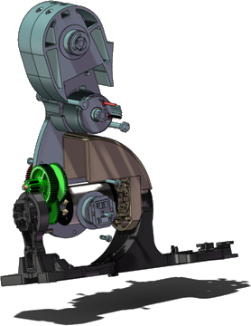
Mobile Tangage Inf 1
Roue
Pignon
Mobile Tangage Inf 2
Mobile Tangage Inf 3

