Slide 1




































$$\vec{z_{1}}$$
$$\vec{z_{1}}$$
$$\vec{z_{2}}$$
$$\vec{z_{1}}$$
$$\vec{z_{1}}$$
(2)
$$\vec{z_{2}}$$
(2)
(2)
(2)
$$O$$
$$O$$
$$\vec{x_{1}}$$
$$\vec{y_{1}}$$
$$O$$
$$O$$
$$\vec{y_{1}}$$
$$\vec{x_{1}}$$
$$\vec{y_{1}}$$
$$\vec{y_{1}}$$
$$\vec{y_{1}}$$
(1)
(1)
(1)
(1)
$$\vec{z_{2}}$$
$$\vec{z_{1}}$$
$$O$$
$$\vec{z_{2}}$$
(2)
$$\vec{x_{1}}$$
(2)
(2)
$$\vec{y_{1}}$$
(1)
$$O$$
$$\vec{y_{1}}$$
(1)
(1)
(1)
(2)
$$\vec{z_{1}}$$
$$\vec{z_{1}}$$
(2)
(2)
$$\vec{z_{1}}$$
$$\vec{z_{2}}$$
$$\vec{y_{1}}$$
$$\vec{x_{1}}$$
$$O$$
$$O_{1}$$
$$\vec{y_{1}}$$
$$\vec{x_{1}}$$
$$O_{1}$$
(2)
$$\vec{z_{1}}$$
$$\vec{z_{1}}$$
$$\vec{z_{2}}$$
(1)
$$O_{2}$$
(1)
(1)
(2)
$$O_{1}$$
(2)
$$\vec{y_{1}}$$
$$\vec{x_{1}}$$
$$O_{1}$$
$$O_{2}$$
(1)
(1)

Slide 2

























$$\vec{z_{1}}$$
$$\vec{z_{1}}$$
$$\vec{z_{2}}$$
$$\vec{z_{2}}$$
$$\vec{z_{1}}$$
(2)
$$\vec{y_{2}}$$
$$O$$
$$\vec{x_{1}}$$
(2)
(2)
$$\vec{y_{1}}$$
$$\vec{x_{1}}$$
$$\vec{y_{1}}$$
$$O$$
$$O$$
(1)
(1)
(1)
$$\vec{z_{1}}$$
$$\vec{z_{1}}$$
$$\vec{z_{2}}$$
$$\vec{z_{1}}$$
$$\vec{z_{2}}$$
$$\vec{z_{1}}$$
$$\vec{y_{2}}$$
(2)
(2)
$$O$$
(2)
(2)
$$O$$
$$\vec{x_{1}}$$
$$\vec{y_{1}}$$
$$\vec{x_{1}}$$
$$O$$
$$\vec{y_{1}}$$
$$\vec{y_{1}}$$
(1)
(1)
$$O$$
(1)
(1)
$$\vec{z_{1}}$$
$$\vec{z_{1}}$$
$$\vec{z_{1}}$$
(2)
(2)
$$O$$
(2)
(2)
$$\vec{x_{1}}$$
$$O$$
$$\vec{x_{1}}$$
$$O$$
$$\vec{y_{1}}$$
$$\vec{x_{1}}$$
$$O$$
(1)
$$\vec{y_{1}}$$
$$O$$
(1)
(1)
(1)
$$\vec{y_{1}}$$

Slide 3
(1)
(1)
(2)
(2)

Slide 4
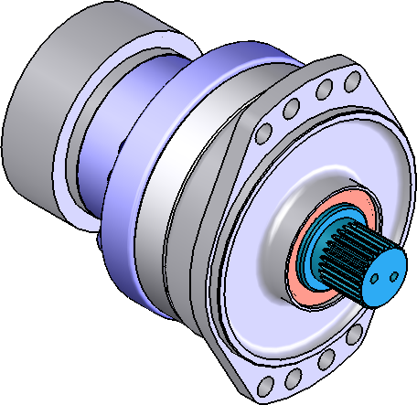
Centrage court
Appui plan

Slide 5
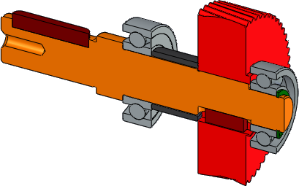
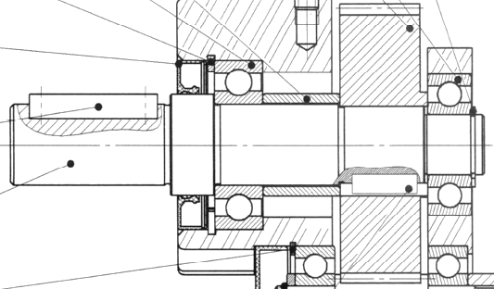
Cylindre long
Contact ponctuel

