Slide 1
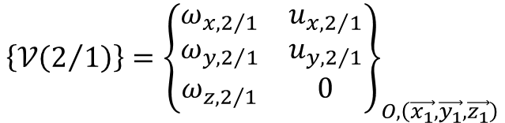

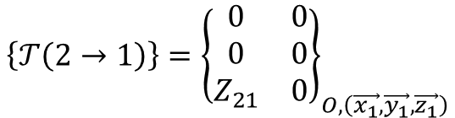

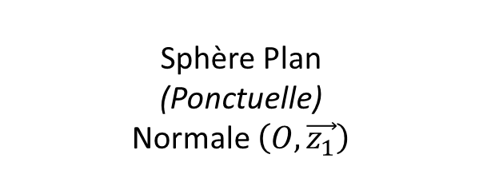


Sphère Plan (Ponctuelle) Normale $\left(O,\vec{z_{1}}\right)$
$$\vec{z_{1}}$$
(2)
$$O$$
$$\vec{x_{1}}$$
$$\vec{y_{1}}$$
(1)
$$\left\{𝒯\left(2→1\right)\right\}={\left\{\begin{matrix}0 & 0 \\ 0 & 0 \\ Z_{21} & 0\end{matrix}\right\}}_{O,\left(\vec{x_{1}},\vec{y_{1}},\vec{z_{1}}\right)}$$
$$\left\{𝒱\left(2/1\right)\right\}={\left\{\begin{matrix}ω_{x,2/1} & u_{x,2/1} \\ ω_{y,2/1} & u_{y,2/1} \\ ω_{z,2/1} & 0\end{matrix}\right\}}_{O,\left(\vec{x_{1}},\vec{y_{1}},\vec{z_{1}}\right)}$$

Slide 2
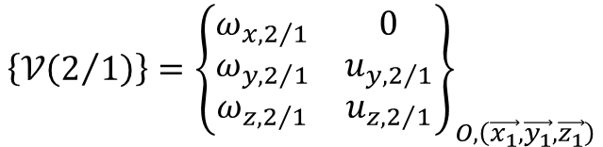

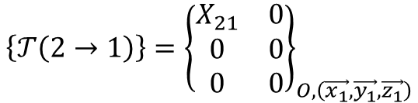

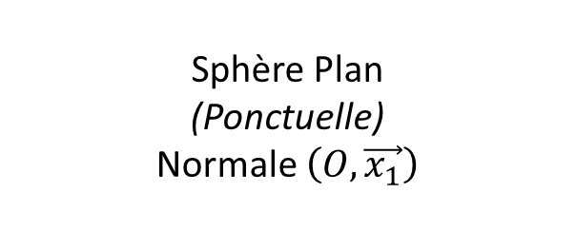

Sphère Plan (Ponctuelle) Normale $\left(O,\vec{x_{1}}\right)$
$$\vec{x_{1}}$$
(2)
$$O$$
$$\vec{y_{1}}$$
$$\vec{z_{1}}$$
(1)
$$\left\{𝒯\left(2→1\right)\right\}={\left\{\begin{matrix}X_{21} & 0 \\ 0 & 0 \\ 0 & 0\end{matrix}\right\}}_{O,\left(\vec{x_{1}},\vec{y_{1}},\vec{z_{1}}\right)}$$
$$\left\{𝒱\left(2/1\right)\right\}={\left\{\begin{matrix}ω_{x,2/1} & 0 \\ ω_{y,2/1} & u_{y,2/1} \\ ω_{z,2/1} & u_{z,2/1}\end{matrix}\right\}}_{O,\left(\vec{x_{1}},\vec{y_{1}},\vec{z_{1}}\right)}$$

Slide 3

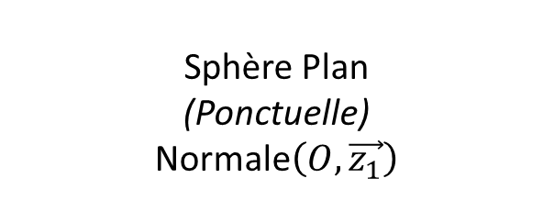


Sphère Plan (Ponctuelle) Normale$\left(O,\vec{z_{1}}\right)$
$$\vec{z_{1}}$$
(1)
(2)
$$O$$
$$\vec{y_{1}}$$
$$\left\{𝒯\left(2→1\right)\right\}={\left\{\begin{matrix}0 & 0 \\ 0 & 0 \\ Z_{21} & 0\end{matrix}\right\}}_{O,\left(\vec{x_{1}},\vec{y_{1}},\vec{z_{1}}\right)}$$
$$\left\{𝒱\left(2/1\right)\right\}={\left\{\begin{matrix}ω_{x,2/1} & u_{x,2/1} \\ ω_{y,2/1} & u_{y,2/1} \\ ω_{z,2/1} & 0\end{matrix}\right\}}_{O,\left(\vec{x_{1}},\vec{y_{1}},\vec{z_{1}}\right)}$$

Slide 4



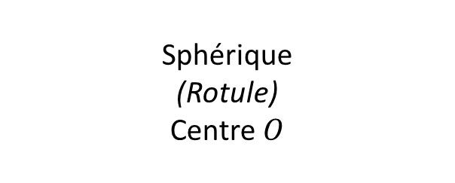


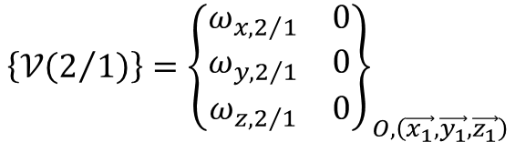

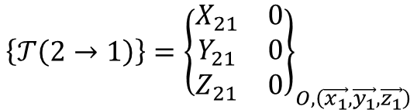
Sphérique (Rotule) Centre $O$
$$\vec{z_{1}}$$
$$\vec{z_{2}}$$
(2)
$$O$$
$$\vec{y_{1}}$$
$$\vec{x_{1}}$$
$$\vec{y_{1}}$$
(1)
$$\left\{𝒯\left(2→1\right)\right\}={\left\{\begin{matrix}X_{21} & 0 \\ Y_{21} & 0 \\ Z_{21} & 0\end{matrix}\right\}}_{O,\left(\vec{x_{1}},\vec{y_{1}},\vec{z_{1}}\right)}$$
$$\left\{𝒱\left(2/1\right)\right\}={\left\{\begin{matrix}ω_{x,2/1} & 0 \\ ω_{y,2/1} & 0 \\ ω_{z,2/1} & 0\end{matrix}\right\}}_{O,\left(\vec{x_{1}},\vec{y_{1}},\vec{z_{1}}\right)}$$

Slide 5




$$\vec{z_{1}}$$
$$\vec{z_{2}}$$
(2)
Sphérique (Rotule) Centre $O$
$$O$$
$$\vec{y_{1}}$$
(1)
$$\left\{𝒯\left(2→1\right)\right\}={\left\{\begin{matrix}X_{21} & 0 \\ Y_{21} & 0 \\ Z_{21} & 0\end{matrix}\right\}}_{O,\left(\vec{x_{1}},\vec{y_{1}},\vec{z_{1}}\right)}$$
$$\left\{𝒱\left(2/1\right)\right\}={\left\{\begin{matrix}ω_{x,2/1} & 0 \\ ω_{y,2/1} & 0 \\ ω_{z,2/1} & 0\end{matrix}\right\}}_{O,\left(\vec{x_{1}},\vec{y_{1}},\vec{z_{1}}\right)}$$

Slide 6
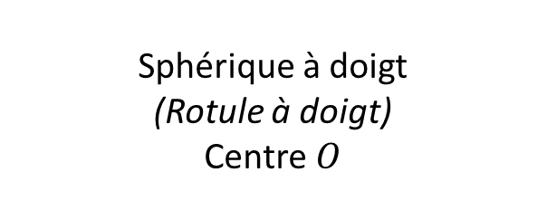

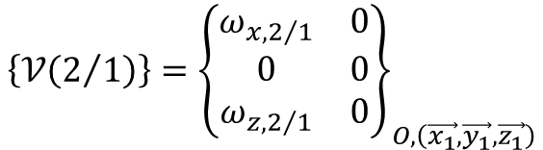
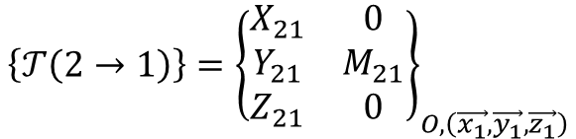
$$\vec{z_{1}}$$
$$\vec{z_{2}}$$
(2)
Sphérique à doigt (Rotule à doigt) Centre $O$
$$O$$
$$\vec{y_{1}}$$
$$\vec{x_{1}}$$
$$\vec{y_{1}}$$
(1)
$$\left\{𝒯\left(2→1\right)\right\}={\left\{\begin{matrix}X_{21} & 0 \\ Y_{21} & M_{21} \\ Z_{21} & 0\end{matrix}\right\}}_{O,\left(\vec{x_{1}},\vec{y_{1}},\vec{z_{1}}\right)}$$
$$\left\{𝒱\left(2/1\right)\right\}={\left\{\begin{matrix}ω_{x,2/1} & 0 \\ 0 & 0 \\ ω_{z,2/1} & 0\end{matrix}\right\}}_{O,\left(\vec{x_{1}},\vec{y_{1}},\vec{z_{1}}\right)}$$

Slide 7




$$\vec{z_{1}}$$
$$\vec{z_{2}}$$
Sphérique à doigt (Rotule à doigt) Centre $O$
(2)
$$O$$
$$\vec{y_{1}}$$
(1)
$$\left\{𝒯\left(2→1\right)\right\}={\left\{\begin{matrix}X_{21} & 0 \\ Y_{21} & M_{21} \\ Z_{21} & 0\end{matrix}\right\}}_{O,\left(\vec{x_{1}},\vec{y_{1}},\vec{z_{1}}\right)}$$
$$\left\{𝒱\left(2/1\right)\right\}={\left\{\begin{matrix}ω_{x,2/1} & 0 \\ 0 & 0 \\ ω_{z,2/1} & 0\end{matrix}\right\}}_{O,\left(\vec{x_{1}},\vec{y_{1}},\vec{z_{1}}\right)}$$

Slide 8
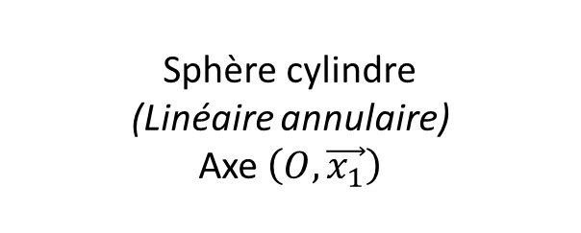




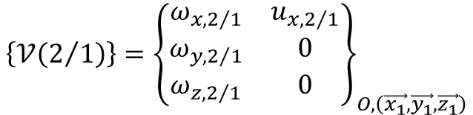

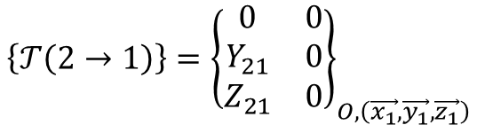
$$\vec{z_{1}}$$
$$\vec{z_{2}}$$
Sphère cylindre (Linéaire annulaire) Axe $\left(O,\vec{x_{1}}\right)$
(2)
$$O$$
$$\vec{x_{1}}$$
$$\vec{y_{1}}$$
(1)
$$\left\{𝒯\left(2→1\right)\right\}={\left\{\begin{matrix}0 & 0 \\ Y_{21} & 0 \\ Z_{21} & 0\end{matrix}\right\}}_{O,\left(\vec{x_{1}},\vec{y_{1}},\vec{z_{1}}\right)}$$
$$\left\{𝒱\left(2/1\right)\right\}={\left\{\begin{matrix}ω_{x,2/1} & u_{x,2/1} \\ ω_{y,2/1} & 0 \\ ω_{z,2/1} & 0\end{matrix}\right\}}_{O,\left(\vec{x_{1}},\vec{y_{1}},\vec{z_{1}}\right)}$$

Slide 9
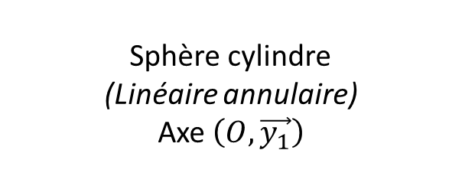



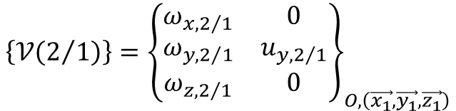
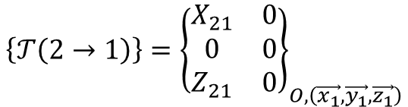
$$\vec{x_{1}}$$
$$\vec{z_{2}}$$
Sphère cylindre (Linéaire annulaire) Axe $\left(O,\vec{y_{1}}\right)$
(2)
$$O$$
$$\vec{y_{1}}$$
$$\vec{z_{1}}$$
(1)
$$\left\{𝒯\left(2→1\right)\right\}={\left\{\begin{matrix}X_{21} & 0 \\ 0 & 0 \\ Z_{21} & 0\end{matrix}\right\}}_{O,\left(\vec{x_{1}},\vec{y_{1}},\vec{z_{1}}\right)}$$
$$\left\{𝒱\left(2/1\right)\right\}={\left\{\begin{matrix}ω_{x,2/1} & 0 \\ ω_{y,2/1} & u_{y,2/1} \\ ω_{z,2/1} & 0\end{matrix}\right\}}_{O,\left(\vec{x_{1}},\vec{y_{1}},\vec{z_{1}}\right)}$$

Slide 10
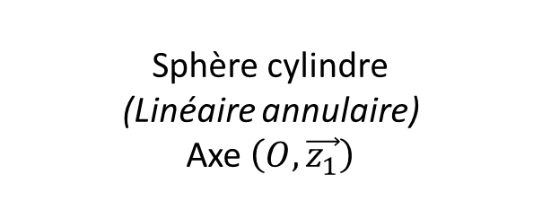



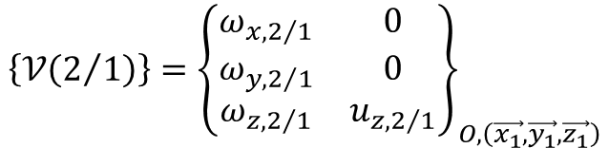
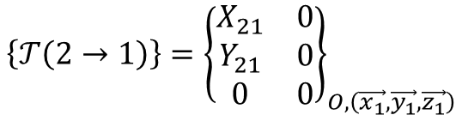
$$\vec{y_{1}}$$
$$\vec{z_{2}}$$
Sphère cylindre (Linéaire annulaire) Axe $\left(O,\vec{z_{1}}\right)$
(2)
$$O$$
$$\vec{z_{1}}$$
$$\vec{x_{1}}$$
(1)
$$\left\{𝒯\left(2→1\right)\right\}={\left\{\begin{matrix}X_{21} & 0 \\ Y_{21} & 0 \\ 0 & 0\end{matrix}\right\}}_{O,\left(\vec{x_{1}},\vec{y_{1}},\vec{z_{1}}\right)}$$
$$\left\{𝒱\left(2/1\right)\right\}={\left\{\begin{matrix}ω_{x,2/1} & 0 \\ ω_{y,2/1} & 0 \\ ω_{z,2/1} & u_{z,2/1}\end{matrix}\right\}}_{O,\left(\vec{x_{1}},\vec{y_{1}},\vec{z_{1}}\right)}$$

Slide 11
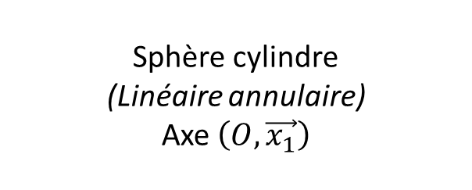



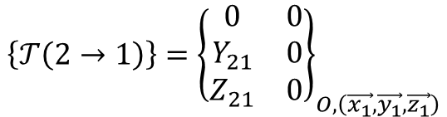
$$\vec{z_{2}}$$
Sphère cylindre (Linéaire annulaire) Axe $\left(O,\vec{x_{1}}\right)$
$$O$$
(2)
$$\vec{x_{1}}$$
(1)
$$\vec{y_{1}}$$
$$\left\{𝒯\left(2→1\right)\right\}={\left\{\begin{matrix}0 & 0 \\ Y_{21} & 0 \\ Z_{21} & 0\end{matrix}\right\}}_{O,\left(\vec{x_{1}},\vec{y_{1}},\vec{z_{1}}\right)}$$
$$\left\{𝒱\left(2/1\right)\right\}={\left\{\begin{matrix}ω_{x,2/1} & u_{x,2/1} \\ ω_{y,2/1} & 0 \\ ω_{z,2/1} & 0\end{matrix}\right\}}_{O,\left(\vec{x_{1}},\vec{y_{1}},\vec{z_{1}}\right)}$$

Slide 12
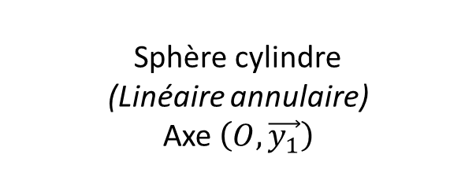


$$\vec{z_{2}}$$
Sphère cylindre (Linéaire annulaire) Axe $\left(O,\vec{y_{1}}\right)$
$$O$$
(2)
$$\vec{y_{1}}$$
(1)
$$\vec{z_{1}}$$
$$\left\{𝒯\left(2→1\right)\right\}={\left\{\begin{matrix}X_{21} & 0 \\ 0 & 0 \\ Z_{21} & 0\end{matrix}\right\}}_{O,\left(\vec{x_{1}},\vec{y_{1}},\vec{z_{1}}\right)}$$
$$\left\{𝒱\left(2/1\right)\right\}={\left\{\begin{matrix}ω_{x,2/1} & 0 \\ ω_{y,2/1} & u_{y,2/1} \\ ω_{z,2/1} & 0\end{matrix}\right\}}_{O,\left(\vec{x_{1}},\vec{y_{1}},\vec{z_{1}}\right)}$$

Slide 13
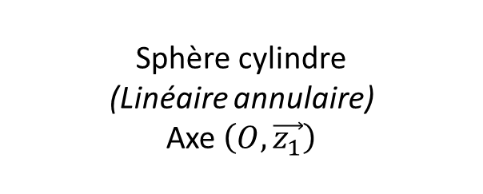


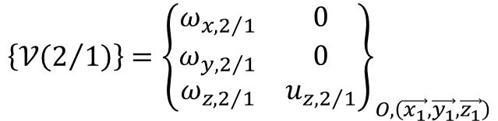
$$\vec{z_{2}}$$
Sphère cylindre (Linéaire annulaire) Axe $\left(O,\vec{z_{1}}\right)$
$$O$$
(2)
$$\vec{z_{1}}$$
(1)
$$\vec{x_{1}}$$
$$\left\{𝒯\left(2→1\right)\right\}={\left\{\begin{matrix}X_{21} & 0 \\ Y_{21} & 0 \\ 0 & 0\end{matrix}\right\}}_{O,\left(\vec{x_{1}},\vec{y_{1}},\vec{z_{1}}\right)}$$
$$\left\{𝒱\left(2/1\right)\right\}={\left\{\begin{matrix}ω_{x,2/1} & 0 \\ ω_{y,2/1} & 0 \\ ω_{z,2/1} & u_{z,2/1}\end{matrix}\right\}}_{O,\left(\vec{x_{1}},\vec{y_{1}},\vec{z_{1}}\right)}$$

Slide 14




$$\vec{z_{1}}$$
$$\vec{z_{2}}$$
Sphère cylindre (Linéaire annulaire) Axe $\left(O,\vec{x_{1}}\right)$
(2)
$$\vec{y_{1}}$$
$$O$$
(1)
$$\left\{𝒯\left(2→1\right)\right\}={\left\{\begin{matrix}0 & 0 \\ Y_{21} & 0 \\ Z_{21} & 0\end{matrix}\right\}}_{O,\left(\vec{x_{1}},\vec{y_{1}},\vec{z_{1}}\right)}$$
$$\left\{𝒱\left(2/1\right)\right\}={\left\{\begin{matrix}ω_{x,2/1} & u_{x,2/1} \\ ω_{y,2/1} & 0 \\ ω_{z,2/1} & 0\end{matrix}\right\}}_{O,\left(\vec{x_{1}},\vec{y_{1}},\vec{z_{1}}\right)}$$

Slide 15


$$\vec{x_{1}}$$
$$\vec{z_{2}}$$
Sphère cylindre (Linéaire annulaire) Axe $\left(O,\vec{y_{1}}\right)$
(2)
$$\vec{z_{1}}$$
$$O$$
(1)
$$\left\{𝒯\left(2→1\right)\right\}={\left\{\begin{matrix}X_{21} & 0 \\ 0 & 0 \\ Z_{21} & 0\end{matrix}\right\}}_{O,\left(\vec{x_{1}},\vec{y_{1}},\vec{z_{1}}\right)}$$
$$\left\{𝒱\left(2/1\right)\right\}={\left\{\begin{matrix}ω_{x,2/1} & 0 \\ ω_{y,2/1} & u_{y,2/1} \\ ω_{z,2/1} & 0\end{matrix}\right\}}_{O,\left(\vec{x_{1}},\vec{y_{1}},\vec{z_{1}}\right)}$$

Slide 16


$$\vec{y_{1}}$$
$$\vec{z_{2}}$$
Sphère cylindre (Linéaire annulaire) Axe $\left(O,\vec{z_{1}}\right)$
(2)
$$\vec{x_{1}}$$
$$O$$
(1)
$$\left\{𝒯\left(2→1\right)\right\}={\left\{\begin{matrix}X_{21} & 0 \\ Y_{21} & 0 \\ 0 & 0\end{matrix}\right\}}_{O,\left(\vec{x_{1}},\vec{y_{1}},\vec{z_{1}}\right)}$$
$$\left\{𝒱\left(2/1\right)\right\}={\left\{\begin{matrix}ω_{x,2/1} & 0 \\ ω_{y,2/1} & 0 \\ ω_{z,2/1} & u_{z,2/1}\end{matrix}\right\}}_{O,\left(\vec{x_{1}},\vec{y_{1}},\vec{z_{1}}\right)}$$

Slide 17
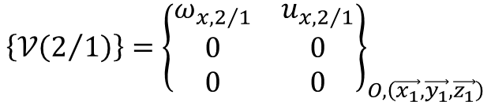

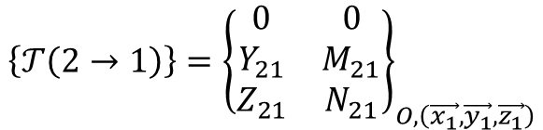



$$\vec{z_{1}}$$
Pivot glissant Axe $\left(O,\vec{x_{1}}\right)$
(2)
$$O$$
$$\vec{x_{1}}$$
$$\vec{y_{1}}$$
(1)
$$\left\{𝒯\left(2→1\right)\right\}={\left\{\begin{matrix}0 & 0 \\ Y_{21} & M_{21} \\ Z_{21} & N_{21}\end{matrix}\right\}}_{O,\left(\vec{x_{1}},\vec{y_{1}},\vec{z_{1}}\right)}$$
$$\left\{𝒱\left(2/1\right)\right\}={\left\{\begin{matrix}ω_{x,2/1} & u_{x,2/1} \\ 0 & 0 \\ 0 & 0\end{matrix}\right\}}_{O,\left(\vec{x_{1}},\vec{y_{1}},\vec{z_{1}}\right)}$$

Slide 18
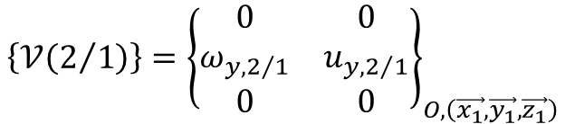

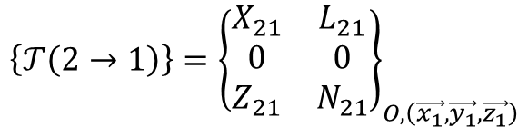



$$\vec{x_{1}}$$
Pivot glissant Axe $\left(O,\vec{y_{1}}\right)$
(2)
$$O$$
$$\vec{y_{1}}$$
$$\vec{z_{1}}$$
(1)
$$\left\{𝒯\left(2→1\right)\right\}={\left\{\begin{matrix}X_{21} & L_{21} \\ 0 & 0 \\ Z_{21} & N_{21}\end{matrix}\right\}}_{O,\left(\vec{x_{1}},\vec{y_{1}},\vec{z_{1}}\right)}$$
$$\left\{𝒱\left(2/1\right)\right\}={\left\{\begin{matrix}0 & 0 \\ ω_{y,2/1} & u_{y,2/1} \\ 0 & 0\end{matrix}\right\}}_{O,\left(\vec{x_{1}},\vec{y_{1}},\vec{z_{1}}\right)}$$

Slide 19
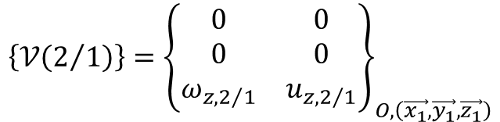

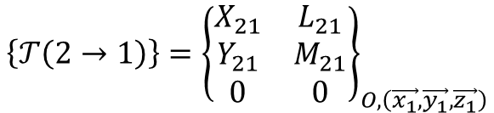



$$\vec{y_{1}}$$
Pivot glissant Axe $\left(O,\vec{z_{1}}\right)$
(2)
$$O$$
$$\vec{z_{1}}$$
$$\vec{x_{1}}$$
(1)
$$\left\{𝒯\left(2→1\right)\right\}={\left\{\begin{matrix}X_{21} & L_{21} \\ Y_{21} & M_{21} \\ 0 & 0\end{matrix}\right\}}_{O,\left(\vec{x_{1}},\vec{y_{1}},\vec{z_{1}}\right)}$$
$$\left\{𝒱\left(2/1\right)\right\}={\left\{\begin{matrix}0 & 0 \\ 0 & 0 \\ ω_{z,2/1} & u_{z,2/1}\end{matrix}\right\}}_{O,\left(\vec{x_{1}},\vec{y_{1}},\vec{z_{1}}\right)}$$

Slide 20





$$\vec{z_{2}}$$
$$\vec{z_{1}}$$
$$\vec{y_{2}}$$
Pivot glissant Axe $\left(O,\vec{x_{1}}\right)$
(2)
$$\vec{y_{1}}$$
$$O_{1}$$
(1)
$$\left\{𝒯\left(2→1\right)\right\}={\left\{\begin{matrix}0 & 0 \\ Y_{21} & M_{21} \\ Z_{21} & N_{21}\end{matrix}\right\}}_{O,\left(\vec{x_{1}},\vec{y_{1}},\vec{z_{1}}\right)}$$
$$\left\{𝒱\left(2/1\right)\right\}={\left\{\begin{matrix}ω_{x,2/1} & u_{x,2/1} \\ 0 & 0 \\ 0 & 0\end{matrix}\right\}}_{O,\left(\vec{x_{1}},\vec{y_{1}},\vec{z_{1}}\right)}$$

Slide 21




$$\vec{x_{2}}$$
$$\vec{x_{1}}$$
$$\vec{z_{2}}$$
Pivot glissant Axe $\left(O,\vec{y_{1}}\right)$
(2)
$$\vec{z_{1}}$$
$$O_{1}$$
(1)
$$\left\{𝒯\left(2→1\right)\right\}={\left\{\begin{matrix}X_{21} & L_{21} \\ 0 & 0 \\ Z_{21} & N_{21}\end{matrix}\right\}}_{O,\left(\vec{x_{1}},\vec{y_{1}},\vec{z_{1}}\right)}$$
$$\left\{𝒱\left(2/1\right)\right\}={\left\{\begin{matrix}0 & 0 \\ ω_{y,2/1} & u_{y,2/1} \\ 0 & 0\end{matrix}\right\}}_{O,\left(\vec{x_{1}},\vec{y_{1}},\vec{z_{1}}\right)}$$

Slide 22




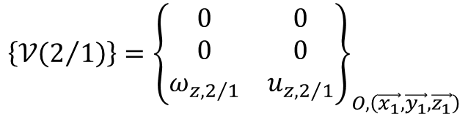
$$\vec{y_{2}}$$
$$\vec{y_{1}}$$
$$\vec{x_{2}}$$
Pivot glissant Axe $\left(O,\vec{z_{1}}\right)$
(2)
$$\vec{x_{1}}$$
$$O_{1}$$
(1)
$$\left\{𝒯\left(2→1\right)\right\}={\left\{\begin{matrix}X_{21} & L_{21} \\ Y_{21} & M_{21} \\ 0 & 0\end{matrix}\right\}}_{O,\left(\vec{x_{1}},\vec{y_{1}},\vec{z_{1}}\right)}$$
$$\left\{𝒱\left(2/1\right)\right\}={\left\{\begin{matrix}0 & 0 \\ 0 & 0 \\ ω_{z,2/1} & u_{z,2/1}\end{matrix}\right\}}_{O,\left(\vec{x_{1}},\vec{y_{1}},\vec{z_{1}}\right)}$$

Slide 23





$$\vec{z_{1}}$$
$$\vec{z_{2}}$$
Pivot glissant Axe $\left(O,\vec{x_{1}}\right)$
$$\vec{x_{1}}$$
$$O_{1}$$
(2)
$$O_{2}$$
(1)
$$\left\{𝒯\left(2→1\right)\right\}={\left\{\begin{matrix}0 & 0 \\ Y_{21} & M_{21} \\ Z_{21} & N_{21}\end{matrix}\right\}}_{O,\left(\vec{x_{1}},\vec{y_{1}},\vec{z_{1}}\right)}$$
$$\left\{𝒱\left(2/1\right)\right\}={\left\{\begin{matrix}ω_{x,2/1} & u_{x,2/1} \\ 0 & 0 \\ 0 & 0\end{matrix}\right\}}_{O,\left(\vec{x_{1}},\vec{y_{1}},\vec{z_{1}}\right)}$$

Slide 24

$$\vec{z_{1}}$$
$$\vec{z_{2}}$$
Pivot glissant Axe $\left(O,\vec{y_{1}}\right)$
$$\vec{y_{1}}$$
$$O_{1}$$
(2)
$$O_{2}$$
(1)
$$\left\{𝒯\left(2→1\right)\right\}={\left\{\begin{matrix}X_{21} & L_{21} \\ 0 & 0 \\ Z_{21} & N_{21}\end{matrix}\right\}}_{O,\left(\vec{x_{1}},\vec{y_{1}},\vec{z_{1}}\right)}$$
$$\left\{𝒱\left(2/1\right)\right\}={\left\{\begin{matrix}0 & 0 \\ ω_{y,2/1} & u_{y,2/1} \\ 0 & 0\end{matrix}\right\}}_{O,\left(\vec{x_{1}},\vec{y_{1}},\vec{z_{1}}\right)}$$

Slide 25



$$\vec{x_{1}}$$
$$\vec{x_{2}}$$
Pivot glissant Axe $\left(O,\vec{z_{1}}\right)$
$$\vec{z_{1}}$$
$$O_{1}$$
(2)
$$O_{2}$$
(1)
$$\left\{𝒯\left(2→1\right)\right\}={\left\{\begin{matrix}X_{21} & L_{21} \\ Y_{21} & M_{21} \\ 0 & 0\end{matrix}\right\}}_{O,\left(\vec{x_{1}},\vec{y_{1}},\vec{z_{1}}\right)}$$
$$\left\{𝒱\left(2/1\right)\right\}={\left\{\begin{matrix}0 & 0 \\ 0 & 0 \\ ω_{z,2/1} & u_{z,2/1}\end{matrix}\right\}}_{O,\left(\vec{x_{1}},\vec{y_{1}},\vec{z_{1}}\right)}$$

Slide 26
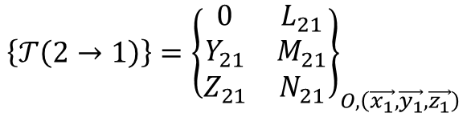






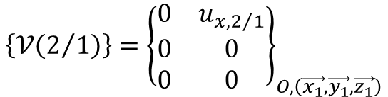
$$\vec{z_{1}}$$
Glissière Direction $\vec{x_{1}}$
(2)
$$O_{2}$$
$$\vec{x_{1}}$$
$$O_{1}$$
$$\vec{y_{1}}$$
(1)
$$\left\{𝒯\left(2→1\right)\right\}={\left\{\begin{matrix}0 & L_{21} \\ Y_{21} & M_{21} \\ Z_{21} & N_{21}\end{matrix}\right\}}_{O,\left(\vec{x_{1}},\vec{y_{1}},\vec{z_{1}}\right)}$$
$$\left\{𝒱\left(2/1\right)\right\}={\left\{\begin{matrix}0 & u_{x,2/1} \\ 0 & 0 \\ 0 & 0\end{matrix}\right\}}_{O,\left(\vec{x_{1}},\vec{y_{1}},\vec{z_{1}}\right)}$$

Slide 27
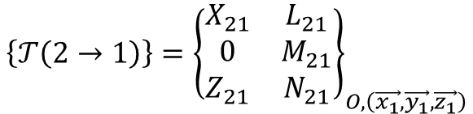




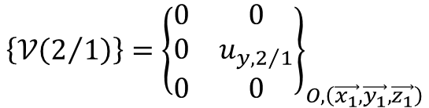
$$\vec{x_{1}}$$
Glissière Direction $\vec{y_{1}}$
(2)
$$O_{2}$$
$$\vec{y_{1}}$$
$$O_{1}$$
$$\vec{z_{1}}$$
(1)
$$\left\{𝒯\left(2→1\right)\right\}={\left\{\begin{matrix}X_{21} & L_{21} \\ 0 & M_{21} \\ Z_{21} & N_{21}\end{matrix}\right\}}_{O,\left(\vec{x_{1}},\vec{y_{1}},\vec{z_{1}}\right)}$$
$$\left\{𝒱\left(2/1\right)\right\}={\left\{\begin{matrix}0 & 0 \\ 0 & u_{y,2/1} \\ 0 & 0\end{matrix}\right\}}_{O,\left(\vec{x_{1}},\vec{y_{1}},\vec{z_{1}}\right)}$$

Slide 28
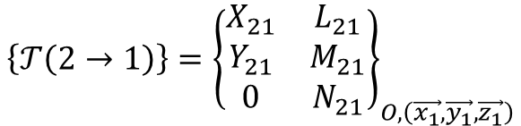




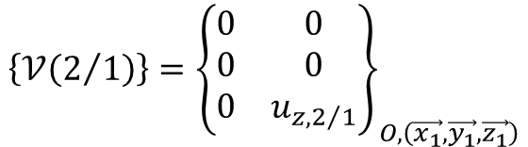
$$\vec{y_{1}}$$
Glissière Direction $\vec{z_{1}}$
(2)
$$O_{2}$$
$$\vec{z_{1}}$$
$$O_{1}$$
$$\vec{x_{1}}$$
(1)
$$\left\{𝒯\left(2→1\right)\right\}={\left\{\begin{matrix}X_{21} & L_{21} \\ Y_{21} & M_{21} \\ 0 & N_{21}\end{matrix}\right\}}_{O,\left(\vec{x_{1}},\vec{y_{1}},\vec{z_{1}}\right)}$$
$$\left\{𝒱\left(2/1\right)\right\}={\left\{\begin{matrix}0 & 0 \\ 0 & 0 \\ 0 & u_{z,2/1}\end{matrix}\right\}}_{O,\left(\vec{x_{1}},\vec{y_{1}},\vec{z_{1}}\right)}$$

Slide 29
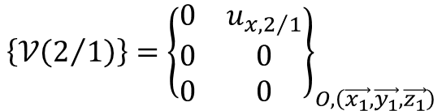
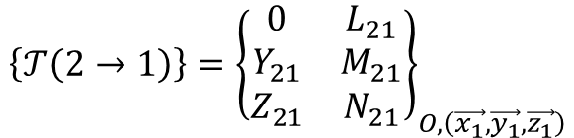

$$\vec{z_{1}}$$
Glissière Direction $\vec{x_{1}}$
$$\vec{x_{1}}$$
(2)
$$O_{1}$$
(1)
$$\left\{𝒯\left(2→1\right)\right\}={\left\{\begin{matrix}0 & L_{21} \\ Y_{21} & M_{21} \\ Z_{21} & N_{21}\end{matrix}\right\}}_{O,\left(\vec{x_{1}},\vec{y_{1}},\vec{z_{1}}\right)}$$
$$\left\{𝒱\left(2/1\right)\right\}={\left\{\begin{matrix}0 & u_{x,2/1} \\ 0 & 0 \\ 0 & 0\end{matrix}\right\}}_{O,\left(\vec{x_{1}},\vec{y_{1}},\vec{z_{1}}\right)}$$

Slide 30
$$\vec{z_{1}}$$
Glissière Direction $\vec{y_{1}}$
$$\vec{y_{1}}$$
(2)
$$O_{1}$$
(1)
$$\left\{𝒯\left(2→1\right)\right\}={\left\{\begin{matrix}X_{21} & L_{21} \\ 0 & M_{21} \\ Z_{21} & N_{21}\end{matrix}\right\}}_{O,\left(\vec{x_{1}},\vec{y_{1}},\vec{z_{1}}\right)}$$
$$\left\{𝒱\left(2/1\right)\right\}={\left\{\begin{matrix}0 & 0 \\ 0 & u_{y,2/1} \\ 0 & 0\end{matrix}\right\}}_{O,\left(\vec{x_{1}},\vec{y_{1}},\vec{z_{1}}\right)}$$

Slide 31
$$\vec{x_{1}}$$
Glissière Direction $\vec{z_{1}}$
$$\vec{z_{1}}$$
(2)
$$O_{1}$$
(1)
$$\left\{𝒯\left(2→1\right)\right\}={\left\{\begin{matrix}X_{21} & L_{21} \\ Y_{21} & M_{21} \\ 0 & N_{21}\end{matrix}\right\}}_{O,\left(\vec{x_{1}},\vec{y_{1}},\vec{z_{1}}\right)}$$
$$\left\{𝒱\left(2/1\right)\right\}={\left\{\begin{matrix}0 & 0 \\ 0 & 0 \\ 0 & u_{z,2/1}\end{matrix}\right\}}_{O,\left(\vec{x_{1}},\vec{y_{1}},\vec{z_{1}}\right)}$$

Slide 32


$$\vec{z_{1}}$$
Glissière Direction $\vec{x_{1}}$
(2)
$$O$$
$$\vec{y_{1}}$$
(1)
$$\left\{𝒯\left(2→1\right)\right\}={\left\{\begin{matrix}0 & L_{21} \\ Y_{21} & M_{21} \\ Z_{21} & N_{21}\end{matrix}\right\}}_{O,\left(\vec{x_{1}},\vec{y_{1}},\vec{z_{1}}\right)}$$
$$\left\{𝒱\left(2/1\right)\right\}={\left\{\begin{matrix}0 & u_{x,2/1} \\ 0 & 0 \\ 0 & 0\end{matrix}\right\}}_{O,\left(\vec{x_{1}},\vec{y_{1}},\vec{z_{1}}\right)}$$

Slide 33


$$\vec{x_{1}}$$
Glissière Direction $\vec{y_{1}}$
(2)
$$O$$
$$\vec{z_{1}}$$
(1)
$$\left\{𝒯\left(2→1\right)\right\}={\left\{\begin{matrix}X_{21} & L_{21} \\ 0 & M_{21} \\ Z_{21} & N_{21}\end{matrix}\right\}}_{O,\left(\vec{x_{1}},\vec{y_{1}},\vec{z_{1}}\right)}$$
$$\left\{𝒱\left(2/1\right)\right\}={\left\{\begin{matrix}0 & 0 \\ 0 & u_{y,2/1} \\ 0 & 0\end{matrix}\right\}}_{O,\left(\vec{x_{1}},\vec{y_{1}},\vec{z_{1}}\right)}$$

Slide 34


$$\vec{y_{1}}$$
Glissière Direction $\vec{z_{1}}$
(2)
$$O$$
$$\vec{x_{1}}$$
(1)
$$\left\{𝒯\left(2→1\right)\right\}={\left\{\begin{matrix}X_{21} & L_{21} \\ Y_{21} & M_{21} \\ 0 & N_{21}\end{matrix}\right\}}_{O,\left(\vec{x_{1}},\vec{y_{1}},\vec{z_{1}}\right)}$$
$$\left\{𝒱\left(2/1\right)\right\}={\left\{\begin{matrix}0 & 0 \\ 0 & 0 \\ 0 & u_{z,2/1}\end{matrix}\right\}}_{O,\left(\vec{x_{1}},\vec{y_{1}},\vec{z_{1}}\right)}$$

Slide 35
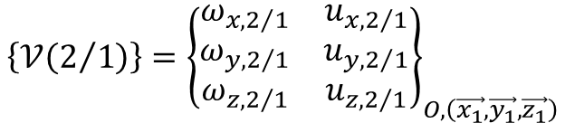

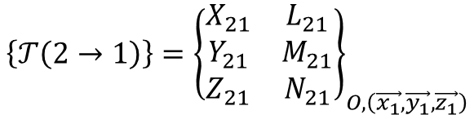





$$\vec{z_{1}}$$
Glissière hélicoïdale Axe $\left(O,\vec{x_{1}}\right)$
$$O$$
(2)
$$\vec{x_{1}}$$
$$\vec{y_{1}}$$
(1)
$$\left\{𝒯\left(2→1\right)\right\}={\left\{\begin{matrix}X_{21} & L_{21} \\ Y_{21} & M_{21} \\ Z_{21} & N_{21}\end{matrix}\right\}}_{O,\left(\vec{x_{1}},\vec{y_{1}},\vec{z_{1}}\right)}$$
$$\left\{𝒱\left(2/1\right)\right\}={\left\{\begin{matrix}ω_{x,2/1} & u_{x,2/1} \\ ω_{y,2/1} & u_{y,2/1} \\ ω_{z,2/1} & u_{z,2/1}\end{matrix}\right\}}_{O,\left(\vec{x_{1}},\vec{y_{1}},\vec{z_{1}}\right)}$$
$$L_{21}=−X_{21}\frac{p}{2π}$$
$$u_{x,2/1}=ω_{x,2/1}\frac{p}{2π}$$

Slide 36






$$\vec{x_{1}}$$
Glissière hélicoïdale Axe $\left(O,\vec{y_{1}}\right)$
$$O$$
(2)
$$\vec{y_{1}}$$
$$\vec{z_{1}}$$
(1)
$$\left\{𝒯\left(2→1\right)\right\}={\left\{\begin{matrix}X_{21} & L_{21} \\ Y_{21} & M_{21} \\ Z_{21} & N_{21}\end{matrix}\right\}}_{O,\left(\vec{x_{1}},\vec{y_{1}},\vec{z_{1}}\right)}$$
$$\left\{𝒱\left(2/1\right)\right\}={\left\{\begin{matrix}ω_{x,2/1} & u_{x,2/1} \\ ω_{y,2/1} & u_{y,2/1} \\ ω_{z,2/1} & u_{z,2/1}\end{matrix}\right\}}_{O,\left(\vec{x_{1}},\vec{y_{1}},\vec{z_{1}}\right)}$$
$$M_{21}=−Y_{21}\frac{p}{2π}$$
$$u_{y,2/1}=ω_{y,2/1}\frac{p}{2π}$$

Slide 37






$$\vec{y_{1}}$$
Glissière hélicoïdale Axe $\left(O,\vec{z_{1}}\right)$
$$O$$
(2)
$$\vec{z_{1}}$$
$$\vec{x_{1}}$$
(1)
$$\left\{𝒯\left(2→1\right)\right\}={\left\{\begin{matrix}X_{21} & L_{21} \\ Y_{21} & M_{21} \\ Z_{21} & N_{21}\end{matrix}\right\}}_{O,\left(\vec{x_{1}},\vec{y_{1}},\vec{z_{1}}\right)}$$
$$\left\{𝒱\left(2/1\right)\right\}={\left\{\begin{matrix}ω_{x,2/1} & u_{x,2/1} \\ ω_{y,2/1} & u_{y,2/1} \\ ω_{z,2/1} & u_{z,2/1}\end{matrix}\right\}}_{O,\left(\vec{x_{1}},\vec{y_{1}},\vec{z_{1}}\right)}$$
$$N_{21}=−Z_{21}\frac{p}{2π}$$
$$u_{z,2/1}=ω_{z,2/1}\frac{p}{2π}$$

Slide 38

$$\vec{z_{1}}$$
$$\vec{z_{2}}$$
Glissière hélicoïdale Axe $\left(O,\vec{x_{1}}\right)$
$$\vec{x_{1}}$$
(2)
$$O$$
(1)
$$\left\{𝒯\left(2→1\right)\right\}={\left\{\begin{matrix}X_{21} & L_{21} \\ Y_{21} & M_{21} \\ Z_{21} & N_{21}\end{matrix}\right\}}_{O,\left(\vec{x_{1}},\vec{y_{1}},\vec{z_{1}}\right)}$$
$$\left\{𝒱\left(2/1\right)\right\}={\left\{\begin{matrix}ω_{x,2/1} & u_{x,2/1} \\ ω_{y,2/1} & u_{y,2/1} \\ ω_{z,2/1} & u_{z,2/1}\end{matrix}\right\}}_{O,\left(\vec{x_{1}},\vec{y_{1}},\vec{z_{1}}\right)}$$
$$L_{21}=−X_{21}\frac{p}{2π}$$
$$u_{x,2/1}=ω_{x,2/1}\frac{p}{2π}$$

Slide 39

$$\vec{z_{1}}$$
$$\vec{z_{2}}$$
Glissière hélicoïdale Axe $\left(O,\vec{y_{1}}\right)$
$$\vec{y_{1}}$$
(2)
$$O$$
(1)
$$\left\{𝒯\left(2→1\right)\right\}={\left\{\begin{matrix}X_{21} & L_{21} \\ Y_{21} & M_{21} \\ Z_{21} & N_{21}\end{matrix}\right\}}_{O,\left(\vec{x_{1}},\vec{y_{1}},\vec{z_{1}}\right)}$$
$$\left\{𝒱\left(2/1\right)\right\}={\left\{\begin{matrix}ω_{x,2/1} & u_{x,2/1} \\ ω_{y,2/1} & u_{y,2/1} \\ ω_{z,2/1} & u_{z,2/1}\end{matrix}\right\}}_{O,\left(\vec{x_{1}},\vec{y_{1}},\vec{z_{1}}\right)}$$
$$M_{21}=−Y_{21}\frac{p}{2π}$$
$$u_{y,2/1}=ω_{y,2/1}\frac{p}{2π}$$

Slide 40
$$\vec{x_{1}}$$
$$\vec{x_{2}}$$
Glissière hélicoïdale Axe $\left(O,\vec{z_{1}}\right)$
$$\vec{z_{1}}$$
(2)
$$O$$
(1)
$$\left\{𝒯\left(2→1\right)\right\}={\left\{\begin{matrix}X_{21} & L_{21} \\ Y_{21} & M_{21} \\ Z_{21} & N_{21}\end{matrix}\right\}}_{O,\left(\vec{x_{1}},\vec{y_{1}},\vec{z_{1}}\right)}$$
$$\left\{𝒱\left(2/1\right)\right\}={\left\{\begin{matrix}ω_{x,2/1} & u_{x,2/1} \\ ω_{y,2/1} & u_{y,2/1} \\ ω_{z,2/1} & u_{z,2/1}\end{matrix}\right\}}_{O,\left(\vec{x_{1}},\vec{y_{1}},\vec{z_{1}}\right)}$$
$$N_{21}=−Z_{21}\frac{p}{2π}$$
$$u_{z,2/1}=ω_{z,2/1}\frac{p}{2π}$$

Slide 41





$$\vec{z_{2}}$$
$$\vec{z_{1}}$$
Glissière hélicoïdale Axe $\left(O,\vec{x_{1}}\right)$
$$\vec{y_{2}}$$
(2)
$$\vec{y_{1}}$$
$$O$$
(1)
$$\left\{𝒯\left(2→1\right)\right\}={\left\{\begin{matrix}X_{21} & L_{21} \\ Y_{21} & M_{21} \\ Z_{21} & N_{21}\end{matrix}\right\}}_{O,\left(\vec{x_{1}},\vec{y_{1}},\vec{z_{1}}\right)}$$
$$\left\{𝒱\left(2/1\right)\right\}={\left\{\begin{matrix}ω_{x,2/1} & u_{x,2/1} \\ ω_{y,2/1} & u_{y,2/1} \\ ω_{z,2/1} & u_{z,2/1}\end{matrix}\right\}}_{O,\left(\vec{x_{1}},\vec{y_{1}},\vec{z_{1}}\right)}$$
$$L_{21}=−X_{21}\frac{p}{2π}$$
$$u_{x,2/1}=ω_{x,2/1}\frac{p}{2π}$$

Slide 42






$$\vec{x_{2}}$$
$$\vec{x_{1}}$$
Glissière hélicoïdale Axe $\left(O,\vec{y_{1}}\right)$
$$\vec{z_{2}}$$
(2)
$$\vec{z_{1}}$$
$$O$$
(1)
$$\left\{𝒯\left(2→1\right)\right\}={\left\{\begin{matrix}X_{21} & L_{21} \\ Y_{21} & M_{21} \\ Z_{21} & N_{21}\end{matrix}\right\}}_{O,\left(\vec{x_{1}},\vec{y_{1}},\vec{z_{1}}\right)}$$
$$\left\{𝒱\left(2/1\right)\right\}={\left\{\begin{matrix}ω_{x,2/1} & u_{x,2/1} \\ ω_{y,2/1} & u_{y,2/1} \\ ω_{z,2/1} & u_{z,2/1}\end{matrix}\right\}}_{O,\left(\vec{x_{1}},\vec{y_{1}},\vec{z_{1}}\right)}$$
$$M_{21}=−Y_{21}\frac{p}{2π}$$
$$u_{y,2/1}=ω_{y,2/1}\frac{p}{2π}$$

Slide 43




$$\vec{y_{2}}$$
$$\vec{y_{1}}$$
Glissière hélicoïdale Axe $\left(O,\vec{z_{1}}\right)$
$$\vec{x_{2}}$$
(2)
$$\vec{x_{1}}$$
$$O$$
(1)
$$\left\{𝒯\left(2→1\right)\right\}={\left\{\begin{matrix}X_{21} & L_{21} \\ Y_{21} & M_{21} \\ Z_{21} & N_{21}\end{matrix}\right\}}_{O,\left(\vec{x_{1}},\vec{y_{1}},\vec{z_{1}}\right)}$$
$$\left\{𝒱\left(2/1\right)\right\}={\left\{\begin{matrix}ω_{x,2/1} & u_{x,2/1} \\ ω_{y,2/1} & u_{y,2/1} \\ ω_{z,2/1} & u_{z,2/1}\end{matrix}\right\}}_{O,\left(\vec{x_{1}},\vec{y_{1}},\vec{z_{1}}\right)}$$
$$N_{21}=−Z_{21}\frac{p}{2π}$$
$$u_{z,2/1}=ω_{z,2/1}\frac{p}{2π}$$

Slide 44







$$\vec{z_{1}}$$
Pivot Axe $\left(O,\vec{x_{1}}\right)$
(2)
$$O$$
$$\vec{x_{1}}$$
$$\vec{y_{1}}$$
(1)
$$\left\{𝒯\left(2→1\right)\right\}={\left\{\begin{matrix}X_{21} & 0 \\ Y_{21} & M_{21} \\ Z_{21} & N_{21}\end{matrix}\right\}}_{O,\left(\vec{x_{1}},\vec{y_{1}},\vec{z_{1}}\right)}$$
$$\left\{𝒱\left(2/1\right)\right\}={\left\{\begin{matrix}ω_{x,2/1} & 0 \\ 0 & 0 \\ 0 & 0\end{matrix}\right\}}_{O,\left(\vec{x_{1}},\vec{y_{1}},\vec{z_{1}}\right)}$$

Slide 45






$$\vec{x_{1}}$$
Pivot Axe $\left(O,\vec{y_{1}}\right)$
(2)
$$O$$
$$\vec{y_{1}}$$
$$\vec{z_{1}}$$
(1)
$$\left\{𝒯\left(2→1\right)\right\}={\left\{\begin{matrix}X_{21} & L_{21} \\ Y_{21} & 0 \\ Z_{21} & N_{21}\end{matrix}\right\}}_{O,\left(\vec{x_{1}},\vec{y_{1}},\vec{z_{1}}\right)}$$
$$\left\{𝒱\left(2/1\right)\right\}={\left\{\begin{matrix}0 & 0 \\ ω_{y,2/1} & 0 \\ 0 & 0\end{matrix}\right\}}_{O,\left(\vec{x_{1}},\vec{y_{1}},\vec{z_{1}}\right)}$$

Slide 46






$$\vec{y_{1}}$$
Pivot Axe $\left(O,\vec{z_{1}}\right)$
(2)
$$O$$
$$\vec{z_{1}}$$
$$\vec{x_{1}}$$
(1)
$$\left\{𝒯\left(2→1\right)\right\}={\left\{\begin{matrix}X_{21} & L_{21} \\ Y_{21} & M_{21} \\ Z_{21} & 0\end{matrix}\right\}}_{O,\left(\vec{x_{1}},\vec{y_{1}},\vec{z_{1}}\right)}$$
$$\left\{𝒱\left(2/1\right)\right\}={\left\{\begin{matrix}0 & 0 \\ 0 & 0 \\ ω_{z,2/1} & 0\end{matrix}\right\}}_{O,\left(\vec{x_{1}},\vec{y_{1}},\vec{z_{1}}\right)}$$

Slide 47




$$\vec{z_{1}}$$
$$\vec{z_{2}}$$
Pivot Axe $\left(O,\vec{x_{1}}\right)$
$$\vec{x_{1}}$$
(2)
$$O$$
(1)
$$\left\{𝒯\left(2→1\right)\right\}={\left\{\begin{matrix}X_{21} & 0 \\ Y_{21} & M_{21} \\ Z_{21} & N_{21}\end{matrix}\right\}}_{O,\left(\vec{x_{1}},\vec{y_{1}},\vec{z_{1}}\right)}$$
$$\left\{𝒱\left(2/1\right)\right\}={\left\{\begin{matrix}ω_{x,2/1} & 0 \\ 0 & 0 \\ 0 & 0\end{matrix}\right\}}_{O,\left(\vec{x_{1}},\vec{y_{1}},\vec{z_{1}}\right)}$$

Slide 48


$$\vec{z_{1}}$$
$$\vec{z_{2}}$$
Pivot Axe $\left(O,\vec{y_{1}}\right)$
$$\vec{y_{1}}$$
(2)
$$O$$
(1)
$$\left\{𝒯\left(2→1\right)\right\}={\left\{\begin{matrix}X_{21} & L_{21} \\ Y_{21} & 0 \\ Z_{21} & N_{21}\end{matrix}\right\}}_{O,\left(\vec{x_{1}},\vec{y_{1}},\vec{z_{1}}\right)}$$
$$\left\{𝒱\left(2/1\right)\right\}={\left\{\begin{matrix}0 & 0 \\ ω_{y,2/1} & 0 \\ 0 & 0\end{matrix}\right\}}_{O,\left(\vec{x_{1}},\vec{y_{1}},\vec{z_{1}}\right)}$$

Slide 49

$$\vec{x_{1}}$$
$$\vec{x_{2}}$$
Pivot Axe $\left(O,\vec{z_{1}}\right)$
$$\vec{z_{1}}$$
(2)
$$O$$
(1)
$$\left\{𝒯\left(2→1\right)\right\}={\left\{\begin{matrix}X_{21} & L_{21} \\ Y_{21} & M_{21} \\ Z_{21} & 0\end{matrix}\right\}}_{O,\left(\vec{x_{1}},\vec{y_{1}},\vec{z_{1}}\right)}$$
$$\left\{𝒱\left(2/1\right)\right\}={\left\{\begin{matrix}0 & 0 \\ 0 & 0 \\ ω_{z,2/1} & 0\end{matrix}\right\}}_{O,\left(\vec{x_{1}},\vec{y_{1}},\vec{z_{1}}\right)}$$

Slide 50




$$\vec{z_{1}}$$
Pivot Axe $\left(O,\vec{x_{1}}\right)$
$$\vec{z_{2}}$$
$$\vec{y_{2}}$$
(2)
$$\vec{y_{1}}$$
$$O$$
(1)
$$\left\{𝒯\left(2→1\right)\right\}={\left\{\begin{matrix}X_{21} & 0 \\ Y_{21} & M_{21} \\ Z_{21} & N_{21}\end{matrix}\right\}}_{O,\left(\vec{x_{1}},\vec{y_{1}},\vec{z_{1}}\right)}$$
$$\left\{𝒱\left(2/1\right)\right\}={\left\{\begin{matrix}ω_{x,2/1} & 0 \\ 0 & 0 \\ 0 & 0\end{matrix}\right\}}_{O,\left(\vec{x_{1}},\vec{y_{1}},\vec{z_{1}}\right)}$$

Slide 51




$$\vec{x_{1}}$$
Pivot Axe $\left(O,\vec{y_{1}}\right)$
$$\vec{x_{2}}$$
$$\vec{z_{2}}$$
(2)
$$\vec{z_{1}}$$
$$O$$
(1)
$$\left\{𝒯\left(2→1\right)\right\}={\left\{\begin{matrix}X_{21} & L_{21} \\ Y_{21} & 0 \\ Z_{21} & N_{21}\end{matrix}\right\}}_{O,\left(\vec{x_{1}},\vec{y_{1}},\vec{z_{1}}\right)}$$
$$\left\{𝒱\left(2/1\right)\right\}={\left\{\begin{matrix}0 & 0 \\ ω_{y,2/1} & 0 \\ 0 & 0\end{matrix}\right\}}_{O,\left(\vec{x_{1}},\vec{y_{1}},\vec{z_{1}}\right)}$$

Slide 52




$$\vec{y_{1}}$$
Pivot Axe $\left(O,\vec{z_{1}}\right)$
$$\vec{y_{2}}$$
$$\vec{x_{2}}$$
(2)
$$\vec{x_{1}}$$
$$O$$
(1)
$$\left\{𝒯\left(2→1\right)\right\}={\left\{\begin{matrix}X_{21} & L_{21} \\ Y_{21} & M_{21} \\ Z_{21} & 0\end{matrix}\right\}}_{O,\left(\vec{x_{1}},\vec{y_{1}},\vec{z_{1}}\right)}$$
$$\left\{𝒱\left(2/1\right)\right\}={\left\{\begin{matrix}0 & 0 \\ 0 & 0 \\ ω_{z,2/1} & 0\end{matrix}\right\}}_{O,\left(\vec{x_{1}},\vec{y_{1}},\vec{z_{1}}\right)}$$

Slide 53






$$\vec{x_{1}}$$
Cylindre – Plan
(Linéaire rectiligne) Ligne de contact $\left(O,\vec{y_{1}}\right)$
Normale $\vec{x_{1}}$
(2)
$$\vec{y_{1}}$$
$$O$$
(1)
$$\vec{z_{1}}$$
$$\left\{𝒯\left(2→1\right)\right\}={\left\{\begin{matrix}X_{21} & 0 \\ 0 & 0 \\ 0 & N_{21}\end{matrix}\right\}}_{O,\left(\vec{x_{1}},\vec{y_{1}},\vec{z_{1}}\right)}$$
$$\left\{𝒱\left(2/1\right)\right\}={\left\{\begin{matrix}ω_{x,2/1} & 0 \\ ω_{y,2/1} & u_{y,2/1} \\ 0 & u_{z,2/1}\end{matrix}\right\}}_{O,\left(\vec{x_{1}},\vec{y_{1}},\vec{z_{1}}\right)}$$

Slide 54






$$\vec{y_{1}}$$
Cylindre – Plan
(Linéaire rectiligne) Ligne de contact $\left(O,\vec{z_{1}}\right)$
Normale $\vec{y_{1}}$
(2)
$$\vec{z_{1}}$$
$$O$$
(1)
$$\vec{x_{1}}$$
$$\left\{𝒯\left(2→1\right)\right\}={\left\{\begin{matrix}0 & L_{21} \\ Y_{21} & 0 \\ 0 & 0\end{matrix}\right\}}_{O,\left(\vec{x_{1}},\vec{y_{1}},\vec{z_{1}}\right)}$$
$$\left\{𝒱\left(2/1\right)\right\}={\left\{\begin{matrix}0 & u_{x,2/1} \\ ω_{y,2/1} & 0 \\ ω_{z,2/1} & u_{z,2/1}\end{matrix}\right\}}_{O,\left(\vec{x_{1}},\vec{y_{1}},\vec{z_{1}}\right)}$$

Slide 55






$$\vec{z_{1}}$$
Cylindre – Plan
(Linéaire rectiligne) Ligne de contact $\left(O,\vec{x_{1}}\right)$
Normale $\vec{z_{1}}$
(2)
$$\vec{x_{1}}$$
$$O$$
(1)
$$\vec{y_{1}}$$
$$\left\{𝒯\left(2→1\right)\right\}={\left\{\begin{matrix}0 & 0 \\ 0 & M_{21} \\ Z_{21} & 0\end{matrix}\right\}}_{O,\left(\vec{x_{1}},\vec{y_{1}},\vec{z_{1}}\right)}$$
$$\left\{𝒱\left(2/1\right)\right\}={\left\{\begin{matrix}ω_{x,2/1} & u_{x,2/1} \\ 0 & u_{y,2/1} \\ ω_{z,2/1} & 0\end{matrix}\right\}}_{O,\left(\vec{x_{1}},\vec{y_{1}},\vec{z_{1}}\right)}$$

Slide 56



$$\vec{z_{1}}$$
Cylindre – Plan
(Linéaire rectiligne) Ligne de contact $\left(O,\vec{x_{1}}\right)$
Normale $\vec{z_{1}}$
(2)
$$O$$
$$\vec{x_{1}}$$
(1)
$$\left\{𝒯\left(2→1\right)\right\}={\left\{\begin{matrix}0 & 0 \\ 0 & M_{21} \\ Z_{21} & 0\end{matrix}\right\}}_{O,\left(\vec{x_{1}},\vec{y_{1}},\vec{z_{1}}\right)}$$
$$\left\{𝒱\left(2/1\right)\right\}={\left\{\begin{matrix}ω_{x,2/1} & u_{x,2/1} \\ 0 & u_{y,2/1} \\ ω_{z,2/1} & 0\end{matrix}\right\}}_{O,\left(\vec{x_{1}},\vec{y_{1}},\vec{z_{1}}\right)}$$

Slide 57

$$\vec{x_{1}}$$
Cylindre – Plan
(Linéaire rectiligne) Ligne de contact $\left(O,\vec{y_{1}}\right)$
Normale $\vec{x_{1}}$
(2)
$$O$$
$$\vec{y_{1}}$$
(1)
$$\left\{𝒯\left(2→1\right)\right\}={\left\{\begin{matrix}X_{21} & 0 \\ 0 & 0 \\ 0 & N_{21}\end{matrix}\right\}}_{O,\left(\vec{x_{1}},\vec{y_{1}},\vec{z_{1}}\right)}$$
$$\left\{𝒱\left(2/1\right)\right\}={\left\{\begin{matrix}ω_{x,2/1} & 0 \\ ω_{y,2/1} & u_{y,2/1} \\ 0 & u_{z,2/1}\end{matrix}\right\}}_{O,\left(\vec{x_{1}},\vec{y_{1}},\vec{z_{1}}\right)}$$

Slide 58

$$\vec{y_{1}}$$
Cylindre – Plan
(Linéaire rectiligne) Ligne de contact $\left(O,\vec{z_{1}}\right)$
Normale $\vec{y_{1}}$
(2)
$$O$$
$$\vec{z_{1}}$$
(1)
$$\left\{𝒯\left(2→1\right)\right\}={\left\{\begin{matrix}0 & L_{21} \\ Y_{21} & 0 \\ 0 & 0\end{matrix}\right\}}_{O,\left(\vec{x_{1}},\vec{y_{1}},\vec{z_{1}}\right)}$$
$$\left\{𝒱\left(2/1\right)\right\}={\left\{\begin{matrix}0 & u_{x,2/1} \\ ω_{y,2/1} & 0 \\ ω_{z,2/1} & u_{z,2/1}\end{matrix}\right\}}_{O,\left(\vec{x_{1}},\vec{y_{1}},\vec{z_{1}}\right)}$$

Slide 59


$$\vec{z_{1}}$$
Cylindre – Plan
(Linéaire rectiligne) Ligne de contact $\left(O,\vec{x_{1}}\right)$
Normale $\vec{z_{1}}$
(2)
$$O$$
$$\vec{y_{1}}$$
(1)
$$\left\{𝒯\left(2→1\right)\right\}={\left\{\begin{matrix}0 & 0 \\ 0 & M_{21} \\ Z_{21} & 0\end{matrix}\right\}}_{O,\left(\vec{x_{1}},\vec{y_{1}},\vec{z_{1}}\right)}$$
$$\left\{𝒱\left(2/1\right)\right\}={\left\{\begin{matrix}ω_{x,2/1} & u_{x,2/1} \\ 0 & u_{y,2/1} \\ ω_{z,2/1} & 0\end{matrix}\right\}}_{O,\left(\vec{x_{1}},\vec{y_{1}},\vec{z_{1}}\right)}$$

Slide 60


$$\vec{y_{1}}$$
Cylindre – Plan
(Linéaire rectiligne) Ligne de contact $\left(O,\vec{z_{1}}\right)$
Normale $\vec{y_{1}}$
(2)
$$O$$
$$\vec{x_{1}}$$
(1)
$$\left\{𝒯\left(2→1\right)\right\}={\left\{\begin{matrix}0 & L_{21} \\ Y_{21} & 0 \\ 0 & 0\end{matrix}\right\}}_{O,\left(\vec{x_{1}},\vec{y_{1}},\vec{z_{1}}\right)}$$
$$\left\{𝒱\left(2/1\right)\right\}={\left\{\begin{matrix}0 & u_{x,2/1} \\ ω_{y,2/1} & 0 \\ ω_{z,2/1} & u_{z,2/1}\end{matrix}\right\}}_{O,\left(\vec{x_{1}},\vec{y_{1}},\vec{z_{1}}\right)}$$

Slide 61


$$\vec{x_{1}}$$
Cylindre – Plan
(Linéaire rectiligne) Ligne de contact $\left(O,\vec{y_{1}}\right)$
Normale $\vec{x_{1}}$
(2)
$$O$$
$$\vec{z_{1}}$$
(1)
$$\left\{𝒯\left(2→1\right)\right\}={\left\{\begin{matrix}X_{21} & 0 \\ 0 & 0 \\ 0 & N_{21}\end{matrix}\right\}}_{O,\left(\vec{x_{1}},\vec{y_{1}},\vec{z_{1}}\right)}$$
$$\left\{𝒱\left(2/1\right)\right\}={\left\{\begin{matrix}ω_{x,2/1} & 0 \\ ω_{y,2/1} & u_{y,2/1} \\ 0 & u_{z,2/1}\end{matrix}\right\}}_{O,\left(\vec{x_{1}},\vec{y_{1}},\vec{z_{1}}\right)}$$

Slide 62






$$\vec{x_{1}}$$
(2)
Appui plan
Normale $\vec{x_{1}}$
$$\vec{y_{1}}$$
$$\vec{z_{1}}$$
(1)
$$\left\{𝒯\left(2→1\right)\right\}={\left\{\begin{matrix}X_{21} & 0 \\ 0 & M_{21} \\ 0 & N_{21}\end{matrix}\right\}}_{O,\left(\vec{x_{1}},\vec{y_{1}},\vec{z_{1}}\right)}$$
$$\left\{𝒱\left(2/1\right)\right\}={\left\{\begin{matrix}ω_{x,2/1} & 0 \\ 0 & u_{y,2/1} \\ 0 & u_{z,2/1}\end{matrix}\right\}}_{O,\left(\vec{x_{1}},\vec{y_{1}},\vec{z_{1}}\right)}$$

Slide 63






$$\vec{y_{1}}$$
(2)
Appui plan
Normale $\vec{y_{1}}$
$$\vec{z_{1}}$$
$$\vec{x_{1}}$$
(1)
$$\left\{𝒯\left(2→1\right)\right\}={\left\{\begin{matrix}0 & L_{21} \\ Y_{21} & 0 \\ 0 & N_{21}\end{matrix}\right\}}_{O,\left(\vec{x_{1}},\vec{y_{1}},\vec{z_{1}}\right)}$$
$$\left\{𝒱\left(2/1\right)\right\}={\left\{\begin{matrix}0 & u_{x,2/1} \\ ω_{y,2/1} & 0 \\ 0 & u_{z,2/1}\end{matrix}\right\}}_{O,\left(\vec{x_{1}},\vec{y_{1}},\vec{z_{1}}\right)}$$

Slide 64






$$\vec{z_{1}}$$
(2)
Appui plan
Normale $\vec{z_{1}}$
$$\vec{x_{1}}$$
$$\vec{y_{1}}$$
(1)
$$\left\{𝒯\left(2→1\right)\right\}={\left\{\begin{matrix}0 & L_{21} \\ 0 & M_{21} \\ Z_{21} & 0\end{matrix}\right\}}_{O,\left(\vec{x_{1}},\vec{y_{1}},\vec{z_{1}}\right)}$$
$$\left\{𝒱\left(2/1\right)\right\}={\left\{\begin{matrix}0 & u_{x,2/1} \\ 0 & u_{y,2/1} \\ ω_{z,2/1} & 0\end{matrix}\right\}}_{O,\left(\vec{x_{1}},\vec{y_{1}},\vec{z_{1}}\right)}$$

Slide 65


$$\vec{z_{1}}$$
Appui plan
Normale $\vec{z_{1}}$
$$O$$
(2)
$$\vec{y_{1}}$$
(1)
$$\left\{𝒯\left(2→1\right)\right\}={\left\{\begin{matrix}0 & L_{21} \\ 0 & M_{21} \\ Z_{21} & 0\end{matrix}\right\}}_{O,\left(\vec{x_{1}},\vec{y_{1}},\vec{z_{1}}\right)}$$
$$\left\{𝒱\left(2/1\right)\right\}={\left\{\begin{matrix}0 & u_{x,2/1} \\ 0 & u_{y,2/1} \\ ω_{z,2/1} & 0\end{matrix}\right\}}_{O,\left(\vec{x_{1}},\vec{y_{1}},\vec{z_{1}}\right)}$$

Slide 66


$$\vec{x_{1}}$$
Appui plan
Normale $\vec{x_{1}}$
$$O$$
(2)
$$\vec{z_{1}}$$
(1)
$$\left\{𝒯\left(2→1\right)\right\}={\left\{\begin{matrix}X_{21} & 0 \\ 0 & M_{21} \\ 0 & N_{21}\end{matrix}\right\}}_{O,\left(\vec{x_{1}},\vec{y_{1}},\vec{z_{1}}\right)}$$
$$\left\{𝒱\left(2/1\right)\right\}={\left\{\begin{matrix}ω_{x,2/1} & 0 \\ 0 & u_{y,2/1} \\ 0 & u_{z,2/1}\end{matrix}\right\}}_{O,\left(\vec{x_{1}},\vec{y_{1}},\vec{z_{1}}\right)}$$

Slide 67


$$\vec{y_{1}}$$
Appui plan
Normale $\vec{y_{1}}$
$$O$$
(2)
$$\vec{x_{1}}$$
(1)
$$\left\{𝒯\left(2→1\right)\right\}={\left\{\begin{matrix}0 & L_{21} \\ Y_{21} & 0 \\ 0 & N_{21}\end{matrix}\right\}}_{O,\left(\vec{x_{1}},\vec{y_{1}},\vec{z_{1}}\right)}$$
$$\left\{𝒱\left(2/1\right)\right\}={\left\{\begin{matrix}0 & u_{x,2/1} \\ ω_{y,2/1} & 0 \\ 0 & u_{z,2/1}\end{matrix}\right\}}_{O,\left(\vec{x_{1}},\vec{y_{1}},\vec{z_{1}}\right)}$$

