Slide 1







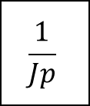

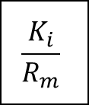

$$U_{g}$$
$$\frac{K_{i}}{R_{m}}$$
$$C_{m}$$
$$\frac{1}{Jp}$$
$$Ω_{m}$$
$$Ω_{g}$$
$$+$$
$$r$$
$$−$$
$$E$$
$$K_{e}$$

