Slide 1





2
$$B$$
$$\vec{x_{2}}$$
$$\vec{x_{0}}$$
1
3
$$\vec{z_{0}}$$
$$A$$
0

Slide 2
2
$$B$$
$$\vec{x_{2}}$$
$$\vec{x_{0}}$$
1
3
$$\vec{z_{0}}$$
$$A$$
0

Slide 3









$$Z_{22}$$
$$Z_{21}$$
2
$$O_{2}$$
$$\vec{x_{0}}$$
$$\vec{z_{0}}$$
$$O_{1}$$
1
3
$$O_{3}$$
$$Z_{3}$$
$$Z_{1}$$
0

Slide 4
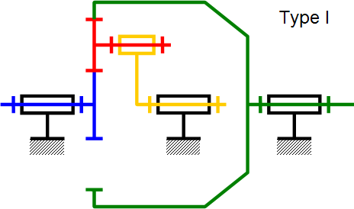
2
$$B$$
$$\vec{x_{2}}$$
$$\vec{x_{0}}$$
1
3
$$\vec{z_{0}}$$
$$A$$
0

Slide 5




$$Z_{21}$$
$$Z_{22}$$
2
1
3
$$Z_{1}$$
0
$$Z_{4}$$
4

Slide 6
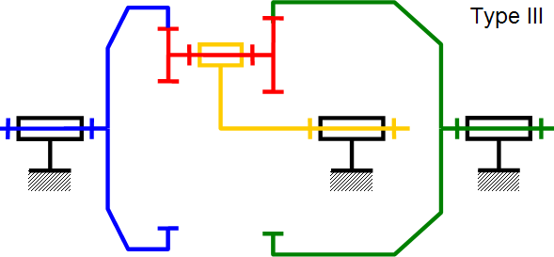
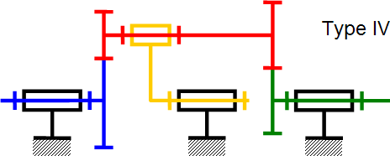



$$Z_{22}$$
$$Z_{21}$$
2
1
3
$$Z_{1}$$
0
$$Z_{4}$$
4

Slide 7

$$Z_{22}$$
$$Z_{21}$$
2
1
4
3
$$Z_{4}$$
0
$$Z_{1}$$

