Slide 1
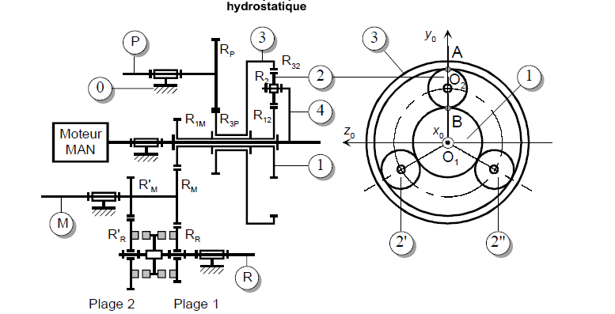
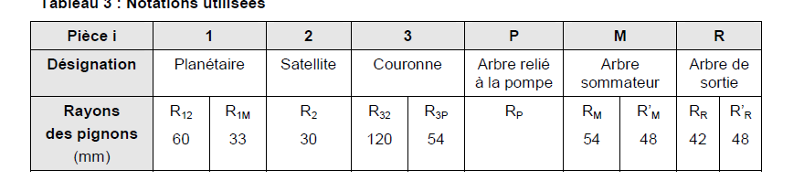
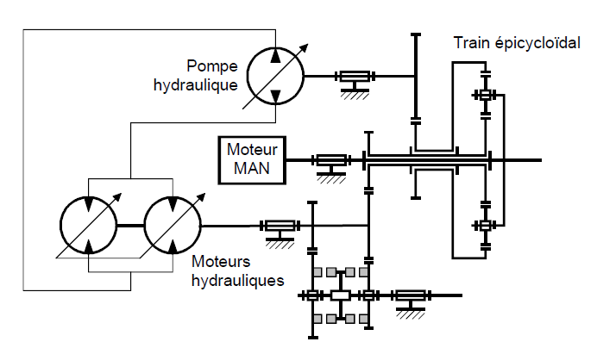










$$R_{P}$$
3
$$R_{2}$$
$$R_{32}$$
Pompe hydraulique
$$R_{1M}$$
2
1
Mm
$$R_{12}$$
$$R_{M}$$
$$R_{M}^{′}$$
4
Mh
$$R_{3P}$$
R
$$R_{R}^{′}$$
$$R_{R}$$

